Slide 1


ISMPP University
Member Research Spotlight: 2024 European Meeting of ISMPP
February 28th, 2024
Webinar will begin promptly at: ​
11 AM ET / 4 PM GMT
Notes:
Thank you for joining us for this ISMPP U; highlighting the member research oral presentations from the most recent European Meeting of ISMPP. Please take a moment to a take a screenshot for CMPP credit.

Slide 2





















ISMPP Would Like to Thank…
1
. . . the following Titanium and Platinum Corporate Sponsors for their ongoing support of the Society:
Notes:
First a sincere thank you to all of ISMPP’s titanium and platinum corporate sponsors for their ongoing support of the Society.

Slide 3
Shaping the Future of Scientific Publishing
Become a ISMPP U Sponsor Today!
Sponsor an upcoming ISMPP U to receive these exclusive benefits!
Enhanced Industry Visibility by showcasing your company brand with logo and tag line on
  The webinar registration page
  On a dedicated slide during the live webinar to a highly engaged audience
  In ISMPP communications and/or social media channels.
Enduring On-demand Visibility with lifetime archive on our Learning Management System for continuous visibility and countless additional impressions, so your sponsorship investment continues to work for you far past the live event.
For Sponsorship Opportunities with ISMPP, Email ismpp@ismpp.org
Notes:
Here are some special reasons to join ISMPP! Knowledge, Community and Professionalism. Check out our website and Join ISMPP Today!

Slide 4

ISMPP Announcements
Application deadline for the September CMPP
exam is August 1
Notes:
The application deadline for the next exam window is August 1, 2023

Slide 5

ISMPP Announcements
20th Annual Meeting of ISMPP
Storytelling: Its Art and Power
April 29th – May 1st, 2024
Grand Hyatt Washington, Washington D.C.
Registration is open!
Closes April 12, 2024
Notes:
Registration is open for the 20th Annual meeting of ISMPP

Slide 6
How To Ask Questions
Feel free to ask a question at any time, however all questions will be held until the end the of the presentation.
To ask a question, open the Q&A window, type your question into the
Q&A box. Click Send
Note: Check Send Anonymously if you do not want your name attached
to your question in the Q&A
We will make every effort to respond to all questions live (out loud)
Notes:
You can submit a question at any time during the presentation by following the instructions on this slide.
The faculty will answer questions at the end of all the presentations.

Slide 7
Disclaimer
Information presented reflects the personal knowledge and opinions of the faculty and does not necessarily represent the position of their current or past employers
Notes:
Please take a moment to read our general disclaimer.

Slide 8
Objectives
Understand how the ACCORD guideline can improve the completeness and transparency of reporting of consensus studies
Comprehend how developing tailored omnichannel communication plans and content development using qualitative and quantitative methodologies can optimize strategies to effectively reach patients, improve shared decision-making, and improve patient outcomes overall
Gain understanding of how AI can be used to generate plain language abstracts of scientific content, and how these deliverables compare to human-written PLSs
Notes:
Listed here are the learning objectives for today’s webinar.

Slide 9

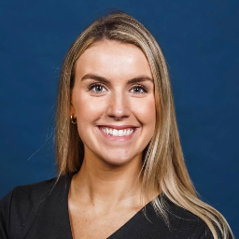


Faculty
Niall Harrison
Senior Scientific Director
OPEN Health Communications
Brittany Wolf Gianares
Director, Oncology Global Medical Content Lead, Pfizer
David McMinn
Lay Summaries Practice Leader Sorcero
Moderator: Will Gattrell
Associate Director, European Markets Medical Communications, Bristol Myers Squibb

Slide 10
Accurate COnsensus Reporting Document (ACCORD) checklist: a reporting guideline for consensus methods
Niall Harrison,¹Patricia Logullo,² Esther J van Zuuren,³ Amy Price,⁴ Ellen L. Hughes,⁵ Paul Blazey,⁶ Christopher C. Winchester,⁷ David Tovey,⁸ Keith Goldman,⁹ Amrit Pali Hungin,¹⁰ and William T. Gattrell¹¹
1. OPEN Health Communications, Marlow, UK; 2. Centre for Statistics in Medicine, University of Oxford, and EQUATOR Network UK Centre, Oxford, UK; 3. Leiden University Medical Centre, Leiden, The Netherlands; 4. Dartmouth Institute for Health Policy & Clinical Practice (TDI), Geisel School of Medicine, Dartmouth College, NH, USA; 5. Camino Communications Ltd, Mansfield, UK; 6. Department of Physiotherapy, University of British Columbia, Vancouver, Canada; 7. Oxford PharmaGenesis, Tubney, Oxford, UK; 8. Journal of Clinical Epidemiology, London, UK; 9. Global Medical Affairs, AbbVie, North Chicago, IL, USA; 10. Faculty of Medical Sciences, Newcastle University, Newcastle, UK; 11. Bristol Myers Squibb, Uxbridge, UK

Slide 11
Disclosure
Niall Harrison is an employee of OPEN Health Communications
Patricia Logullo is a member of the UK EQUATOR Centre, based in the University of Oxford; EQUATOR promotes the use of reporting guidelines, many of which are developed using consensus methods, and she is personally involved in the development of other reporting guidelines
Esther J. van Zuuren reports no conflicts of interest
Amy Price reports no conflicts of interest
Ellen L. Hughes is an employee of Camino Communications
Christopher C. Winchester is an employee, Director, and shareholder of Oxford PharmaGenesis Ltd., a Director of Oxford Health Policy Forum CIC, a Trustee of the Friends of the National Library of Medicine, and an Associate Fellow of Green Templeton College, University of Oxford
David Tovey is co–editor-in-chief of the Journal of Clinical Epidemiology and chairs the Scientific Advisory Committee for the Centre for Biomedical Transparency
Keith Goldman is an employee of AbbVie
Amrit Pali Hungin in the last five years worked with Reckitt Benckiser for the development of the definitions and management of gastro-oesophageal reflux disease
Paul Blazey reports no conflicts of interest
William T. Gattrell is an employee of Bristol Myers Squibb
At the outset of the work, Niall Harrison was an employee of Ogilvy Health UK and William Gattrell was an employee of Ipsen
11

Slide 12


Background: why ACCORD?
Consensus methods are recognised as being more reliable than individual opinions and experiences¹⁻³
The reporting of studies using consensus methods is often of poor quality⁴⁻⁷
A comprehensive reporting tool is
needed because numerous methods are
used to assess consensus
12
Notes:
Consensus is widely used tool in medical research, including in clinical practice guidelines, diagnostic guidelines, disease classification, establishing research priorities, and developing core outcome sets … and developing reporting guidelines
Systematic reviews have found that current reporting of studies using consensus methods is poor, and we know that reporting guidelines can improve reporting quality
Delphi is probably the most widely used method of assessing consensus, but other methods such as NGT and RAND/UCLA appropriateness method are also common
The AGREE-II tool includes 23 items of which only one (‘Formulation of Recommendations’) relates to the method used to obtain consensus (Brouwers 2016)
The COS-STAR statement (Kirkham 2016) is specific to the development of core outcome sets; its methods section includes several items relating to the consensus process, but is specific to this type of study
The CREDES guideline (Junger 2017) is specific to Delphi and designed with a focus on palliative care, and AGREE-II
We therefore identified a need for a reporting tool with broad applicability

Slide 13



Objective
To develop a reporting guideline applicable to …
All types of consensus methods
All areas of biomedical research
Researchers anywhere in the world
13
Notes:
Our aim was to develop a new tool, applicable worldwide, that will facilitate the rigorous and transparent reporting of all types of consensus methods across the spectrum of health research
The checklist will make the rigour of the consensus methods used to guide the recommendations clear for readers
Reporting consensus studies with greater clarity and transparency may enhance trust and confidence in guideline and other recommendations made by consensus panels
ACCORD it is not a methodological guideline. It is not intended to provide guidance on how researchers and specialists should design their consensus activities, and it makes no judgement on which method is most appropriate in a particular context.

Slide 14
Project overview and timeline
2021
2022
2023
2024
EQUATOR
and OSF registration
SC invitations
Protocol development
Protocol published¹
SLR
SLR published²
Ethics approval
SC surveys
Draft checklist
Delphi invites
Delphi surveys
Final checklist
Guideline submitted
Guideline preprint³
Pilot study
E&E submitted
E&E, explanation and elaboration; OSF, open science framework; SC, steering committee; SLR, systematic literature review
1. Gattrell WT, et al. Res Integr Peer Rev. 2022;7(1):3.
2. van Zuuren EJ, et al. BMJ Open. 2022;12(9):e065154.
3. Gattrell WT, et al. medRxiv 2023.08.22.23294261; doi: https://doi.org/10.1101/2023.08.22.23294261
This information is for educational use only. Do not copy. Do not distribute.
14
Notes:
The ACCORD protocol drew on EQUATOR recommendations and set out a number of stages; there were some small adjustments but these remained the framework of the project
The first stage took place between May 2021 and August 2022, and was to define the project methodology, including its scope and the composition of the steering committee and delphi panel
The protocol received endorsement from ISMPP, was registered on the OSF, and ultimately published in research integrity and peer review
Three key benefits – provided clarity on our goals; established a baseline for our approach that we could refer back to (even if we later modified it); and started to raise awareness of the project
The second stage took place between November 2021 and September 2022, and was to conduct a systematic literature review to confirm the need for ACCORD and identify existing relevant research into the quality of consensus reporting
The results indicated a clear need to improve the quality of reporting of consensus methods, particularly around areas such as panel composition, definition of consensus, roles and responsibilities, and conflicts of interest
From the results, a preliminary list of reporting statements was created; retrospective analysis confirmed that this included the majority of topics that would be in the final checklist
The third stage took place between May 2022 and March 2023 and was to agree and refine checklist items
Initial items from the SLR were reviewed and refined by the SC over the course of two surveys
A delphi panel was recruited, aiming for broad range of expertise and geography, and a three-round delphi process was conducted to finalise the checklist
The fourth stage is the creation and dissemination of the final reporting guideline, together with supporting activity, and is ongoing; the E&E has been recently submitted
As we used a consensus process in this project, we have aimed to meet the standards of reporting that we are proposing!

Slide 15




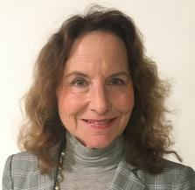
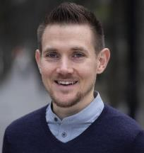


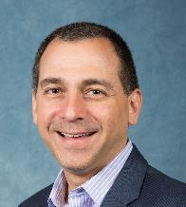
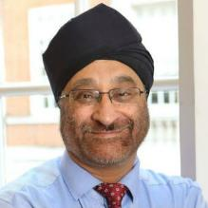

ACCORD steering committee
Will Gattrell
Bristol Myers Squibb
Niall Harrison
OPEN Health
Patricia Logullo
University of Oxford and EQUATOR
Esther J. van Zuuren
Leiden University Medical Centre
Amy Price
Stanford School of Medicine
Patient Editor, BMJ
Paul Blazey
University of British Columbia, Vancouver, Canada
Christopher C. Winchester
Oxford PharmaGenesis
David Tovey
Journal of Clinical Epidemiology
Keith Goldman
AbbVie
Amrit Pali Hungin
University of Newcastle
Ellen L. Hughes
Camino Communications
15
Notes:
WG and NH founded the ACCORD project, seeking endorsement from the International Society of Medical Publication Professionals (ISMPP) in April 2021. ISMPP provided practical support and guidance on the overall process at project outset but was not involved in checklist development
The ACCORD Steering Committee, established over the following months, was multidisciplinary in nature and comprised researchers from different countries and settings. Potential members were identified via ISMPP, literature research, professional connections and network recommendations.
PB joined the Steering Committee in September 2022 as a methodologist to support the execution of the ACCORD Delphi process and provide additional expertise on consensus methods.

Slide 16




ACCORD consensus process
Information pack sent to participants
Anonymous online survey developed and piloted
Three iterative rounds of voting and commenting
Adjudication and finalisation by steering committee
16
Notes:
ACCORD development used a modified Delphi process; the modification was that the preliminary list of items for voting was based on the findings of the SLR rather than initial ideas or statements from the panel
Introductory pack included: letter, PLS, informed consent statement, protocol and SLR, items excluded by SC
Surveys administered via JISC, a GDPR-compliant platform accessed via University of Oxford. After piloting, order of items was not randomised (change to protocol)
Three rounds of voting and commenting – scoring from ‘strongly agree’ to ‘strongly disagree’ plus ‘neither agree nor disagree’; possible to suggest new items
A priori threshold of ≥80% of a minimum of 20 respondents voting ‘Agree’ or ‘Strongly agree’ (felt by the SC to be a robust response threshold)
Consensus had to be stable over 2 rounds – items were removed once threshold reached
Email reminders
Feedback between rounds included anonymised total votes and relevant free-text comments
Finalisation was via three two-hour virtual workshops involving the steering committee; co-chairs presented a recommended approach (approve/modify/reject)

Slide 17
Self-identified demographics of Delphi panellists
Characteristic | Round 1 (N=58) 21 October–4 November 2022 | Round 2 (N=54) 21 December 2022–16 January 2023 | Round 3 (N=51) 10–27 Feb 2023
Gender, n (%)
Female Male Non-binary Prefer not to say | 31 (53.4) 27 (46.6) 0 0 | 28 (51.9) 25 (46.3) 1 (1.9) 0 | 28 (54.9) 22 (43.1) 0 1 (2.0)
Geographic location of current primary residence and work, n (%)
Africa Asia Europe North America Oceania South America | 3 (5.2) 4 (6.9) 31 (53.4) 16 (27.6) 1 (1.7) 3 (5.2) | 3 (5.6) 4 (7.4) 28 (51.9) 15 (27.8) 1 (1.9) 3 (5.6) | 2 (3.9) 4 (7.8) 26 (51.0) 15 (29.4) 1 (2.0) 3 (5.9)
Background*, n (%)
Clinician Journal editor Patient partner† Policymaker Publications professional Researcher Other | 16 (27.6) 8 (13.8) 6 (10.3) 3 (5.2) 17 (29.3) 29 (50.0) 11 (19) | 14 (25.9) 6 (11.1) 6 (11.1) 3 (5.6) 17 (31.5) 29 (53.7) 6 (11.1) | 13 (25.5) 8 (15.7) 5 (9.8) 4 (7.8) 15 (29.4) 24 (47.1) 8 (15.7)
*Panellists could select more than one option.
†In Rounds 2 and 3, this category was changed to: Patient, Patient Partner, Family Member or Carer.
This information is for educational use only. Do not copy. Do not distribute.
17
Notes:
Following preliminary drafting of checklist items by the steering committee, based primarily on the output of the SLR, a modified three-round Delphi was conducted to refine the checklist
This format allowed for iteration of revisions, with the option to include additional rounds if necessary
An online, anonymous platform (JISC) was used, with materials piloted beforehand
Panellists who agreed to take part received an initial information pack and a summary of feedback between rounds
From 133 invitations, the final panel included 58 respondents, of whom 51 completed all three rounds (88% retention); we had even gender balance, reasonable geographic spread, and a good representation of different types of expertise
The Steering Committee reviewed feedback between rounds and held a series of workshops in February and March 2023 to finalise the checklist
Other occupation categories included:
In Round 1: Patient & Research Community: Pharmaceutical Physician; Research Funder; Academician (Professor); Guideline Developer; Medical Communications Services; Data manager; Research in Medical Education; Healthcare Consultant; Patient Advocacy Leader; Physician; Health and Care Guideline Developer.
In Round 2: Data Manager; Medical Education Research and Clinician; Guideline Developer; Administrator; Professor.
In Round 3: Data Manager; Consensus Development Facilitator; Professor; Patient Organisation; Guideline Developer.

Slide 18
Summary of checklist development
56 items from systematic review*
41 items from SC surveys
36 approved items from Delphi
20 excluded or lost by combining with other items
1 excluded
2 items lost by combining
Delphi 1
7 new proposed
36
SC finalization meetings
SC Survey 1
47
1 reinstated item
9 new proposed
4 excluded or combined
Delphi 2
45
33 approved
5 lost by combining
35 items in final checklist
10
(4 unstable,
6 significantly modified)
40
SC Survey 2
1 new proposed
7 excluded
41
Delphi 3
3 approved
*Including relevant information beyond the predefined data extraction form.
This information is for educational use only. Do not copy. Do not distribute.
18

Slide 19
Restored item: patient and public involvement
Did not reach stable consensus
Panellist feedback
Optional vs essential?
“Depends on the topic of Delphi consensus, should be optional”
“For me this rests on the topic of the exercise”
Best terminology?
“The difference between lay and patient and public partners is potentially confusing”
“DO NOT change ‘participants’ to ‘partners’”
Round 1
Round 2
Round 3
19
Notes:
Delphi item M10 (patient and public involvement) failed to achieve stable consensus during the voting process (Round 1, 87.5%; Round 2, 73.1%; Round 3, 76%). The comments from the panel led the Steering Committee to conclude that panellists had not reached agreement on reporting patient and public involvement due to the item being essential in some—but not all—consensus processes (“Depends on the topic of Delphi consensus, should be optional”; “For me this rests on the topic of the exercise”), and because of disagreements about preferred terminology (“The difference between lay and patient and public partners is potentially confusing”; “DO NOT change ‘participants’ to ‘partners’”). However, the Steering Committee identified many situations where the inclusion of patients would be considered essential. Priority-setting and core outcome identification are just two areas where patient participation in consensus exercises is becoming standard [28-30]. Based on unanimous agreement (11/11), the Steering Committee decided to reinstate M10 as reporting item M5, while taking into account the most consistent comments regarding wording (notably, that “lay” should not be used).

Slide 20
ACCORD checklist structure
Title:
1 item
Methods:
21 items
Discussion:
2 items
Introduction:
3 items
Results:
5 items
Other:
3 items
20
Notes:
The final ACCORD checklist comprised 35 items that were identified as essential to ensure clear and transparent reporting of consensus studies.

Slide 21
Addressing reporting gaps
Panel composition
Definition of consensus
Roles and responsibilities
Conflicts of interest
M3. Explain the criteria for panellist inclusion and the rationale for panellist numbers. State who was responsible for panellist selection.
M4. Describe the recruitment process (how panellists were invited to participate).
M12. State the definition of consensus (for example, number, percentage, or categorical rating, such as ‘agree’ or ‘strongly agree’)
and explain the rationale for that definition.
R4. Report the final outcome of the consensus process as qualitative (for example, aggregated themes from comments) and/or quantitative (for example, summary statistics, score means, medians and/or ranges) data.
M2. Describe the role(s) and areas of expertise or experience of those directing the consensus exercise.
M5. Describe the role of any members of the public, patients or carers in the different steps of the study.
M19. State if the steering committee was involved in the decisions made by the consensus panel.
O1. List any endorsing organisations involved and their role.
O2. State any potential conflicts of interests, including among those directing the consensus study and panellists. Describe how conflicts of interest were managed.
O3. State any funding received and the role of the funder.
21
Notes:
Looking at how ACCORD addresses gaps identified in the SLR explains the number of methodological items.; you can see that key reporting gaps are concentrated in the methods
The detailed methodological reporting in ACCORD can be used directly for consensus-based studies or can be used in combination with other tools, such as AGREE and are COS-STAR, that are for specific types of study but provide little guidance on what should be reported for the consensus elements
Additional information:
M4. Include communication/advertisement method(s) and locations, numbers of invitations sent, and whether there was centralised oversight of invitations or if panellists were asked/allowed to suggest other members of the panel.
M2. For example, whether the project was led by a chair, co-chairs or a steering committee, and, if so, how they were chosen. List their names if appropriate, and whether there were any subgroups for individual steps in the process.
M5. Did not achieve stable consensus (Round 1, 87.5%; Round 2, 73.1%; Round 3, 76%). The comments from the panel led the Steering Committee to conclude that panellists had not reached agreement on reporting patient and public involvement due to the item being essential in some—but not all—consensus processes (“Depends on the topic of Delphi consensus, should be optional”; “For me this rests on the topic of the exercise”), and because of disagreements about preferred terminology (“The difference between lay and patient and public partners is potentially confusing”; “DO NOT change ‘participants’ to ‘partners’”). However, the Steering Committee identified many situations where the inclusion of patients would be considered essential. Priority-setting and core outcome identification are just two areas where patient participation in consensus exercises is becoming standard [28-30]. Based on unanimous agreement (11/11), the Steering Committee decided to reinstate M10 as reporting item M5, while taking into account the most consistent comments regarding wording (notably, that “lay” should not be used).
O3. Specify, for example, any funder involvement in the study concept/design, participation in the steering committee, conducting the consensus process, funding of any medical writing support. This could be disclosed in the methods or in the relevant transparency section of the manuscript. Where a funder did not play a role in the process or influence the decisions reached, this should be specified.

Slide 22
Comparison with other checklists
Title/abstract
Introduction
Methods
Results
Discussion
Other
Total
35
37
43
22
22
Notes:
The methodological focus of ACCORD is confirmed by comparison with other reporting checklists
We recognise extensions might be needed in areas such as non-clinical biomedical studies, health economics, or health informatics and artificial intelligence

Slide 23



Usability of ACCORD
71.4% (10/14) participants rated ACCORD as less complex than other reporting checklists
Over two-thirds (24/35, 68.6%) of items had a mean understandability ≥4.5/5
Full survey results in Gattrell et al, poster 18.
23
Notes:
Survey conducted online in July 2023
Most (11/14) respondents were publication professionals
These results have informed the forthcoming explanation and elaboration

Slide 24


Summary
ACCORD is the first reporting guideline applicable to all consensus-based studies
ACCORD is the first reporting guideline initiated and led by publications professionals
ACCORD provides authors with a tool to improve the completeness and transparency of reporting consensus exercise
Reporting consensus studies with greater clarity and transparency may enhance trust in the recommendations made by consensus panels
Further information is available via the ACCORD website: https://www.ismpp.org/accord
Download the full article from PLoS Medicine
Download the preprint of the E&E
24
Notes:
We encourage users of ACCORD to share their experiences and feedback

Slide 25










Acknowledgements
Thanks to all the Delphi panellists for their vital contribution to the project, including: Anirudha Agnihotry, DDS; Brian S. Alper, MD, MSPH, FAAFP, FAMIA; Julián Amorín-Montes MD; Thierry Auperin, PhD; Slavka Baronikova; Franco Bazzoli; Marnie Brennan; Melissa Brouwers, PhD; Klara Brunnhuber; Teresa M. Chan; Martine Docking; Jenny Fanstone; Ivan D. Florez; Suzanne B. Gangi; Sean Grant; Susan Humphrey-Murto; Alexandra Frances Kavaney; Rachel E. Kettle, PhD; Samson G. Khachatryan; Karim Khan, MD, PhD; Margarita Lens, MSci; Elizabeth Loder, MD, MPH; Aubrey Malden; Lidwine B. Mokkink; Ronald Munatsi; Prof. Dr. Marlen Niederberger; Mina Patel, PhD; William R. Phillips, MD, MPH; Kris Pierce; Sheuli Porkess; Weini Qiu; Linda Romagnano, PhD; Maurizio Scarpa, MD, PhD; Dan Shanahan; Paul Sinclair; Professor Ripudaman Singh; Dr Curtis Sonny; Ms Ailsa Stein; Carey M Suehs; Bob Stevens; Dr Chit Su Tinn; Professor Vasiliy Vlassov MD; Konstantin P Vorobyov, MD.
Thanks to those who contributed to the implementation study, including: Brian S. Alper, MD, MSPH, FAAFP, FAMIA; Emily Bruggeman; Vandana Chaudhary; Bert Yu-Hung Chen; Aisling Dixon; Gwendolyn F. Elphick; Marcus Gbekle; Silvia Maina; Susan E. Martin; Debora Mesojedovas; Dhanya Mukundan; Chona F. Patalen; Sangita P. Patil; Meenakshi P. Subramanian; Lin Wang
Project management support was provided by Mark Rolfe, Helen Bremner, Amie Hedges and Mehraj Ahmed from Oxford PharmaGenesis.
The authors would like to thank the support provided by ISMPP, in particular the input provided by the current President, Robert Matheis, at the outset of the project.
Jan Schoones (Leiden University Medical Centre) assisted in development of the search strategy.
Zbys Fedorowicz contributed to data screening, extraction and interpretation for the systematic review.
Laura Harrington, PhD, an employee of Ogilvy Health, provided medical writing support.
Download the full article from PLoS Medicine
Download the preprint of the E&E
25

Slide 26
Customizing patient communications through quantitative and qualitative insights
Brittany Wolf Gianares,¹ Nishal Patel,¹ Dean Campbell,² Martina Schwarzkopf,¹ Raj Patel,³ Christan M. Thomas,² Jennifer Ghith,² Kristine W. Schuler,²
¹Pfizer, Inc., New York, NY, USA; ²Pfizer, Inc., Collegeville, PA, USA, ³Pfizer, Inc., Peapack, NJ, USA

Slide 27
A Multistep Pathway For Patient Engagement
INTRODUCING:
RESEARCH QUESTION:
How can we optimize patient communication tailored to their personal preferences?
OUR APPROACH
Specific Wording
Broad Trends
Engagement
Patient Profiling
Identifying barriers to content use
Content Validation
Understand beliefs, barriers
and needs
Evaluate patient–HCP use
Develop patient-supportive materials
Identify gaps
Establish patient personas
Develop tailored omnichannel plan
Evaluate impact
Assess barriers
Impact and readability
Engage with patient steering committees
166,133 anonymized patients with prostate
cancer – validation by HCP and patient interviews
Survey of 125 pan-oncology patients
25 patients reviewing
two PLS templates
27

Slide 28

Patient Steering Committees
Provide Key Information on Unmet Needs
Collaboration with patient steering committees to identify health literacy barriers affecting patient care
Engagement
Identify educational gaps
US-based committees
Part of an ecosystem of 40+ advocacy groups
Quarterly Disease State Steering Committee meetings and regular meetings with the Pan-Tumor Group
Pfizer Oncology Patient Centricity Ecosystem (POPCE)
US, United States of America.
This information is for educational use only. Do not copy. Do not distribute.
28

Slide 29
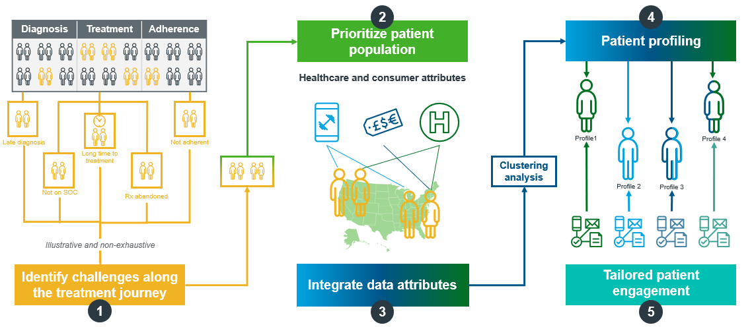
Patient Profiling: Dynamic Approach to Identify Barriers and Opportunities for Improved Communication
PILOT FOCUS:
Optimizing time to treatment in patients with prostate cancer
Patient profiling
SOC, standard of care.
This information is for educational use only. Do not copy. Do not distribute.
29

Slide 30





Patient Profiling: Dynamic Profiling
Identified 2 Key Groups to Focus On
RESEARCH QUESTION:
“Who are the patients with prostate cancer and where can we impact?”
Establish patient personas using data attributes
and analyses
Method:
Clustering analysis using IQVIA claims data (from Jan 2020–Dec 2022) to identify four patient profiles of men with prostate cancer, qualitative assessment by patients and HCPs
Patient profiling
Accessibility-challenged traditionalists
Under-served
digital wizards
Critical
modernists
Multi-morbid traditionalists
Older, lower education, prefer traditional communication methods, e.g., cable TV
and newspaper
Younger, higher proportion black population, prefer digital and mobile communication, e.g., digital radio and TV, and
mobile messaging
Younger, highest education, prefer digital communication, e.g., email, digital news,
and streaming TV
Older, more co-
morbidities, prefer traditional communication methods,
e.g., newspaper and direct mail
Delayed treatment causes
Concerns around QoL, and experience transportation and logistical challenges
Hold a traditional view
of ‘masculinity’ and hide
their diagnosis
Seek multiple opinions and focus on making ‘the right decision’
Prioritize interests and activities, while having limited access to physicians
Priority group
Priority group
HCP, healthcare professional; QoL, quality of life.
This information is for educational use only. Do not copy. Do not distribute.
30
Notes:
Rationale for priority groups to verbalize: The reason we prioritized these two groups are because we assessed the feasibility for industry to act on the intervention and the fact that the interventions would potentially have the greatest impact

Slide 31
Patient Profiling: Actionable Insights Helped Design Future Medical Content for 2 Priority Groups
RESEARCH QUESTION:
“What are the beliefs, treatment barriers, and communication needs among priority patients?”
Method:
Clustering analysis using IQVIA claims data (from Jan 2020–Dec 2022) to identify four patient profiles of men with prostate cancer, qualitative assessment by patients and HCPs
Understand unique beliefs, barriers and needs
Patient profiling
Accessibility-challenged traditionalists
Under-served digital wizards
Beliefs:
HCP knows best
Worry about significant side effects and QoL
Feel ‘on their own’ as logistics of care may be challenging
Beliefs:
More private and prefer to receive information from their doctor
Associate support groups with “sympathy-seeking” or “venting”
Barriers to getting treated ‘in time’:
Difficulty understanding diagnosis and/or treatments
Low urgency to start treatment
Barriers to affording and understanding care
Barriers to getting treated ‘in time’:
Low urgency to start treatment; worried about impact on QoL
Less proactive about healthcare
Unable to afford certain treatments
Communication needs:
Education on disease progression
Improved logistical support
Engagement through PCP or urologist via printed materials
Communication needs:
Address community stigma
Engagement through their doctors or via digital channels
Education on the importance of timely treatment
HCP, healthcare professional; PCP, primary care physician; QoL, quality of life.
This information is for educational use only. Do not copy. Do not distribute.
31

Slide 32




Patient Profiling: New Omnichannel Plans Incorporated These Insights For Each Priority Group
RESEARCH QUESTION:
“How can we tailor communications to the patient types?”
Method:
Clustering analysis using IQVIA claims data (from Jan 2020–Dec 2022) to identify four patient profiles of men with prostate cancer, qualitative assessment by patients and HCPs
Patient profiling
Develop tailored communication tactics and omnichannel plan
HCP-distributed handouts
Accessibility-challenged traditionalists
Potential tactics and messages:
Share resources to enable logistical support to attend medical appointments
Identify HCPs treating these patients and determine barriers to scheduling / capacity constraints
Provide data to enable risk vs. benefit assessments of various treatment options
Help them identify and mitigate comorbidities that could interfere with treatment
Help them understand and mitigate possible treatment-related side effects
EXAMPLE delivery channels
Printed/traditional media
Local organizations via community physician
Patient navigator carers
32
HCP, healthcare professional.
This information is for educational use only. Do not copy. Do not distribute.

Slide 33



Patient Profiling: New Omnichannel Plans Incorporated These Insights For Each Priority Group
RESEARCH QUESTION:
“How can we tailor communications to the patient types?”
Method:
Clustering analysis using IQVIA claims data (from Jan 2020–Dec 2022) to identify four patient profiles of men with prostate cancer, qualitative assessment by patients and HCPs
Patient profiling
Develop tailored communication tactics and omnichannel plan
Patient navigator
Under-served Digital wizards
Potential tactics and messages:
Demystify stigma of prostate cancer (and its implications) in the Black community
Share the importance of “in-time” treatment among Black men
Explain the importance of screening and risk
Educate on how to communicate with loved ones and care team
Education on managing side effects and QoL while on treatment
EXAMPLE delivery channels
Digital tools (i.e., phone
and digital engagement)
Physician
HCP, healthcare professional; PAG, patient advocacy group.
This information is for educational use only. Do not copy. Do not distribute.
33

Slide 34



Survey: Understanding the Scientific Landscape
Perspectives From Patients With Cancer and Caregivers
An online pan-oncology survey of patients and caregivers was used to identify the barriers, value, and use of existing content
Barriers, value, & use
125 US patients with cancer and/or their caregivers recruited to participate in a survey
Respondents completed a 10-minute online survey (Feb 2023)
Survey administered
via Savvy Cooperative (#AskPatients)
PLS, plain language summary; US, United States of America.
This information is for educational use only. Do not copy. Do not distribute.
34

Slide 35
Survey: Patients Rely on PAGs, WebMD,
Journals, Social, and Doctor Materials
RESEARCH QUESTION:
“Which resources do oncology patients use to stay up-to-date?”
Method:
10-minute online survey of pan-oncology patients and caregivers (Feb 2023) to gather insight and understand EPC format preferences¹
Evaluate impact of available resources
Barriers, value, & use
Other
EPC, enhanced publication content; PAG, patient advocacy group.
1. Schuler KW, et al. Presented at the 19th Annual Meeting of ISMPP; April 24–26, 2023; Washington, DC, USA; Poster #42
This information is for educational use only. Do not copy. Do not distribute.
35

Slide 36
Survey: Patients Struggle to Find
and Interpret Medical Articles
RESEARCH QUESTION:
“What are the hurdles to oncology patients keeping up-to-date with the latest scientific knowledge?”
Method:
10-minute online survey of pan-oncology patients and caregivers (Feb 2023) to gather insight and understand EPC format preferences¹
Barriers, value, & use
Assess
barriers
EPC, enhanced publication content.
1. Schuler KW, et al. Presented at the 19th Annual Meeting of ISMPP; April 24–26, 2023; Washington, DC, USA; Poster #42
This information is for educational use only. Do not copy. Do not distribute.

Slide 37





Survey: Patients Want to Share PLS and Journal Articles \
RESEARCH QUESTION:
N=114
“What do oncology patients find most useful to share with their healthcare providers?”
Journal
article
Podcasts
Method:
10-minute online survey of pan-oncology patients and caregivers (Feb 2023) to gather insight and understand EPC format preferences¹
Videos
Evaluate patient–HCP use and sharing
Interactive
Infographics
Barriers, value, & use
PLS
92% of patients report that they would share EPC with their HCP
EPC, enhanced publication content; HCP, healthcare professional; PLS, plain language summary
1. Schuler KW, et al. Presented at the 19th Annual Meeting of ISMPP; April 24–26, 2023; Washington, DC, USA; Poster #42
This information is for educational use only. Do not copy. Do not distribute.

Slide 38
Survey: The Majority of Patients Ranked all Enhanced Content Types as Highly Useful Resources
RESEARCH QUESTION:
“How useful do you think the following types of resources would be to help you better understand medical information from a scientific journal article?
Method:
10-minute online survey of pan-oncology patients and caregivers (Feb 2023) to gather insight and understand EPC format preferences¹
N=124
Extremely/Moderately useful
Slightly/Mostly not useful
Not at all useful
I do not know what this is
12%
2%
6%
13%
7%
2%
4%
Evaluate patient–HCP use and sharing
23%
Barriers, value, & use
34%
PLS
Videos
21%
Interactive
Infographics
Podcasts
57%
63%
70%
86%
EPC, enhanced publication content; HCP, healthcare professional; PLS, plain language summary
1. Schuler KW, et al. Presented at the 19th Annual Meeting of ISMPP; April 24–26, 2023; Washington, DC, USA; Poster #42
This information is for educational use only. Do not copy. Do not distribute.

Slide 39
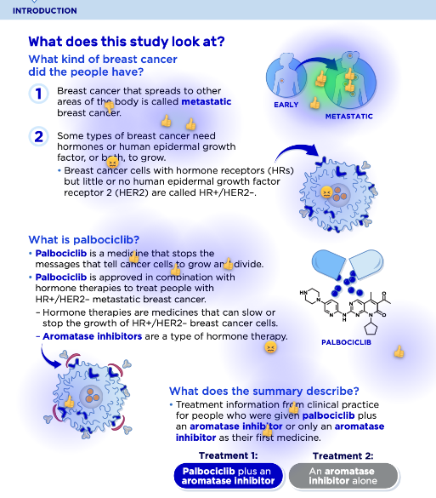
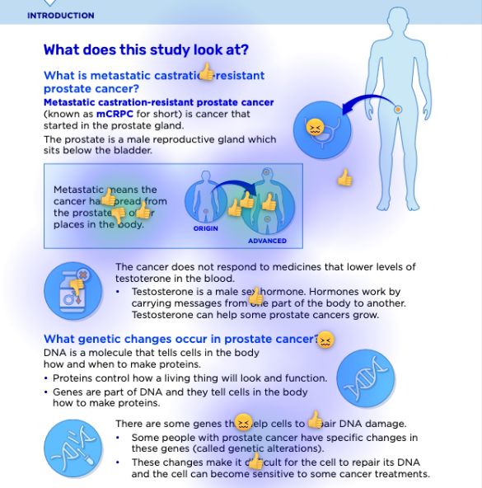
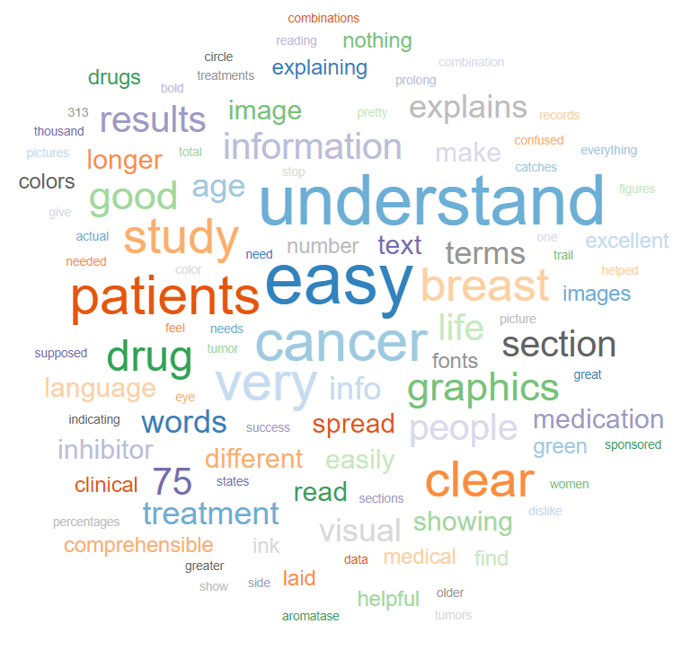
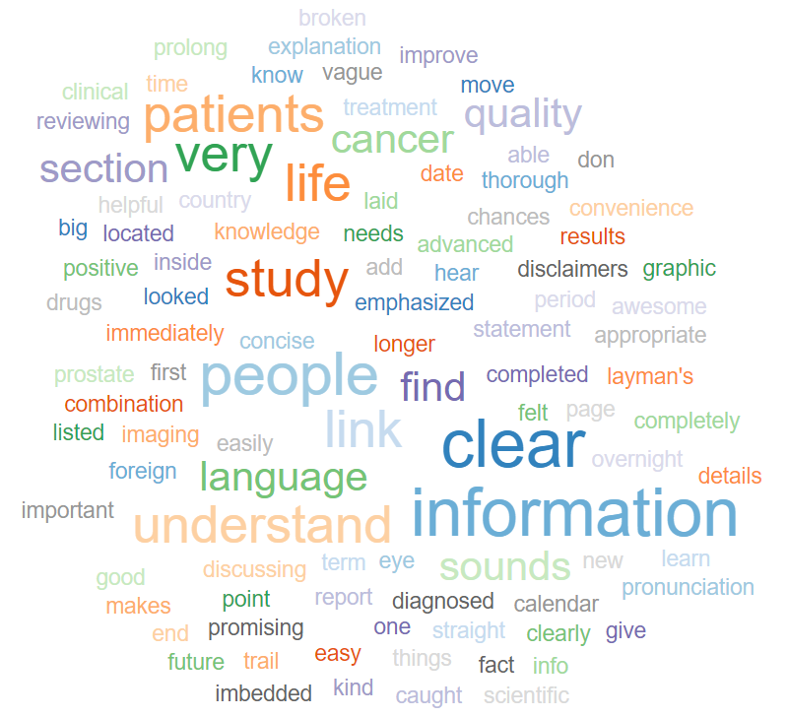
Assessing PLS: Patients Identified Key Opportunities to Improve Clarity of Different PLS Formats
RESEARCH QUESTION:
“How can we advance PLS to meet patient needs?”
Method:
Subset of patients from the pan-oncology survey evaluated two redesigned PLS to identify potential improvements
Patients called for:
Glossary to define complex terminology
Imagery that accurately reflects medications, cellular processes,
and patients
Avoid complicated or chemical-structure imagery
Fair balance between efficacy and safety, information on QoL if available
Assess
Impact and
readability
Content validation
EPC, enhanced publication content; PLS, plain language summary; QoL, quality of life.
This information is for educational use only. Do not copy. Do not distribute.
39

Slide 40
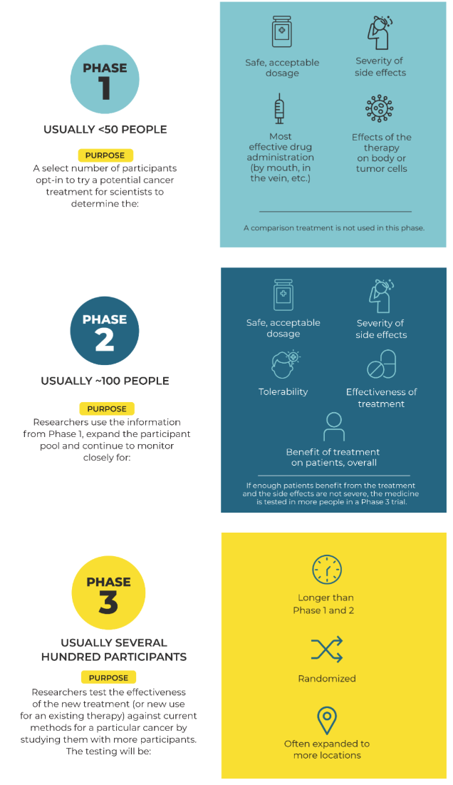


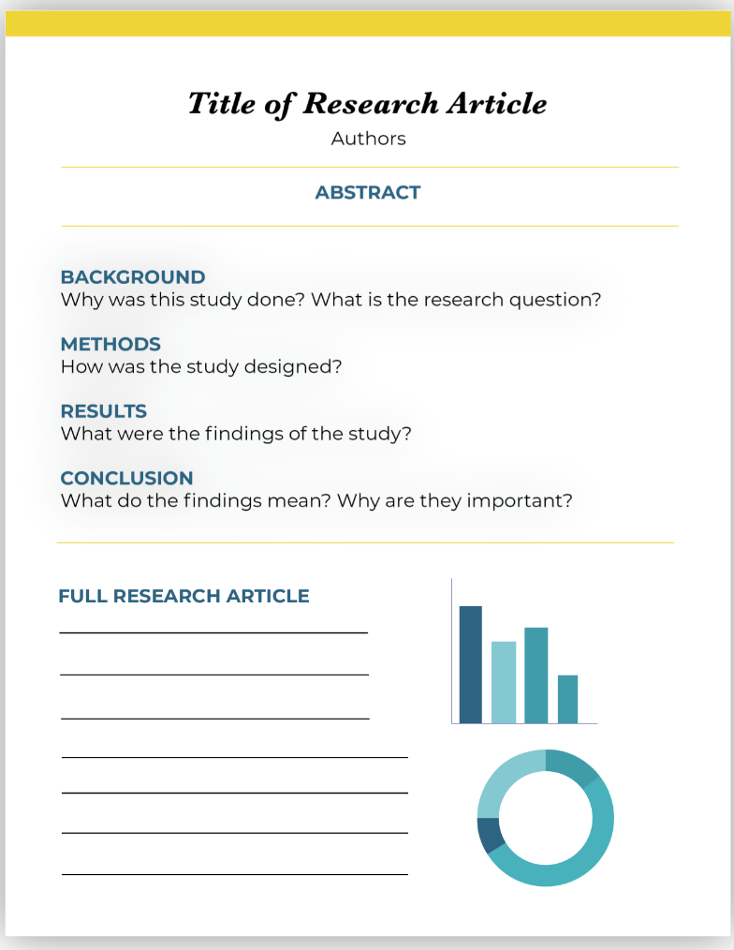
New Health-Literacy Resources
were Developed Based on Insights
In response to the data-driven and qualitative approaches described:
7 new health literacy resources were developed to support PLS, aid in understanding data, and improve shared decision-making between patients and HCPs
Understanding the Clinical Trial Process
Navigating Clinical Trial Information Websites
Four Tips for Finding Medical Information Online
How to Read an Abstract for a Clinical Trial Publication
Common Terms Used in Abstracts/ Research Articles for Clinical Trials
Abstract PLS at Scientific Congresses
The Basics of Medical Meetings
Content validation
Assess
Impact and
readability
HCP, healthcare professional; PLS, plain language summary.
This information is for educational use only. Do not copy. Do not distribute.
40
Notes:
Understanding the Clinical Trial Process: Comprehending the complexities of the clinical trial process can be challenging; still, it remains crucial to enable patients living with cancer to make well-informed decisions regarding their care
Navigating Clinical Trial Information Websites: During your cancer care, you may be interested in participating in a clinical trial; however, finding one that suits your needs may be overwhelming
Four Tips for Finding Medical Information Online: Unfortunately, there is a lot of misinformation on the internet about cancer. While the internet can be a helpful resource for people living with cancer, it’s important that the information is reliable, clear, and from a reputable source
How to Read an Abstract for a Clinical Trial Publication: There are countless research articles that provide information on clinical trials for many different types of cancer
Common Terms Used in Abstracts and Research Articles for Clinical Trials: Words used in abstracts and research articles for cancer clinical trials can be difficult to understand. This guide builds off and complements, “How to Read an Abstract for a Clinical Trial Publication.”
Abstract PLS at Scientific Congresses: Abstract Plain Language Summaries (aPLS) are resources that make data presented at medical meetings easier to understand to the layperson
The Basics of Medical Meetings: It’s important for patients to understand what medical meetings are and how the information or data that is shared there can impact their cancer care

Slide 41
In Summary,
Applying omnichannel principles can optimize scientific communication strategies to effectively reach patients and improve shared decision-making
Tailored communication plans and content development can help improve patient outcomes overall
Medical writing support for this presentation was provided by dna Communications, funded by Pfizer Inc.
This information is for educational use only. Do not copy. Do not distribute.
.
41

Slide 42
Seeing it in the Flesch: Comparing readability between
AI-generated and human-written plain language abstracts
David McMinn, Tomas Valena, & Walter Bender

Slide 43
Disclosures
David McMinn, Tomas Valena, & Walter Bender are employees of Sorcero.
Encore of ISPOR EU Oral presentation, Copenhagen, November 2024.

Slide 44


Plain Language Summary (PLS) Imperatives
Ethical
Regulatory
imperative
imperative
European Commission Clinical Trials Expert Group. Good Lay Summary Practice. October 2021.
Available at: https://health.ec.europa.eu/system/files/2021-10/glsp_en_0.pdf

Slide 45
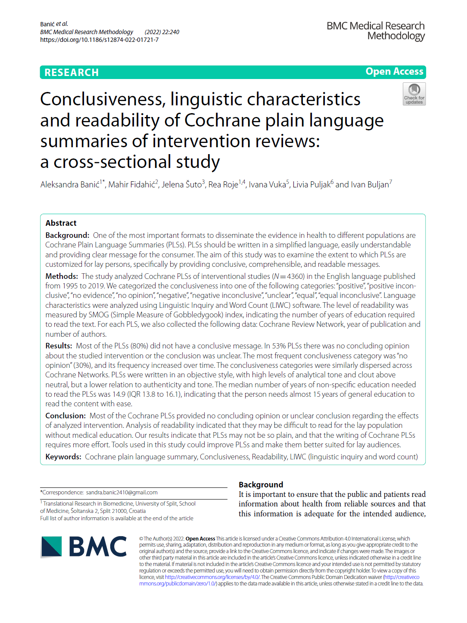
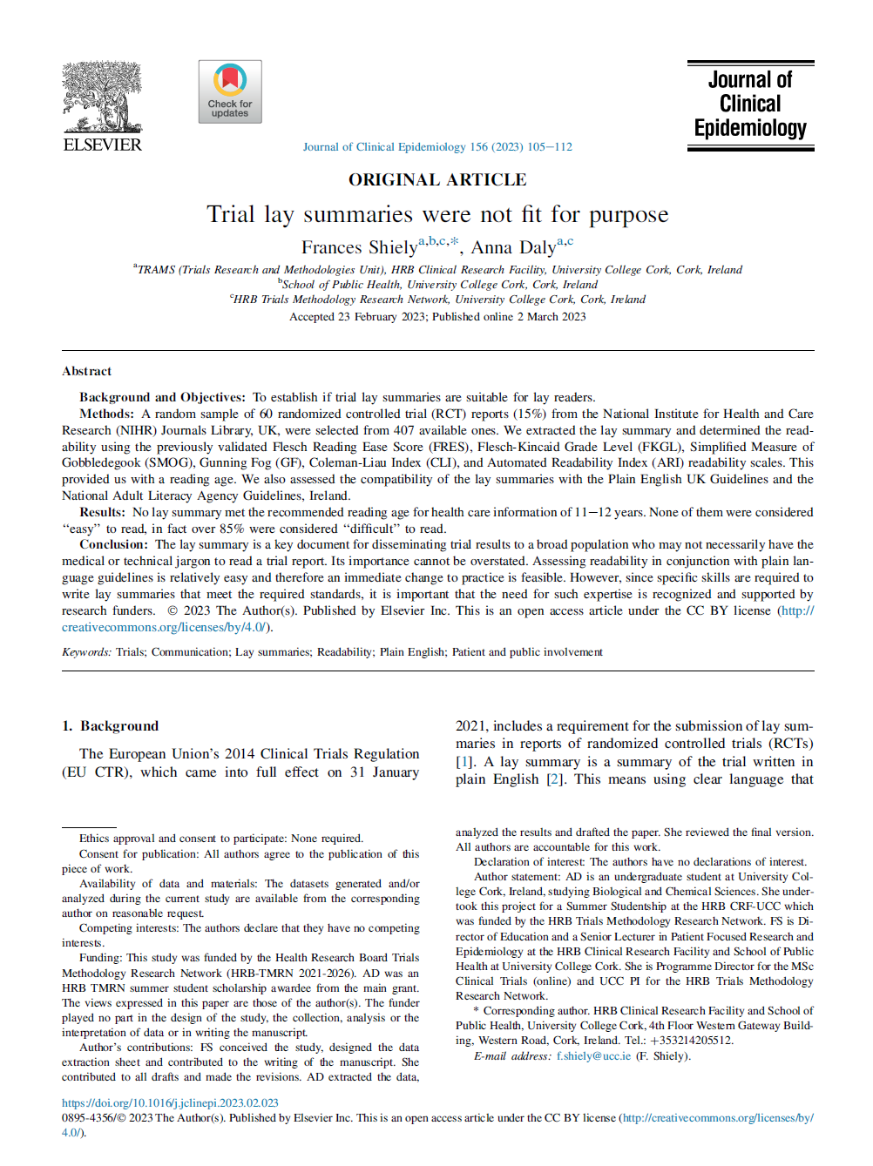
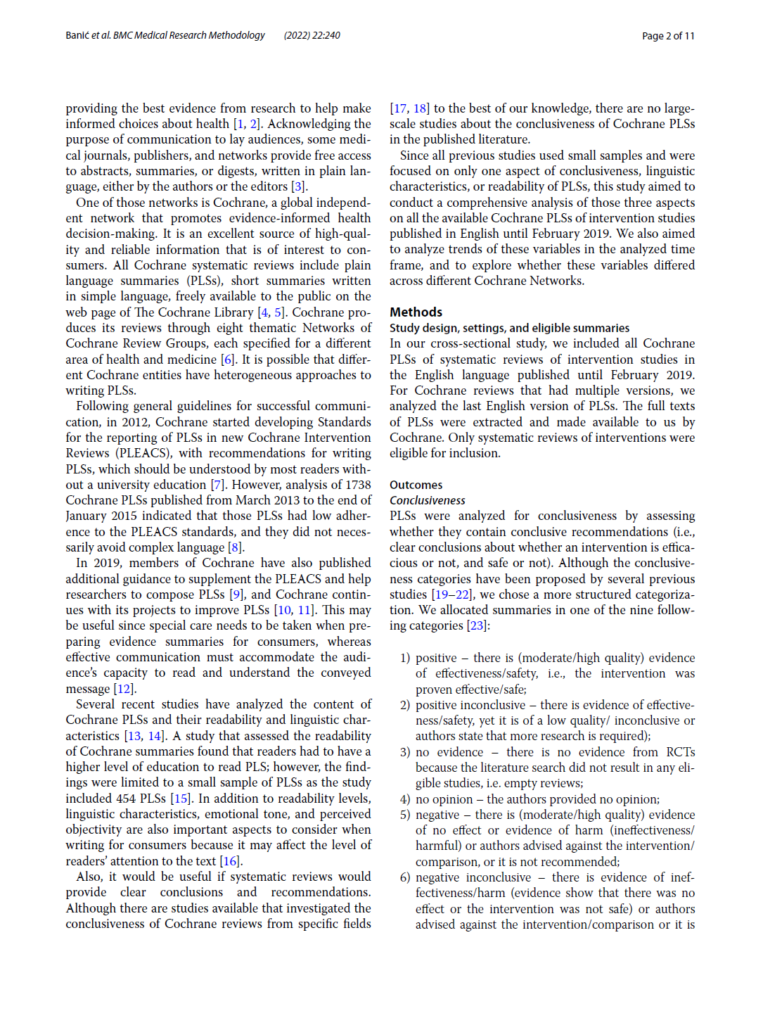
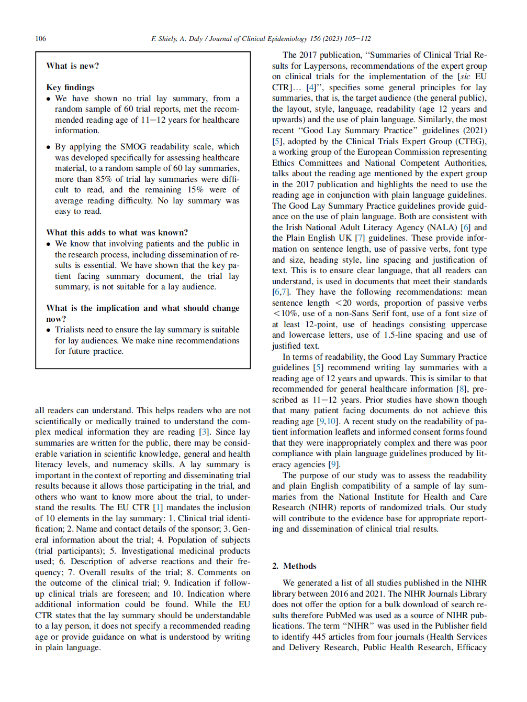
Current PLS documents are not fit for purpose
“Analysis of readability indicated that they may be difficult to read for the lay population without medical education. Our results indicate that PLSs may not be so plain, and that the writing of Cochrane PLSs requires more effort.”¹
“No lay summary met the recommended reading age for health care information... None of them were considered ‘‘easy’’ to read, in fact over 85% were considered ‘‘difficult’’ to read.”²
1. Banic A, et al. BMC Medical Research Methodology 2022;22:240.
2. Shiely F & Daly A. Journal of Clinical Epidemiology 2023;156:105-112.

Slide 46
How can we do better? …AI?
Study aim
Compare the readability scores of AI-generated abstract PLSs (aPLS) vs corresponding published (human-written) abstract PLSs

Slide 47

Methods | Abstract search
PubMed search: ‘Plain Language Summary’ – pragmatic selection of n=50*
Published scientific abstract
(n=48)
Published human-written aPLS (n=48)
AI-generated aPLS
[x2 bespoke approaches with task-specific coding]
(n=48)
Approach 1: biobert, text-bison@001, bart-large-mnli, scibert.
Approach 2: biobert, gpt-3.5-turbo, bart-large-mnli, scibert.
*Corresponding scientific abstracts not available for n=2

Slide 48
Methods | Assessments & analysis
Readability metrics
Flesch-Kincaid, ARI, Linsear-Write, and SPACHE
Accessibility
Average readability scores for each aPLS type plotted against population-level literacy distribution
Reading time
Calculated using previously published algorithm¹
SME-assessed quality
Each AI-generated aPLS rated as ‘Good, Moderate, or Poor’, before and after process optimisation
Analysis
Readability metrics: Comparison of mean scores across abstract type (ANOVA with pairwise comparisons, p values)
Accessibility, reading time, & SME-assessed quality reported descriptively
1. Demberg V & Keller F. Cognition 2008;109:193-210.
ANOVA, analysis of variance; aPLS, abstract plain language summary; ARI, Automated Readability Index; SME, subject matter expert.

Slide 49
Abstract therapy areas and journals
Therapy Areas
Journals
N=48 abstracts

Slide 50
AI aPLSs more readable than human-written aPLSs
*
*
*
*
*
*
*
Mean readability score (Grade level)
*
Plain language target
Readability scale
N=48 abstracts
Analysis of variance with Bonferroni pairwise comparisons. *p<0.01

Slide 51
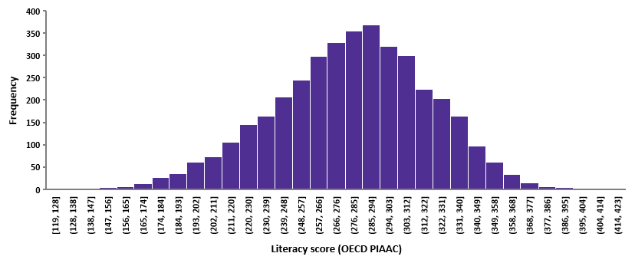
AI aPLSs more accessible than human-written aPLSs
Approximately Grade 8 reading ability
Increasing audience size
AI aPLS
Human aPLS
Scientific abstract
3.3%
11.1%
3.3%
12.2%
33.3%
33.3%
38.2%
38.2%
0.7%
US OECD PIAAC literacy data (n=3892): https://webfs.oecd.org/piaac/puf-data/csv/
Wiley Communications: What’s the latest US literacy rate? https://www.wyliecomm.com/2021/08/whats-the-latest-u-s-literacy-rate

Slide 52
AI aPLSs take less time to read than scientific abstracts
*
*
*
Reading time calculated using algorithm published in Demberg V & Keller F. Cognition 2008;109:193-210.
N=48 abstracts
Analysis of variance with Bonferroni pairwise comparisons. *p<0.01

Slide 53
>75% of AI aPLSs classed as ‘Good’ quality
Before optimization
After optimization*
Approach 1
Approach 1
Approach 2
*Process optimization included source content classification and discrepancy checks
Scoring criteria
Good: Requires only minimal editing before being classed as a suitable first draft; Moderate: Requires some editing, has minor hallucinations, or in places has failed to accurately grasp key concepts from the source document; Poor: Failed to run the model (or only partly ran model), or there were major hallucinations, or poorly translated the source content to lay language

Slide 54
Strengths and limitations
Broad range of therapy areas
Variety of readability scales
Different AI models tested
Findings placed in context of population-level literacy
Relatively small sample
No end-user assessment

Slide 55
Conclusions
Plain-language summaries of scientific content generated using bespoke AI processes and task-specific coding are easier to read and are more accessible than those written by humans
Research is ongoing to investigate the labour-saving potential of this approach for aPLS generation; a follow-up study includes end-user assessments

Slide 56
Audience Q&A
To ask a question, open the Q&A window, type your question into the Q&A box. Click Send.
Notes:
And now it's time to answer your questions. As a reminder, please type them into the Q&A box at the bottom of your screen.

Slide 57
Upcoming ISMPP U Webinars
March
15, 2024
Measuring the Impact of Publications in APAC region
March
27, 2024
Cooking up a Pub Plan – Adding Some Flavor to the Usual Fare
Notes:
Also, be on the lookout for ISMPP’s next ISMPP U

Slide 58
ISMPP University
Member Research Spotlight: 2024 European Meeting of ISMPP
February 28th, 2024
Webinar will begin promptly at: ​
11 AM ET / 4 PM GMT
Notes:
If you were unable to at the beginning, please take a moment to take a screenshot for CMPP credit.

Slide 59

Thank you for attending!
We hope you enjoyed today's presentation.
After closing out of Zoom, please click the CONTINUE button
on your screen to take our short survey. Thank you!
Notes:
Thank you again for attending today’s webinar. Please take a moment to fill out the survey link that will be sent to you.
After closing out of ZOOM, please click the ‘continue’ button on your screen to take a short survey.
Thank you!

Slide 60
Faculty Bios

Slide 61
Niall Harrison, MSc
Senior Scientific Director at OPEN Health
Co-chair of ACCORD, a reporting guideline for studies using consensus methods
CMPP, certified medical publications professional; ISMPP, international society of medical publications professional

Slide 62
Brittany Wolf Gianares, MPH
Director, Oncology Global Medical Content Lead at Pfizer
Passionate advocate for health literacy and data accessibility for all
Presented and published on plain language summaries, shared decision-making, and patient engagement in the scientific dialogue
CMPP, certified medical publications professional; ISMPP, international society of medical publications professional

Slide 63
David McMinn, PhD
Lay Summaries Practice Leader, Sorcero
Experienced medical communications professional
Particular expertise in the development of clinical trial lay summaries
Interested in the application of new technologies in the medical communications space
CMPP, certified medical publications professional; ISMPP, international society of medical publications professional

Slide 64

William Gattrell, PhD
Works in the Medical Communications team at Bristol Myers Squibb
Previously was a pubs lead at Ipsen, leading on the company’s Open Access and Plain Language Summary commitments
Published research on the impact of medical writing support and the carbon footprint of congress attendance, and is a co-lead on the ACCORD reporting guidelines
CMPP, certified medical publications professional; ISMPP, international society of medical publications professional

