Slide 1

Water Rights: Change of Ownership
Water Availability Division
Water Rights Compliance Assurance Team (WRCAT)
Notes:
Water Rights Compliance Assurance Team (WRCAT)

Slide 2
Overview
What is a Water Right?
Title 30 TAC §297.81-.83
Change of Ownership Process
Water Use Reports
Contact Information
Questions
Notes:
Outline of presentation

Slide 3
What is a Water Right?
Texas Water Code (TWC) §11.002(5)
“A right acquired under the laws of Texas to impound, divert, or use state water.”
Notes:
If you use state water in any way, then you need a water right.
There are a few exceptions as it pertains to impoundments through the TWC §11.142.
A water right is still required to divert from a TWC §11.142 exempt reservoir for non-exempt purposes.

Slide 4
So…What is State Water?
State Water is:
  “The water of the ordinary flow, underflow, and tides of every flowing river, natural stream, and lake, and of every bay or arm of the Gulf of Mexico, and the stormwater, floodwater, and rainwater of every river, natural stream and watercourse in the state.”
Notes:
TWC 11.021(a)

Slide 5
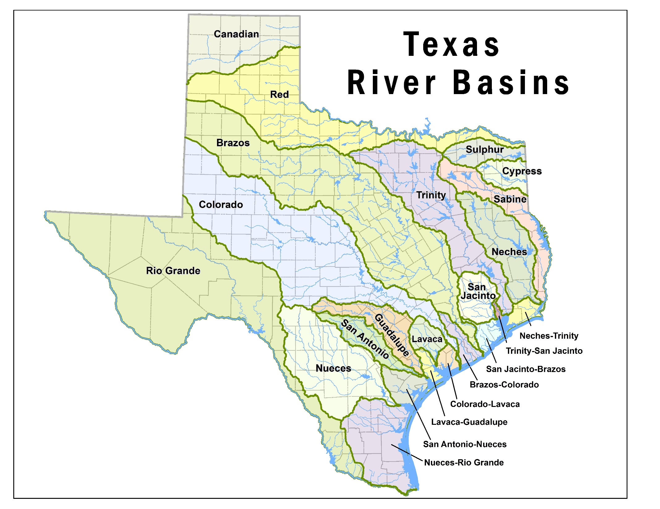
Texas River Basins
Notes:
Map of Texas River Basins.

Slide 6
Water Rights By Basin
Basin | # of WRs
01 Canadian | 38
02 Red River | 282
03 Sulphur | 57
04 Cypress | 89
05 Sabine | 197
06 Neches | 238
07 Neches-Trinity | 110
08 Trinity | 640
09 Trinity-San Jacinto | 17
10 San Jacinto | 151
11 San Jacinto-Brazos | 63
12 Brazos | 1137
Basin | # of WRs
13 Brazos-Colorado | 68
14 Colorado | 1224
15 Colorado-Lavaca | 30
16 Lavaca | 56
17 Lavaca-Guadalupe | 5
18 Guadalupe | 353
19 San Antonio | 267
20 San Antonio-Nueces | 19
21 Nueces | 256
22 Nueces-Rio Grande | 85
23 Rio Grande | 866
Total Water Rights | 6248
Notes:
Total number of water rights in each basin as of March 8, 2018.
This does not include Water Supply Contracts and the LCRA Management Plan.

Slide 7
Title 30 TAC §297.81:
General Rules of Conveyance
Irrigation water rights convey proportionately with the land, unless specifically withheld.
  Exceptions:
    An irrigation authorization is issued to a non-landowner, making it personal to the permitee.
    If the irrigation water right is held by a Water Corporation, Water District, River Authority or Governmental Entity. The water right must be specified in the conveyance document.
Notes:
The irrigation authorization cannot pass with the land if it is issued to a non-landowner.

Slide 8
Title 30 TAC §297.81:
General Rules of Conveyance (cont.)
If the water right is reserved from conveyance and the owner wishes to alter the Place of Use, Diversion Point or Purpose of Use, then an amendment must be filed with the Executive Director pursuant to TAC §295.71.
(d)A water right may be conveyed separately from the land; provided, however, the water right must be utilized in accordance with its terms and conditions until amended by the commission.
Notes:
Authorization changes to a water right are handled by the Water Rights Permitting Team (WRPT).
If a new owner wishes to amend a water right, they must become an owner of record before an amendment occurs.
WRCAT and WRPT work together to process applications with changes to authorizations.

Slide 9
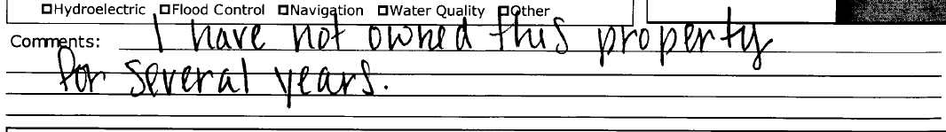
Title 30 TAC §297.82:
Duty to inform the Executive Director
An owner of a water right, or his or her agent, shall promptly inform the Executive Director of any transfer of water right or change of the owner's address.
Notes:
297.82 keywords are “shall…promptly…any.

Slide 10
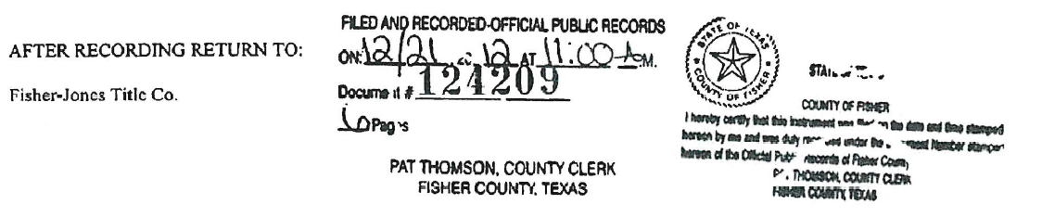
Title 30 TAC §297.83:
Recording Conveyances of Water Rights
Water right conveyance documents must be recorded with the County Clerk.
Provide copies of the recorded instruments evidencing a complete chain of title from the owner of record.
Notes:
297.83 takeaway: get your documents recorded either with the county clerk or court. We are looking for recording information to verify that the documents are complete.

Slide 11
Examples of Documents Submitted
Warranty Deeds
Special Warranty Deeds
Bill of Sale
Water Rights Transfer Deed
Partition Deed
Gift Deed
Quitclaim Deed
Will, Probate Order, Will Inventory
Deed of Trust
Trust Agreement
Covenants & Restrictions
Certificate of Merger
Certificate of Formation
Water Rights Conveyance
Notes:
These are some of the common documents we see, but there are as many types of conveyance documents as there are lawyers to write them.

Slide 12
Change of Ownership for a Surface
Water Right
TWC §11.040
  (a) A permanent water right is an easement and passes with the title to land.
  (b) A written instrument conveying a permanent water right may be recorded in the same manner as any other instrument relating to a conveyance of land.
Change of Ownership Form No. 10204
  Water Right Number
  New Owner Name
  Mailing Address
  Phone Numbers
Must be notarized to be accepted.
Notes:
The following is required information on the Change of Ownership Form:
Water Right Number
New Owner Name
Mailing Address
Phone Numbers

Slide 13
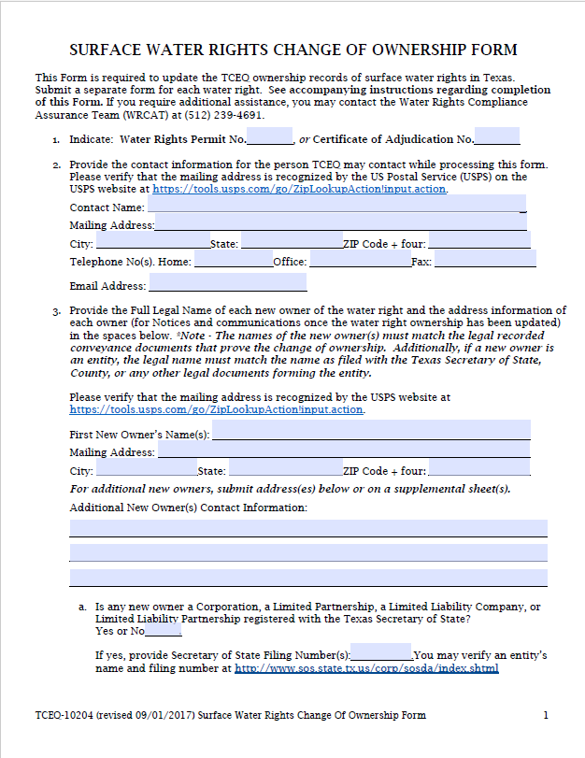
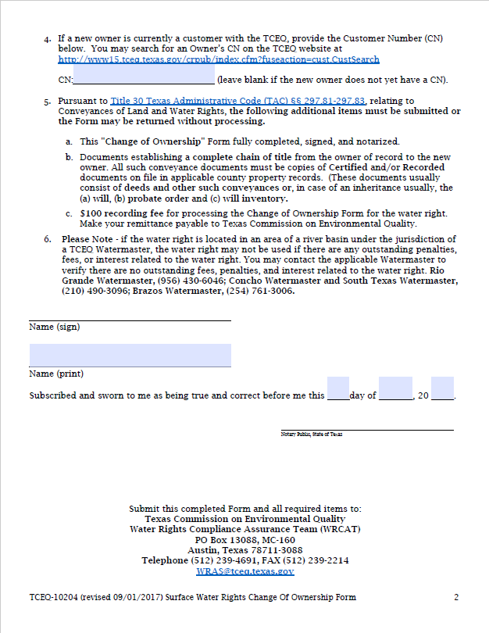
Change of Ownership Form No. 10204:
2 Form Pages, 4 instruction pages
Notes:
This is an image of the Water Rights Change of Ownership Form. The following is required information on the Change of Ownership Form:
Water Right Number
New Owner Name
Mailing Address
Phone Numbers
Signature block
Notary signature block
Only notarized forms can be accepted

Slide 14
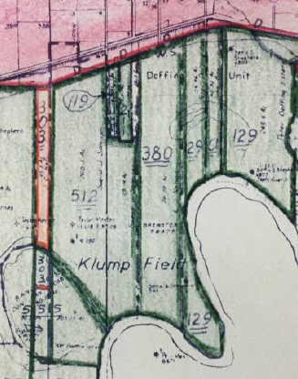
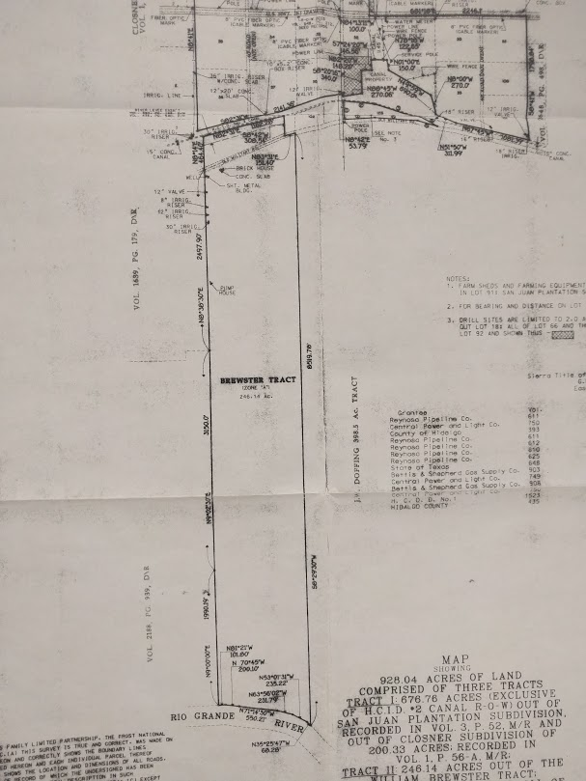
Value of a Plat Map
Plat Map – A plat map is a document drawn to scale, showing the divisions of a piece of land.
  Provides a recent or updated visual of the land conveyed in a deed or set of deeds.
  Can aid in processing a change of ownership if the land descriptions are unclear or the land has changed over time.
Notes:
When ever possible, supply a Plat Map.
Image 1: Original map of appurtenant tract in Rio Grande
Image 2: Submitted Plat map showing current property, total acreage, and other adjacent properties.

Slide 15
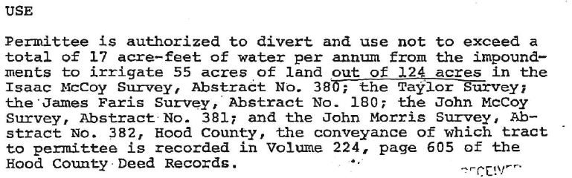
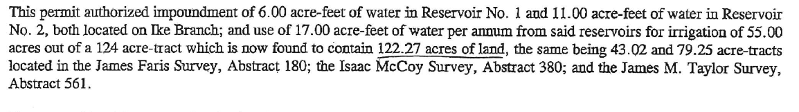
An Example of Map Use:
Original Water Right
2005 Memo
Tract has been divided
New acreage total
Notes:
Authorized / 1st change 23 years later / 10 years later for 2nd change.
This Permit originally authorized 6 acre-foot and 11 acre-foot impoundments, and 17 acre-feet of water for irrigation of 55 acres out of a 124-acre tract.
A memo in 2005, based upon conveyance documents and tract description, clarified and updated the acreage amount and reservoir locations.

Slide 16
2005 Memo: acreage breakdown
The referenced deed indicated that Cliff Dweller, et ux, had acquired another tract of 63.868 acres, by a deed of record in Volume 1330, Page 483 of the Real Records of Hood County. According to Bill Foldd’s letter dated March 1, 1995, neither he nor the Elmer Fudd Farms had any interest left in the water right involved. An attempt is being made to secure a copy of the Dweller’s deed to the 63,868 acre-tract in order to determine if it included the above listed 21.486 acre-and 11.235 acre-portions of the 122.27 acre-tract.
The ownership of the reservoirs, land and, on a proportionate basis, of the water rights is established as follows:
Elmer Fudd Farms 2.99 ac/ft per annum for irrigation of 9.67 ac out of 21.486 ac
John Smith Part of Reservoir No. 2, and 2.40 ac/ft per annum for irrigation of 7.77 ac out of 17.269 ac
Bill Foldd 1.56 ac/ft per annum for irrigation of 5.05 ac out of 11.235 ac
Cliff Dweller Reservoir No. 1, part of reservoir No. 2, and 10.05 ac/ft per annum for irrigation of 32.51 ac out of 72.28 ac
Two reservoirs and 17.00 ac/ft for irrigation of 55 ac out of 122.27 ac
Notes:
Further Division of the tract: now listed as four different tracts.
Incomplete chain of title: note 21.486 ac/tr and 11.235 ac/tr left in names of entities identified during COO to no longer be owners of record.
Unclear acreages: are the 21.486 ac/tr and 11.235 ac/tr wholly included in the 63.868 ac/tr, partially included, or not at all?

Slide 17
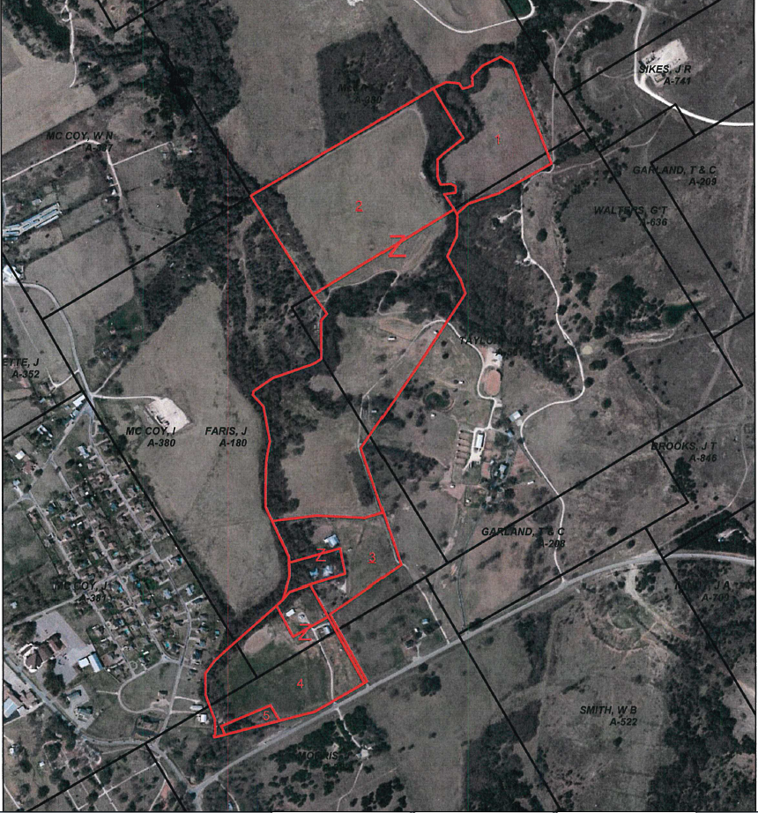
Map of Current Tracts (Satellite)
Satelite image overlaid by tract boundaries.
Notes:
Map of tracts helps illustrate what is appurtenant land, and can be used in conjunction with metes and bounds descriptions in deeds and CAD maps if available. These maps were created as part of a research contract with Englemann Land Services, LLC.

Slide 18
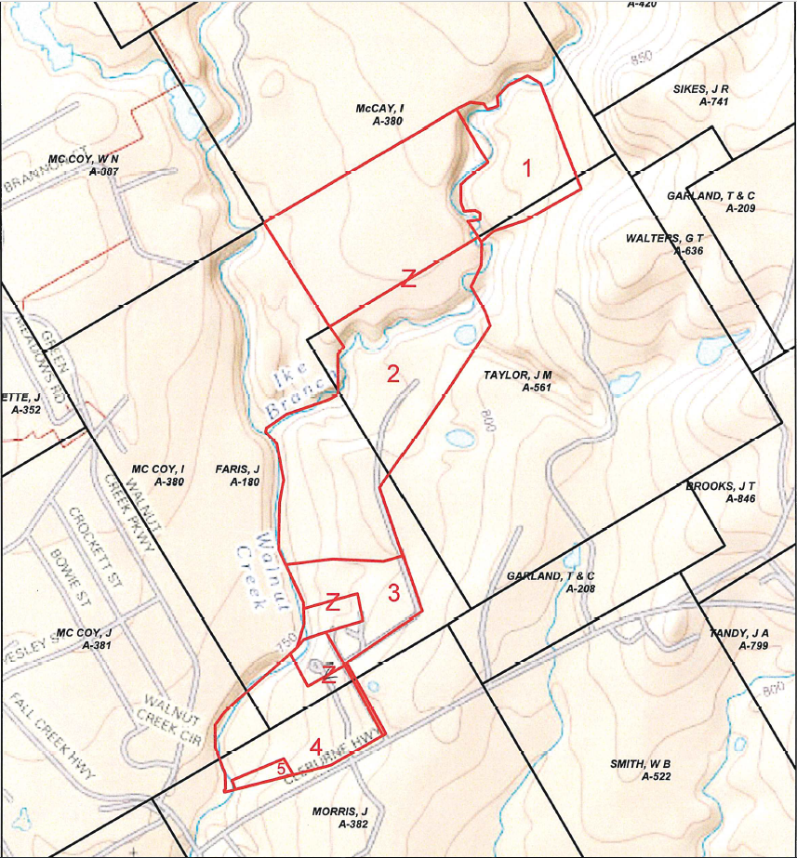
Map of Current Tracts (Terrain)
Reservoir
Terrain image overlaid by tract boundaries.
Notes:
Maps showing locations of relevant features are also helpful when the land has been divided into smaller parcels. In instances where an impoundment exists, the owner of the impoundment authorization is the owner(s) of the inundated land. These maps were created as part of a research contract with Englemann Land Services, LLC.

Slide 19
What Causes a Delay
Incomplete Change of Ownership packages.
  Missing or un-notarized application form.
  Missing fee (§295.139).
    Standard practice is one fee per application per water right.
  Documents that have not been recorded with the County Clerk (§297.83).
  Incomplete contact information.
  Including a plat map is always a good idea.
Unclear conveyance documents.
Gaps in recorded chain of title.
Acreage values that have changed over time.
Notes:
Not reading the instructions.
Easy as 1,2,3 Notarized form, $100 fee, Recorded documents

Slide 20
Take-Away
Submit:
  Complete, recorded chain of title documents.
  Completed, notarized Change of Ownership Form, and
  $100 recording fee.
Please make your remittance payable to the Texas Commission on Environmental Quality.
Also, if available, a map of the land being conveyed.
Notes:
By referencing the Water Right number in all correspondences it makes processing submitted information smoother.

Slide 21
Annual Surface Water Use Reports
Title 30 TAC §295.202
  If you take water during the year, you need to report what you took.
  TWC §11.031 and §11.032.
    Mailed out the first business day in January.
    Must be returned by March 1st.
    8 different forms based on authorized uses of the water right.
  Water Supply Contract holders must also report their use.
  Water rights located in a Watermaster area will report use directly to the Watermaster and should not submit an annual report to TCEQ headquarters.
Notes:
Some forms will look the same based upon use.
Return by March 1st each year.

Slide 22
Annual Surface Water Use Reports (cont.)
Before 2016, there was one form for all water rights.
A Frequently Asked Questions (FAQ) guide has been made available on the TCEQ website.
8 different forms based on authorized uses of the water right.
Notes:
We now have 8 forms based upon authorized use.

Slide 23
Use Types
Common Use Types
Less Common Use Types
Agriculture, Irrigation
Municipal/Domestic
Industrial/Mining
Domestic and Livestock (D&L)
Recreation
Flood Control
Water Quality
Recharge
Wildlife/Conservation
Other
Notes:
Most water rights fall under the first group of uses.

Slide 24
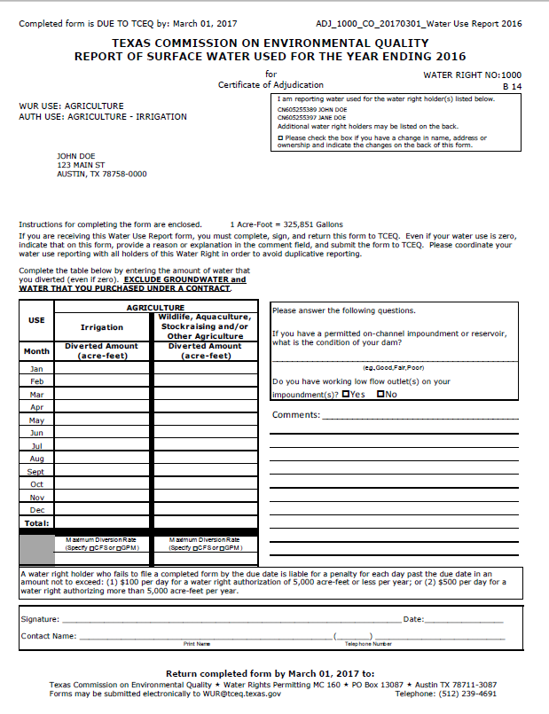
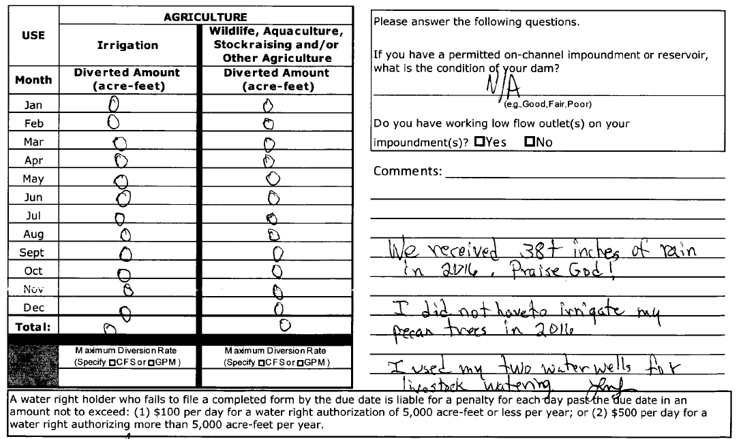
Example, Agriculture
Example: completed
Notes:
Agriculture WUR and typical comments.
Exclude Groundwater and Contract water.

Slide 25
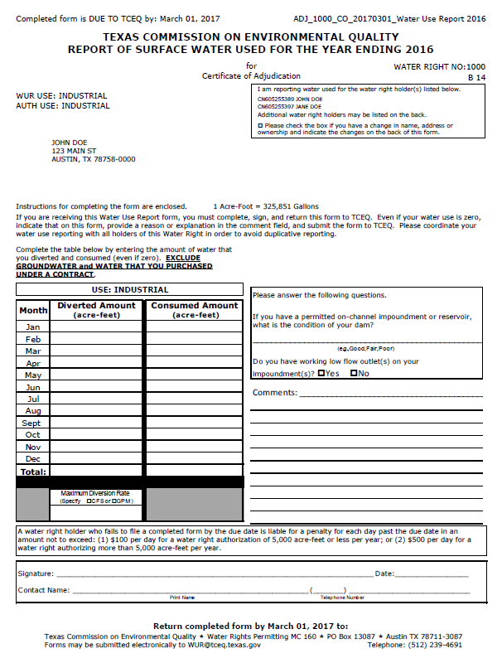
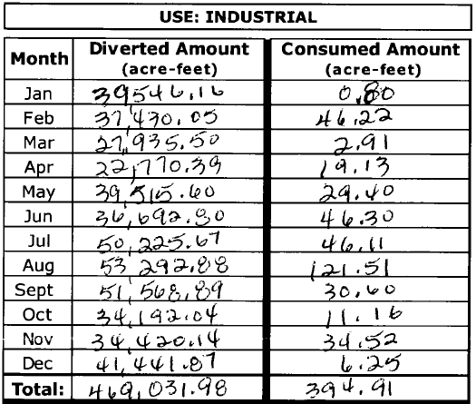
Example: Industrial, Mining
Industrial or Mining WUR completed
Notes:
Industrial and Mining use the same form.
Rate? GPM or CFS
Acre-feet or Gallons?
Exclude Groundwater and Contract water.

Slide 26
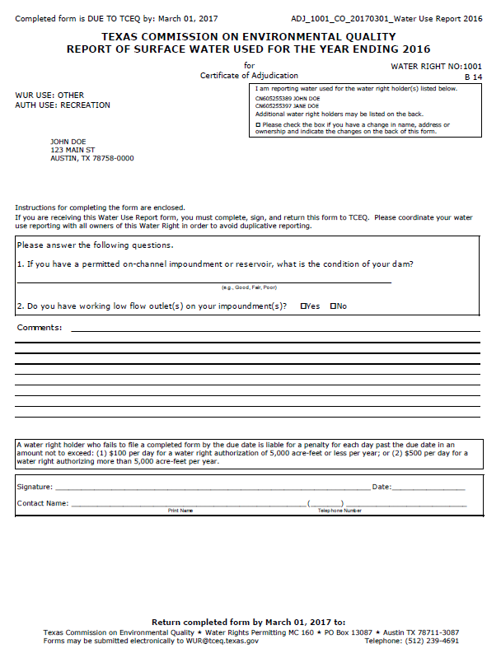
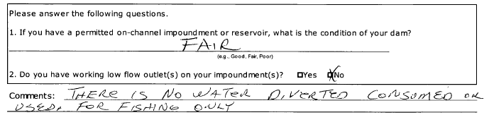
Example: Recreation
WUR Recreation comment
Notes:
No Diversions only storage authorized

Slide 27
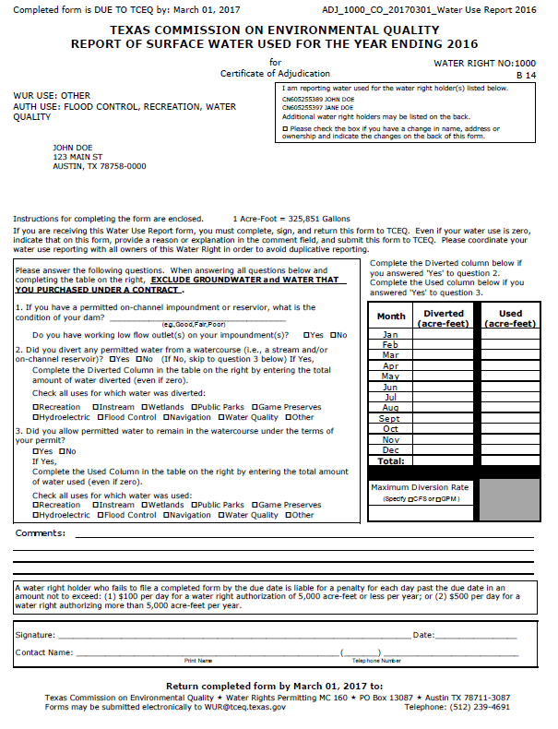
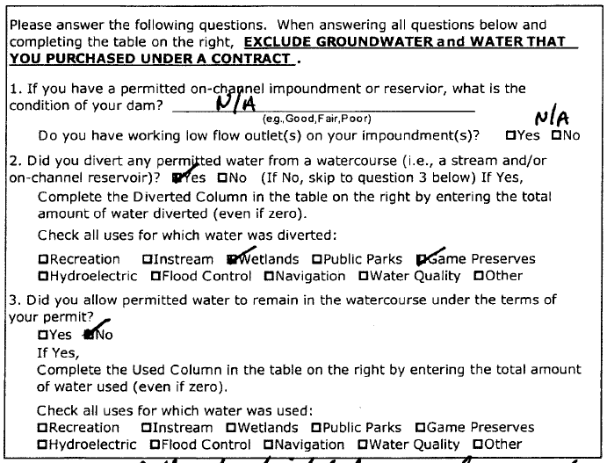
Example: Other
Other WUR Completed
Notes:
The Other form attempts to encompass the remaining uses not previously covered.
Exclude Groundwater and Contract water.

Slide 28
General Water Use Report Form Online
Generalized form available online.
  Water Use Report Form (TCEQ-10316)
Applicable to all use types.
10 pages long.
  First 2 pages required for all reports.
  Additional pages as applicable to the water right.
  All 10 pages may not apply in a given situation.
Notes:
IF all else fails use the general form, but please provide contact information.

Slide 29
Returning Water Use Reports
Forms mailed to the address on file are generated specifically for each water right based on unique authorizations and should be first choice for usage reporting.
In the event that your reports do not arrive or become damaged, you may call WRCAT to have another copy of the form mailed, faxed, or emailed to you or,
Download the general use form 10316 from the TCEQ website, however, this form will have no indication on which portions apply to your specific water right.
Notes:
Please send the WUR in ‘promptly’ and completed. Please only send it in once, it is not required that a form be submitted by mail, fax, email, and carrier pigeon. If you are concerned with it getting to us, please contact us after or request an email verification upon submittal.

Slide 30
Water Usage Reporting in Watermaster Areas
Water rights located in a Watermaster area will report use directly to the Watermaster.
These water rights do not submit an annual usage report to TCEQ headquarters.
Notes:
Contact your watermaster.
If you are not sure that your water right is in a watermaster, please contact the Water Availability Division.

Slide 31
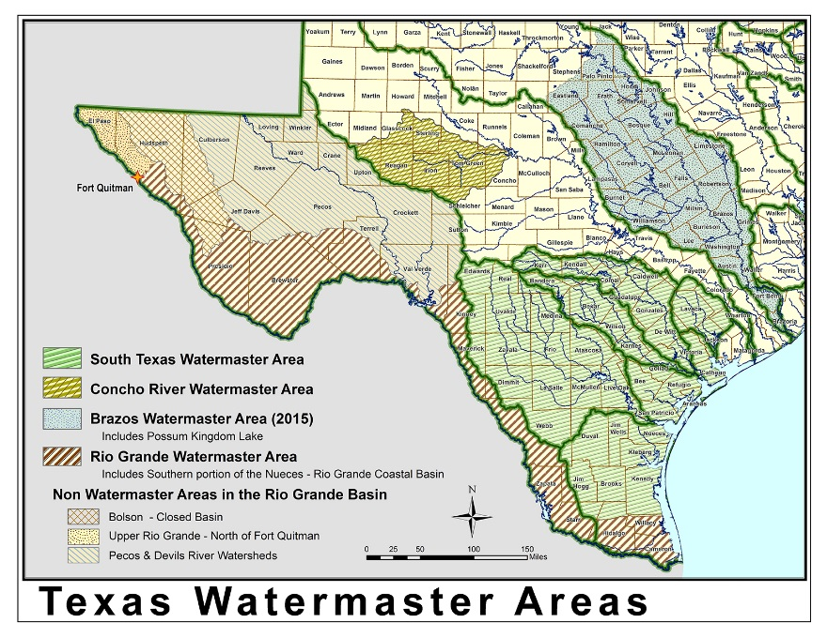
Texas Watermaster Areas
Notes:
Map of the Texas Watermaster Areas.

Slide 32
Number of Water Rights within the Watermaster Areas
Watermaster Area | # of WRs
South Texas | 994
Concho | 220
Brazos | 922
Rio Grande | 855
Total | 2991
Notes:
Total number of water rights as of March 8, 2018.
This does not include Water Supply Contracts.

Slide 33
Ways to Submit Your Water Use Report
By Mail:
  PO Box 13087, MC-160, Austin, Texas 78753
By Email
  WUR@tceq.texas.gov
By Fax
  512-239-2214

Slide 34
Frequently Asked Questions
We made no diversions this year, how do I report this?
How do I report if I am no longer the owner of the property/water right?
I only have a recreational water right, why did I receive the Water Use Report Form?
Do I have to have this form notarized?
What happens if I don’t meet the March 1st deadline?
Notes:
If there are no diversions, report this on Water Use Report form.
Indicate that there has been a change of ownership, and include contact information for the current owner if known.
All uses of Texas State water must be reported, including non-diversion or non-consumptive uses.
No, historically the forms were required to be notarized. This changed was initialed to promote prompt responses.

Slide 35

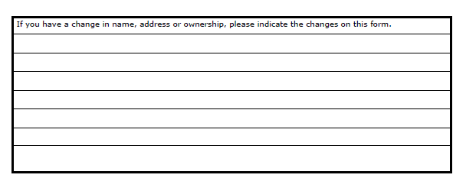
How do I report if I am no longer the owner of the property/water right?
Current owners listed
Updated owner contact information from reverse side.
Notes:
Please mark the box and indicate the new name, address, and/or ownership on the reverse side.

Slide 36
March 1st Deadline
Texas Water Code §11.031(b)
  Effective September 1, 2013 a person who fails to submit a Water Use Report Form by March 1st can be fined:
    (1) up to $100 a day for water right authorizations of 5,000 acre-feet or less per year;
    (2) up to $500 a day for water right authorizations greater than 5,000 acre-feet per year.
If you did not receive a report to fill out:
  Call the Water Rights Compliance Assurance Team
    512-239-4691

Slide 37
Goal of the Water Use Report
Assembling the best available usage information statewide.
  This data is made available to the public on the TCEQ Website.
  Having the best available information allows decision makers to make the best informed decisions regarding available water.

Slide 38
Contact Information
For water right Changes of Ownership, Water Use Reports and Amendments to a Water Right please call:
  512-239-4691
For general information on water rights permitting, please go to:
  www.tceq.texas.gov/permitting/water_rights/wawr_permits.html

Slide 39
Questions?

