Slide 1


“Defending Academic Freedom: Protecting Research, Teaching and Scientific Integrity”
Isaac Kamola, Director
AAUP’s Center for the Defense of Academic Freedom

Slide 2

Outline
What is Academic Freedom
  Founding of the AAUP; 1915 Declaration of Principles; 1940 Statement of Principles
2. Current attack on academic freedom (including scholarly associations)
3. Resources for fighting back

Slide 3
Historical Context, pre-1915
American colleges were originally fairly small and committed to training the clergy; knowledge was understood as received and passed down, rather than discovered.
Because of the colonial context and states rights, no national system of higher education emerged. Instead, we have a patchwork of private and public/state institutions.
Rise of professional associations during the late 1800s and early 1900s (APSA 1903; SRDC 1922) to defend professional autonomy

Slide 4
Vulnerability of the Faculty
During the early 20th century faculty served as at-will employees who could be dismissed it they ran afoul of university presidents or boards. Some high profile examples include:
Alexander Winchell: dismissed for writing about a version of evolution that conflicted with beliefs of the Methodist Church.
Richard Ely: investigated for advocating unionization and strike actions.
Edward Bemis: dismissed for in speech in which he argued that Ely was fired for supporting Pullman worker.
Edward Ross: fired for criticizing the railroads

Slide 5
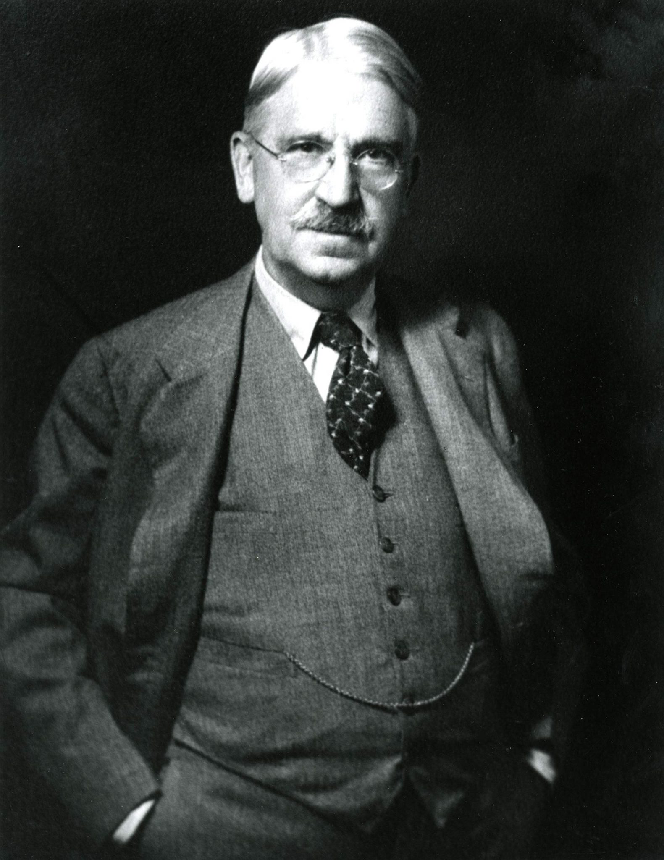
Founding of the American Association of University Professors
The AAUP was founded in January 1915 as a professional association focused on academic freedom and shared governance
At its second meeting, in December 1915, the AAUP received the annual report of its Committee A on Academic Freedom and Tenure, which became the “1915 Declaration of Principles on Academic Freedom and Academic Tenure”
John Dewey, First AAUP President
This image is licensed under the Creative Commons Attribution-Share Alike 4.0 International license.

Slide 6
Academic Freedom in the 1940 Statement
In 1940 the AAUP and Association of American Colleges (now American Association of Colleges and Universities; AAC&U) ratified a document that recognized academic freedom in three domains:
1) Freedom in Research
“Teachers are entitled to full freedom in research and in the publication of the results, subject to the adequate performance of their other academic duties; but research for pecuniary return should be based upon an understanding with the authorities of the institution.”

Slide 7
1940 Statement
2) Freedom in Teaching
“Teachers are entitled to freedom in the classroom in discussing their subject, but they should be careful not to introduce into their teaching controversial matter which has no relation to their subject. Limitations of academic freedom because of religious or other aims of the institution should be clearly stated in writing at the time of the appointment.”

Slide 8
1940 Statement
3) Extramural speech
“College and university teachers are citizens, members of a learned profession, and officers of an educational institution. When they speak or write as citizens, they should be free from institutional censorship or discipline, but their special position in the community imposes special obligations. As scholars and educational officers, they should remember that the public may judge their profession and their institution by their utterances. Hence they should at all times be accurate, should exercise appropriate restraint, should show respect for the opinions of others, and should make every effort to indicate that they are not speaking for the institution.”
[See also: “Committee A Statement on Extramural Utterances” (1964)]

Slide 9
1940 Statement
4) Intramural Speech
Though not explicitly stated within the 1940 Statement, through its investigations over the previous 25 years, the AAUP articulated a fourth implicit element of academic freedom: intramural speech. The freedom to discuss and criticize one’s institution.
Without the freedom of intramural speech, shared governance cannot exist.

Slide 10
1940 Statement
A key intervention in the 1940 Statement was the creation of a standard tenure system including:
written terms of appointment,
a maximum of a 7-year probationary period before tenure, during which academic freedom would be protected, and
termination after tenure only for cause or “demonstrably bona fide” financial exigency.

Slide 11
1940 Statement
The “1940 Statement” also laid out the process of terminating faculty for cause:
“Termination for cause of a continuous appointment, or the dismissal for cause of a teacher previous to the expiration of a term appointment, should, if possible, be considered by both a faculty committee and the governing board of the institution. In all cases where the facts are in dispute, the accused teacher should be informed before the hearing in writing of the charges and should have the opportunity to be heard in his or her own defense by all bodies that pass judgment upon the case. The teacher should be permitted to be accompanied by an advisor of his or her own choosing who may act as counsel. There should be a full stenographic record of the hearing available to the parties concerned. In the hearing of charges of incompetence the testimony should include that of teachers and other scholars, either from the teacher’s own or from other institutions. Teachers on continuous appointment who are dismissed for reasons not involving moral turpitude should receive their salaries for at least a year from the date of notification of dismissal whether or not they are continued in their duties at the institution.”

Slide 12

1940 Statement Affirmed by:
Negotiated by the AAUP and the AAC&U, the “1940 Statement” has since been affirmed by more than 270 scholarly and professional associations, from:
Academic Senate for California Community Colleges 1996
Academic Senate of the California State University 2004
Academy of Legal Studies in Business 1971
Academy of Management 1965
Acoustical Society of America 2015
African Studies Association 1975
Agricultural and Applied Economic Association 1962
Agricultural History Society 2004
American Academy for Jewish Research 2014
American Academy of Religion 1967
American Anthropological Association 1970
American Association for Applied Linguistics 1986…
In one of the earliest endorsements, the Statement was adopted for librarians in 1946.

Slide 13
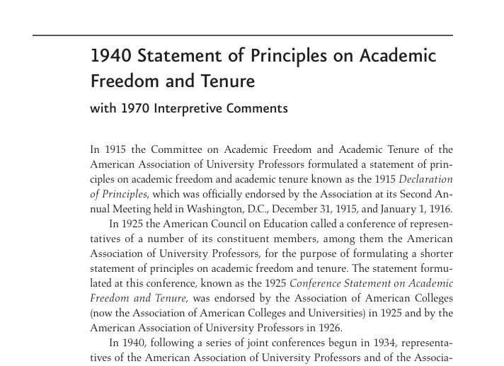
1940 Statement Affirmed by:
to:
…Southern Society for Philosophy and Psychology 1953
Southern States Communication Association 1966
Southwest Academy of Management 2024
Southwestern Philosophical Society 1964
Southwestern Social Science Association 1964
Texas Association of College Teachers 1976
Texas Association of Colleges for Teacher Education 1977
Texas Community College Teachers Association 1970
Texas Library Association 1977
University Film and Video Association 1968
Urban History Association, 2014
Western History Association 1966
Western Society for French History 2024
Western States Communication Association 1976
Women's, Gender, and Sexuality Studies South 2009
World Communication Association 1999
World History Association 2014

Slide 14

Academic Freedom and Shared
Governance
1966 Statement jointly formulated by the AAUP, the American Council on Education (ACE), and the Association of Governing Boards of Universities and Colleges (AGB).

Slide 15
What does shared governance look like in practice?
When shared governance is working well, faculty have considerable oversight into the governance of those aspects of the institution that guide the core teaching and research mission of the institution. This includes faculty senates or elected faculty committees overseeing:
the curriculum
the appointment, reappointment, and promotion of faculty
and, the assessment of whether there is cause of termination or non-renewal.
Faculty should also be involved in decision-making process on all aspects of the institution as they influence teaching and research (priorities of a capital campaign, admissions strategies, athletics, library and technology acquisitions, etc.)

Slide 16

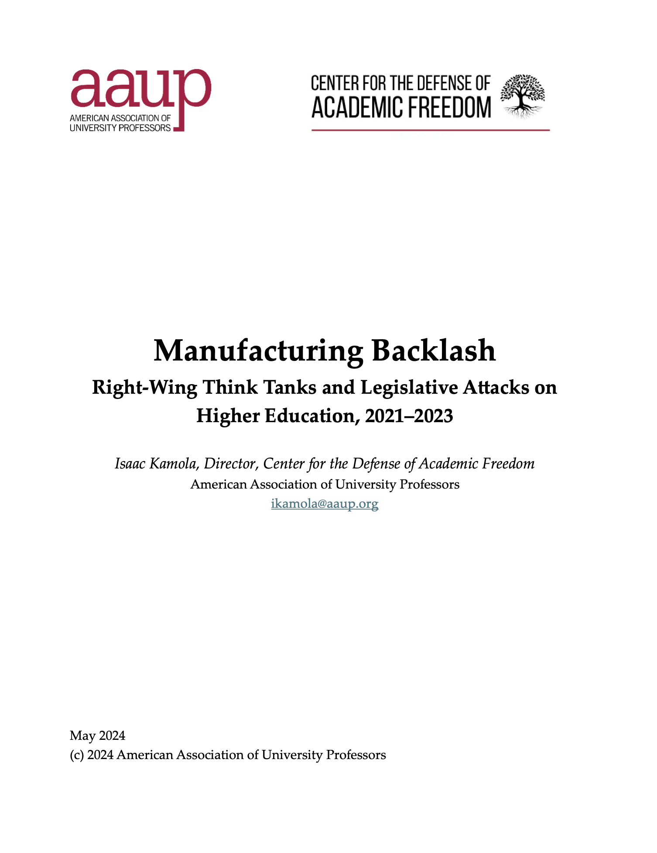
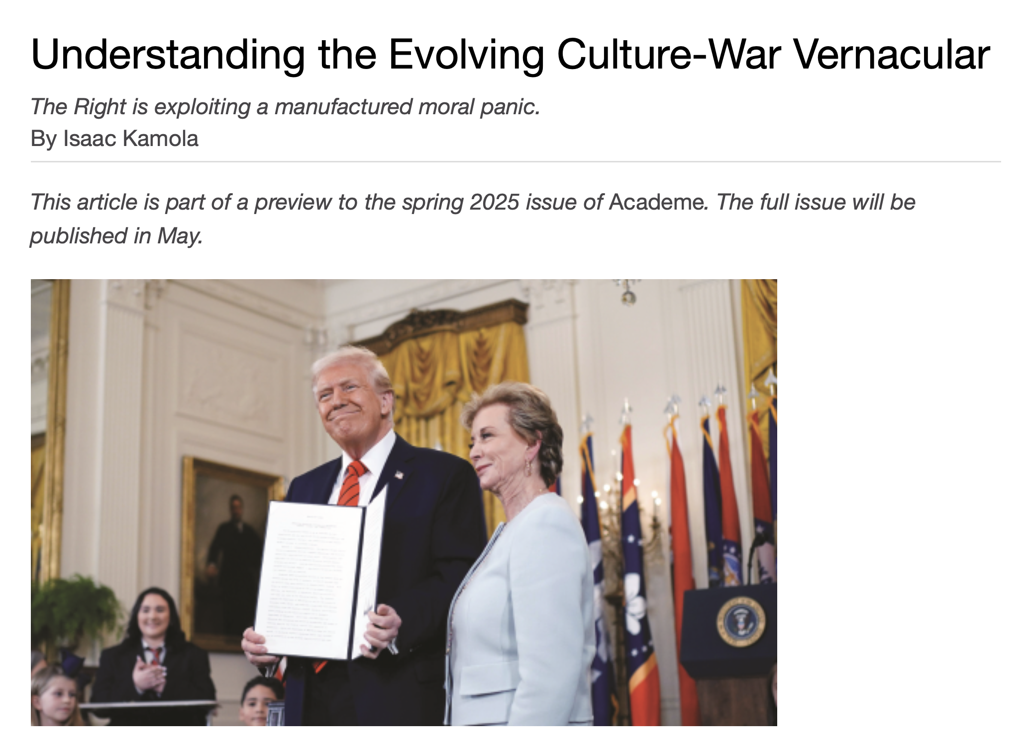
Manufactured Backlash

Slide 17
Manufactured Backlash, 2021-2024
“Divisive concepts”/“specified concepts” legislation (i.e. FL HB 7)
Anti-DEI legislation (i.e. FL SB 266)
Attacks on faculty research (plagiarism, etc.)
Weaken faculty autonomy (curriculum, accreditation, etc.)
Accusations of campus antisemitism
  House Education and the Workforce Committee hearings (2023)
  Project Esther (2024)

Slide 18


Intensifies under Trump 2.0

Slide 19
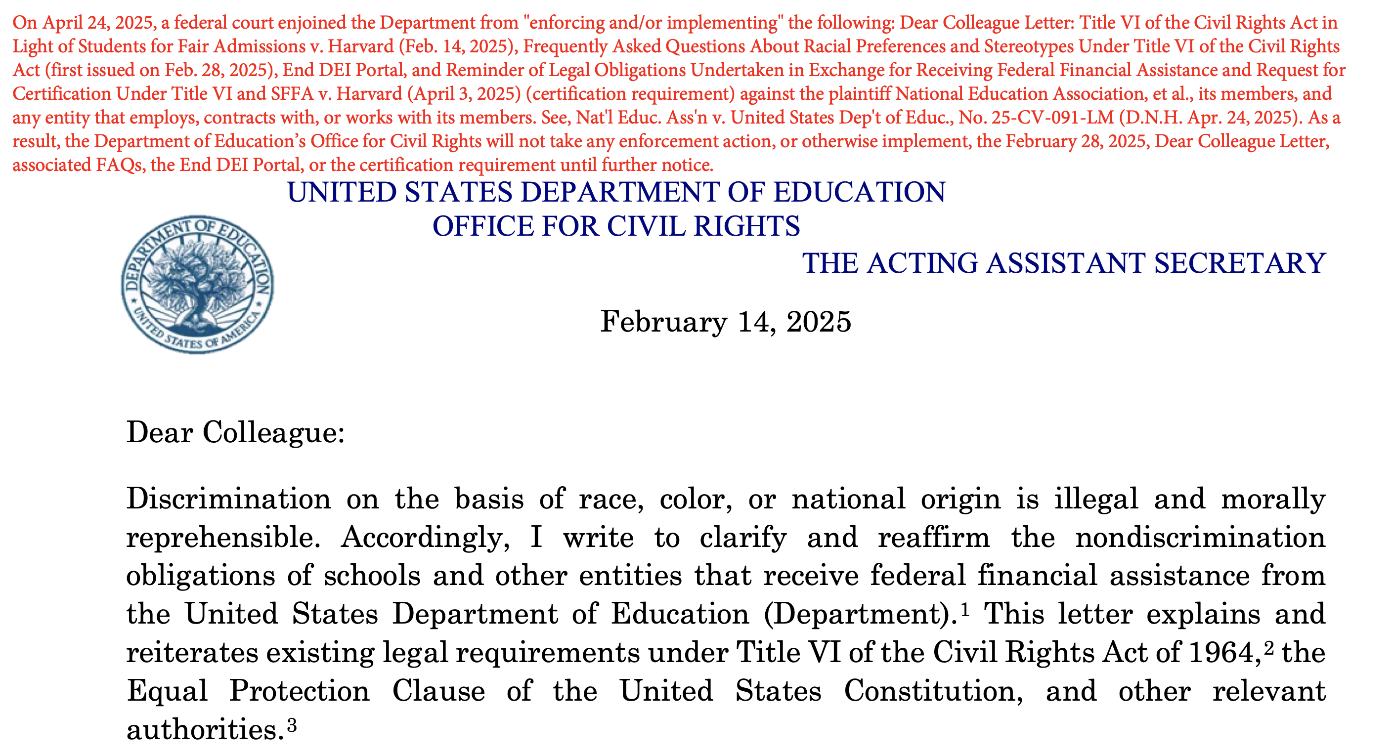

Slide 20
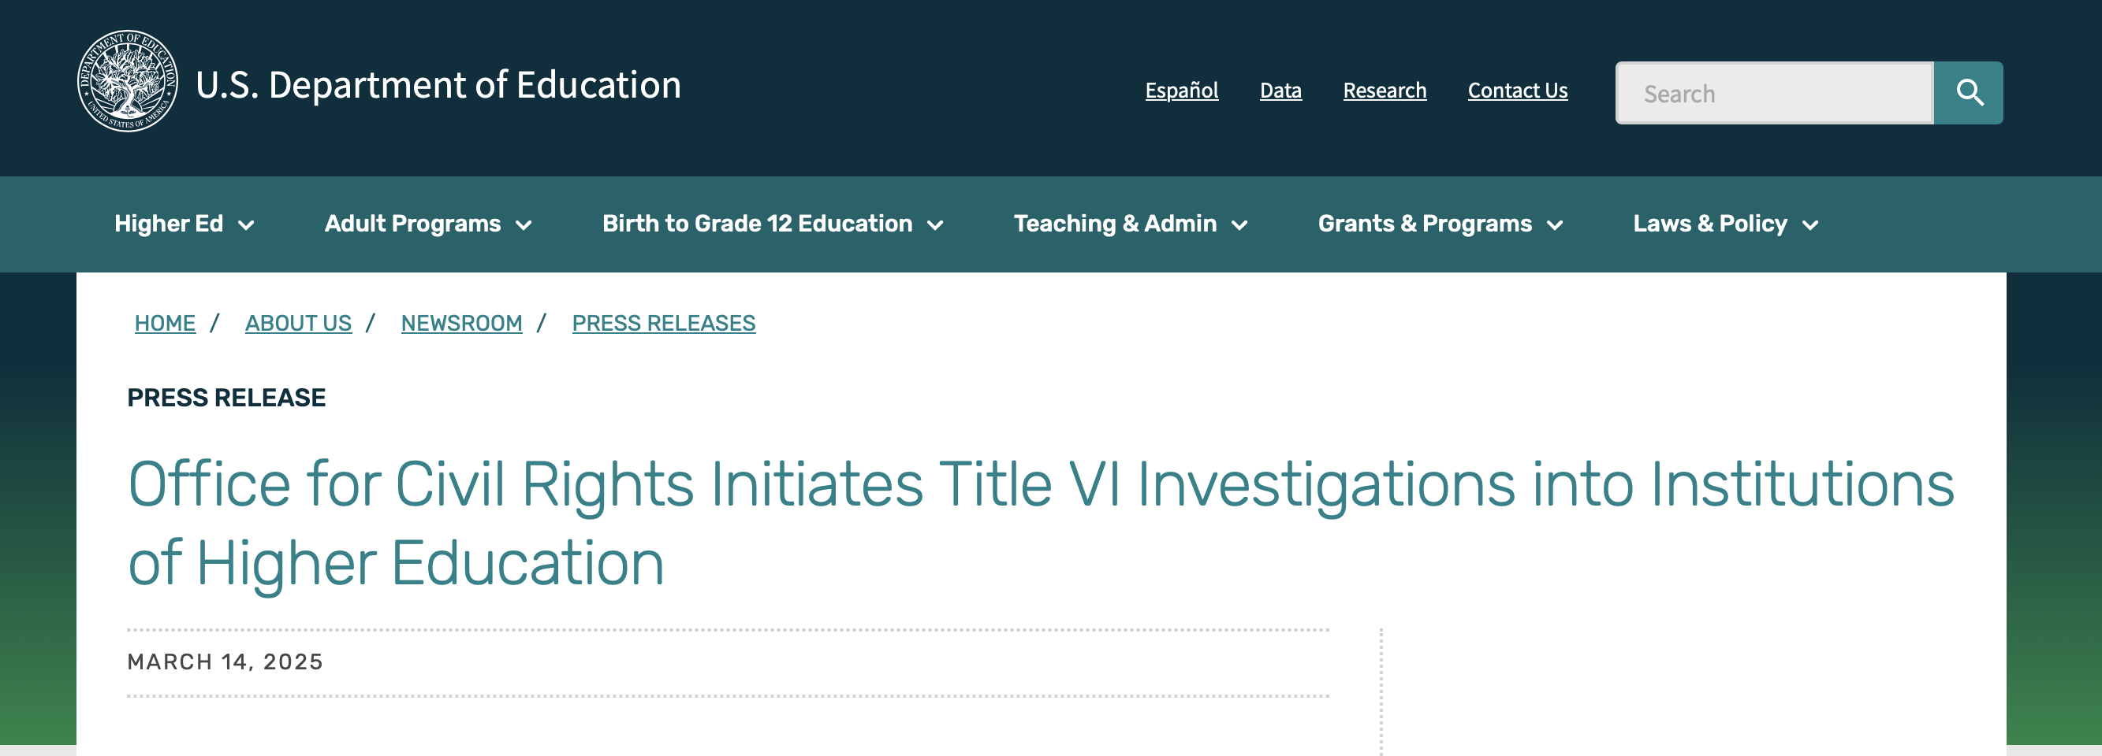

Slide 21
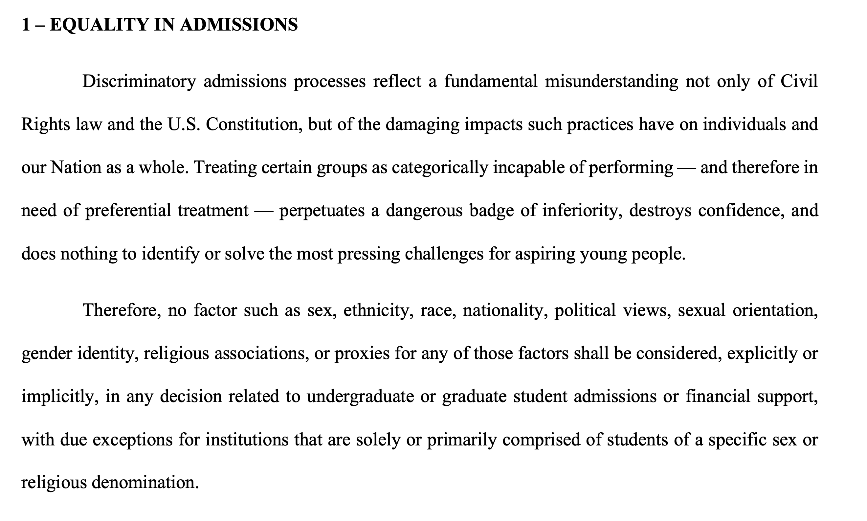
“Compact”

Slide 22

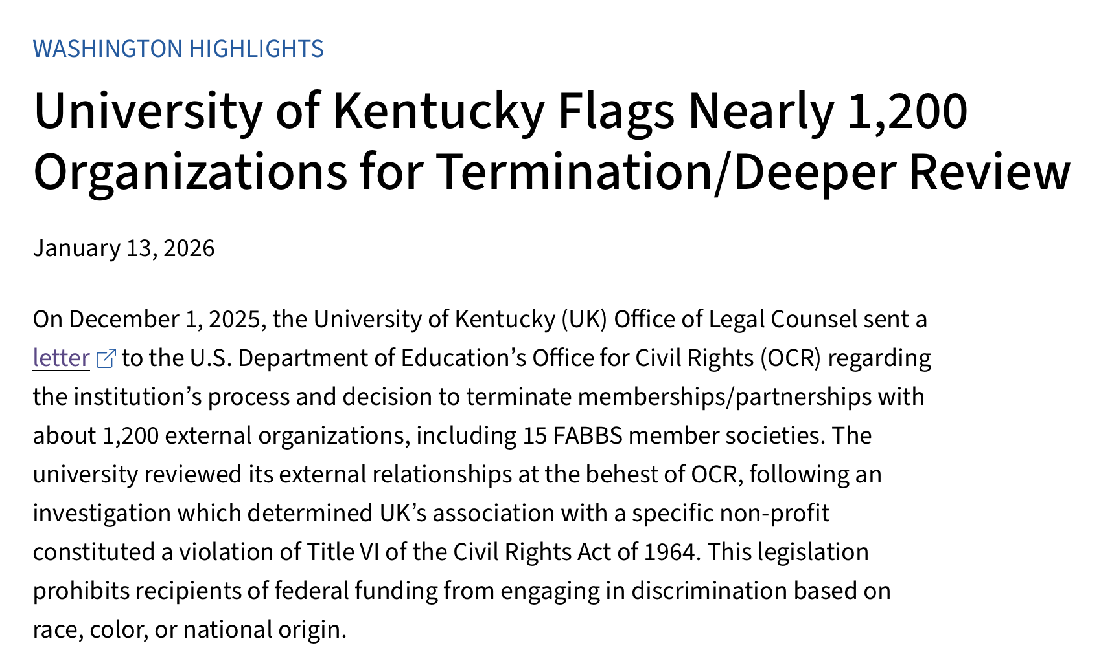

Slide 23
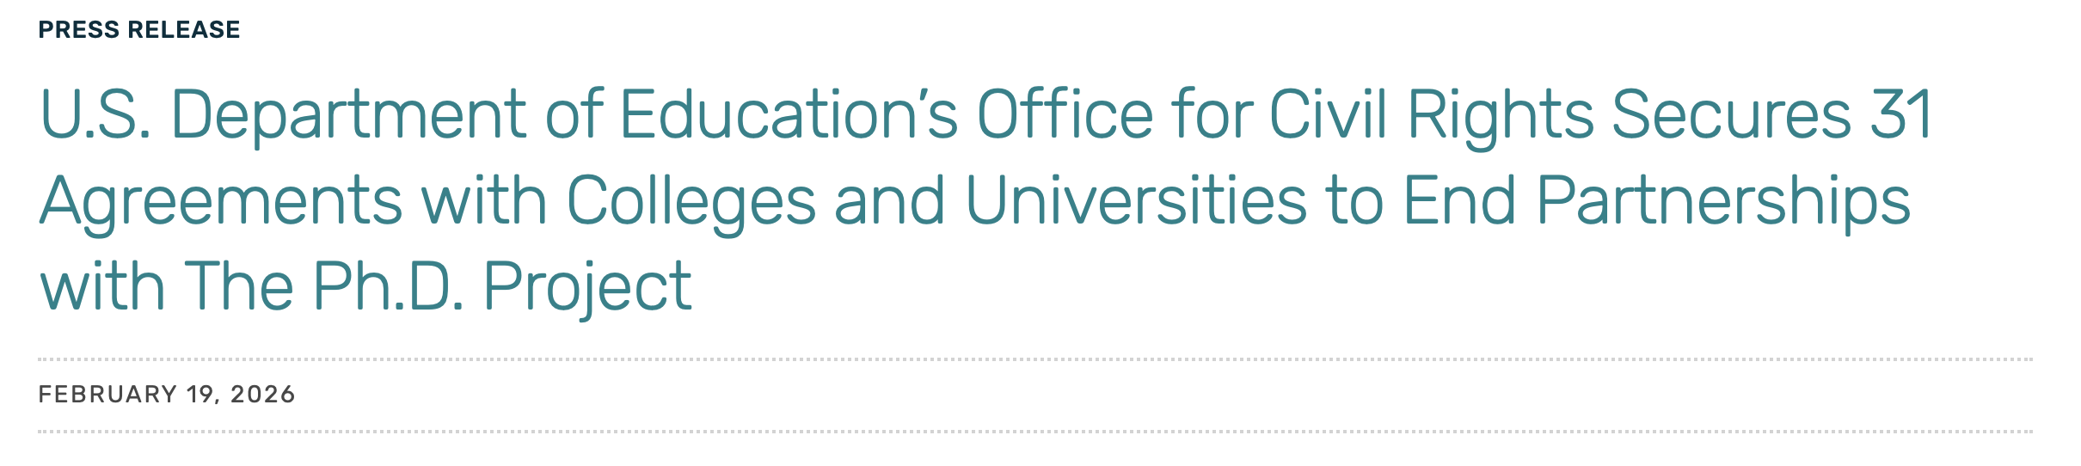

Slide 24
What Can We Do About It?
1) DEFEND ACADEMIC FREEDOM
Higher education and the “common good”
Education as a pillar of democracy
2) BUILD ACDEMIC FREEDOM CAPACITY IN MEMBERSHIP ORGS.
    Governance is a “joint effort,” based on different areas of expertise
    3) Organize! Organize! Organize!
Join your union or local AAUP chapter
Work with other campus unions & students

Slide 25
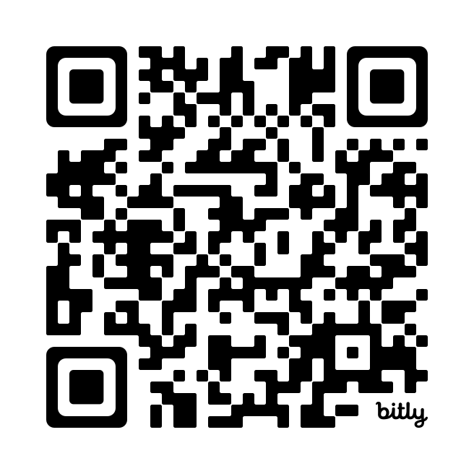
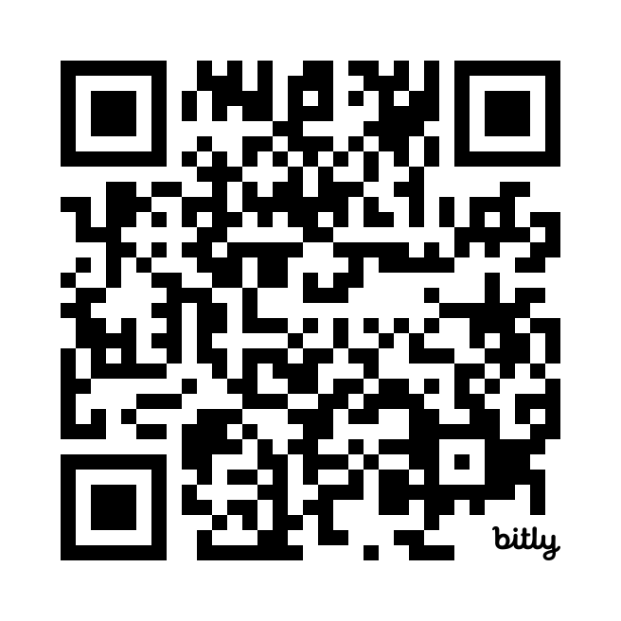
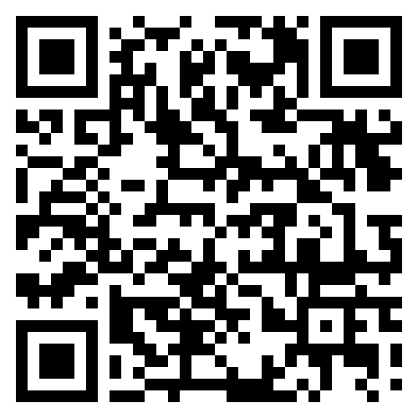
“Academic Freedom Syllabus”
“Academic Freedom Field Guide”
Info about AAUP servies, legal support, digital safety, and doxing protection
“Academic Freedom On The Line” (Substack)

