Slide 1
Higher Injection Pressure – Is It Your Fault, Skin Damage, Or Someone Else’s Well?
Presented by:
Ken Johnson
Environmental Engineer
(214) 665-8473
Johnson.ken-e@epa.gov
EPA Region 6
May 6, 2017

Slide 2
What Makes Injection Well Pressure Increase When Injecting?
Injector Operating Bottom Hole Pressure Response
=
Static Reservoir Pressure (may not reach surface)
+ Wellhead Pressure
+ ∆P_{hydrostatic wellbore column}
- ∆P_{wellbore friction loss}
- ∆Pcompletion skin factor pressure drop
-∆P_{reservoir rock pressure drop}
+ ∆Preservoir boundary pressure increase
We’ll focus on skin factor and reservoir boundary (faults and offset injector) pressure increases for this presentation

Slide 3
Three Common Sources of Injection Pressure Increases
At The Wellbore
Skin Effect
Characterized by dimensionless skin factor, S
Usually measure S with a pressure transient test
Annual falloff
Positive S means a pressure increase at the wellbore
Out In The Reservoir
Geologic Fault
Can be sealing or partially laterally transmissive
Offset Class I or II injector(s)
Either Class well can have the same effect

Slide 4
Impact of Geologic Fault
Has a gradual long term impact with an increase in well operating pressure
Distance to the fault (L_{fault}) coupled with reservoir transmissibility (kh/u) determines the time for pressure increase from fault pressure to begin to develop
Full effect of the fault takes awhile to develop
Operating pressure increase is also a function of the injector rate (Q)
Can observe fault distance with a falloff test if injector is close enough

Slide 5
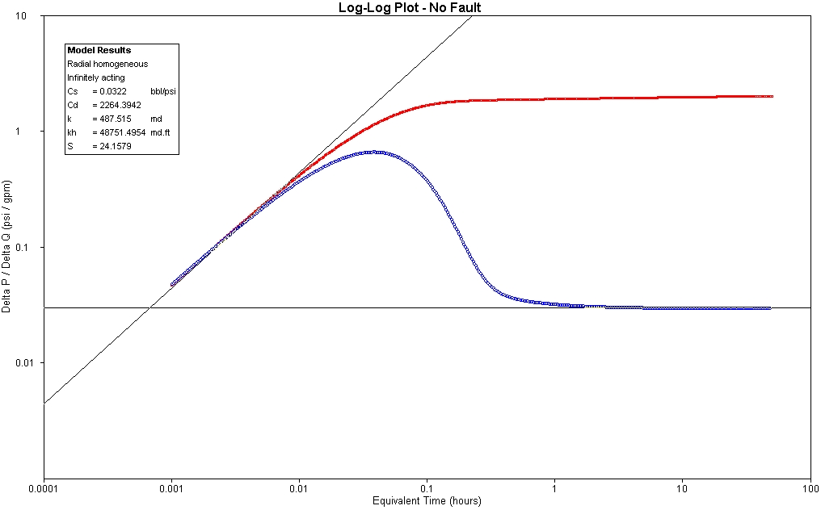
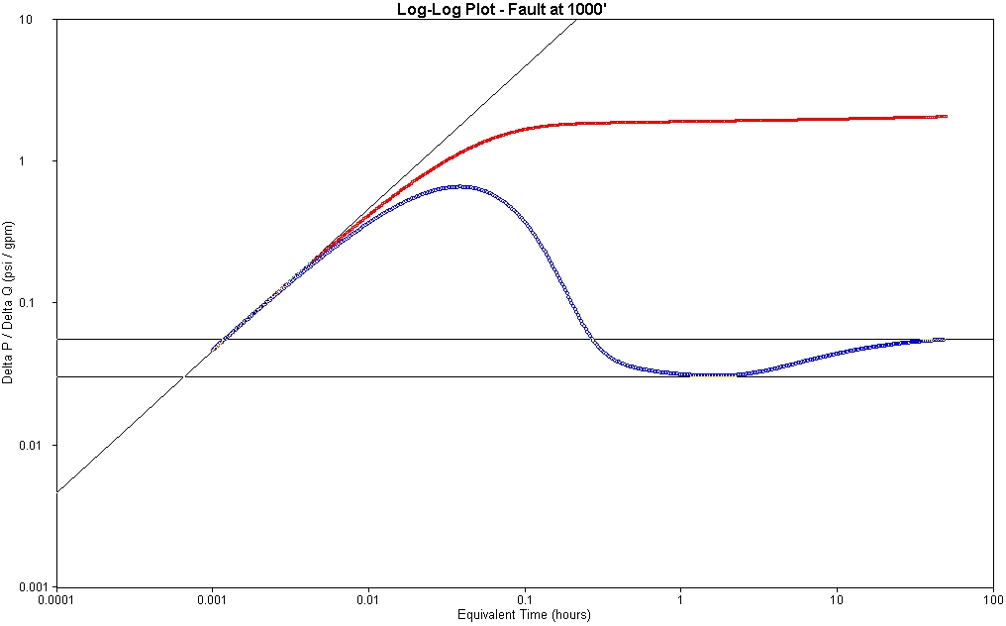
Falloff Response With and Without Fault Effects
Images are log plot charts for No Fault and Fault at 1000 ft.
Radial flow
Start of fault
effects
Fully developed
fault effect
Radial flow

Slide 6
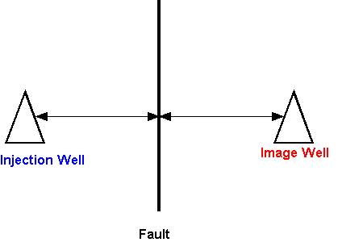
How To Project Fault Pressure Impact At Facility Injector
Represent fault boundary as an “image” well with same Q as the injector
Image well is equidistant from the fault on its other side
Calculate the effects of “image” well on the actual injector’s operation pressure
Image is a graphic depiction of a formula for fault pressure.
L_{fault to real well}
L_{fault to image}

Slide 7
Estimating Fault Pressure Buildup Impact
Use infinite acting reservoir model equations from Petroleum Engineering references
SPE Monographs 5 (Appendix C) and 23, SPE Well testing textbooks 1 and 9
Calculate P_{d}, t_{d}, and r_{d} then solve for P fault impact at the facility injector
Note d subscript means dimensionless variable
Calculate dimensionless model values from reservoir conditions and permit time and convert to model outcomes in real dimensions
Distance to boundary, r = L_{fault to real well} + L_{fault to image} _{well} (for fault case)

Slide 8
Estimating Fault Pressure Buildup Impact
Dimensionless equations for infinite acting reservoir model are:
t_{d} = 0.0002637(k)(∆t)/(ɸ)(µ)(c_{t})(r_{w} ²)
r_{d} = r/r_{w} (r_{w} is facility injector well radius)
P_{d} = 0.5(ln(t_{d}/(r_{d}²)) + 0.80907)
Can adjust r and ∆t to any point in permit time and any distance in reservoir to see what boundary (and facility injector) effects are
Take values from specified reservoir and permit conditions (Q, k, h, µ, r_{w}, c_{t}, ɸ) and solve for ∆ P at the well (or at various locations in the reservoir)
∆ P = 141.2(Q)(β)(µ)P_{d}/(k)(h) (using values taken from reservoir and permit conditions)

Slide 9
How To Project Offset Injector Pressure Buildup Impact At Facility Injector
Treated similarly to a fault, except:
the rate may vary and
no “mirror” distance impact
Direct distance between wells determines time for pressure buildup impact
Facility injector and Offset injector
Image is a graphic depiction of offset injector pressure buildup
Treated similarly to a fault, except:
the rate may vary and
no “mirror” distance impact
Direct distance between wells determines time for pressure buildup impact
Facility injector
L_{offset}
Offset injector

Slide 10
Estimating the Offset Effect
Again use infinite acting reservoir model equations
Calculate P_{d}, t_{d}, and r_{d} (as in fault example) then solve for P offset impact at the facility injector
Note that r in offset well case is L_{offset}
In a comparison where a fault and offset injector are each the same distance away, the L_{fault} is 2x L_{offset}

Slide 11
Skin Factor Pressure Buildup Impact
Skin Factor, S
Dimensionless parameter obtained from pressure transient tests to characterize completion conditions (- stimulated, + damaged)
∆P_{skin} = 0.87*m*S = 0.87*(162.6*Q*β*µ/k*h)*S in psi
Kh/µ is transmissibility in md-ft/cp, Q is rate in bpd
Skin pressure drop magnitude is rate dependent!
Higher Q with +S means more pressure, horsepower, and electricity to inject
Skin represents an immediate increase or decrease (if negative) in wellbore injection pressure
Skin does not affect pressure buildup out in the reservoir, only at the injector
Skin can be decreased with stimulation, reperforating, wellbore cleanouts, or fracturing
Skin increases due to wellbore fill, plugging of perforations, scale buildup, and invasion of pore space around the well with dirty injectate

Slide 12
Let’s Look at 4 Hypothetical Injection Well Situations: At the Facility and Out in the Injection Interval
Injector reservoir and operating conditions:
P_{static} = 1500 psi
k = 200 md; h = 50 ft; Φ = 30%; μ = 0.5 cp; c_{t} = 6x10⁻⁶ psi⁻¹
Permit life = 10 years; Maximum Q = 300 gpm (10,285 bpd); S= 0; r_{w} = 0.292 ft (7 in. casing)
Case 0: Undamaged completion (S=0)
Case 1: Damaged completion
Skin factor, S of +40 from a recent falloff test
Case 2: A fault 2 miles away
Has a regional fault that is considered sealing based on geology, but skin factor of 0
Case 3: An offset Class I injector 2 miles away
Offset injects continuously at 300 gpm
Facility injector has a skin factor of 0
How does the injector’s projected bottom hole operating pressure trend in each of these cases?

Slide 13
Comparison of Pressure Buildups at End of Permit Life
Image is a chart of pressure buildups by location
Location in Pressure Buildup Model | Infinite Acting Reservoir with S=0 (psi) | Infinite Acting Reservoir with S=40 (psi) | Sealing Fault 2 miles away (psi) | Offset Injector2 miles away (psi)
At facility injector | 930.5 | 3835 | 1049.4 | 1099.1
1 mile from facility injector | 218.8 | 218.8 | 335.5 | 437.5
Incremental ∆P at facility Injector over 0 skin case | --- | 2904.5 | 118.9 | 168.6

Slide 14
Key Points
An injection well’s bottom hole injection pressure is the net of several responses
Some are at the wellbore and others out in the reservoir
Reservoir components may take months, or years to impact a well’s injecting bottom hole pressure
Faults and offset wells are reservoir components
Depends on combination of reservoir and operating parameters
Skin impacts the injector wellbore only
Can use infinite acting reservoir model (IARM) equations to do a “basic” reservoir/injection capacity assessment for pressure buildup for permits and petitions
Some “what if” capability for various completion and reservoir boundary conditions
IARM equations available in petroleum engineering texts and suitable for calculator or spreadsheet applications

Slide 15
References
“Transient Well Testing,” SPE Monograph 23, Medhat Kamal, 2009
“Advances in Well Test Analysis,” SPE Monograph 5, R.C. Earlougher Jr., 1977
“Well Testing,” SPE Textbook Series Volume 1, John Lee, 1982
“Pressure Transient Testing,” SPE Textbook Series Volume 9, John Lee et al., 2003

