Slide 1


Slide 2
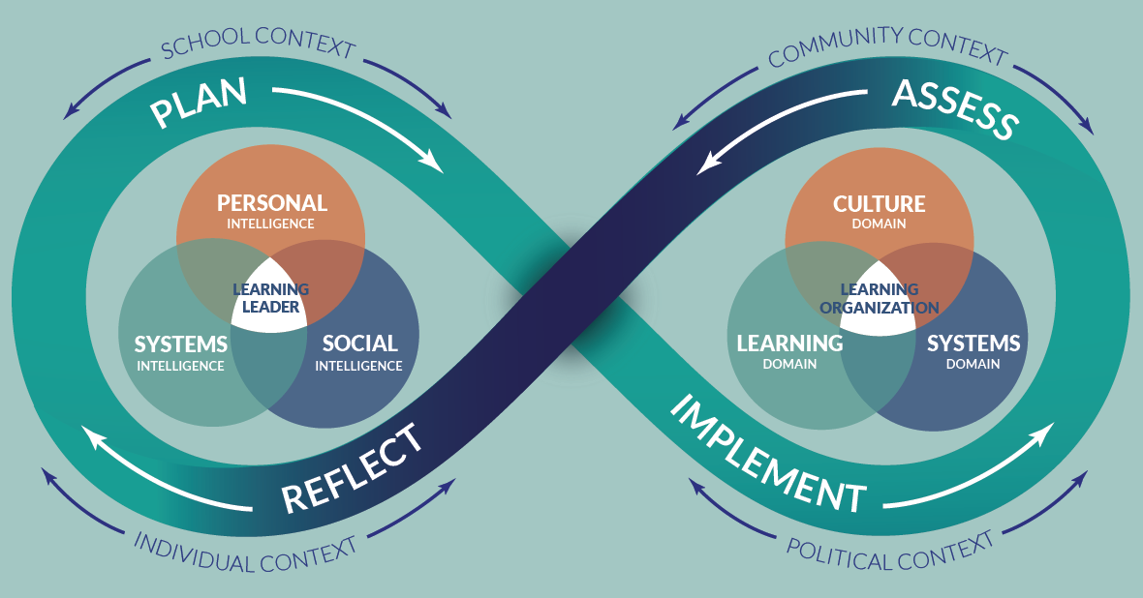
School Leader Paradigm©

Slide 3
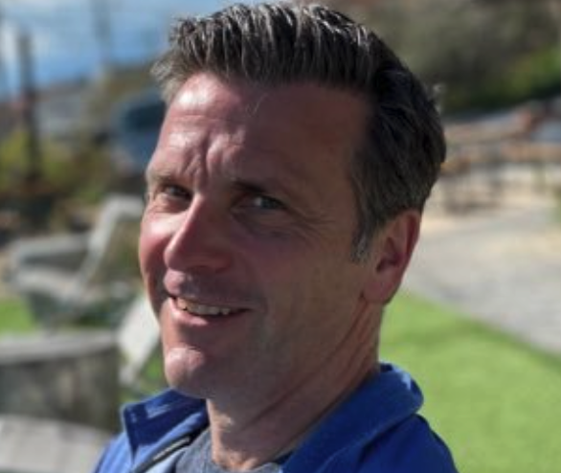


About Us- Our Advisors
Peter DeWitt
Next Level Leaders Advisor, Facilitator pmdewitt518@gmail.com
Jenni Donohoo
Next Level Leaders Advisor, Facilitator jenni.donohoo@praxis-engage.com

Slide 4
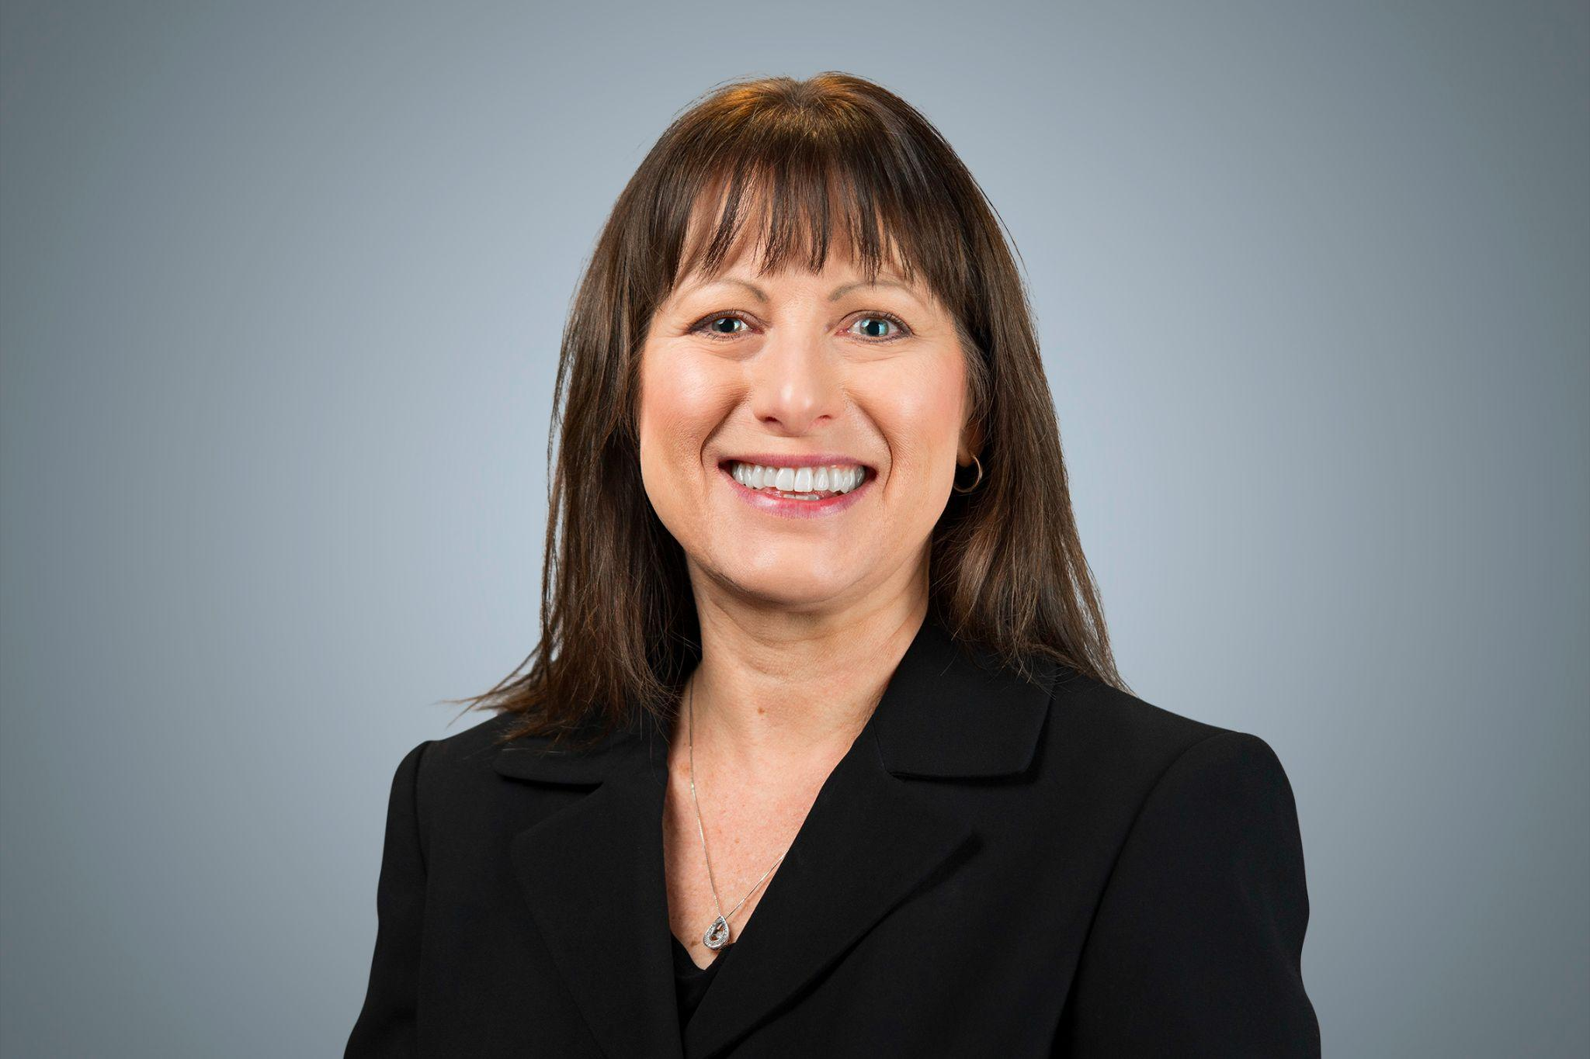
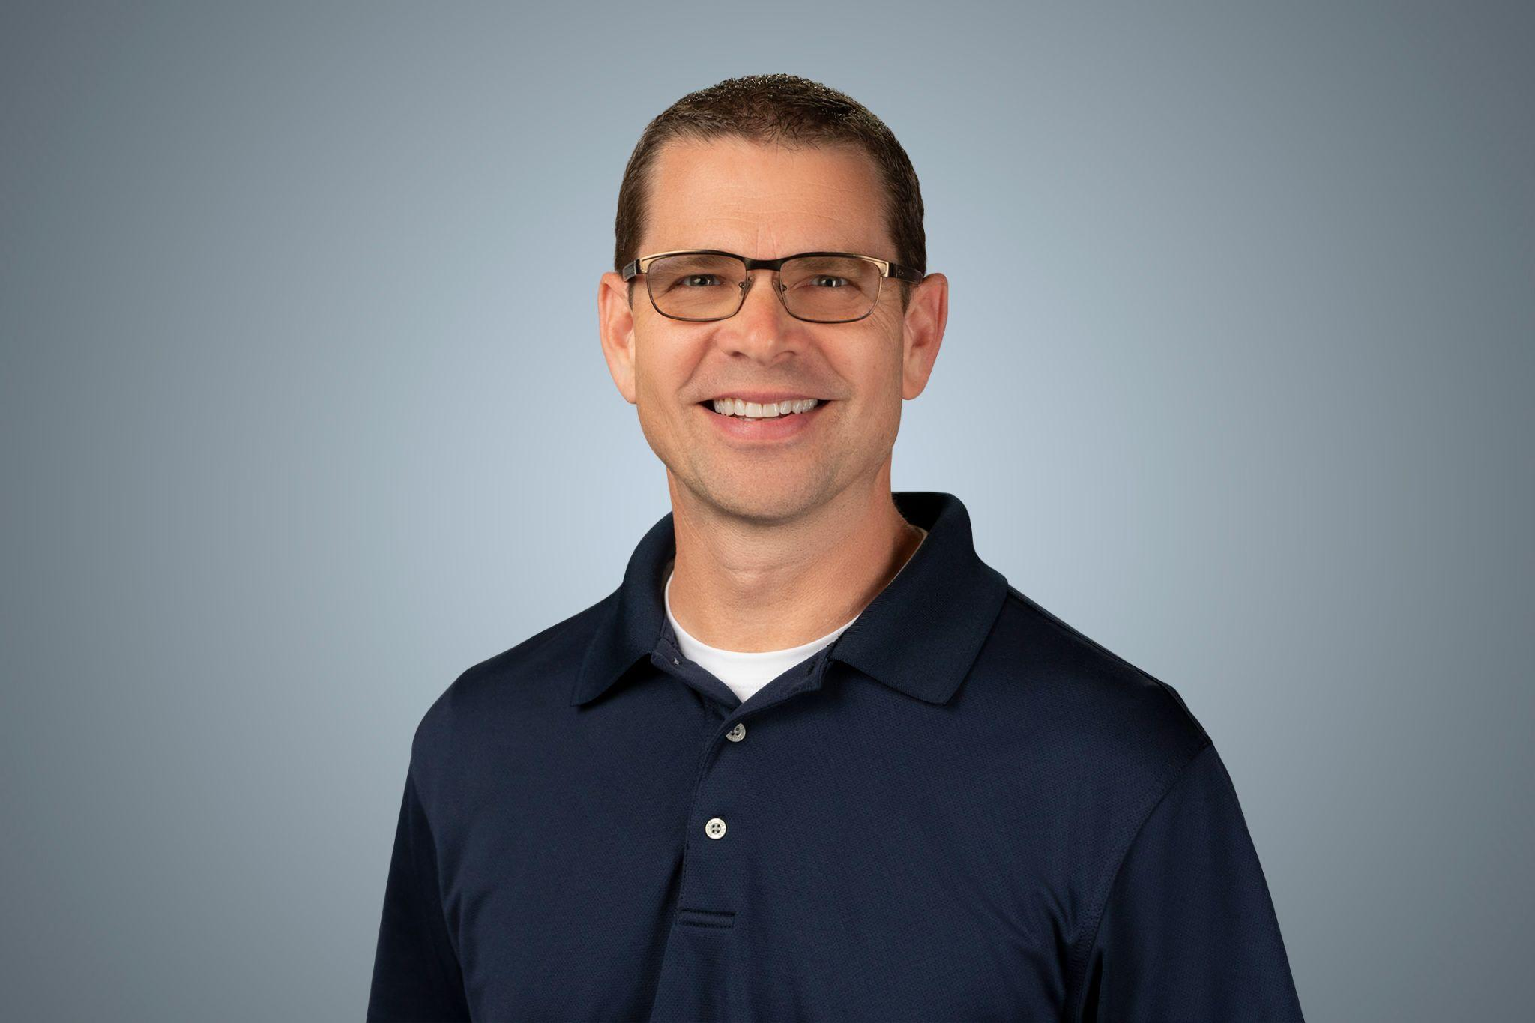

About Us- NLL Planning Team
Kim Fry
Assistant Executive Director, WASA
Shawn Batstone
Assistant Executive Director, WASA
Gina Yonts
Associate Director, AWSP

Slide 5

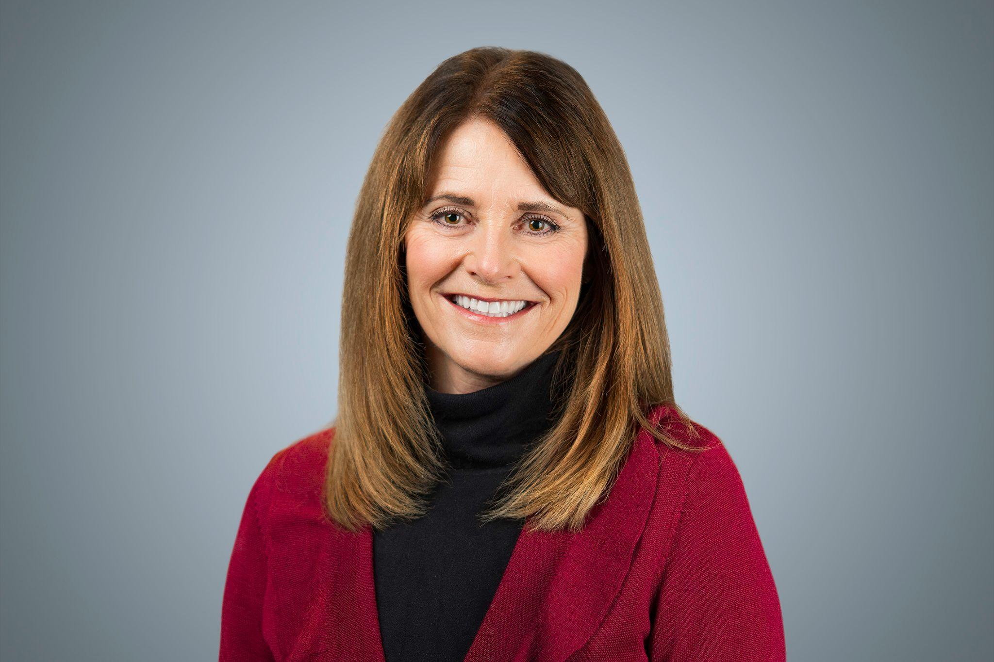
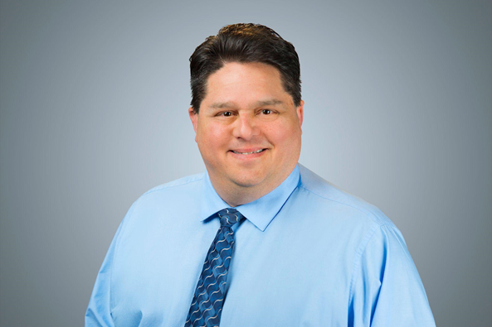
Advocate Role- we are here to help!
Ashley Barker
Monica Chandler
NLL Advocate
Paul Harvey
NLL Advocate

Slide 6


Enemies of Efficacy - Uncertainty - Judgment
Review

Slide 7

Dimensions
Promoting & participating in teacher learning & development .84
Planning, coordinating, evaluating teaching & the curriculum .42
Establishing goals & expectations .42
Strategic resourcing .31
Ensuring an orderly & supportive environment .27
Robinson, V. M. J., Lloyd, C. A., & Rowe, K. J. (2008). The Impact of Leadership on Student Outcomes: An Analysis of the Differential Effects of Leadership Types. Educational Administration Quarterly, 44(5), 635-674.

Slide 8
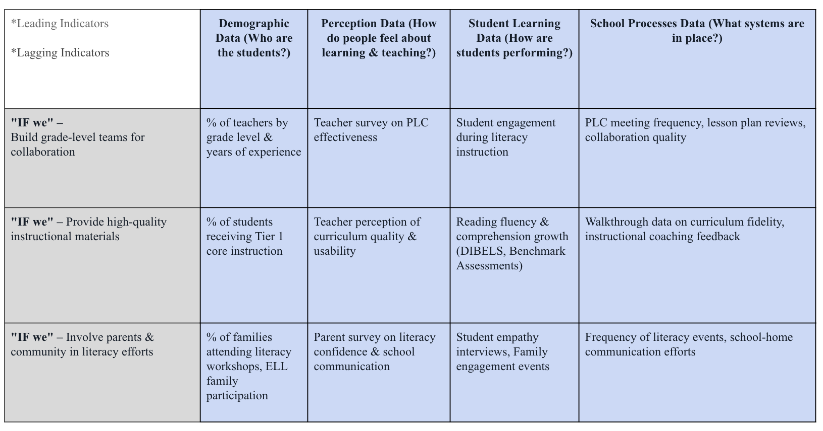
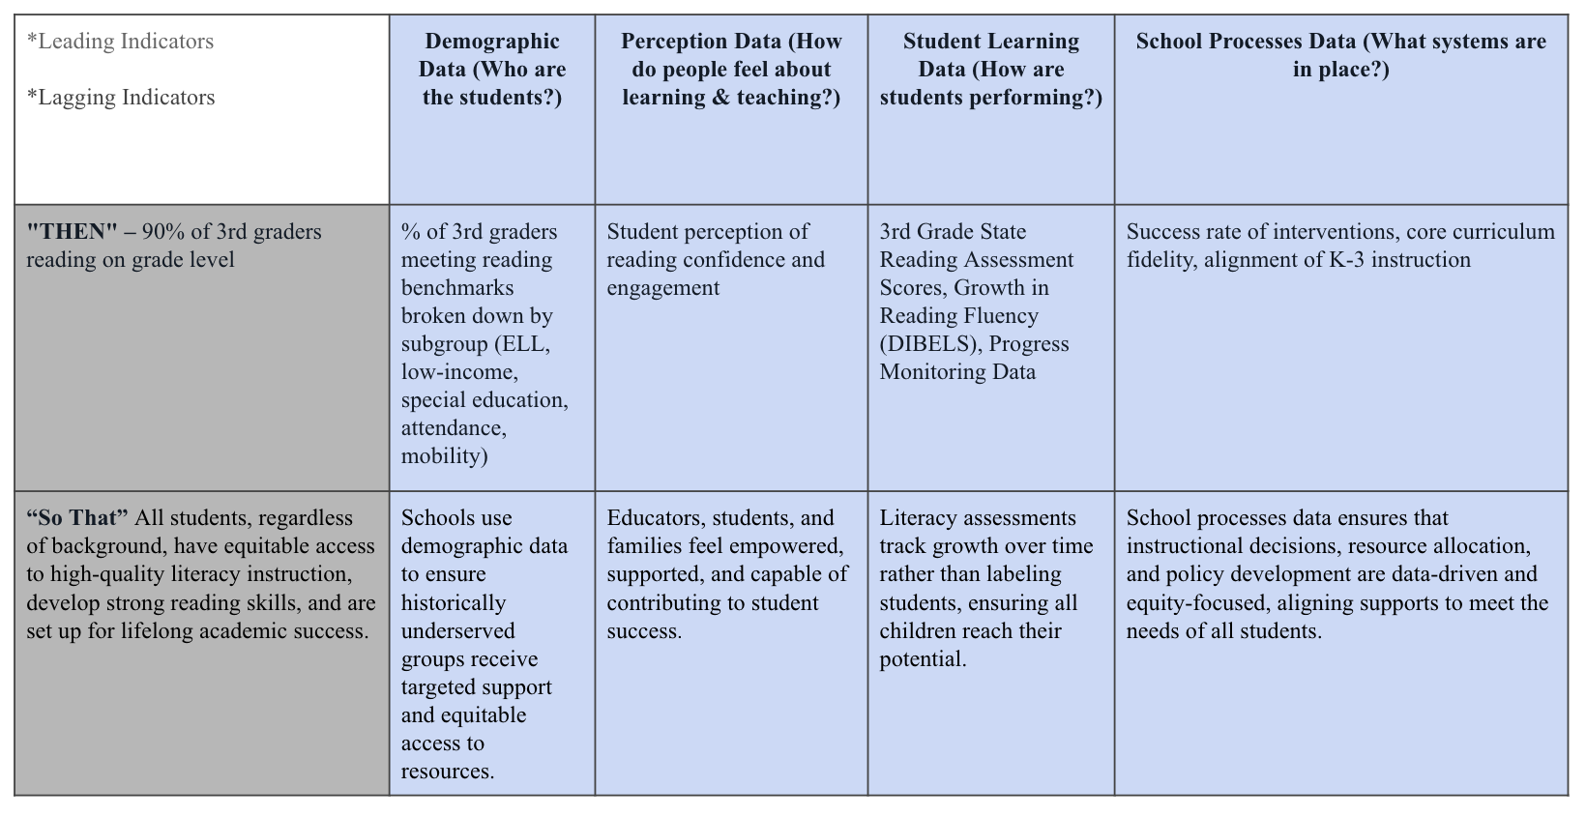
Example: Literacy
Shared Understanding
Problem of Practice (PoP)
65% of third graders are not reading at grade level.
Priority
Shift from a third-grade literacy issue to a comprehensive K-3 literacy focus.
Reflection and Next Steps
Micro Reflection
Joint Work
Theory of Action
If we,
build grade-level teams who have regular times to meet, plan, and develop lessons
provide teachers with high quality instructional materials, and
intentionally involve parents and the community
Then we,
will have 90% of third graders reading on grade level at the end of three years
So that,
All students, regardless of background, have equitable access to
high-quality literacy instruction, develop strong reading skills,
and are set up for lifelong academic success.
Evidence of Impact
Data and Evidence
Micro Reflection
Linking Collective Leader Efficacy with Collaborative Inquiry Cycle
Nelson/DeWitt 2025

Slide 9
Promoting and Participating in Teacher Learning and Development
Length: 30 minutes
🔷 1. Regrounding (5 minutes) What’s one way you've helped teachers learn this year—even if it felt small?
🔷 2. “One Thing That Worked" Story Swap (8 minutes)
Breakout Rooms (3–4 per group)
Prompt:
“Share one specific move that worked this year to promote or participate in teacher learning—even if it wasn’t perfect. What did you learn from it?”

Slide 10
Chat Box Discussion
What is 1 idea a colleague shared in the breakout room that you might try before the end of this year?

Slide 11

🔷 The Flipped Meeting Move (5 minutes)
Facilitator shares your “flipped faculty meeting” story, using it to draw out two key leadership principles:
Modeling learning is just as important as promoting it
The structure of meetings can reflect a learning stance without requiring major overhaul
Chat prompt:
“Where could you ‘flip’ something small to model learning with your staff—without adding more to your plate?”
🔷 Close: “Leadership Moves I Can Actually Do” (4 minutes):
Flip a team meeting with a short article + reflection
Join one PLC next month and ask a genuine question
Try “I’m learning too…” as a frame during feedback
Ask one teacher what they’re learning, then share it
Co-learn something small—an app, an article, a new practice

Slide 12
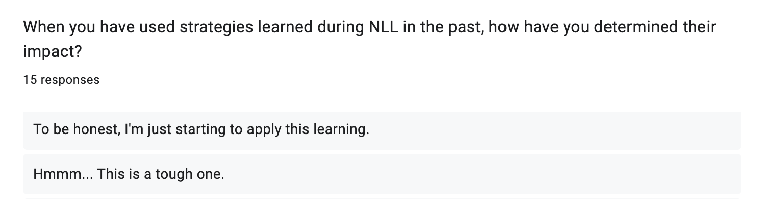
Transfer to Practice
Your Feedback
Notes:
Share that we are using survey responses to plan for Cohort 2.

Slide 13
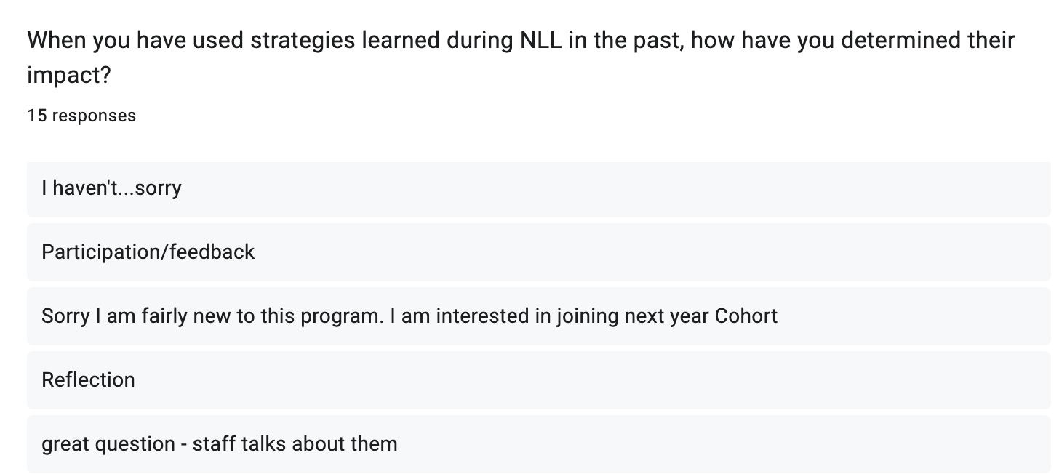
Transfer to Practice
Your Feedback

Slide 14
Transfer to Practice
Effective professional learning needs to enable educators to learn new knowledge and skills and to transfer these into their practice.
How can the NLL team better support your
transfer to practice?

Slide 15

A Look at Transfer

Slide 16



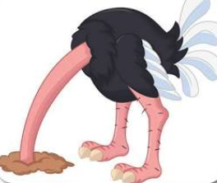


Simple Transfer
Complex Transfer
Oliver (Ollie)
Dan
Laura
Jonathan
Cathy
Samantha
Head-in-the-sand Ostrich
Drilling Woodpecker
Look-alike Penguin
Livingston Seagull
Carrier
Pigeon
Soaring
Eagle
A Look at Transfer

Slide 17

Making Connections to Your Own Experience
Reflect Metacognitively: “Am I…”
Overlooking? Missing opportunities, ignoring, persisting in former ways?
Duplicating? Performing the drill exactly as practiced, copying?
Replicating? Tailoring to my content, customizing, applying in similar situations?
Integrating? Combining with other ideas and using a raised consciousness?
Propagating? Carrying the strategy to other content, bridging?
Innovating? Taking the ideas beyond the initial concept, tailoring to specific needs?
Making Connections

Slide 18
Reminders-
Our last NLL event- 6/20/25- Davenport Grand Hotel 8AM-3PM: contact Ryan Hickerson to confirm.
NLL Planning Questionnaire (Spokane)
NLL Merchandise Order-
NLL Merch Ordering Form (Cedarbrook) #2
Notes:
Kim/Shawn can present.
Review the notes -
Learning transfer - Fostering a learner’s mindset
Emenies of Efficacy
Transfer and Action

Slide 19
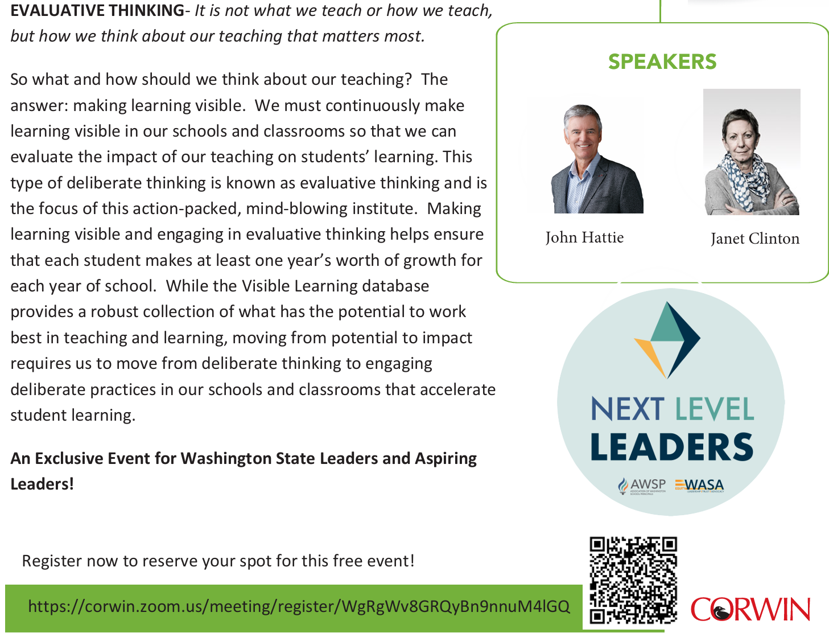

May 6th 2025
2PM-3:30PM PT

Slide 20


Slide 21


Slide 22


