Slide 2
Vaccine Counseling Workshop
Tara M. Pellegrino, DO
Assistant Professor
Department of Family Medicine
Rowan SOM

Slide 3
Faculty Disclosure
It is the policy of the ACOFP Program Committee Annual Convention & Scientific Seminars organizers that all individuals in a position to control content disclose any relationships with commercial interests upon nomination/invitation of participation. Disclosure documents are reviewed for potential conflict of interest (COI), and if identified, conflicts are resolved prior to confirmation of participation. Only those participants who had no conflict of interest or who agreed to an identified resolution process prior to their participation were involved in this CME activity.
All faculty in a position to control content for this session have indicated they have no relevant financial relationships to disclose.
The content of this material/presentation in this CME activity will not include discussion of unapproved or investigational uses of products or devices.

Slide 4
Program Committee
Chair: Joel M. Feder, DO, FACOFP dist.
Vice Chair: Andrew D. Adair, DO FACOFP
AC 21 Chair: Matthew W. Told, DO
AC 21 Vice Chair: Rob Danoff, DO, MS, FACOFP, FAAFP
Ioanna Z. Giatis- Kessler, DO, FACOFP
Sonia Rivera-Martinez, DO, FACOFP
Karen Frayser Evans, DO
Bernadette A. Riley, DO, FACOFP
Jennifer L. Gwilym, DO, FACOFP
Thomas Zimmerman, DO, FACOFP
Rebecca D. Lewis, DO
Hallie Zwibel, DO
Katarina Lindley, DO, FACOFP
Patricia Eileen Happel, DO, FACOFP
Karen M. Sheflin, DO, FACOFP
Nancy A. Bono, DO, FACOFP
David. A. Connett, DO, FACOFP dist.

Slide 5
Objectives
Identify the importance of vaccine counseling in primary care
Address the concerns of patients regarding vaccinations during the COVID 19 pandemic
Become more family with health inequalities that may lead to disparities in vaccination

Slide 6
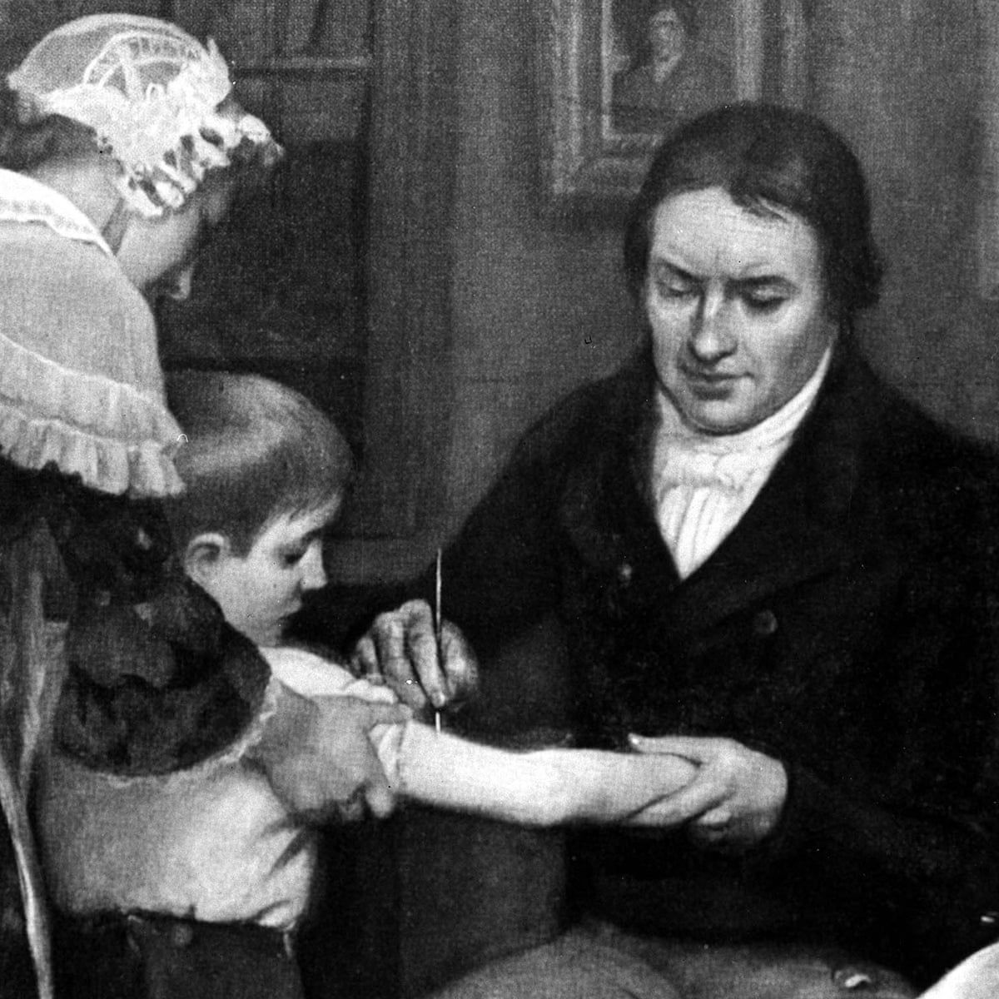
Vaccine history
1700s- Dr. Edward Jenner
Observed that milkmaids who previously had cowpox were protected from smallpox
Utilized “Vaccinia” to help eradicate smallpox

Slide 7
Vaccine history
1800s Louis Pasteur
Discovery of attenuation
Led to development of vaccination for anthrax and rabies

Slide 8
Vaccine history
Late 19th century
Inactivated whole bacteria
Bordetella pertussis vaccine
Discovery of bacterial toxins and antitoxins
Neutralizing toxins (antibodies) in serum
“Filterable agents” aka viruses
Yellow fever vaccine
Early 20th century—influenza vaccine

Slide 9
Vaccine history
Mid- 20th century
“Golden age” of vaccine development
Growth of viruses in cell culture led to rapid vaccine development
1950s- Polio vaccines
1960s- MMR vaccine
1970s- Varicella vaccine
1980s-
Protein conjugation to improve immunogenicity of polysaccharides
Haemophilus influenzae type b, Meningococcal, Pneumococcal
Genetic engineering- utilizing substrates to produce immunogenic proteins
Hepatitis B
Borrelia burgdorferi
HPV (2000s)

Slide 10
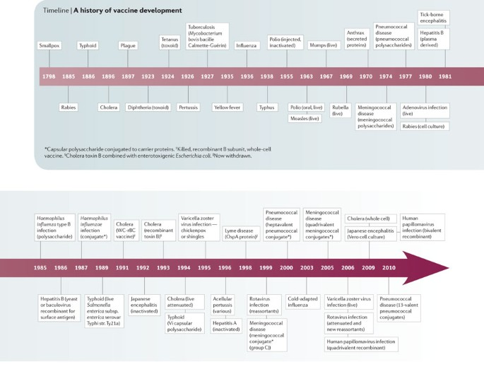

Slide 11
COVID 19 Vaccines
Vaccine development focuses on targeting the Spike “S” protein based on viral neutralizing antibodies
Preventing uptake via human ACE2 receptor
April 2020- 115 vaccine candidates
Modalities being used for development unlike prior licensed vaccines
Previous experience with oncologic treatments being utilized
Speed of development
Flexibility in antigen manipulation

Slide 12
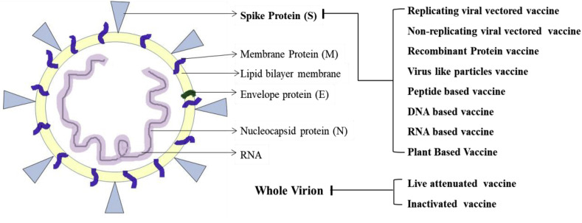

Slide 13
COVID 19 Vaccines
mRNA vaccine encoding S protein
mRNA-1273
Novel lipid nanoparticle (LNP)-encapsulated mRNA-based vaccine that encodes for a full-length, prefusion stabilized spike (S) protein of SARS-CoV-2
94.1% efficacy at preventing Covid-19 illness
Approved for age 18 and older
BNT162b2 mRNA
Lipid nanoparticle–formulated, nucleoside-modified RNA vaccine that encodes a prefusion stabilized, membrane-anchored SARS-CoV-2 full-length spike protein
95% protection against Covid-19
Approved for age 16 and older

Slide 14
COVID 19 Vaccines
Adenovirus vaccine
Utilizes viral vector by adding gene unique to the virus- Spike protein on surface of SARS-CoV-2
Viral vector serves as “shuttle” to get the gene into human cell
Viral vector uses this gene and cell’s “machinery” to produce spike protein and display on cell’s surface which triggers immune response
Several currently in trials
JNJ-78436735 currently undergoing evaluation for EUA

Slide 15
COVID 19 Vaccines
DNA vaccine
Utilizes DNA plasmid as vector to deliver gene encoding S protein
Genetic material is translocated to the host cell’s nucleus which transcribes the DNA for antigen presenting cell which triggers immune response
Prior DNA vaccine trials did not produce immune response sufficient to elicit significant clinical benefits
Research working on optimizing the delivery and cell’s response
Worthwhile since stable molecule so does not require storage at extreme temperatures
Several currently in trials

Slide 16
Vaccine Distribution
Challenges with supply and demand
Vaccine skepticism
Multiple dosing regimens
Vaccination disparities

Slide 17
Vaccination Disparities
Vaccination rates continue to be lower among minority groups
History of distrust in healthcare
Recent analysis of COVID-19 vaccine distribution in 14 states shows non-Hispanic whites are more than 2x as likely to have received vaccine

Slide 18
National Health Interview Survey 2012
Adult vaccination assessed based on race/ethnicity
Influenza, Tetanus, Pneumococcal, HPV, Zoster
Vaccination coverage was significantly lower among non-Hispanic blacks, Hispanics, and non-Hispanic Asians compared with non-Hispanic whites
Vaccination gaps narrowed when taking into account socioeconomic factors but still remained at statistically significant level

Slide 19
Distrust in Healthcare
Decline in overall trust in healthcare over last 40 years
Managed care
For-profit healthcare
Publicity surrounding medical errors
Malpractice
Fraud and abuse within healthcare system

Slide 20
Distrust in Healthcare
Trust as fundamental component of patient-physician relationship
Long history of distrust in minorities
Tuskegee study
Segregation in hospitals
Trials on prisoners in PA

Slide 21
Tuskegee Study
Began 1932 by Public Health Service
Involved 600 black men
399 with syphilis, 201 without disease
No informed consent for patient
Men told they were being treated for “bad blood”
In exchange patients received free medical exams, meals, and burial insurance

Slide 22
Tuskegee Study
Patients did not receive appropriate treatment for medical conditions
Originally planned to be 6 months but trial went on for 40 years
1972- Panel reviewed the study under Assistant Secretary for Health and Scientific Affairs
Concluded men entered trial freely but researchers never informed them of the real purpose of the study
1947- Penicillin became drug of choice for treatment of syphilis
Penicillin was not offered to study participants and participates not given open to withdrawal from trial

Slide 23
Tuskegee Study
Panel concluded trial was “ethically unjustified”
Summer 1973- Class action lawsuit filed on behalf of study participants
1974- $10 million settlement reached
Tuskegee Health Benefit Program
US government to provide lifetime of medical benefits and burial benefits
1975 expanded to spouses and offspring

Slide 24
Racial Segregation in Hospitals
Segregation on part of patients and physicians
Several cases brought to courts
Eliminated in 1966 with introduction in Medicare program
Hospital segregation played role in shaping current racial differences in health inequalities
Higher infant and maternal mortality rates

Slide 25
Prisoner Trials in PA
1950s Holmesburg Prison, Dr. Albert Kligman
Inmates given very little information about the experiment but paid $10-$300
Tested various items- creams, detergents, shampoos, perfumes
Often required skin biopsies and incisions
Ended in 1974 after national publicity and congressional hearings ended human experimentation on prisoners and mental health patients

Slide 26
Healthcare Inequalities
Well documented health disparities in United States
Gaps across a number of health indicators between the general population and particular cultural groups including African Americans, Native Americans and Latino/a Americans
Minority groups disproportionately report poorer healthcare interactions and outcomes
More likely to hold negative perception of healthcare services
Feel discriminated against when receiving care
Feel unwelcome, unheard, and “rushed along”

Slide 27
Healthcare Inequalities
Healthcare access and utilization
Insurance, transportation, child care, time off work
Fear of discrimination and distrust in system
Higher risk occupation
Essential workers, food industry, healthcare settings, public transportation
Income inequality
Limited access to educational opportunities which limits occupation opportunities
Cannot afford to miss work/risk lost income
Housing
Multigenerational households, shared housing, homelessness

Slide 28
How to address concerns
Listen to the patient’s concerns
Address misconceptions
Provide with information, clinical trials, evidence, science to educate
Allow them to make the best decision for them
Respect their decision/choice---give them time to review information, do not expect immediate answer

Slide 29
Vaccine counseling
Most studies done previously in pediatrics
Concern mostly arrives from side effects and safety
History of thimerosol in vaccines
MMR and Varicella cause the most concern, more recently also HPV
Studies indicate that information received from health care professional was most likely to change parent’s mind

Slide 30
Addressing Vaccine Hesitancy
Most patients who ask questions about vaccine safety are not truly resistant
Be curious and ask respectful questions
Give a strong recommendation
If patient continues to refuse, respect their decision and table discussion to another day

Slide 31
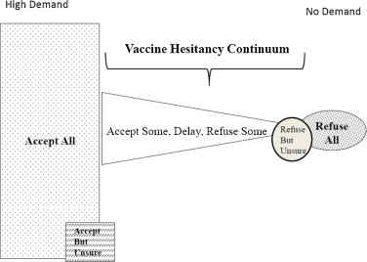

Slide 32
Models to approach vaccine hesitancy
3 C's (Confidence, Complacency, Convenience)
CASE approach (Corroborate, About me, Science, Explain/Advise)
3 A's (Ask, Acknowledge, Advise)

Slide 33
3 C’s Model
Confidence
Trust in vaccines- efficacy and safety
Motivations of developers and policy makers
Trust in system the delivers the vaccines
Complacency
Perceived risk of disease is low
May be influenced by success of vaccination programs
Convenience
Availability and accessibility of vaccines
Ability to understand- language and health literacy
Time and place of vaccine administration

Slide 34
3 C’s Model

Slide 35
CASE Approach
Corroborate
Acknowledge concerns
Find some point that can be agreed upon- “I understand why you might be concerned about this”
Set tone for respectful conversation
About me
Describe your background and research you have done to build knowledge base on the topic
Science
Describe the scientific evidence and resources
Explain/Advise
Give your advice/recommendation to the patient

Slide 36
3 A’s Model
Ask
Discuss with patient their concerns
Try to get some history regarding the basis for concerns
Acknowledge
Recognize their concerns and respectfully acknowledge their importance
Advise
Give patient your recommendation with supporting scientific evidence

Slide 37
Counseling on COVID-19 Vaccines
Common patient concerns
Speed of vaccine development
Natural immunity vs vaccine initiated immunity
Known side effects
Unknown side effects- long term side effects?
Number of doses required- boosters needed?

Slide 38
Counseling on COVID-19 Vaccines
Be empathetic and understanding
Provide timeline and set expectation
Explain importance about the vaccine and give strong recommendation
Listen to concerns
Answer questions based on current available evidence
Encouraged patients to get scheduled/registered
Provide with literature/resources

Slide 39
Questions??
Tara M Pellegrino, DO
pellegtm@rowan.edu

Slide 40
References
https://www.cnn.com/2021/01/26/us/vaccination-disparities-rollout/index.html Accessed 2/3/21
Lu PJ, O'Halloran A, Williams WW, Lindley MC, Farrall S, Bridges CB. Racial and Ethnic Disparities in Vaccination Coverage Among Adult Populations in the U.S. Am J Prev Med. 2015;49(6 Suppl 4):S412-S425. doi:10.1016/j.amepre.2015.03.005
Armstrong K, Ravenell KL, McMurphy S, Putt M. Racial/ethnic differences in physician distrust in the United States. Am J Public Health. 2007;97(7):1283-1289. doi:10.2105/AJPH.2005.080762
https://www.cdc.gov/tuskegee/timeline.htm Accessed 2/9/2021
Largent EA. Public Health, Racism, and the Lasting Impact of Hospital Segregation. Public Health Reports. 2018;133(6):715-720. doi:10.1177/0033354918795891
Goodman, Howard. “Studying prison experiments Research: For 20 years, a dermatologist used the inmates of a Philadelphia prison as the willing subjects of tests on shampoo, foot powder, deodorant, and later, mind-altering drugs and dioxin.” The Baltimore Sun. July 21, 1998.
Plotkin, S., Plotkin, S. The development of vaccines: how the past led to the future. Nat Rev Microbiol 9, 889–893 (2011). https://doi.org/10.1038/nrmicro2668
Wu SC. Progress and Concept for COVID-19 Vaccine Development. Biotechnol J. 2020;15(6):e2000147. doi:10.1002/biot.202000147
Tung Thanh Le, et al. “The COVID-19 vaccine development landscape” Nature. May 2020. 19:305-306.
BMJ 2020;371:m4471 http://dx.doi.org/10.1136/bmj.m4471 Published: 17 November 2020
Shepherd, S.M., Willis-Esqueda, C., Paradies, Y. et al. Racial and cultural minority experiences and perceptions of health care provision in a mid-western region. Int J Equity Health 17, 33 (2018). https://doi.org/10.1186/s12939-018-0744-x
https://www.cdc.gov/coronavirus/2019-ncov/community/health-equity/race-ethnicity.html. Accessed 2/12/2021

Slide 41
References
Jackson, MD, Lisa, et al. “An mRNA Vaccine against SARS-CoV-2 — Preliminary Report” N Engl J Med 2020; 383:1920-1931. DOI: 10.1056/NEJMoa2022483
Polack MD, Fernando, et al. “Safety and Efficacy of the BNT162b2 mRNA Covid-19 Vaccine.” N Engl J Med 2020; 383:2603-2615 DOI: 10.1056/NEJMoa2034577
https://www.cdc.gov/vaccines/covid-19/hcp/viral-vector-vaccine-basics.html#:~:text=Adenovirus%20is%20one%20of%20the,of%20SARS%2DCoV%2D2. Accessed 2/12/2021
Rab S, Afjal, Javaid M, Haleem A, Vaishya R. An update on the global vaccine development for coronavirus. Diabetes Metab Syndr. 2020;14(6):2053-2055. doi:10.1016/j.dsx.2020.10.023
Rawat K, Kumari P, Saha L. COVID-19 vaccine: A recent update in pipeline vaccines, their design and development strategies. Eur J Pharmacol. 2021;892:173751. doi:10.1016/j.ejphar.2020.173751
Silveira MM, Moreira GMSG, Mendonça M. DNA vaccines against COVID-19: Perspectives and challenges. Life Sci. 2021;267:118919. doi:10.1016/j.lfs.2020.118919
Kripke C. Counseling parents about vaccine safety. Am Fam Physician. 2008 Dec 1;78(11):1248. PMID: 19069016.
Loehr J, Savoy M. Strategies for Addressing and Overcoming Vaccine Hesitancy. Am Fam Physician. 2016 Jul 15;94(2):94-6. PMID: 27419325.
Noni E. MacDonald, “Vaccine hesitancy: Definition, scope and determinants” Vaccine. Volume 33, Issue 34, 2015, Pages 4161-4164. https://doi.org/10.1016/j.vaccine.2015.04.036.
https://www.aap.org/en-us/advocacy-and-policy/aap-health-initiatives/immunizations/Pages/vaccine-hesitant-parents.aspx. Accessed 2/12/2021
https://www.cdc.gov/vaccines/covid-19/hcp/engaging-patients.html. Accessed 2/12/2021

