Slide 1
ISMPP University
Best practices for agency and pharma partnerships
August 28, 2024
Webinar will begin promptly at:
11 AM ET / 4 PM GMT
Notes:
Hi everyone; welcome and thank you for joining today’s ISMPP U, “a point counterpoint on the best practices for agency and pharma partnerships.”

Slide 2




















ISMPP Would Like to Thank…
2
. . . the following Titanium and Platinum Corporate Sponsors for their ongoing support of the Society:
Notes:
First a sincere thank you to all of ISMPP’s titanium and platinum corporate sponsors for their ongoing support of the Society.

Slide 3

ISMPP Announcements
Application deadline for the March CMPP
exam is February 1
Notes:
And, for those who are seeking to become CMPP-certified or looking to renew your certification, The application deadline for the next exam window is February 1, 2025

Slide 4

ISMPP Announcements
NEW ISMPP Academy
Save the date: November 13-14, 2024
Where: Convene at Commerce Square, Two Commerce Square, Philadelphia, PA 19103
ISMPP Academy is a meeting that will deliver
best practices education to professionals:
• Who work at biotechnology, small pharma, and medical device companies •
• Who are newer to the field •
• Who want to build their expertise •
Registration is open!
Notes:
Remember to Save the Date for the new ISMPP Academy, a Fall meeting format in Philadelphia this year, November 13-14. Be on the lookout, registration is now open.

Slide 5
How To Ask Questions
Feel free to ask a question at any time, however all questions will be held until the end the of the presentation.
To ask a question, open the Q&A window, type your question into the
Q&A box. Click Send
Note: Check Send Anonymously if you do not want your name attached
to your question in the Q&A
We will make every effort to respond to all questions live (out loud)
Notes:
You can submit a question at any time during the presentation by following the instructions on this slide.
The faculty will answer questions at the end of all the presentations.

Slide 6
Disclaimer
Information presented reflects the personal knowledge and opinions of the faculty and does not necessarily represent the position of their current or past employers
Notes:
Please take a moment to read our general disclaimer.

Slide 7
Objectives
By the end of the session, attendees will be able to:
Gain an understanding of the different priorities of pharmaceutical companies and publication agencies
Recognize the impact of adhering to publications best practices on timelines and budgets (data checks, internal and external reviews, navigating nonresponding authors)
Develop insights into challenges of small pharma/biotech working with agencies (limited budgets and resource)
Acquire practical strategies for building effective collaborations and achieving publications objectives
Notes:
Listed here are the learning objectives for today’s webinar.

Slide 8
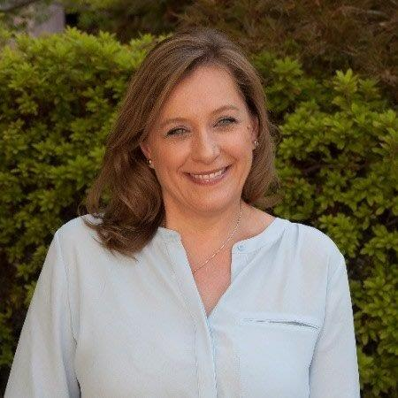


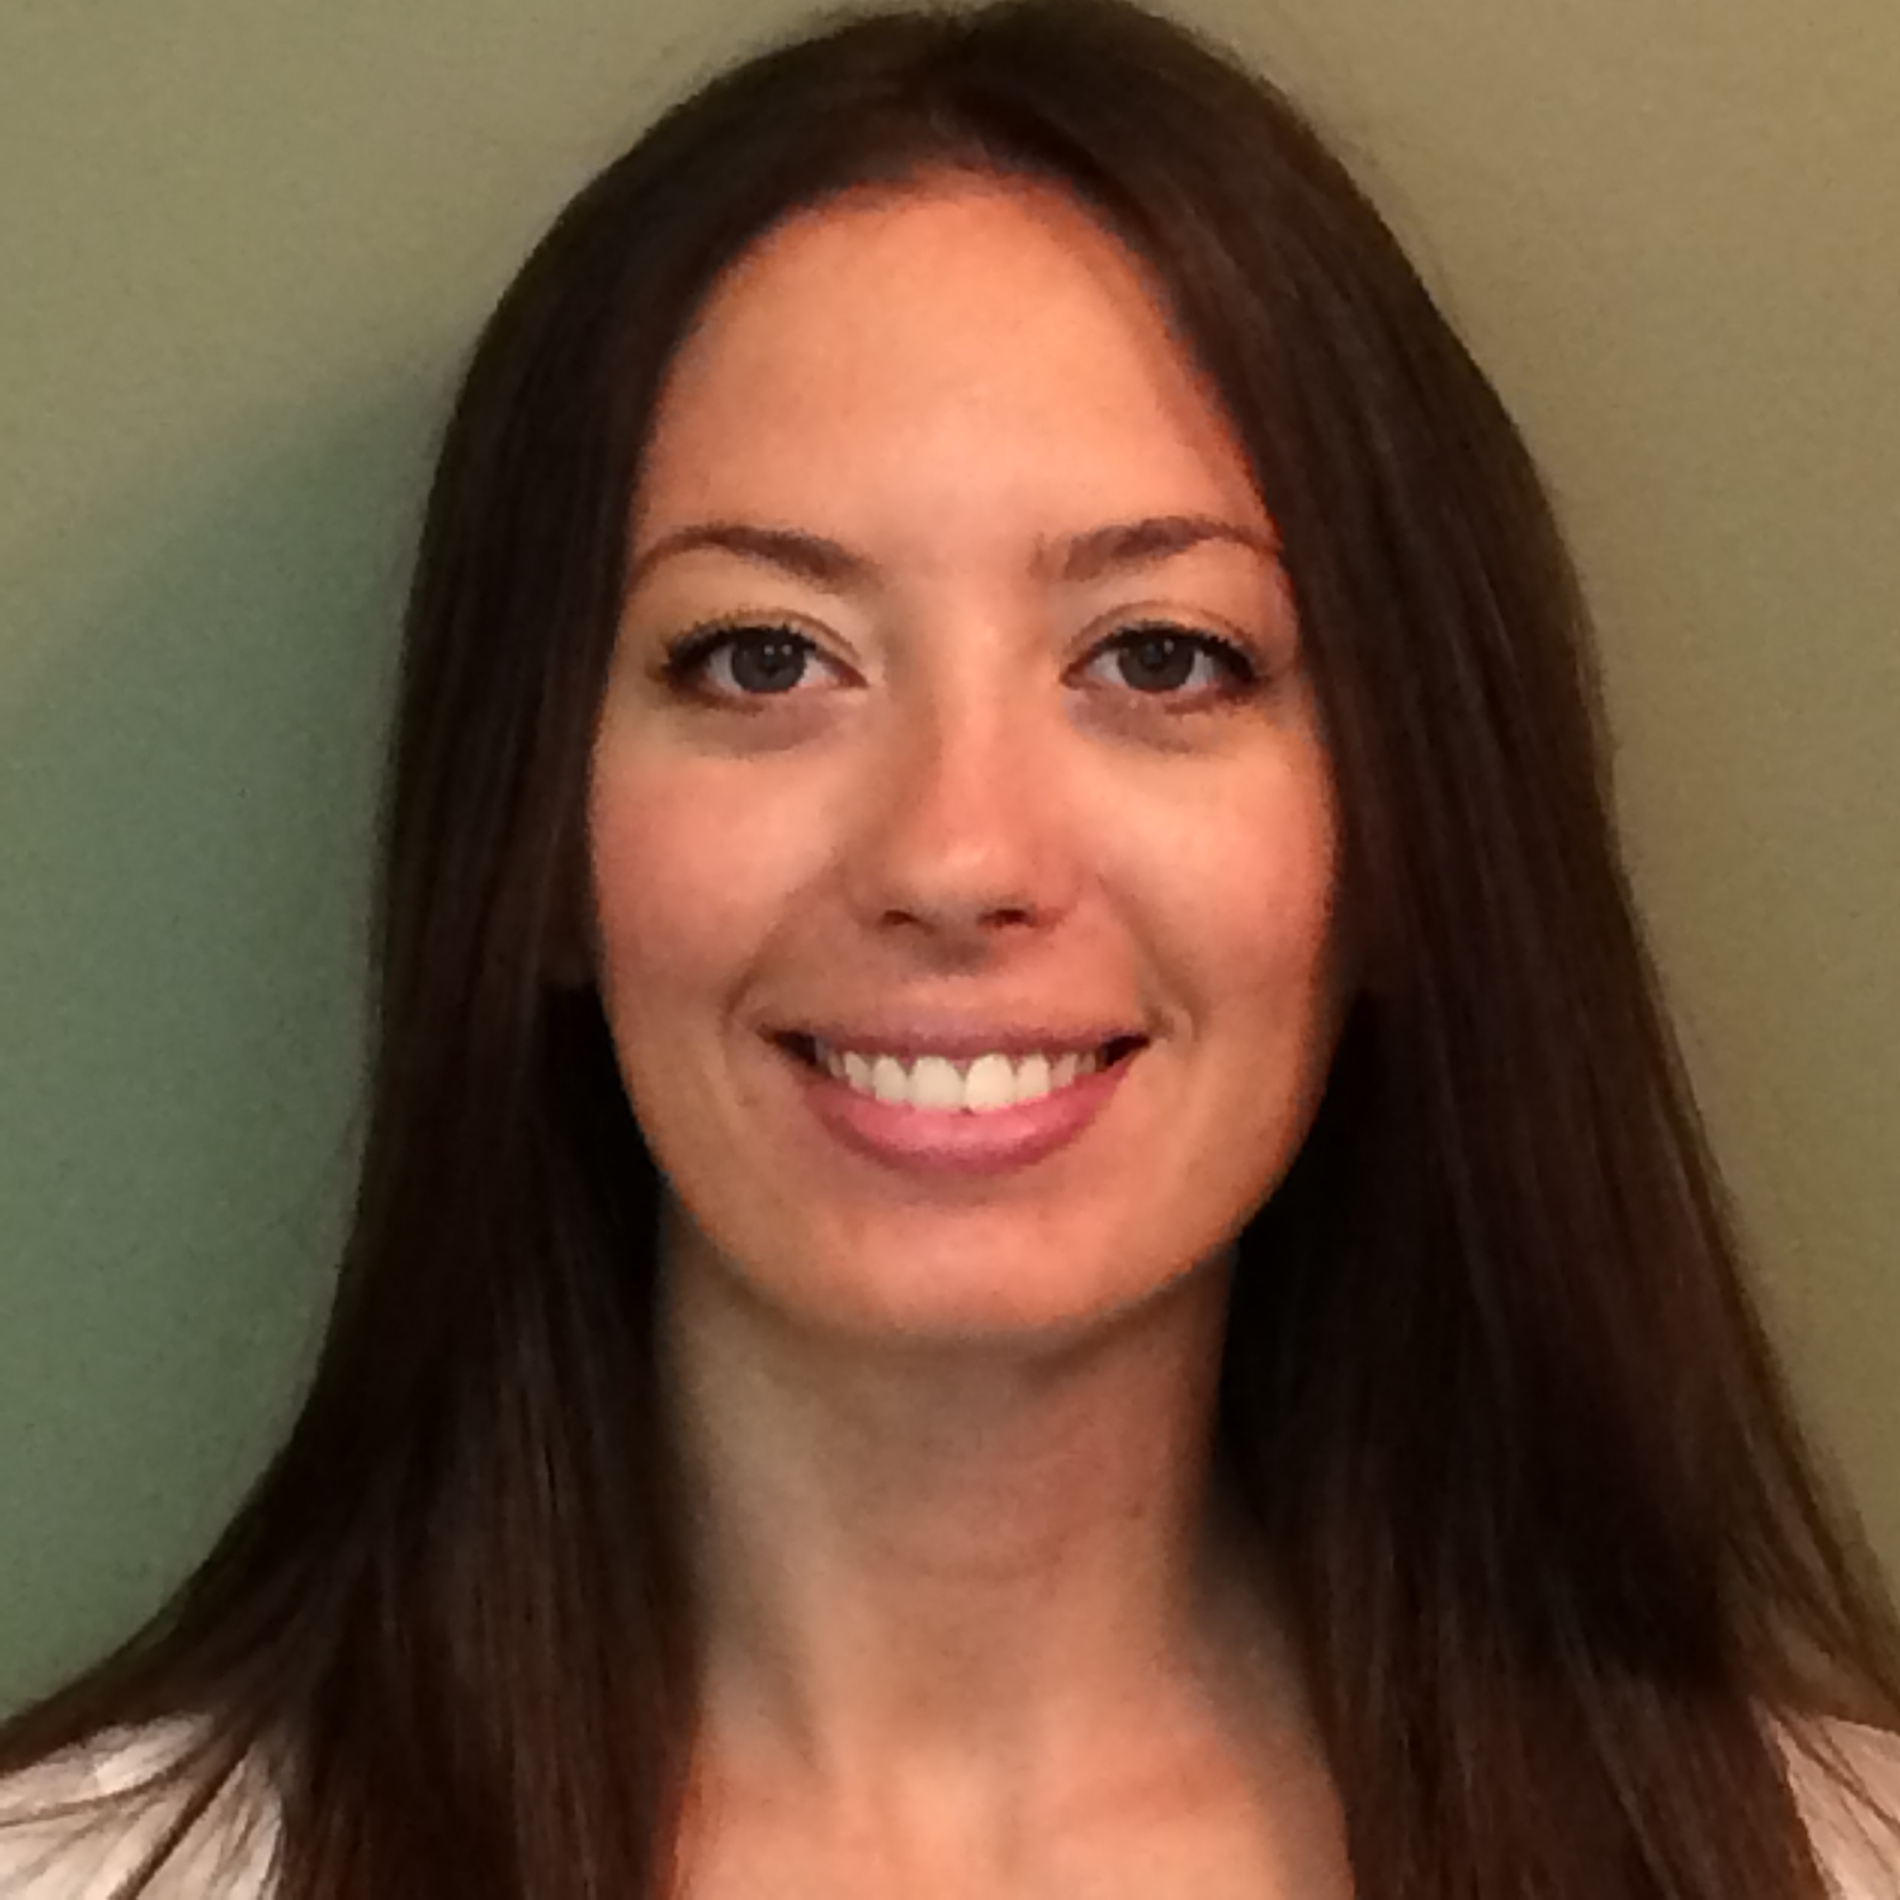

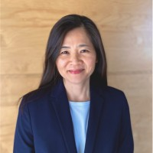
Faculty
Amy Foreman-Wykert
Executive Director, Scientific Communications, Inflammation Therapeutic Area, Amgen Inc.
Alexandra Stirling
Medical Communications and Strategy
Independent Consultant
Nicole Parker
Executive Vice President, Publications Strategy & Transformation, HCG
Ashley Metzger
Client Strategy Lead, Envision Pharma Group
Ann Loftus
Sr Director, Publications and Scientific Communications, Blueprint Medicines
Moderator: Tracy Cao
Director, Publication Strategy, Johnson & Johnson
Notes:
Just say name and title here

Slide 9
Case study 1: Onboarding a new agency/publications client

Slide 10

What would you do?
A pharma company is onboarding a new agency and aims to meet a submission deadline that is coming up quickly!
  Client to send introductory email to authors to hand off to the agency
  Hold review telecons (versus sending comments via email/Datavision) to walk through comments
  Tell the agency to just move forward and get everything done as fast as possible

Slide 11
When onboarding a new agency/client, what is your perspective around initiation of first projects?
Notes:
And now it's time to answer your questions. As a reminder, please type them into the Q&A box at the bottom of your screen.

Slide 12
Onboarding a new agency/publications client: Initiation of first projects
Perspectives
Agency
Pharma
Understanding the publication or communication strategy is essential to helping clients meet the desired objectives
Conduct a kickoff to set up the partnership
Articulate preferred ways of working and communications, download on strategy, and start a dialogue to build trust and collaboration
From the agency point of view, ask the right questions, especially if something isn’t clear or more information is needed
SOPs may not fully capture the nuances of project development
Ask questions and get to know the extended team
Collaboration and broad team alignment on detailed processes will ensure compliance, quality, and streamlined development
Give time to onboard
Consider timelines and projects
Communicate frequently
Share feedback
Make sure agency knows who they can contact directly to ask questions or seek clarity (ex: medical directors? Clinical team?)
Consider providing templates or examples for agency to work from (ex: concept sheets, previous successful drafts)
Initiation and initiation of first projects

Slide 13
Solution:
Start with the knowledge that agency and pharma have the same goals: to create strategic, accurate, and compliant projects that are delivered efficiently to have positive impact on patients.
Allow time for the onboarding process and be willing to ask questions and listen to feedback to create a trustful collaboration.

Slide 14
What would you do?
The pharma client is working on an important paper for submission. The team wants to make sure they get it just right, but the agency is asking for more budget as the number of drafts exceeds what is in the SOW.
  Discuss a realistic addendum with the agency
  Make the updates yourself and then send to the agency to have a “quick look” before author review
  Refuse to give additional funds. A draft is a draft is a draft!

Slide 15
When onboarding a new client, what is your perspective around timelines and budgets?
Notes:
And now it's time to answer your questions. As a reminder, please type them into the Q&A box at the bottom of your screen.

Slide 16
Onboarding a new agency/publications client: Timelines and budgets
Perspectives
Agency
Pharma
Critically review timelines during project kickoff
Direct and timely communication, especially of any issues or updates; bring solutions proactively
If there is a time-sensitive situation, collaborate and scenario plan
Understand your clients’ strategic and financial priorities, so you can provide informed solutions—both reactively and proactively
Plan for excellence but be ready for a curve ball
Pre-agreed standards help reduce surprises and guide discussions and decision making
  Example: a standard ideal timeline vs a rushed timeline, detailed process steps/assumptions, potential implications outlined, including budget variances.
Try to protect timelines
Communicate changes quickly and clearly
Advise on impact to budget or timelines
Meet regularly to focus specifically on budget matters, rather than during normal status calls
Make sure deadlines are transparent to agency (ex: quarterly reports required for internal purposes, invoicing dates)
Timelines and Budgets

Slide 17
Solution:
Once again, communication! Inform quickly and clearly on project challenges, changes in scope, impact to budget or timelines.
Set standard potential scenarios in advance (example standard versus rushed timeline, standard budget variance potential, etc.)

Slide 18
Case study 2: Abstract Submission

Slide 19
What would you do?
An author is not responding to draft review requests (multiple emails from agency with follow-up from pharma)
  Remove author
  Send “risk being removed” email if no response
  Call author to ask for their review
  Offer to set up meeting where feedback can be given in real time

Slide 20
When working through abstract submission, what is your perspective as it relates to authorship?
Notes:
And now it's time to answer your questions. As a reminder, please type them into the Q&A box at the bottom of your screen.

Slide 21
Abstract Submission to congress: Authorship
Perspectives
Agency
Pharma
There may be a need to rely on the client's access to the author
Changes to author lists after project initiation, or nonresponsive authors could present challenges with compliance, timelines and have budget implications
Ensure there is an established process (including broad stakeholder awareness) for identifying compliant author lists
Aligned processes for preferred approaches to standard author challenges can ease burden during busy development times
Provide author list and identify the lead/presenting author
Share any changes that would affect author or content
Reach out for help contacting authors
Consider condensing author lists on abstract and shorter presentations
Authorship

Slide 22
Solution:
With the goal of ensuring publications are compliant, flagging author issues early is important to allow time to address
Partner with Pharma clients to identify ways to resolve authorship issues

Slide 23
What would you do?
The agency is working on an encore submission with a very tight timeline. The client wants to add a new piece of data but still expects this to go through the encore SOP.
  Agree that this can be considered an encore presentation because only one new piece of data is being added
  Tell your agency partner that the team does not want to bother the presenter with another review and the SOP needs to be adjusted accordingly
  Set up a meeting with the team to explain that this is no longer an encore and the associated timeline and budget implications

Slide 24
When working through abstract submission, what is your perspective as it relates to evolving strategy (combining data, adding encore, copyright considerations)?
Notes:
And now it's time to answer your questions. As a reminder, please type them into the Q&A box at the bottom of your screen.

Slide 25
Abstract Submission to congress: Evolving strategy
Perspectives
Agency
Pharma
The communication strategy is a living document. It is important for the agency to remain informed of changes in strategy to determine what impact that might have on publications in development.
Understand an abstract's position within the broader publication plan, and how it furthers the clients’ strategy
Scenario plan and think ahead to the implications and eventual presentation, and what this means for the data
Urgent strategic needs will happen
Project debriefs are a great way to continue to evolve together
Plans are dynamic
Provide context and key changes
Communicate changes to authors early and set expectations
Pre-set encore plans to the extent possible
Evolving Strategy

Slide 26
Solution:
Need to be agile, communication is key
Anticipate as much as possible and be proactive with your partners (agency or pharma)

Slide 27
Audience Q&A
To ask a question, open the Q&A window, type your question into the Q&A box. Click Send.
Notes:
And now it's time to answer your questions. As a reminder, please type them into the Q&A box at the bottom of your screen.

Slide 28
Upcoming ISMPP U Webinars
September 18, 2024:
Retaining top talent in Medical Communications
October 23, 2024:
Open Access in honor of International Open Access Day: Copyright Confusion: Demystifying Creative Commons Licences for Industry-Funded Research
Notes:
Here is a snapshot of the upcoming ISMPP U for August, a focus on the best practices to beginning a new relationship between agency and pharma. Registration soon to be open. We hope you will join.
Also be on the lookout for the September ISMPP U, focusing on retaining top talent in Medical Communications. Registration is now open.

Slide 29

Thank you for attending!
We hope you enjoyed today's presentation.
After closing out of Zoom, please click the CONTINUE button
on your screen to take our short survey. Thank you!
Notes:
Thank you again for attending today’s webinar. Please take a moment to fill out the survey link that will be sent to you.
After closing out of ZOOM, please click the ‘continue’ button on your screen to take a short survey.
Thank you!

Slide 30
Faculty Bios

Slide 31
Amy Foreman-Wykert
Executive Director, Scientific Communications, Inflammation Therapeutic Area, Amgen Inc.
19 years of experience in scientific publication writing, editing, planning, and team leadership
Fosters innovation and best practices to advance scientific communication capabilities
Volunteer for multiple ISMPP Task Forces and Committees
CMPP, certified medical publications professional; ISMPP, international society of medical publications professional

Slide 32
Alexandra Stirling
Over 20 years working on a range of medical communication areas including publication writing, tactical planning and strategy
Leverages her clinical training and experience to bring a clinician’s perspective into content development and planning
Current work is focused on driving the development of strategically aligned publication plans
CMPP, certified medical publications professional; ISMPP, international society of medical publications professional

Slide 33
Nicole Parker
Executive Vice President, Publications Strategy & Transformation, HCG
15 years in medical communications, focusing on publications strategy, planning, and innovation
Loves elevating the science and telling the data story for the intended audience, to address specific challenges
Volunteer for ISMPP Committees and regular ISMPP attendee
CMPP, certified medical publications professional; ISMPP, international society of medical publications professional

Slide 34
Ashley Metzger
Client Strategy Lead, Envision Pharma Group
16 years in medical communications, driving transformational strategic results through collaborative partnerships
Motivated to create innovative, efficient, and effective solutions to each product challenge
CMPP, certified medical publications professional; ISMPP, international society of medical publications professional

Slide 35
Ann Loftus
Sr Director, Publications and Scientific Communications, Blueprint Medicines
Over 20 years experience in both agency and pharmaceutical companies
Focus on both internal and external resource planning and excellence as well as investigating ways companies of all sizes can adapt and develop process that are "fit for purpose"
Long time supporter and ISMPP member
CMPP, certified medical publications professional; ISMPP, international society of medical publications professional

Slide 36
Moderator: Tracy Cao
Director, Publication Strategy, Johnson & Johnson
Over 10 years in scientific communications including publication writing, planning, and strategy
Experience in freelance, agency, and pharmaceutical company settings
Involved in various ISMPP activities
CMPP, certified medical publications professional; ISMPP, international society of medical publications professional

