Slide 1
Emergent Literacy and Language Development for Non-Speaking, Tactile Learners

Slide 2
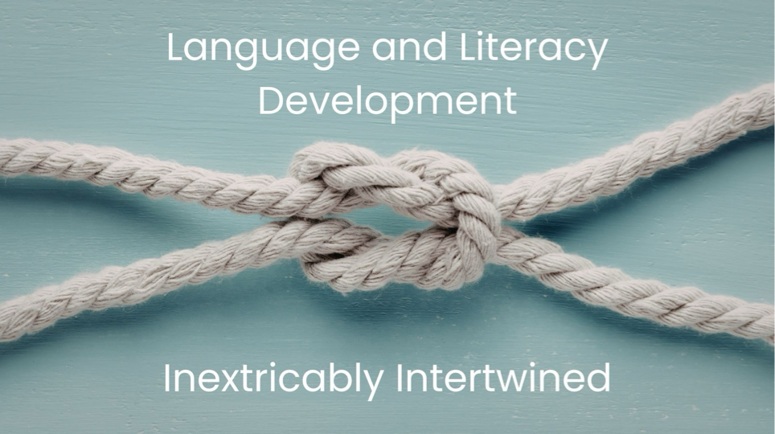
Language and Literacy Development
Notes:
Language development begins as an intensely social and sensory process long before children use spoken words, print, braille, or formal signs. For learners who are blind, deafblind, or have low vision, language and emergent literacy often develop through touch, movement, shared experiences, and emotional connection rather than through sight or sound alone. These learners construct meaning by interacting directly with people, objects, and environments they can physically explore, laying the groundwork for symbolic understanding essential to the development of complex literacy skills.

Slide 3
Communication and Literacy Skills
Expressive communication may include body movements, facial expressions, vocalizations, gestures, and tactile signals (Nicholas et al., 2019).
  Represent early steps toward symbolic representation, leading to engaging with tactile representations, braille books, and environmental braille before conventional braille reading and writing.
  Example: Reaching → hand movement → consistent tactile sign
Tactile-bodily communication plays a central role in both language learning and early literacy development
  Communication partners support this growth by responding consistently to the learner’s actions, mirroring emotional expressions, and labeling experiences through touch or movement.
  Over time, this reciprocal communication supports concept development, sequencing, memory, and symbolic representation, which are all core components of emergent literacy.
Notes:
Example: a learner may begin by reaching toward a favorite object, later progress to using a hand movement to request it and eventually develop a consistent tactile sign to represent it. These progressions illustrate how language and symbolic thinking emerge from meaningful, shared interactions.

Slide 4
Communication and Literacy Skills Cont.
Language development depends on:
  Access
  Connection
  Shared meaning
  Feeling safe
When we create environments rich in tactile, emotional, and experiential communication, we establish a basis for language and literacy development grounded in the learner’s perceptions and understandings of the world.
Notes:
Does literacy development depend on access, connection, shared meaning, and feeling safe?

Slide 5
The Circle Model on Tactile Language
A deep dive into the dynamic tactile language tool and its connections to emergent literacy

Slide 6
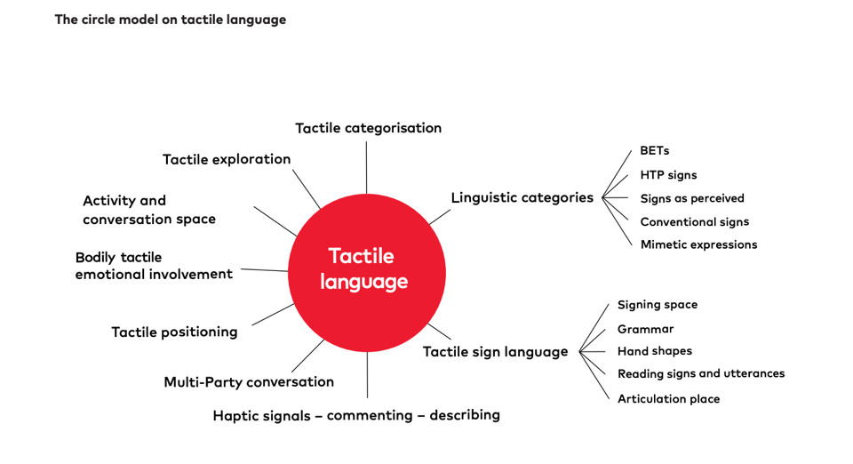
Circle Model on tactile language

Slide 7
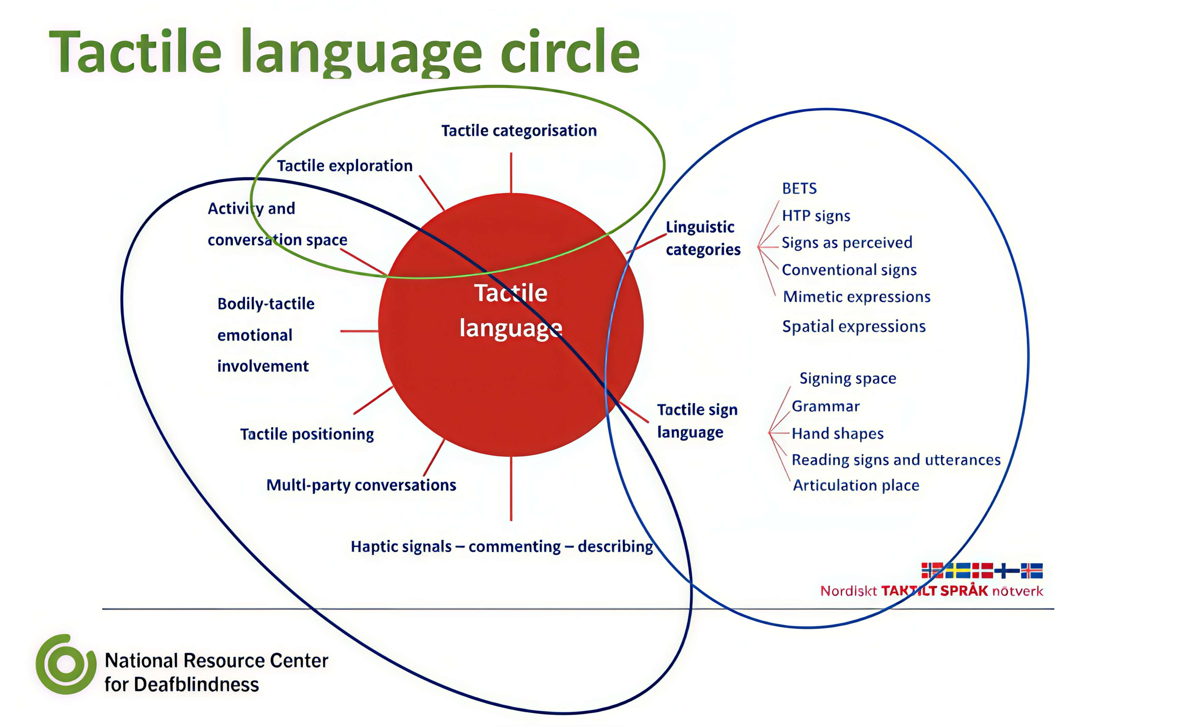
Tactile Language Circle

Slide 8
Tactile Exploration and Categorization

Slide 9
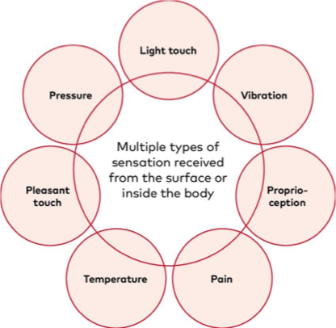
Tactile Exploration & Categorization
Obtain information through surface texture, temperature, flexibility, spatial position, & size in relation to the individual (Nicholas et al., 2019).
Represents primary pathway for perceptual, cognitive, & early literacy development.
Identify similarities and differences among objects & experiences, forming categories based on haptic qualities rather than visual features (Bennett et al., 2025).
Develops early literacy behaviors of sorting, matching, sequencing, & pattern recognition.
Internalized sensory representations form the foundation for later symbolic expression, narrative recall, & comprehension.
(Nicholas et al., 2019)
Notes:
Surface: texture, temperature, flexibility, spatial position, size
Body: all circles in the image

Slide 10
Linguistic Categories and Tactile Sign Language

Slide 11
Bodily Emotional Trace (BET)
Embodied emotional memories formed through sensory experiences that leave a lasting impression on the body.
Primarily developed through touch, movement, rhythm, vibration, and emotionally attuned interactions with trusted partners.
Form narrative and meaning-making structures for non-speaking tactile learners.
Develop memory for sequence, anticipation, and shared experience, all of which are foundational to literacy.
Notes:
BETs are sensations you receive in different ways through experiences, which creates bodily traces - what you remember of the sensation is what was meaningful to you. It can be, for example, how something felt against your skin, a movement that you did in the activity or a feeling that lingers in the body. The learner can comment on this memory by, for example, touching the place on their body where they felt something.
Recreating Experiences: Moving arms in a specific rhythm to remember playing a drum, or acting out the feeling of sand between toes.
Emotional Memory Traces: A child might repeat a specific movement made when happy, such as tapping their chest to represent a previous joyful interaction, or stiffening their body to recall a fearful or uncomfortable event.
Idiosyncratic Communication: A person might touch their shoulder to indicate a desire to return to a place where they received a gentle pat on the shoulder, or recreate the sensation of water to ask to go swimming.

Slide 12
BETs support emergent literacy by:
Establishing predictable beginnings & endings that mirror the structure of stories & written texts.
Creating emotional associations with meaning-making activities (e.g., interactive read-alouds) to increase engagement and motivation.
Supporting joint attention & turn-taking, which underlie dialogic reading and writing interactions.
Serving as pre-symbolic memory traces that later attach to tactile symbols, object cues, signs, & braille.
Notes:
Dialogic reading is the process of having a dialogue with students around the text they are reading. This dialogue involves asking questions to help children explore the text at a deeper level, including defining new words, analyzing the components of a story and being able to talk about the text. In other words, dialogic reading is a form of guided and scaffolded reading where the focus is on interpretive and critical comprehension more than on accuracy and fluency.

Slide 13
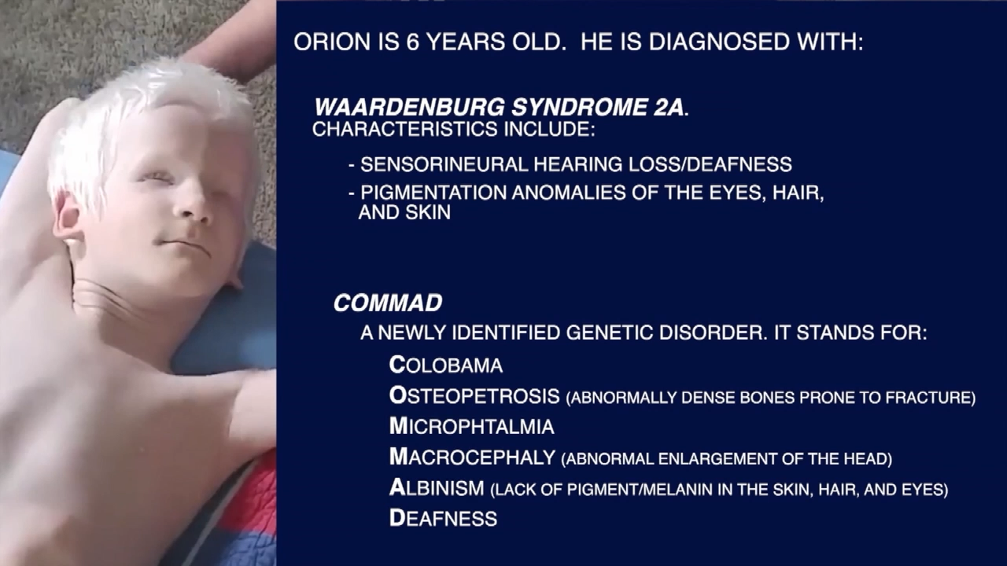
BET Examples
BET In Literacy Example:
A consistent tactile greeting before engaging in dialogic read-alouds becomes a bodily emotional trace that signals “reading together.” Over time, this trace supports the learner’s anticipation of text-based interaction, functioning as an embodied equivalent of recognizing a book cover or title.
BET In Communication Example Video

Slide 14
Hyper Tactile Perception (HTP) Signs
Emerge from intensive tactile exploration (examine an object’s shape, texture, temperature, flexibility, and function through touch [Bennett et al., 2025]).
The sign reflects these tactile features, conveying meaning grounded in direct sensory experience rather than visual representation.
Rooted in tactile cognition, emphasizing understanding and symbolization through physical interaction and haptic feedback (Saluja et al., 2024).
Tactile congruence: the sign captures the functional and sensory essence of an object as experienced through touch, highlighting that meaning is constructed through embodied interaction rather than visual abstraction (Aker et al., 2022).
Notes:
Although HTP signs may be challenging for communication partners to interpret, particularly those familiar with visually based sign systems, they represent an authentic and conceptually accurate form of communication. Their precision lies in tactile congruence matching between tactile (touch) sensations and another sensory modality (visual or auditory)

Slide 15
HTP signs support emergent literacy by:
Encouraging analytic thinking (identifying shape, function, and properties), which parallels how readers analyze symbols and words.
Supporting symbol-object relationships, which is a foundational literacy skill.
Allowing learners to generate meaningful, self-derived symbols, reinforcing the idea that symbols represent concepts.
Preparing learners for braille discrimination, including shape, spacing, pressure, and pattern recognition.
Notes:
HTP signs reflect concept formation through tactile analysis, a critical precursor to reading comprehension and written expression. Through intensive tactile exploration, learners identify essential features of objects, supporting the development of semantic precision needed for literacy.

Slide 16

HTP Sign Example
Using the cup at your station:
Close your eyes
Hold the empty cup in your left hand and use your right hand to examine its inner shape.
Set the cup aside while maintaining the shape of your right hand when you were exploring.
This hand shape represents the potential HTP sign for cup.
  An HTP sign for “cup” based on its inner shape becomes a stable tactile symbol that can later be paired with a braille label or tactile symbol, supporting word–concept correspondence.
Notes:
activity

Slide 17
Mimetic Expressions
Bodily expressions that originate from an individual’s direct sensory and motor experiences, recreated in the same manner as the individual initially felt them.
Rooted in the body’s memory of lived experiences
  convey meaning through gestures, movements, and tactile enactments rather than conventional linguistic forms.
Often emerge through tactile or bodily reenactments of experiences.
Exemplify how meaning can be communicated through the body itself, transcending visual or auditory language systems (Bennett et al., 2025).
Embodied storytelling - represent experiences through action and movement before formal language emerges.
Parallel early narrative skills such as retelling, sequencing, and elaboration.

Slide 18
Mimetic expressions support emergent literacy by:
Enabling experience-based narratives as a precursor to written storytelling.
Supporting temporal sequencing (what happened first, next, last).
Conveying descriptive detail and emotion which is essential for comprehension and expressive writing.
Bridging lived experience and symbolic representation, facilitating later transitions to signs, tactile symbols, and braille text.

Slide 19
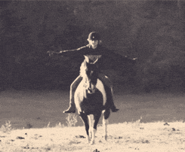
Mimetic Expression Example
When recalling riding a horse, the learner conveys the experience not by labeling “horse” with a standard sign, but by rhythmically moving their upper body to mimic the ride and using their hands or legs to suggest balance or reins.
The learner communicates the physical sensations and emotional experience of the activity rather than using a conventional label. Reenacting horseback riding through rhythmic movement can later be paired with tactile symbols, object cues, or braille words to represent the experience as a story.
(www.giphy.com, 2026)
What mimetic expression would you create based on this gif?
Notes:
Sequencing, narrative, expressive communication on a shared experience, memory retrieval

Slide 20
Signs as Perceived
Tactile signs reproduced exactly as experienced by a deafblind individual, reflecting the body-based sensory and motor memory of the original interaction.
Learner expresses it as they felt it on their hands or body.
  Can result in variations from conventional visual sign language forms, including reversed directionality, altered hand placement, reproduced tactile pathways, partial or fragmented signs, body-anchored signs, and idiosyncratic personal signs.
Represent legitimate, authentic forms of language that reflect the learner’s perceptual framework (Näslund & Kastrup Pedersen, 2019; Deafblind Information Australia, 2025).

Slide 21
Signs as Perceived support emergent literacy by:
Demonstrating symbolic intent - a foundational skill for reading and writing.
Reflecting individual perceptual frameworks, reinforcing that meaning precedes standardization.
Supporting ownership of language to increase engagement with literacy tasks.
Providing a bridge from embodied communication to more conventional tactile linguistic forms, including braille.
Recognizing and honoring these signs as communication, paralleling the practice of valuing early scribbles and nonstandard spellings as meaningful developmental steps in emergent writers.
Notes:
Signs as perceived represent early orthographic variation, similar to invented spelling or emergent handwriting in sighted learners. They demonstrate that the learner understands language as a system that can be represented, even when forms differ from conventional models.

Slide 22
Conventional Signs
Widely recognized within established visual sign languages or signed systems, such as ASL or SEE.
May be adapted for tactile use; produced on the hands or body, simplified, or modified based on the learner’s tactile experience. Meaning and form can shift depending on how they were learned and perceived
  Important to understand context and individual experience.
Adapted conventional signs may acquire specific tactile or contextual meanings distinct from their visual origins (Näslund & Kastrup Pedersen, 2019; Bennett et al., 2022, 2025).

Slide 23
Conventional signs support emergent literacy by:
Introducing stable linguistic forms that can align with braille or print representations.
Supporting vocabulary expansion, which is essential for reading comprehension.
Supporting clearer communication between the learner and others.
Facilitating the understanding that the differences between conventional signs and personal signs fosters dialect awareness.
Notes:
Conventional signs provide access to shared linguistic structures, enabling learners to participate in culturally recognized language systems.

Slide 24
Tactile Sign Language
Signing Space Tactile signing space may differ from visual sign language, often encompassing the entire body and incorporating surrounding objects.
Grammar and Hand Shapes Developed by the deafblind individual, grammar and hand shapes differ from visual sign language and draw on this 2nd subcategory. Self-created signs are valid and should be incorporated into reciprocal communication. (Bennett et al., 2025).
Reading Signs and Utterances Precision and attentiveness are crucial in tactile sign language, as slight variations in movement can significantly alter meaning. Movement should be used to enhance, clarify, and reinforce themes, & convey emotions that would typically be expressed through facial expressions and gestures in verbal or visual sign language.
Articulation Place The positioning of signs on the body or hands, tailored to the individual’s sensory accessibility, enabling the negotiation of meaning (Näslund & Kastrup Pedersen, 2019).
Notes:
Tactile Sign Language involves adapting visual sign language into an accessible tactile format, including modifications related to signing space, grammar, hand shapes, reading signs and utterances, and articulation place (Bennett et al., 2022, 2025).

Slide 25
Tactile sign language supports emergent literacy by:
Establishing grammar and syntax, which transfer to understanding written language structures.
Using movement and rhythm as tactile analogues to prosody and punctuation.
Supporting precision and attention to detail, which is critical for braille reading and writing.
Allowing meaning to be negotiated through articulation place and movement, reinforcing symbolic flexibility.
Notes:
Through tactile sign language, learners develop a robust language system that supports later engagement with braille, tactile graphics, and written text.

Slide 26
Bodily Tactile Space
Notes:
The third subcategory of the Circle Model refers to how individuals navigate, position themselves, and interact with objects and their surrounding environment. The learning environment and bodily positioning play a critical role in how information is accessed, interpreted, and used for learning, and in how learners participate meaningfully in shared reading and literacy experiences. These elements support joint attention, turn-taking, and the co-construction of shared meaning, foundational processes in emergent literacy development.

Slide 27
Haptic Signals for Commenting & Describing
Intentional, gentle touches used to convey real-time social and environmental information without interrupting ongoing tactile or signed communication.
Typically made on the back, shoulder, or upper arm, these cues provide context such as who is speaking, emotional tone, or actions occurring in the environment that cannot be directly perceived through touch.
Haptics in a Coffee Shop
Notes:
Important to discuss the 2 main types of human science and communication haptics:
Haptic Perception: The biological and psychological process of recognizing and manipulating objects through the sense of touch.
Haptic Communication: Non-verbal communication via touch, such as a handshake, a pat on the back, or a caress.
https://www.helenkeller.org/resources/haptics-demonstration-videos/

Slide 28
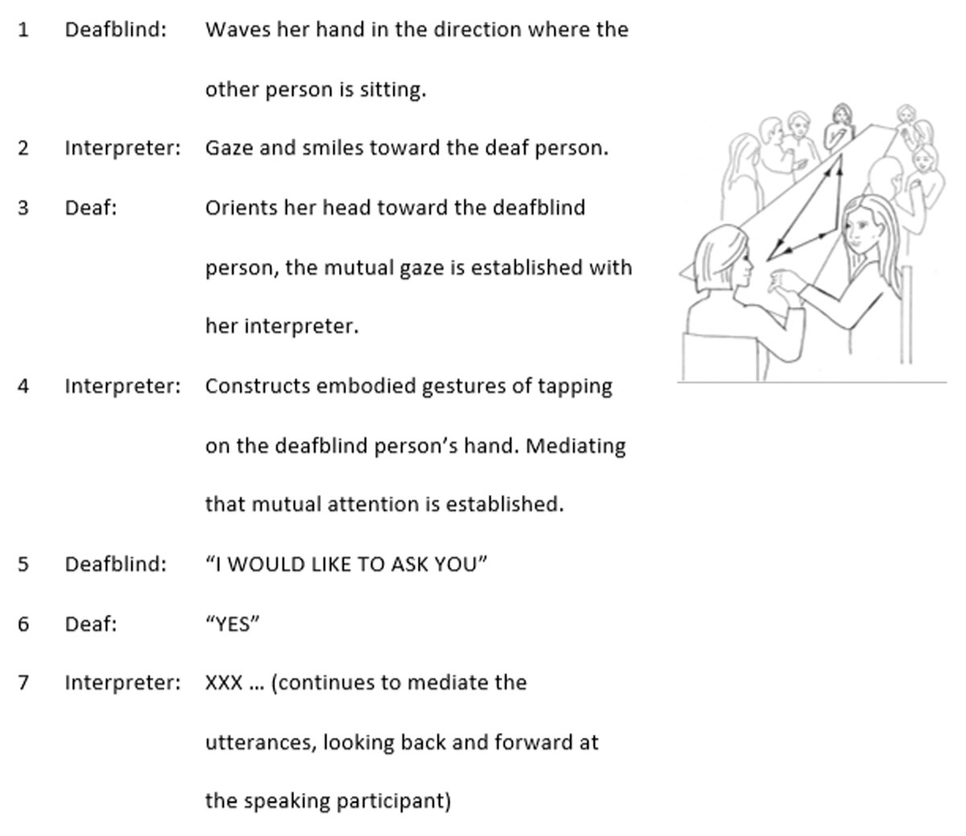
Multi-Party Conversations
Structured interactions in which more than one communication partner engages with a deafblind individual.
Intentionally organized so everyone can participate in a sensorily accessible way (e.g., through touch, shared tactile signs, or bodily movements).
Can occur with or without conventional language, depending on the communication forms used by the participants (Worm et al., 2020).
Using Action Signals to Facilitate a Meeting

Slide 29
Tactile Positioning
How an individual who is deafblind and their communication partner physically orient themselves to maintain direct tactile access.
Supports clear communication and language development by allowing both participants to feel each other’s gestures, expressions, and body language.
Communication partner can recognize and respond to the deafblind individual’s bodily expressions in real time (Texas School for the Deaf, 2025).
Tactile Positioning

Slide 30
Bodily Tactile Emotional Involvement
Emphasizes the importance of emotional connection through touch.
The communication partner actively mirrors, matches, and affirms the non-speaking individual’s emotional expressions
  Through tactile cues: changes in muscle tension, rhythm, or movement, to communicate understanding and empathy.
This tactile emotional reciprocity builds trust and ensures that the individual feels recognized and respected as a communication partner (Texas Deafblind Project, 2025).

Slide 31
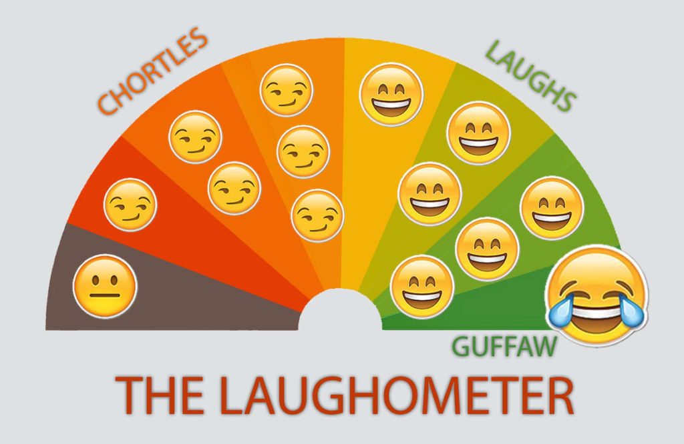
Example: Laughing
  Mildly funny
  Hilarious
  Not funny
(Toren Atkinson, 2017)
Notes:
Activity: show laughing in Protactile (flutter or gentle scratches) : Communicate laughing: 1. Mildly funny 2. Hilarious 3. Not funny?

Slide 32
Activity and Conversation Space
Activity Space: the area where an action or experience occurs. It is where the individual and their partner are when actively engaged in an activity.
Conversation Space: encompasses the tactile or signed exchanges that arise around the activity, whether before, during, or after it takes place.
Separating these spaces helps clarify when the focus is on the action versus when it shifts to shared reflection or planning (National Center on Deafblindness, 2025).

Slide 33
Tactile Exploration
Use the sense of touch to examine, understand, and interact with objects, materials, and environments.
Gain knowledge about an object’s shape, texture, temperature, and function.
Form meaningful, lasting impressions that support concept development, categorization, and expressive communication (Nicholas et al., 2019).

Slide 34
In Conclusion
Language development is an embodied, sensory, & social process cultivated alongside emergent literacy.
Tactile exploration, emotional connection, & shared bodily experiences help learners develop symbolic systems that parallel the processes of early braille and print literacy.
The Circle Model on Tactile Language provides a framework for understanding how tactile communication supports concept development, symbolic representation, narrative understanding, & shared meaning-making.
Recognize & respond to tactile expressions as legitimate language & early literacy behaviors to support learners in developing rich, meaningful communication & literacy systems that reflect how they experience the world.

Slide 35
Questions?

Slide 36
Thank You
Shanna Hamilton: hamiltons@tsbvi.edu

Slide 37
References
Aker, S., Innes-Brown, H., Faulkner, K.F., Vatti, M., Marozeau, J. (2022). Effect of audio-tactile congruence on vibrotactile music enhancement. Journal of the acoustical society of America. Volume 152. Issue 6. https://pubs.aip.org/asa/jasa/article/152/6/3396/2839846/Effect-of-audio-tactile-congruence-on-vibrotactile
Bennett, K., Hamilton, S., Montgomery, C., Schultz, M., Sewell, D., Tiggs, S., van den Tillaart, B., (2022). Essential tools of the trade for teachers of students who are deafblind: A how-to guide for completing evaluations. Texas School for the Blind and Visually Impaired.
Bennett, K. Hamilton, S. Majzel, J. (2025). Essential tools of the trade for teachers of students who are deafblind: A guide for completing evaluations. Texas School for the Blind and Visually Impaired.
Brum, C. Bruce, S.M. (2023). Shared reading with learners who are deafblind: Instructional materials and learning environments. Journal of Visual Impairment & Blindness (JVIB). American Foundation for the Blind (AFB). Sage Publications. https://www.researchgate.net/publication/372639530_Shared_Reading_With_Learners_Who_are_Deafblind_Instructional_Materials_and_Learning_Environments#fullTextFileContent
da Silveira Coêlho, M.L., Wingenbach, T.S.H., Boggio, P.S. (2022). Social and affective neuroscience of embodiment. In: Boggio, P.S., Wingenbach, T.S.H., da Silveira Coêlho, M.L., (2023). Social and affective neuroscience of everyday human interaction: From theory to methodology [Internet]. Cham (CH): Springer; 2023. Chapter 3. https://www.ncbi.nlm.nih.gov/books/NBK595456/
Deafblind Information Australia, (2025). About deafblindness. Communicating. https://www.deafblindinformation.org.au/about-deafblindness/congenital-deafblindness/for-families-carers/learning-and-communicating/communicating/#:~:text=Body%20signs%20%E2%80%93%20signs%20are%20made,open%20hand%20on%20the%20shoulder
Helen Keller Services (2026). Haptics demonstration videos. https://www.helenkeller.org/resources/haptics-demonstration-videos/
Iturbe, C.Z. (2019). What is dialogic reading? Cambridge University Press and Assessment. https://www.cambridge.org/elt/blog/2019/04/18/dialogic-reading/
Lindström, C. (2025). Tactile sensations: A basis for language development. Texas Symposium on Deafblind Education: Convergence: Embracing New Beginnings with Presence and Connections.

Slide 38
References Cont.
Majzel, J. Hamilton, S. (n.d.). Deep in the heart of literacy: Thematic emergent literacy units for learners of all ages and abilities. Texas School for the Blind and Visually Impaired.
Näslund, J. Kastrup Pedersen, B. (2019). The circle model on tactile language. If you can see it, you can support it. https://nordicwelfare.org/wp-content/uploads/2019/06/If-you-can-see-it-you-can-support-it-a-book-on-tactile-language.pdf
National Center on Deafblindness (2025). Modifications to the learning environment. https://www.nationaldb.org/info-center/educational-practices/modifications-to-the-learning-environment/#:~:text=Environments%20that%20promote%20communication%20and,tactually%20interesting)%20materials%20and%20activities
Nicholas, J. T., Johannessen, A. M. Nunen, T. V. (2019). Tactile working memory scale. Nordic Welfare Centre.
Saluja, S., Croy, I., Stevenson, R.J., (2024). The functions of human touch: An integrative review. Journal of nonverbal behavior. Springer. https://link.springer.com/article/10.1007/s10919-024-00464-x
Texas Deafblind Project (2025). Role of social and emotional development. https://txdeafblindproject.org/children-who-are-deafblind-with-additional-disabilities/role-of-social-and-emotional-development/#:~:text=Hello%20and%20goodbye%20rituals%20are,know%20we%20will%20be%20back
Texas School for the Deaf, Statewide Outreach Center (2025). Tactile approaches, Tactile signing. https://www.texasdeafed.org/apps/pages/index.jsp?uREC_ID=4360996&type=d&pREC_ID=2559043#:~:text=Tactile%20signs%20and%20symbols%20are,signer%20to%20read%20the%20fingerspelling
The Christian Science Monitor (2020). New touch-based language by deafblind people: Protactile. https://www.youtube.com/watch?v=8im72wFTa9Y
Worm, M., Damen, S., Minnaert, A., Janssen, M.J. (2020). Multiparty conversations with people with congenital deafblindness: operationalization, significance, and requirements. Secondary Education Psychology. https://www.frontiersin.org/journals/education/articles/10.3389/feduc.2020.542376/ful

