Slide 1

aer@aerbvi.org | 703-671-4500
www.aerbvi.org
Notes:
PLEASE DO NOT EDIT OR REMOVE

Slide 2


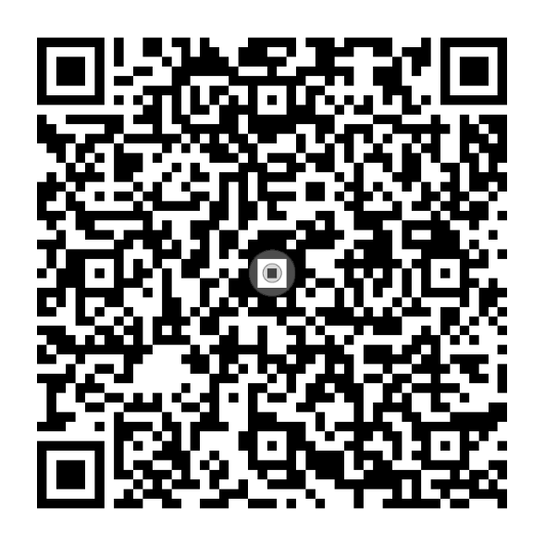
Foundations of Vision Rehabilitation Therapy
EDITORS
Dr. Helen Lee and Jennifer Ottowitz
To order online,
visit aph.org/shop
Or call 1-800-223-1839
Notes:
PLEASE DO NOT EDIT OR REMOVE

Slide 3
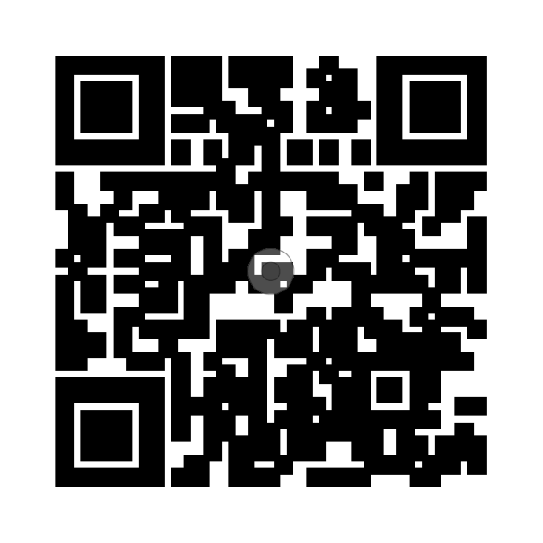

Foundations of Vision
Rehabilitation
Therapy
Access the entire AER eLearning series when you
scan the QR code.
Notes:
PLEASE DO NOT EDIT OR REMOVE

Slide 4

Earning ACVREP Continuing Education Credits
To earn your ACVREP credit for this session you must be in attendance for 85% of the webinar to qualify. At the end of this session, take the survey on the e-learning platform. Once you have completed the survey, the certificate of CEU’s will be sent in an email and also will be available in your e-learning account
Sessions and ACVREP CE credits are included in your AER Membership.
Notes:
PLEASE DO NOT EDIT OR REMOVE

Slide 5
Foundations of VRT: Chapter 4: Learning and Teaching

Slide 6
Learning Objectives
1: The participant will gain understanding of the various ways adults learn, especially those with vision loss, and be encouraged to apply these principles to their teaching methods.
2: The participant will explore various techniques used to teach learners with vision loss, including effective strategies for VRTs who are themselves visually impaired.

Slide 7

Major Strengths of the VRT
Individualization of content, learning styles and teaching methods
Flexibility to accommodate students due to age, existing knowledge, visual functioning, culture and experience.

Slide 8

Learning with Vision Loss
This Photo by Unknown Author is licensed under CC BY-NC

Slide 9

Basic Learning Assumptions:
All students can learn, no matter their age, abilities, or experience.
Adult learners learn differently than children
Each adult learner is unique and should be actively involved in the learning and teaching process based on their experiences, values, intelligence, stage of human development, age of onset, and degree of vision loss.

Slide 10
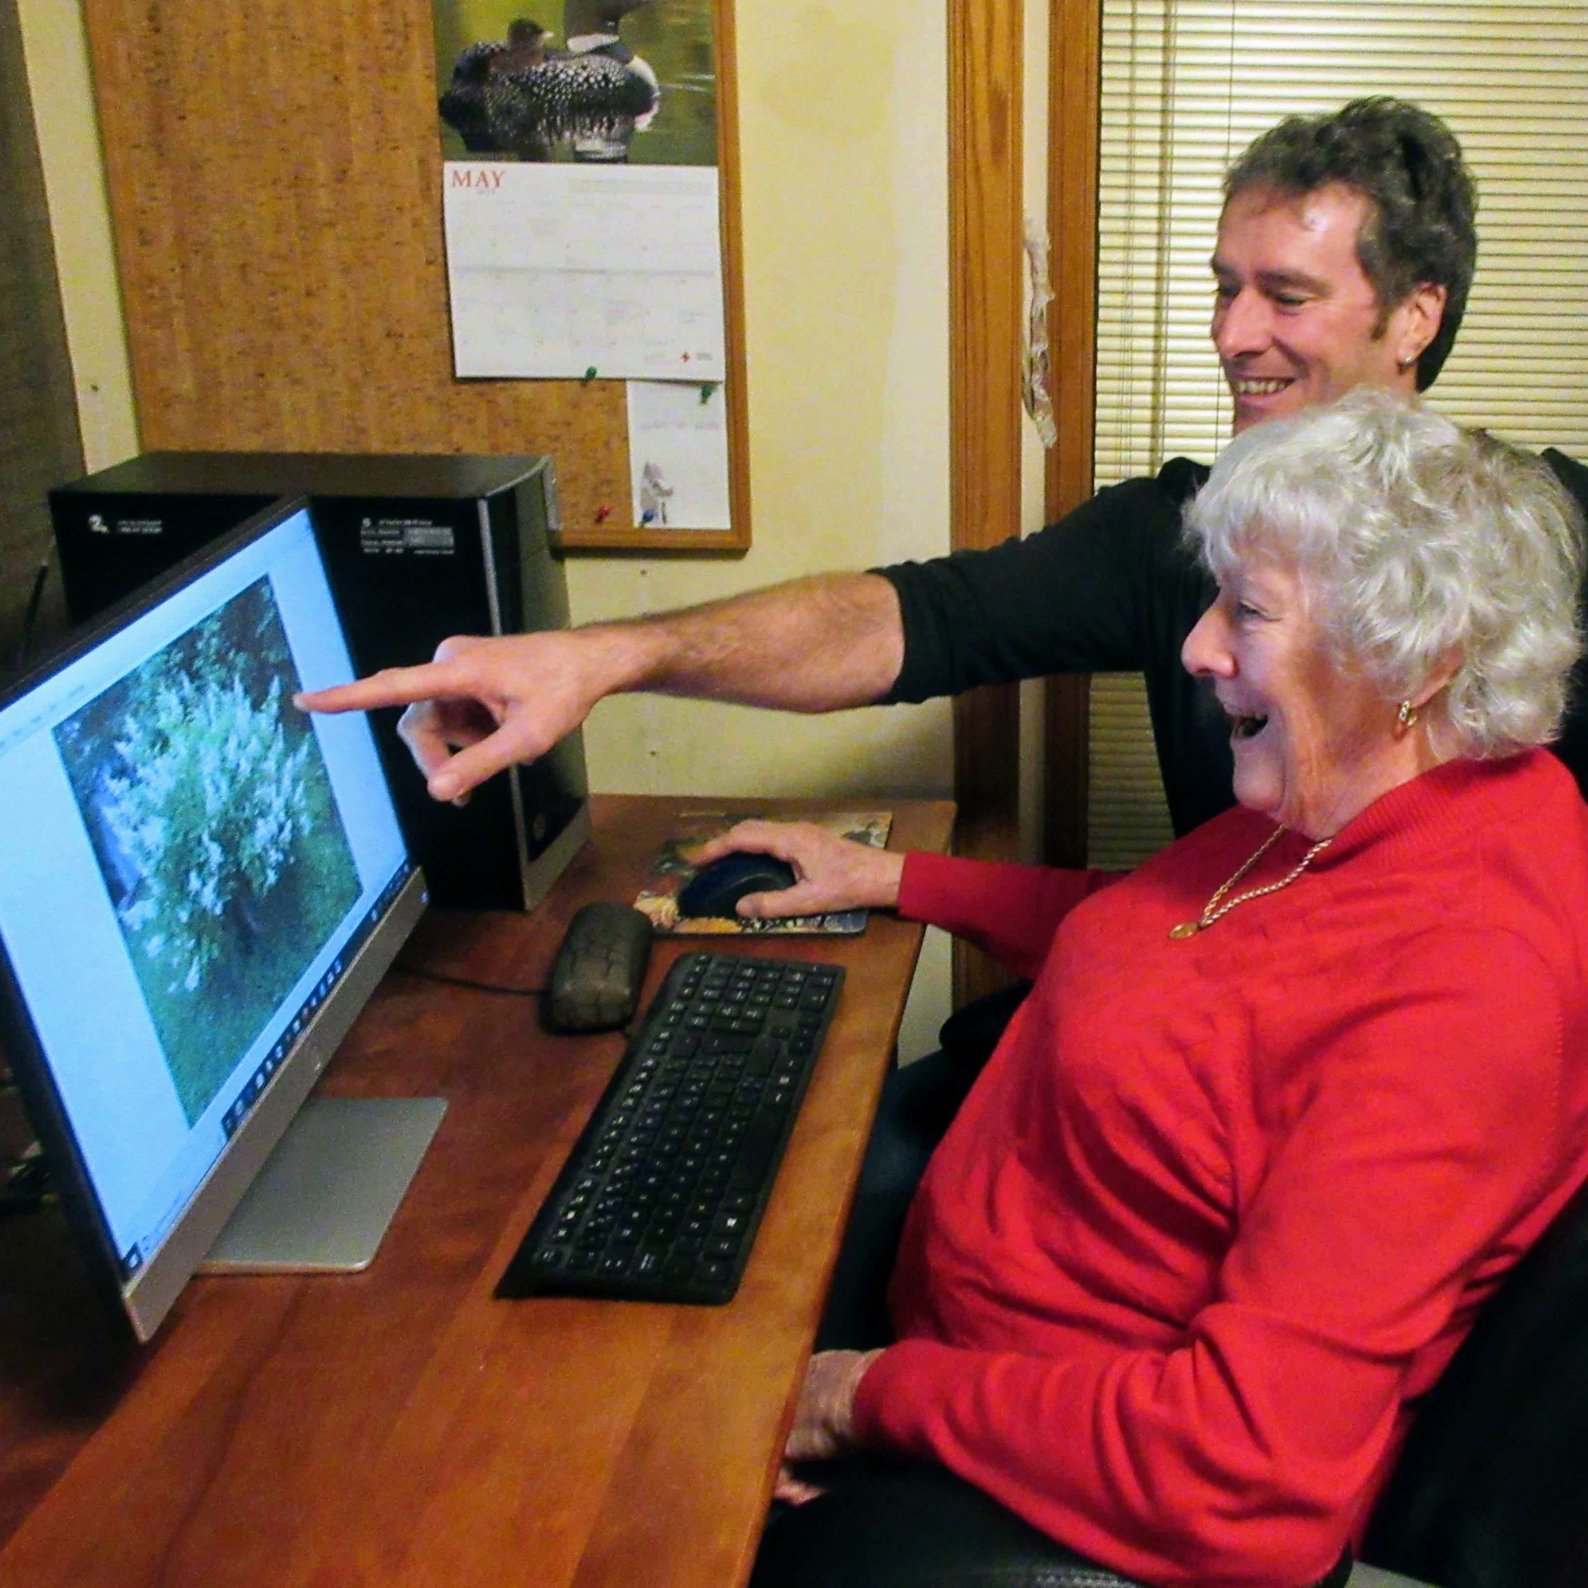
Adult Learning Theories
Cognitive Learning (Neisser)
Social Learning (Bandura)
Andragogy (Knowles)
Problem Based Learning (Barrows) (Structured Discovery)
Transformational Learning(Mezirow)
This Photo by Unknown Author is licensd under CC BY
Notes:
Cognitive Learning Theory – (Neisser) based on cognitive psychology that explains learning in terms of information that is stored cognitively for future use. Relies heavily on interactions, analysis, and memory.
Social Learning –(Bandura) people learn form one another, and do well in group settings through observation, imitation and modeling.
Andragogy – (Knowles)the art and science of helping adults to learn as opposed to children (pedagogy) contain 6 important assumptions: established self-concept, experience, the need to know, problem centered focus, internal motivation, understanding of why they should learn. Four basic principles are – self-directed, building on existing skills, practical and relevant skills, focus on problem solving skills.
Problem Based Learning (Structured Discovery) (Barrows) self-directed learning where the student is presented with an open-ended problem to be solved, and is often enhanced by working in groups (i.e. MSU Vet School) NFB (Ryles)- structured discovery learning includes – non-visual skills, problem-solving, positive personal attitudes, overcoming public misconceptions, and giving back.
Transformational Learning (Mezirow) Learning can change previous ideas and concepts. So learning a task can assist with the adjustment to vision loss as perceived dependencies are altered by learning independent living skills..

Slide 11
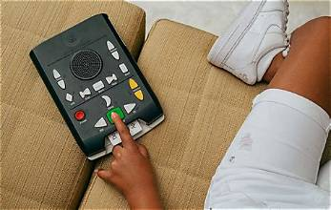
Learning Styles (Canfield)
Visual
Auditory
Reading/Writing
Kinesthetic
Tactile Learning

Slide 12
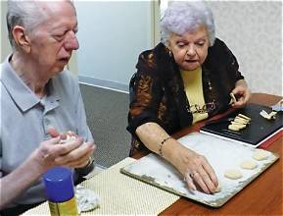
Memory Strategies with Older Adults
Distraction Free Environment
Mnemonics
Chunking/Classification
Organization
Repetition/Practice
Time to Process
Accommodating Fatigue
Keeping Language Simple
Reminding the Student who you are and what agency you are with

Slide 13

Include Learner’s Cultural Background
Values
Language
Actions
Possessions
Notes:
Values – gender issues, independence, religious/spiritual perspective
Language – use of idioms, interpreters
Actions – eye contact, what is considered rude, socialization before lesson
Possessions – foods, homemade products, gifts

Slide 14
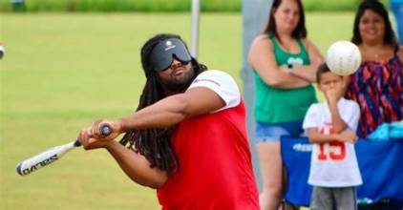
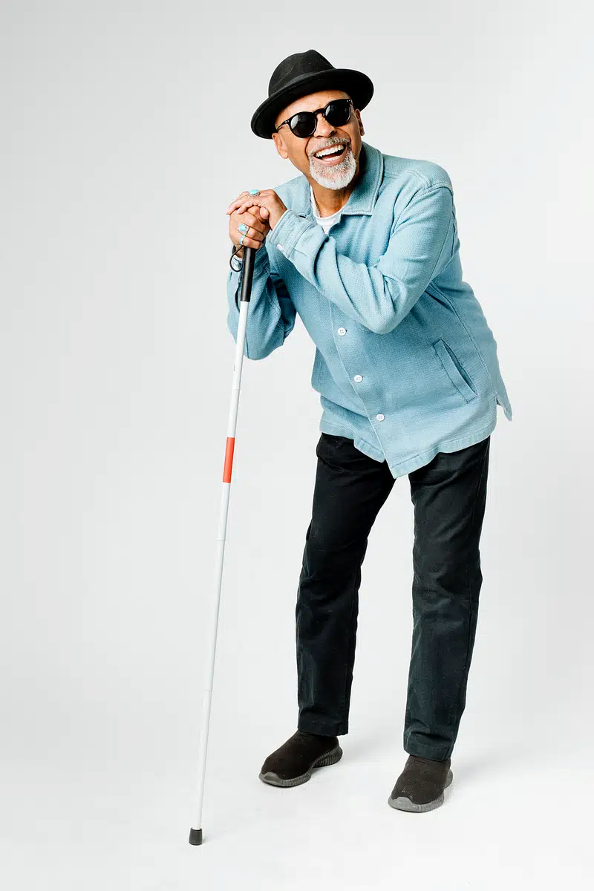
Effects of Visual Impairment on Learning

Slide 15

Teaching an Adult Student with Vision Loss

Slide 16
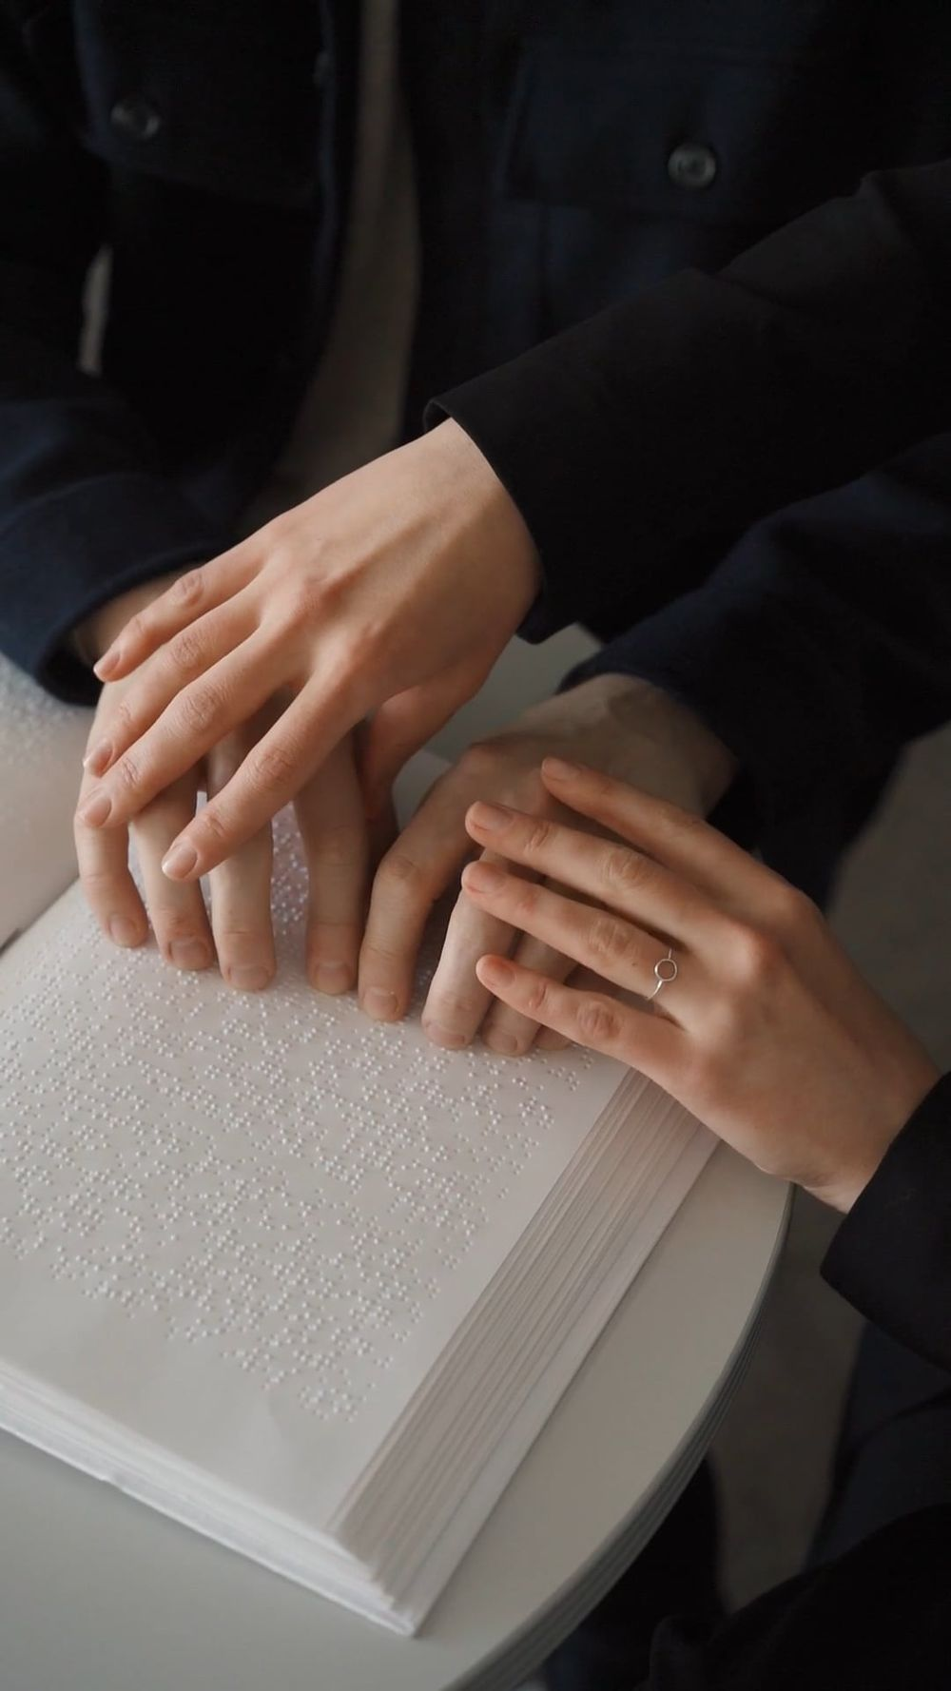
Instructor Behaviors
Show enthusiasm for client, lesson and profession
Have high expectations in addition to empathy, understanding, and consideration
Explain expectations for both client and instructor
Demonstrate experience in knowledge and preparation

Slide 17

Building Rapport
Develop a relationship of trust.
Create a safe environment to learn, ask questions, and make mistakes.
Provide encouragement and support.
Facilitate independent problem solving.
This Photo by Unknown Author is licensed under CC BY

Slide 18
Aspects of Instruction
Communicating effectively
Monitoring pace of instruction
Reinforcing success in learning
Performing task analysis
Instructing on use of adapted techniques and devices

Slide 19

Instructional Communication
Precise, consistent language
Analogies and metaphors
Modeling versus manipulation
Tactile models and auditory cues

Slide 20
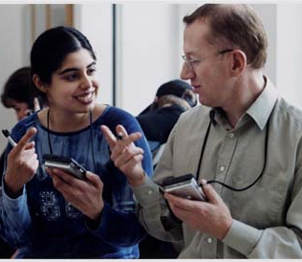
Adaptations for Those with Hearing Impairment
Enhance use of remaining hearing
Repeat then restate
Have learner repeat instructions
to ensure understanding
Use of interpreters
This Photo by Unknown Author is licensed under CC BY-NC-ND
Notes:
Remaining hearing may be enhanced by using assistive listening devices,
communicating to the better hearing ear, reducing auditory distractions, and facing the
person when talking.

Slide 21


Pace of Instruction
Identifying amount of time for instruction
Evaluating learner performance/ understanding

Slide 22


Providing Feedback
Tone
How much
How often

Slide 23

Task Analysis
Guides instruction
Analyzes performance and progress
Impacts amount of time needed for instruction

Slide 24

Instruction on Adaptations
SEER approach
Least restrictive adaptation theory
Providing training on use of adaptive devices
Notes:
SEER: Safe - the adaptation or technique will not pose a threat or danger when it is
consistently used by the client or to others; Effective - the adaptation or technique works well
and produces the results that were intended; Efficient - the adaptation or technique assists the
client in doing things using a reasonable and acceptable amount of time and energy; Reliable -
the adaptation or technique is dependable and consistent in what it does.
Least restrictive approach theory
• Category #1 sense shifting: changing one&#39;s approach to a task;
• Category #2 altering the environment: making the task easier or movement within the
environment safer;
• Category #3 utilizing familiar devices: performing task with common tools and readily
available items;
• Category #4 using a specialty product: using a tool or device from a specialty company
designed for a particular task.

Slide 25

Group Instruction
Benefits
Considerations
Managing group dynamics
Notes:
Benefits for the client include: offering a nonthreatening and less stressful learning
environment, socialization, peer learning and mentoring, and motivation to continue
individual instruction.
Benefits for VRT include: maximizing time and resources, increase number of clients
served, and increasing awareness of services.
Considerations include: size and set up of physical space, amount of time available,
number of participants, and specific needs of participants.

Slide 26
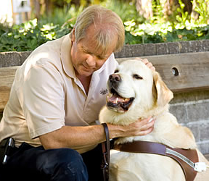
Instructors Who Are B/LV
Positive role model/professional image
Managing environments
Enhancing efficiency
This Photo by Unknown Author is licensed under CC BY

Slide 27
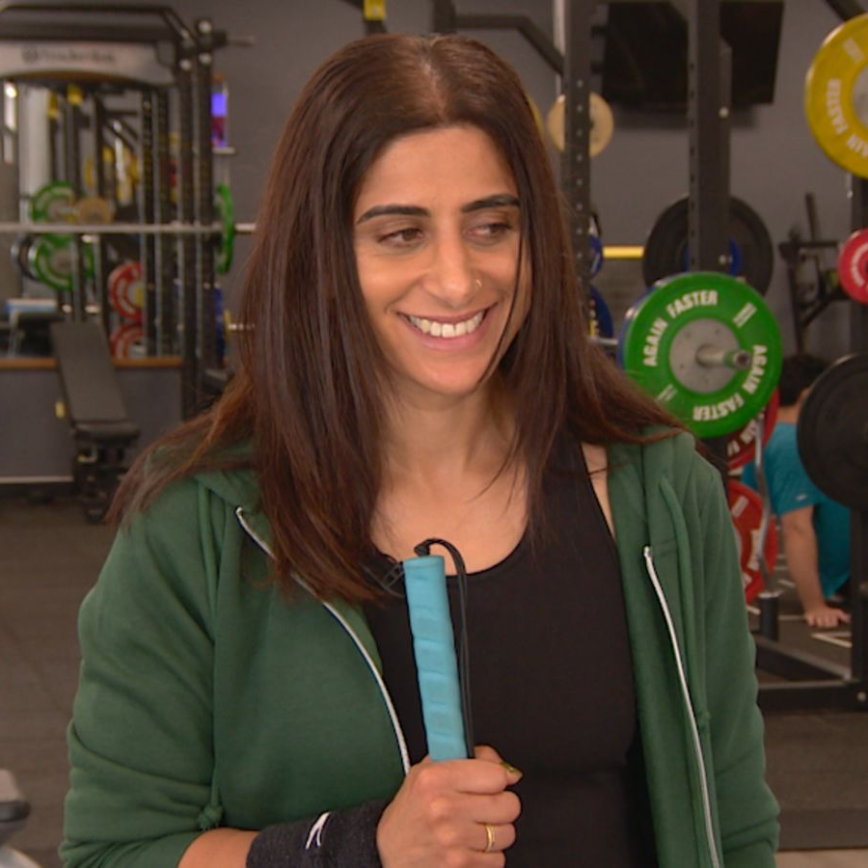
Monitoring and Evaluation for B/LV instructors
Physical monitoring
Client feedback
Verbal and nonverbal
cues

Slide 28

Additional Teaching Tips
Begin lesson with check in
Teach the lesson
Recap what was learned
Inform about next steps
Documentation is a part of
teaching

Slide 29

Thank you
Jennifer Ottowitz
jottowitz@colled.msstate.edu
BJ LeJeune
Bjlejeune2001@gmail.com
Notes:
To add alt text in PowerPoint, select the object to which you want to add alt text. Right click on the object and select “edit Alt Text” from the drop-down menu. Type the alt text into the content box on the right, have PowerPoint generate a description for you, or mark the object as decorative.

