Slide 3
To review:
In our last session:
articulate ways to increase meaningful student involvement in initiatives in your school/district.
identify ways that collaborative inquiry can be a powerful design for professional learning.
brainstorm solutions to challenges of implementation.
Notes:
Ladder of student involvement
Challenge Protocol
Seeking questions vs. answers….

Slide 4
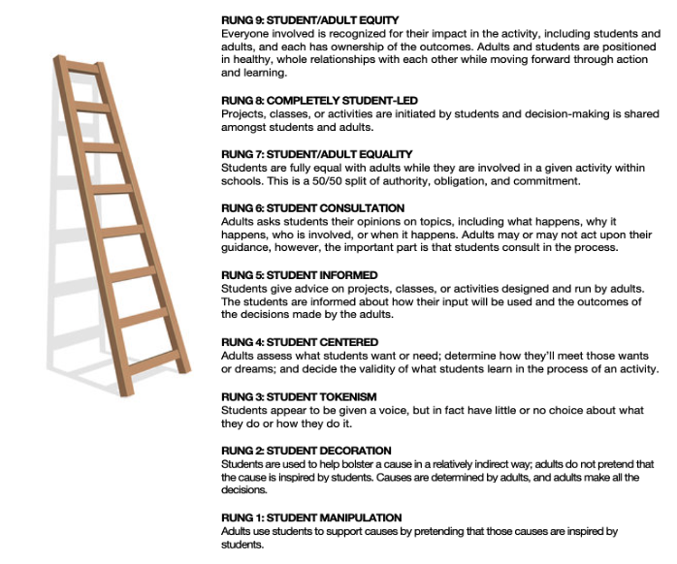
Ladder of Student Involvement
How have you used the ladder of
student involvement?

Slide 5
Challenge Protocol Debrief
What about the protocol was the most challenging for you?
What about the protocol was the most helpful for you?
How might you use this protocol in the future?

Slide 6
Question - Storming?
“Question-storming”—brainstorming for questions rather than answers—is now a creativity technique.
Arnaud Chevallier, Frédéric Dalsace, and Jean-Louis Barsoux
The Art of Asking Smarter Questions. Harvard Business Review.

Slide 7
Learning Intentions
Today, we are continuing to learn:
to apply what we’ve learned in our leadership practice.
how collaborative inquiry can help with improvement efforts.

Slide 8
Success Criteria
By the end of this session, we will be able to:
identify ways that collaborative inquiry can be a powerful design for professional learning.
identify our next steps in our inquiry process.

Slide 9
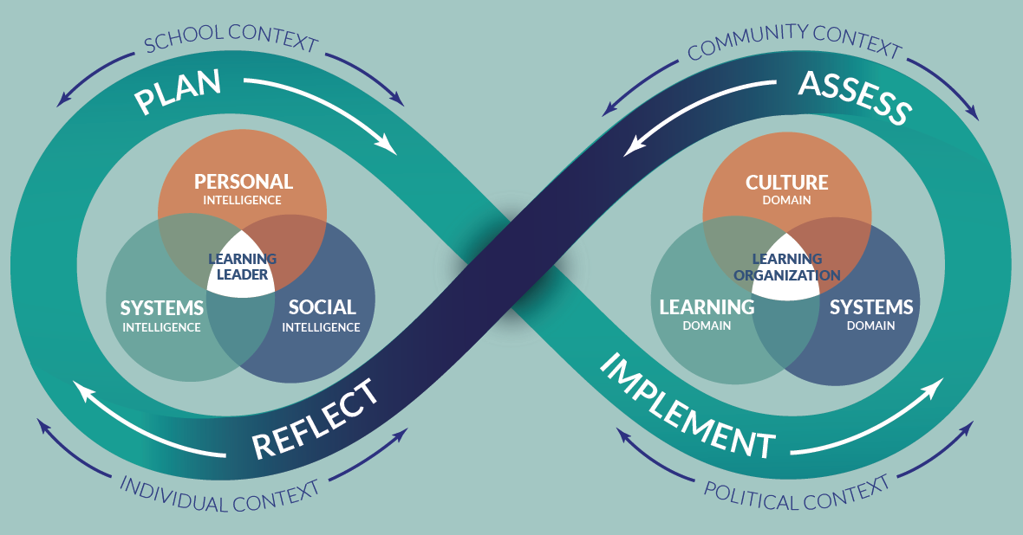
School Leader Paradigm
Notes:
Jenni

Slide 11
Collaborative Inquiry
Hearing about others’ inquiries makes you consider new ideas both for yourself and for your district.
Documenting your own learning (placemat) helps you understand what this process is like for others.
Relationships don’t need to come before the work begins; they can develop as you do the work.
Learning with an ‘outside’ critical friend can be an important part of the learning experience.
Katz, S. (2015). What Are We Learning About Supervisory Officer Learning?
Ontario Public Supervisory Officers Association

Slide 12
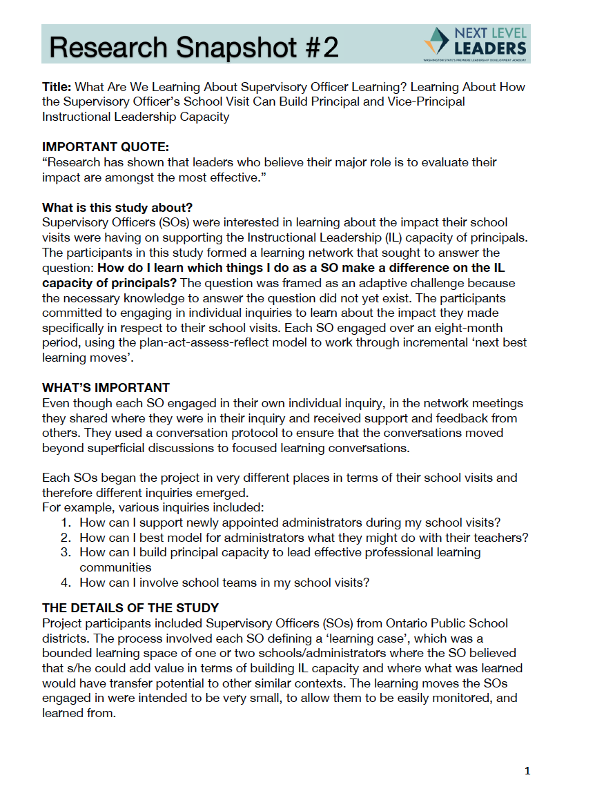
What Are We Learning?
As you read the article code the text:
I = Interesting to me
C = Connections to my experience
Q= Questions that come to mind
Katz, S. (2015). What Are We Learning About Supervisory Officer Learning?
Ontario Public Supervisory Officers Association

Slide 13
What Are We Learning?
In small groups discuss:
What did you find interesting?
What connections did you make to your own experience?
What questions came to mind?
Katz, S. (2015). What Are We Learning About Supervisory Officer Learning?
Ontario Public Supervisory Officers Association
Notes:
Random groups of 3 - 9 min.
5 min. whole group share

Slide 14
What Are We Learning?
How are the findings from this study’s Learning About the Process similar or different from what you’ve experienced as part of the Next Level Leaders Network?
What promising leadership practices resonate with you? Why?
How does the template for inquiry (Figure 1) help you in thinking about your leadership ‘moves’ and what you might learn FROM them and ABOUT them as you support teachers in improving teaching and learning?
How do you learn which things you do as a school leader make a difference on the instructional capacity of teachers?
Katz, S. (2015). What Are We Learning About Supervisory Officer Learning?
Ontario Public Supervisory Officers Association
Notes:
Same groups of 3 - 12 mins.

Slide 15
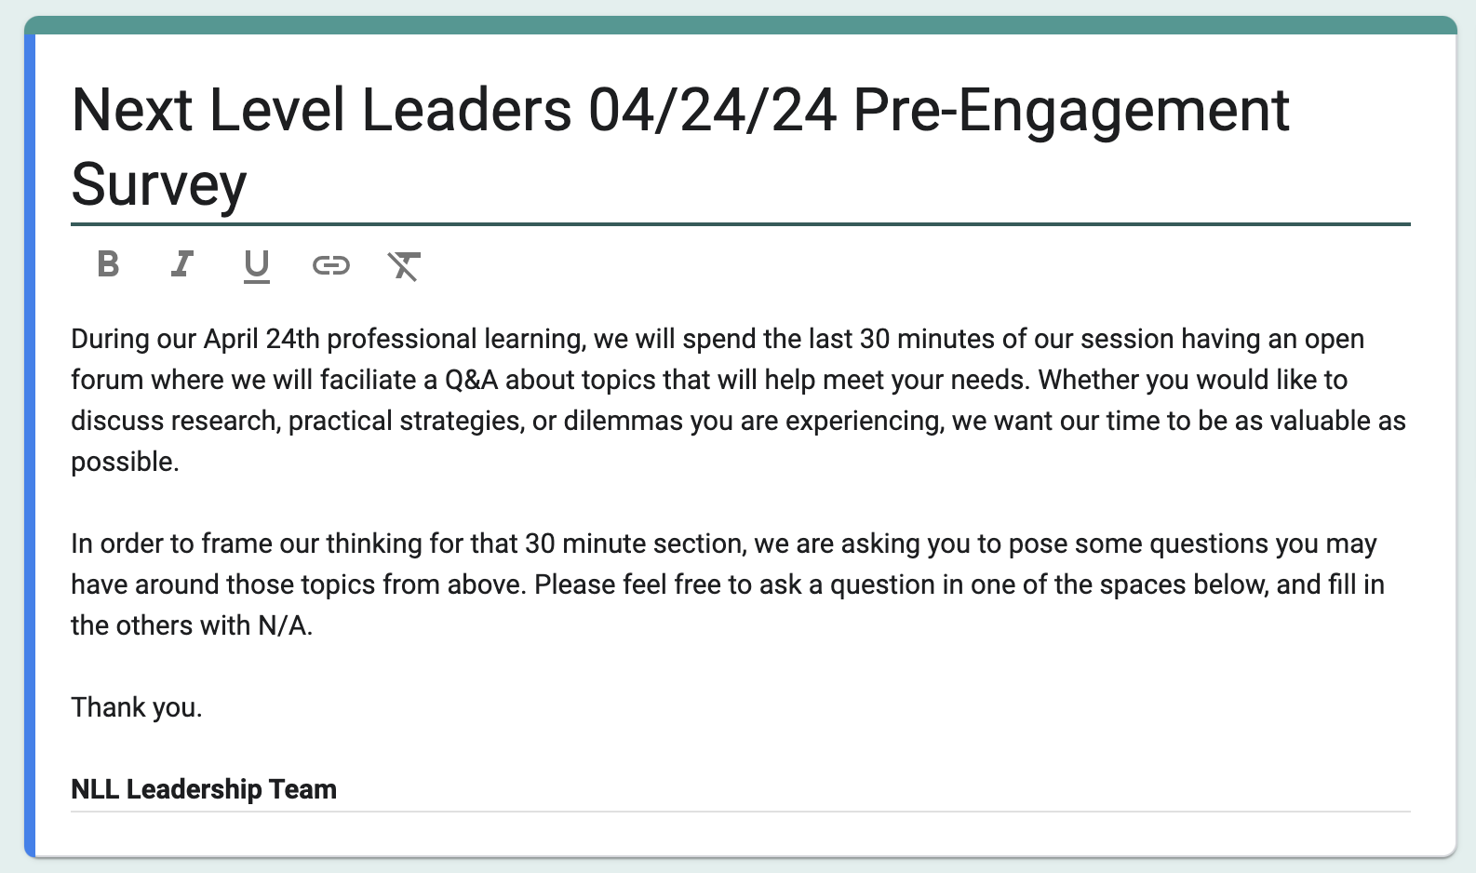
Q & A

Slide 16
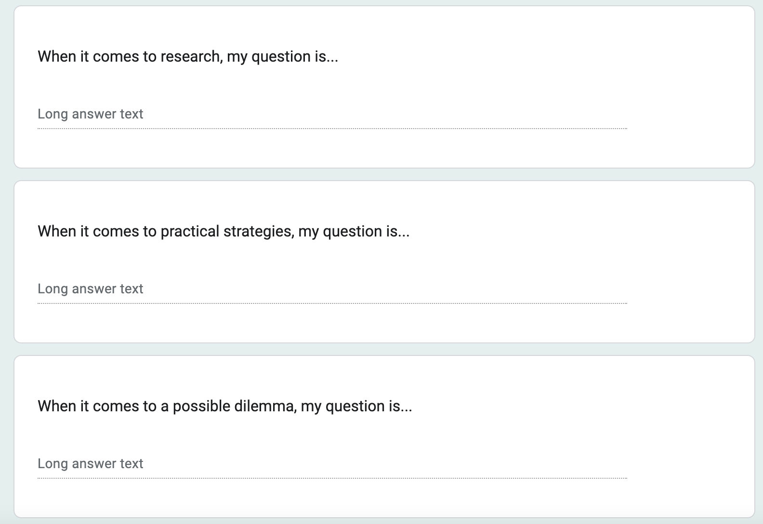
Q & A

Slide 17
Category | Questions
Research | 1. How to best find the time to be intentional and effective, yet well-informed? 2. What conditions best support teacher growth, our current reality, and where are we hitting/missing the mark? 3. Who is the researcher and how was it verified? 4. Best practice for improving attendance or supporting students with trauma? 5. How do we know what research is most relevant? 6. What are top needs of current leaders and how do we strengthen networking to have a sustainable leadership 7. How do you narrow the body of research to find what you are interested in with limited time? 8. What are some ways to empower students, colleagues, and families to support student growth? 9. Tier 1 strategies for new principals to focus on within their SIP?
Practical Strategy | 1. How best can I work my elementary staff into looking at things completely differently? 2. How do I spend my time effectively to improve instruction? 3. What systems or strategies do others use to stay in front or ahead of the work? 4. What strategies are you using to re engage families in the schools? 5. How do I have candid conversations with low-performance staff while maintaining honor? 6. Can we generate a bank of PD strategies for new central office leaders? 7. Managing needed change within tighter resources?
Dilemma | 1. How can I convince my staff that they need to work all day long, not just when students are in their classrooms? 2. Best way of transitioning work to a new principal after moving to another role? 3. How can we address attendance and apathy in a way that makes a difference? 4. How do I start over, training my staff on PLC work when they don’t want to attend? 5. Working with Fundamentalist Teachers who want to maintain the status quo. 6. How do I support the person taking over my building and support my current staff through the transition? 7. Building instructional leadership capacity of central office. 8. How to staff for student achievement and improvement with limited staffing?

Slide 18
Theme | Description
Time Management and Prioritization | Questions show a need for managing time effectively and prioritizing tasks amidst a busy schedule. Leaders are seeking strategies to efficiently allocate time to research, strategic planning, and daily responsibilities to maximize their effectiveness in leadership roles.
Professional Development and Empowerment | There is a focus on enhancing professional development for educators and empowering school communities. This includes building leadership skills, fostering student and staff ownership of educational processes, and implementing impactful professional development strategies.
Engagement and Relationship Building | Leaders are interested in improving engagement with families, staff, and other stakeholders. They seek methods to strengthen community ties, enhance communication, and create collaborative environments that support educational goals.
Resource Management and Strategic Implementation | With constraints in funding and resources, questions center on utilizing existing resources most effectively and strategically implementing changes to achieve educational outcomes. Leaders are looking for guidance on navigating these challenges to support student achievement and school improvement.

Slide 19
Questioning is a uniquely powerful tool for unlocking value in organizations: It spurs learning and the exchange of ideas, it fuels innovation and performance improvement, it builds rapport and trust among team members. And it can mitigate business risk by uncovering unforeseen pitfalls and hazards.
Wood-Brooks, A; John, Leslie, K. The Surprising Power of Questions. Harvard Business Review.

Slide 20
Question - Storming?
“Question-storming”—brainstorming for questions rather than answers—is now a creativity technique.
Arnaud Chevallier, Frédéric Dalsace, and Jean-Louis Barsoux
The Art of Asking Smarter Questions. Harvard Business Review.

Slide 21
Success Criteria
By the end of this session, we will be able to:
identify ways that collaborative inquiry can be a powerful design for professional learning.
identify our next steps in our inquiry process.

Slide 22
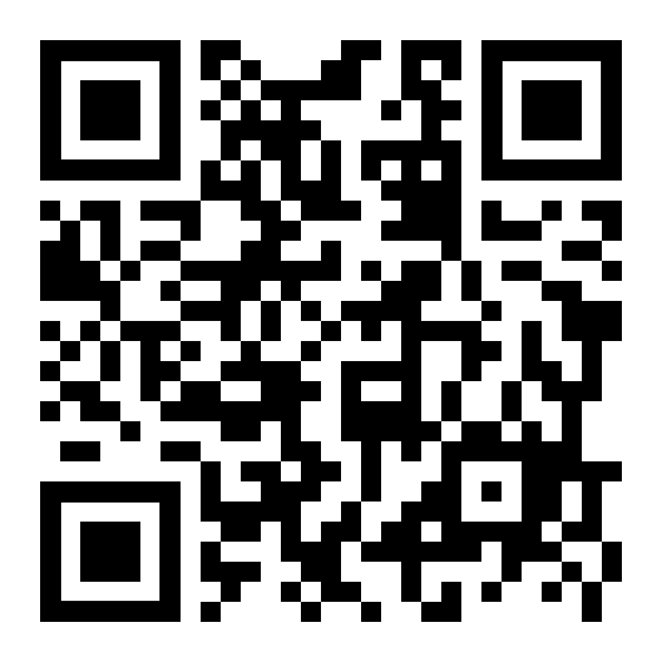
Feedback

Slide 23
Until Next time…..and additional opportunities

Slide 24
NEXT LEVEL LEADERS June MEETING
GRAND HOTEL, SPOKANE
JUNE 21, 2024 (arrive June 20)

Slide 25
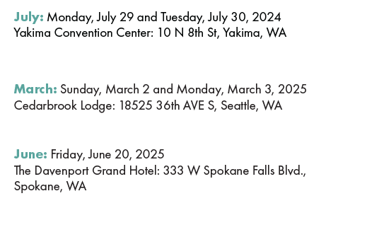
SAVE THE DATE!
2024-2025
Professional Learning
Schedule

Slide 26
REGISTRATION IS OPEN!
wasa-oly.org/Summer24

Slide 27
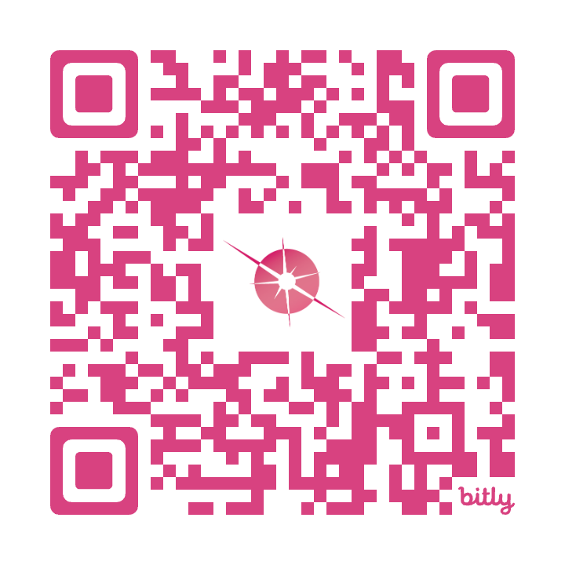
1:1 Leadership Coaching Offer
Personalized Leadership Coach
Six (3) x 60-minute sessions and a leadership assessment!
Your schedule, your context
No additional costs!
To secure your spot sign up using the QR code or email
Alyssa.Gallagher@btsspark.org

Slide 28
Register today at www.awsp.org/LSL

Slide 29
REGISTER NOW @AWSP.OG
Register today at www.awsp.org/BEL

Slide 30
Notes:
Lunch

Slide 33
STUDENT ENGAGEMENT. STUDENT EMPOWERMENT. STUDENT VOICE.

