Slide 1
Snakes & Ladders in Servitization Using a Game to Capture Inhibitors and Enablers of Transformation
JIM EUCHNER & DR DAN ANDREWS
The Advanced Services Group
Aston Business School
www.advancedservicesgroup.co.uk
Notes:
The first question to address is “What are advanced services, and why should I care about them?
The answer is profitability. Manufacturing firms across industries are becoming commoditized. The window of exclusivity on a new product innovation can be fleeting. Overseas competitors are getting better.

Slide 2
Advanced Services Partnership
Foster cross-industry learning about advanced services
Identify alternative paths to advanced services
Understand the organizational change requirements
Address the common challenges
Understand the value and appropriate use of emerging technologies
© Aston Business School 2018

Slide 3
What are Advanced Services?
Service-led competitive strategy
Emphasis is on the value of the product in use rather than the sale of product itself
Services are designed to leverage products: products are designed to improve the effectiveness of services
Product
Service
© Aston Business School 2018

Slide 4
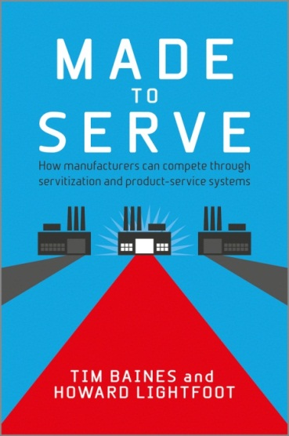
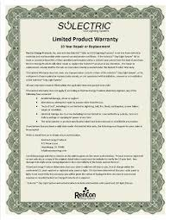
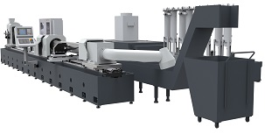
Types of Services
Services Supporting Customers
Spare parts
Warranty
Product provision
BASE SERVICES
OUTCOME FOCUSED ON PRODUCT PROVISION
Services Supporting Products
© Aston Business School 2017

Slide 5
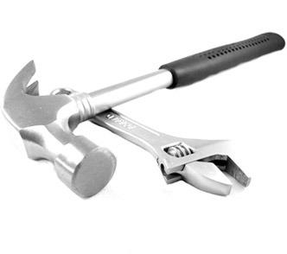
Types of Services
Services Supporting Customers
Helpdesk
Repairs
Maintenance Overhauls
Training
INTERMEDIATE SERVICES
OUTCOME FOCUSED ON PRODUCT CONDITION
BASE SERVICES
OUTCOME FOCUSED ON PRODUCT PROVISION
Services Supporting Products
© Aston Business School 2017

Slide 6
Types of Services
Services Supporting Customers
OUTCOME FOCUSED ON PRODUCT CAPABILITY
ADVANCED
SERVICES
INTERMEDIATE SERVICES
OUTCOME FOCUSED ON PRODUCT CONDITION
BASE SERVICES
OUTCOME FOCUSED ON PRODUCT PROVISION
Services Supporting Products
© Aston Business School 2017

Slide 7
Why Advanced Services?
Customer Benefits
Improved operations (uptime)
Lower total cost of ownership
Reduced administrative and monitoring tasks
Pay more directly for use/benefit
Peace of mind
© Aston Business School 2017

Slide 8
Why Advanced Services?
Supplier/Manufacturer
Differentiation beyond product
Value-based pricing
Participation in a larger portion of the customer’s value stream
Customer retention for related products
© Aston Business School 2017

Slide 9
Transformation Journey

Slide 10
Benchmarking
Advanced Services
Hoyer Logistics
Alstom Rail
MAN Truck
Eurocoptor
Rolls Royce
Caterpillar
Goodyear
© Aston Business School 2018

Slide 11
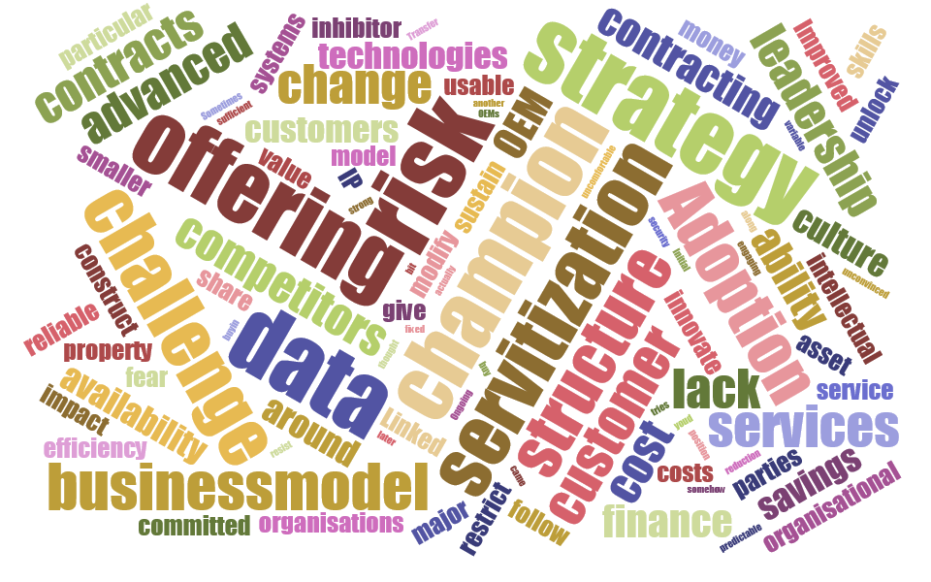
VISUALIZING the journey
to Advanced Services
© Aston Business School 2018

Slide 12
The Path to Advanced Services
Four Phases
EXPLORATION
TRACTION
ACCELERATION
EXPLOITATION
o
BUILDING AWARENESS & PERSONAL COMMITMENT
BUILDING EXPERIENCE & CONSENSUS
BUILDING SCALE
BUILDING DOMINANCE
© Aston Business School 2018

Slide 13
Strategy-Led
Strategic decision at CEO level
Innovation Driven
Customer-Centered Innovation
Business Model Innovation
Customer Pull
Customer’s preferred way of doing business
Technology Push
Driven by possibilities of new technology (IoT, machine learning, cloud)

Slide 14
Poll
Where is your company in the move to advanced services?
Not a priority right now
Exploration
Traction – active initiative
Acceleration – in market
Exploitation – a corporate strategy
© Aston Business School 2018

Slide 15
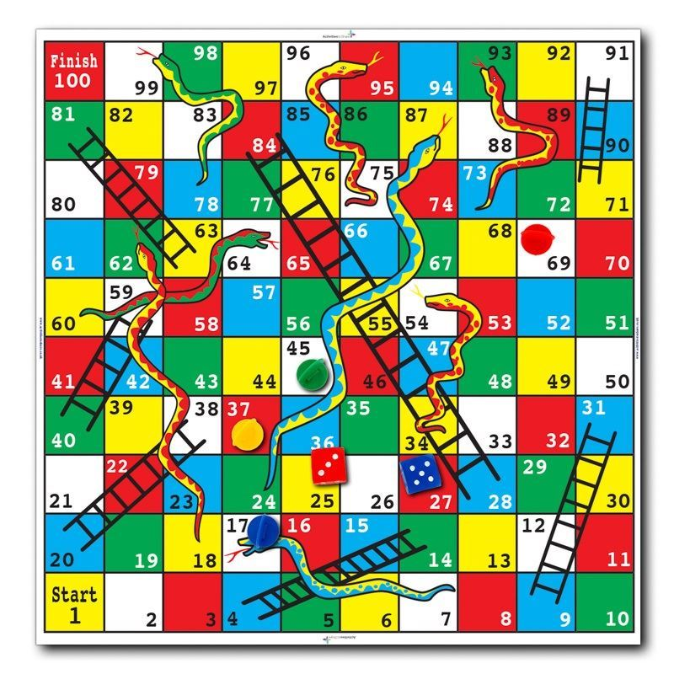
Snakes and Ladders
“It’s more like a game of snakes and ladders”
Reflects non-linear transformation processes
Obtains insight into the barriers and enablers associated with non-linear processes
© Aston Business School 2018

Slide 16
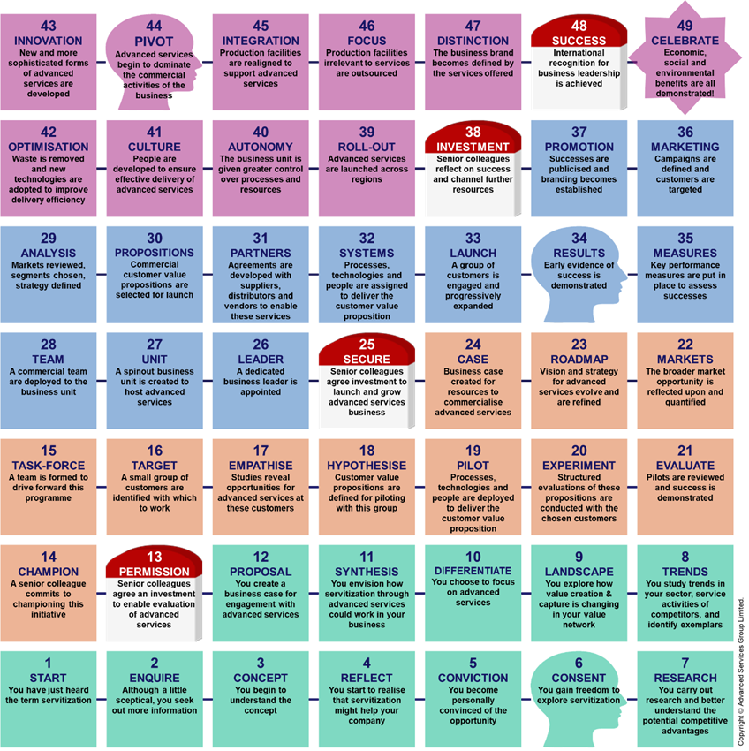
© Aston Business School 2018

Slide 17
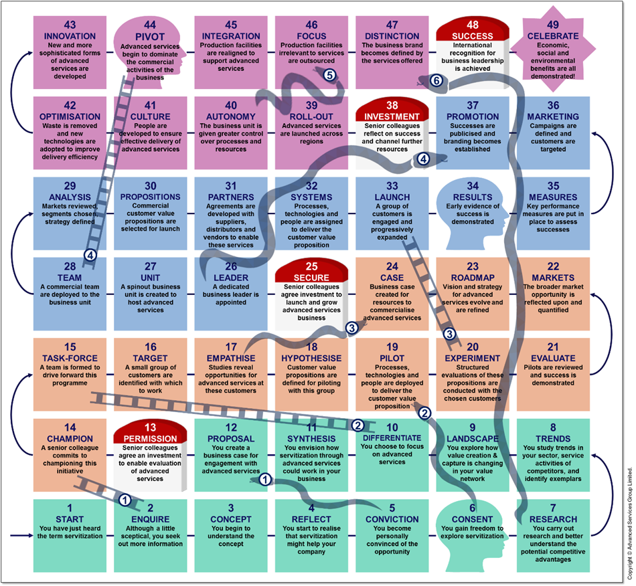
Snakes and Ladders
© Aston Business School 2018

Slide 18
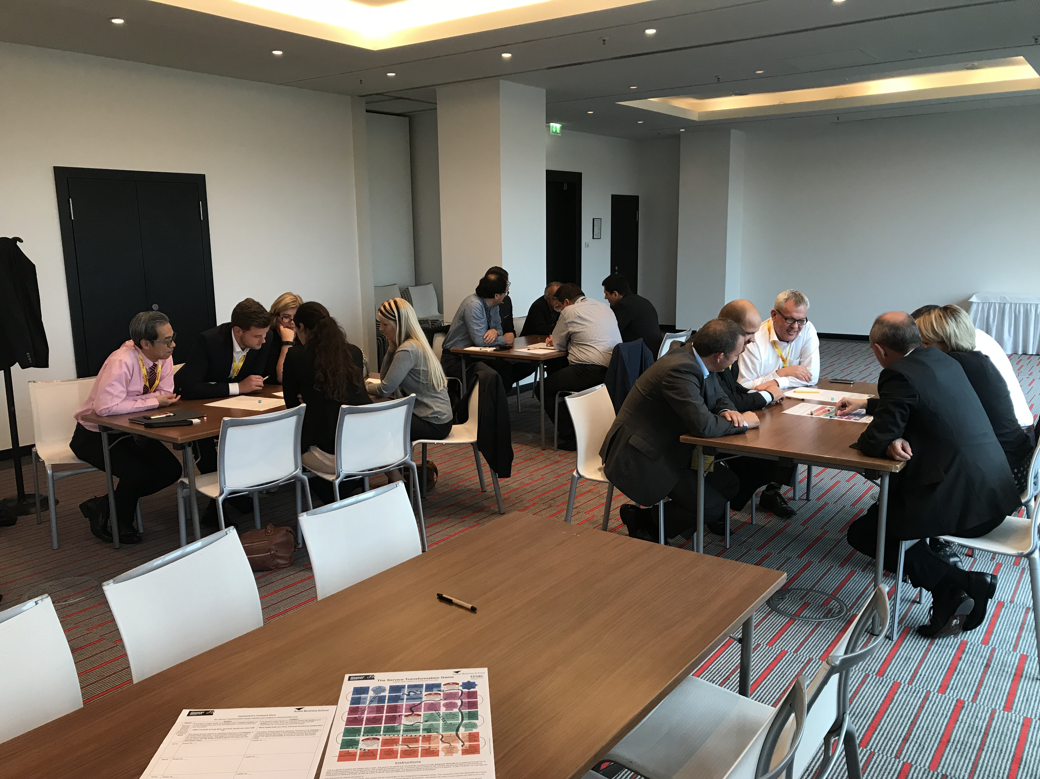
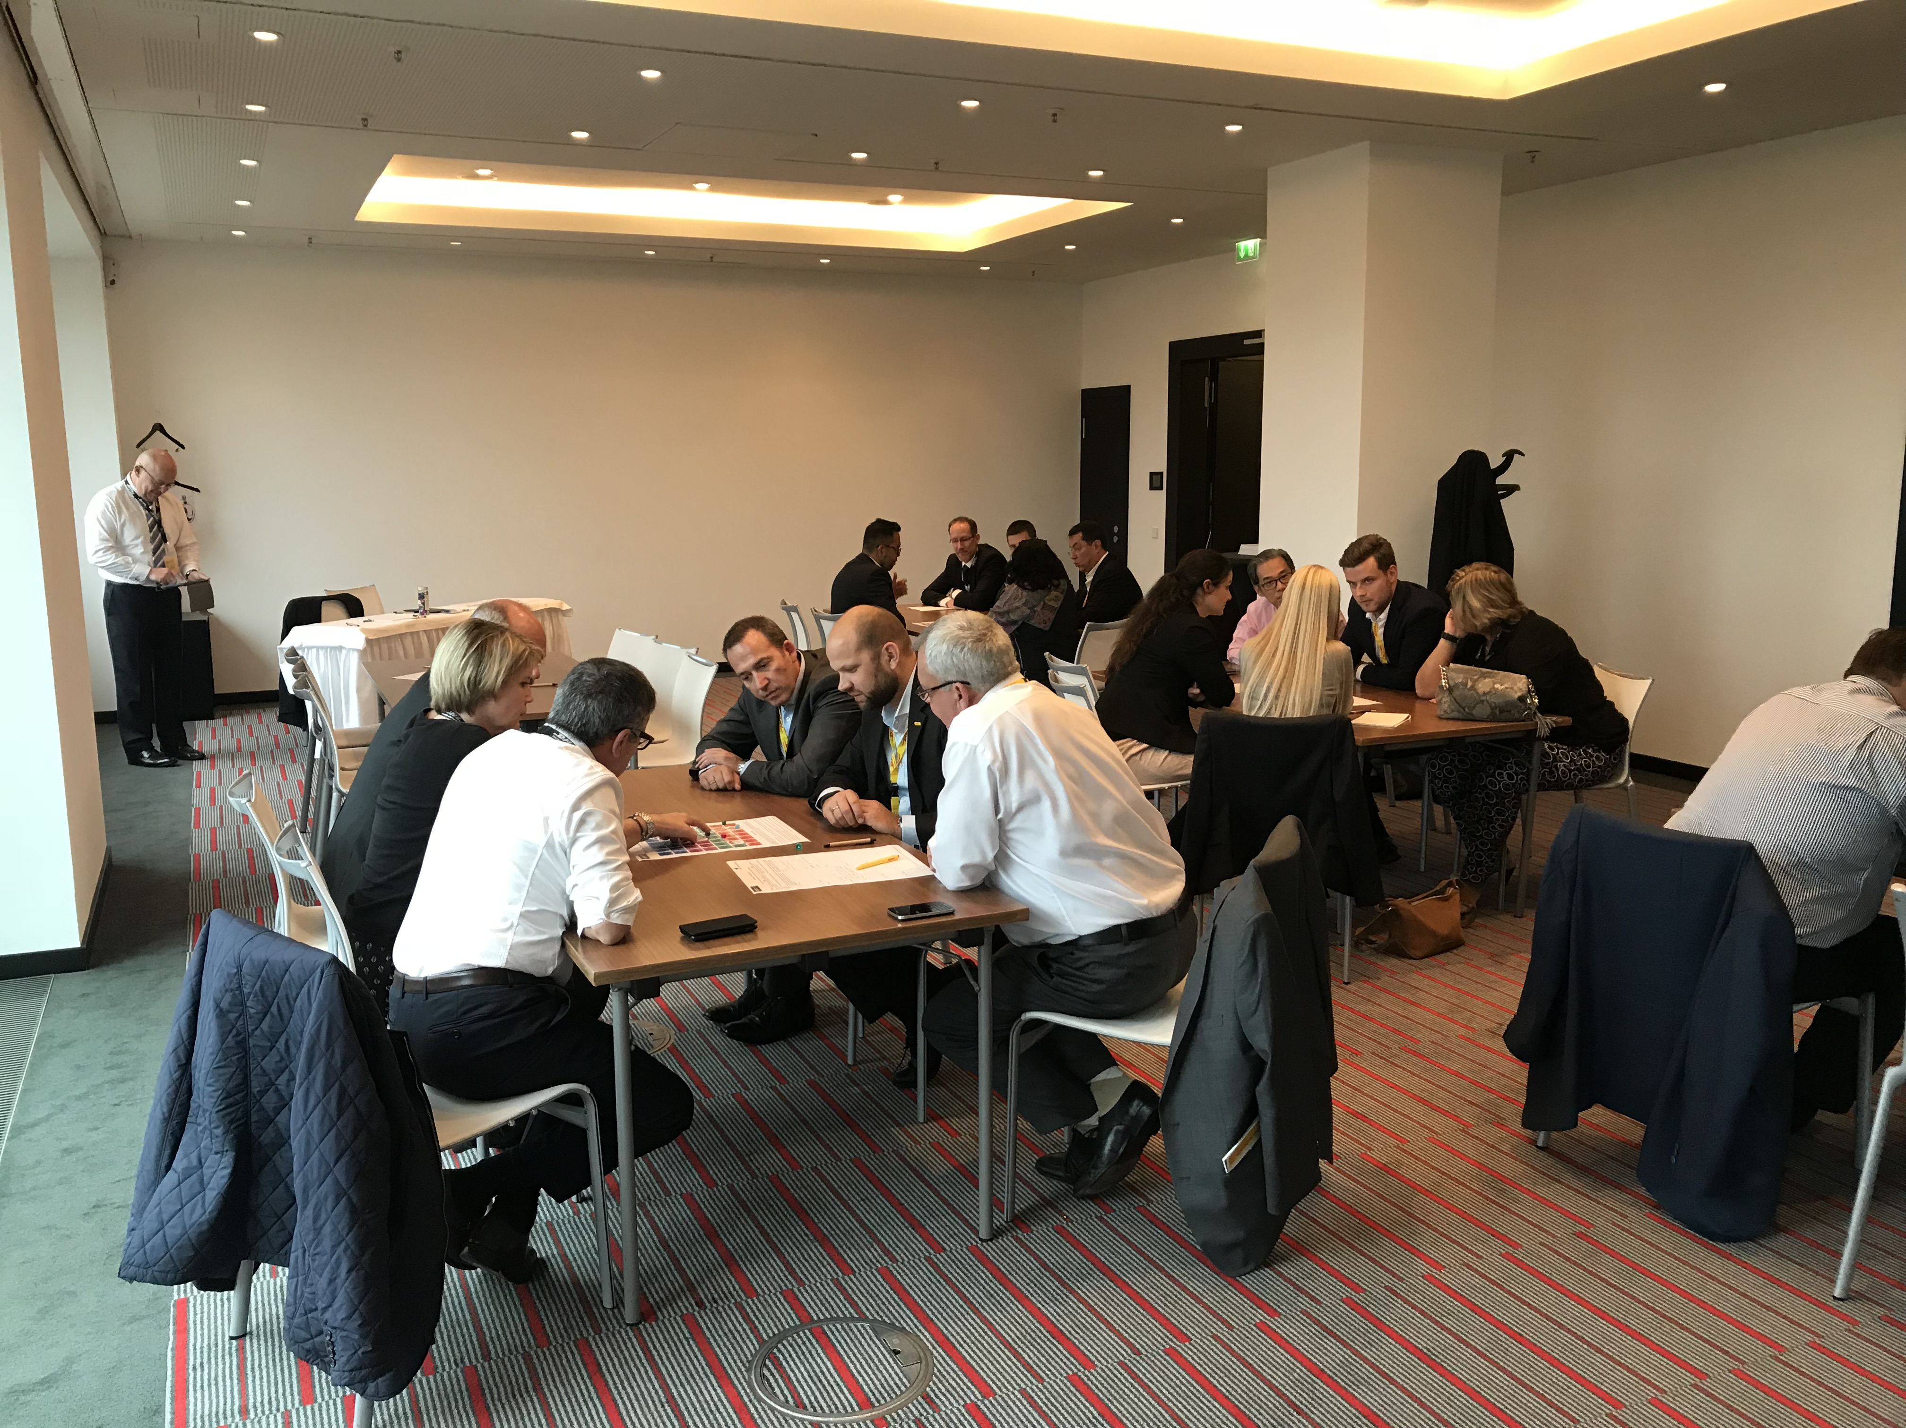
© Aston Business School 2018

Slide 19
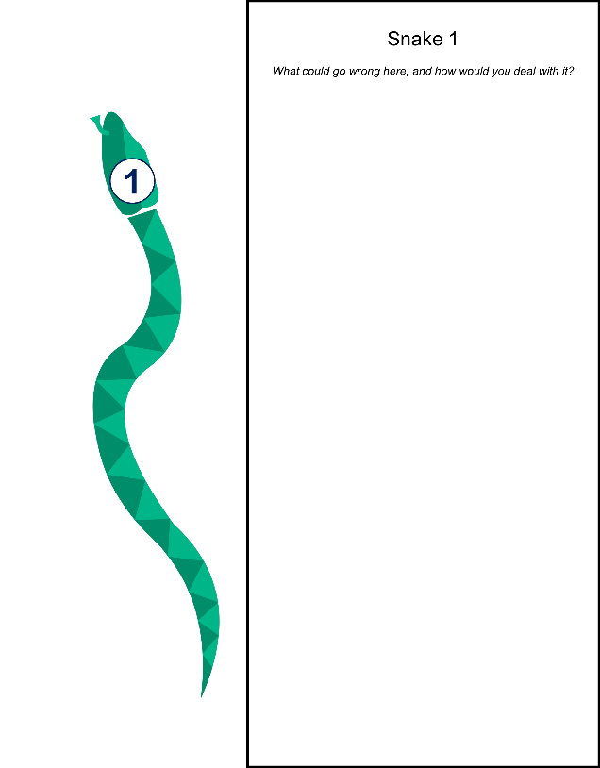
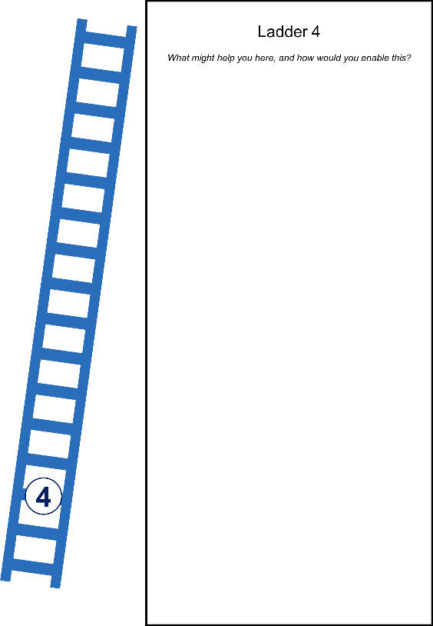
© Aston Business School 2018

Slide 20
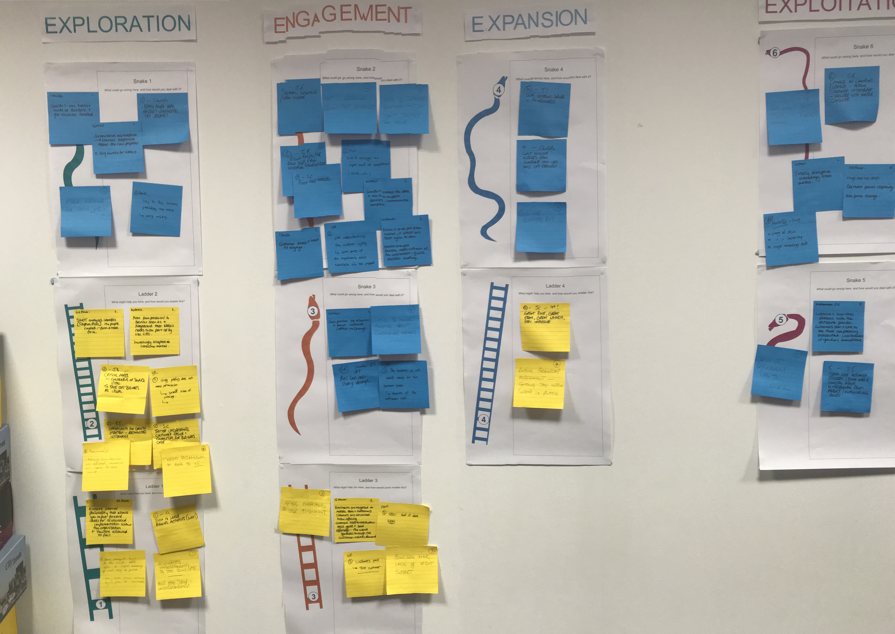
© Aston Business School 2018

Slide 21
Findings - Exploration
Culture of the firm and/or the customer
Leadership
Management
Power
Politics
Market acceptance
Stakeholder buy-in
The day-to-day
Technology to entice customers
© Aston Business School 2018

Slide 22
Findings - Engagement
Pilots – preparation and evaluation
Convincing internal & external stakeholders
Evidence for business cases
Cost / maturity of available technology
© Aston Business School 2018

Slide 23
Findings - Expansion
Tied to success of Engagement
Successful pilot – good team – good launch
Resources
Promotion
Skillsets
Organizational structure
© Aston Business School 2018

Slide 24
Findings - Exploitation
Organizational culture – transforming to delivery of services rather than products
Maintaining internal and external stakeholder engagement
Shifting skills
Shifting mindsets
© Aston Business School 2018

Slide 25
Poll
What would be the key issues in your organization when pursuing advanced services?
Your organization’s culture
Your customer’s culture
The marketplace
Technology
Something else
© Aston Business School 2018

