Slide 1
Public Water System Supervision Program Quality Assurance Project Plan
Gary Regner
PWSS Program QA Manager
Gary.Regner@tceq.texas.gov
512-239-4528
Jessica Hoch
Drinking Water Assessment Team Lead
Jessica.Hoch@tceq.texas.gov
512-239-2353

Slide 2
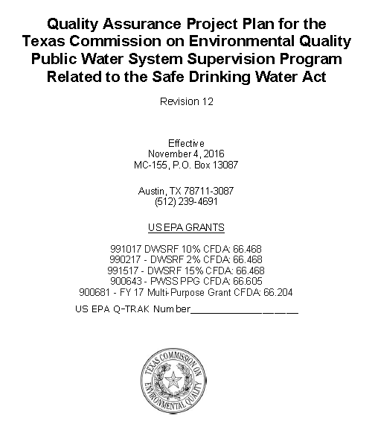
Quality Assurance Project Plan
Quality Assurance and Quality Control processes related to environmental data collection activities
Includes 10 addenda addressing program-specific QA and QC
Revised every 3 years with annual updates
Last revision 11/4/2016
1st Annual update in 2017
EPA approval
12/20/2017
2nd Annual update in 2018

Slide 3
Quality Assurance Project Plan
Addendum 1 – Sampling, Analysis, and Reporting of Chemical Compliance Data
Applies to Chemical Compliance laboratories and sample collection contractor only
Addendum 2 – Laboratory Guidance for the Analysis and Reporting of Tap Water Samples under the Lead and Copper Rule
Applies to labs analyzing Pb/Cu tap samples

Slide 4
Quality Assurance Project Plan
Addendum 3 – Laboratory Guidance for the Analysis and Reporting of Water Quality Parameters Under the Lead and Copper Rule
Applies to labs analyzing WQP samples
Addendum 4 – Laboratory Guidance for Analysis and Reporting Under the Revised Total Coliform Rule
Applies to labs analyzing microbial samples under the RTCR

Slide 5
Quality Assurance Project Plan
Addendum 5 – Comprehensive Compliance Investigations
Applies to data collection and management resulting from region conducted CCIs
Addendum 6 – Source Water Susceptibility Assessments
Applies to source water data collection and management

Slide 6
Quality Assurance Project Plan
Addendum 7 – Review and Approval of Public Water System Engineering Plans
Applies to data collection and management related to PWS plans and specifications
Addendum 8 – Texas Optimization Program Evaluations
Applies to data collection and management from TCEQ performance evaluations (CPE/SPE)

Slide 7
Quality Assurance Project Plan
Addendum 9 – Acquisition of Treatment Technique and Disinfectant Residual Data
Applies to data collection and management related to treatment techniques and disinfectant residual monitoring
Addendum 10 – Special Investigation QAPP Template
Template for TCEQ special investigations that involve sample collection and analysis

Slide 8
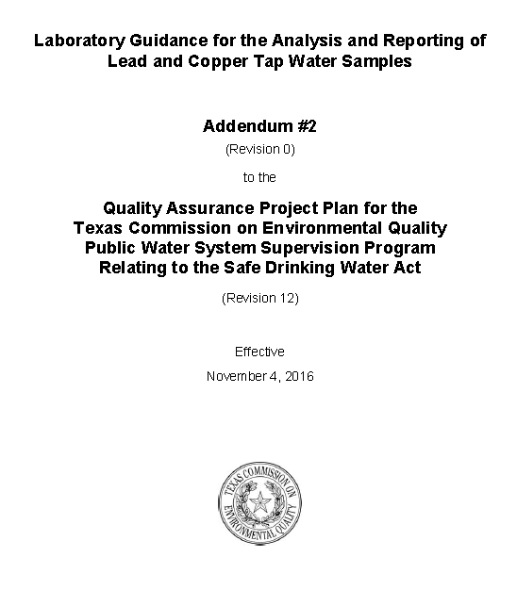
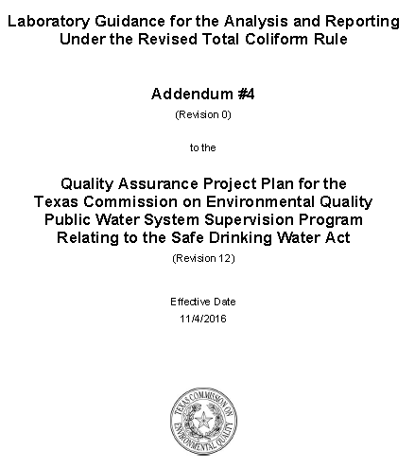
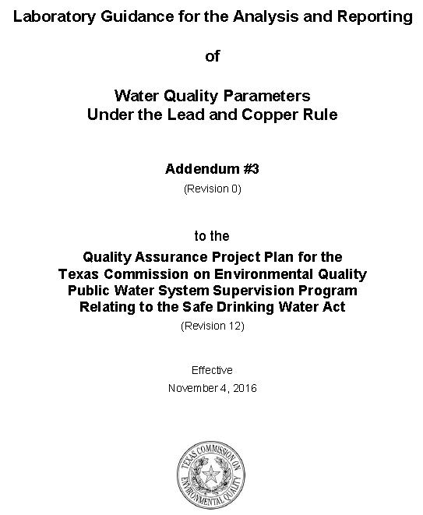
2017 Annual Updates Addenda Revised
Addendum 3—Guidance for the Analysis and Reporting of Water Quality Parameters under the Lead and Copper Rule
Addendum 2—Guidance for the Analysis and Reporting of Lead and Copper under the Lead and Copper Rule
Addendum 4—Guidance for Analysis and Reporting under the Revised Total Coliform Rules
Notes:
All three guidance documents primarily address laboratory requirements for sample receipt, analysis, and reporting. Requirements are program specific and reflect rules and regulations specific to the drinking water program. Laboratories need to be aware there situations in which drinking water rules and regulations applying to laboratories which are more stringent than the TNI Standards. I think most laboratories understand this, but there we received a few questions related to this issue. For example, the TNI specifies the sample label must have a unique identifier only. Appendix A, Figure A-1 of the Certification Manual for Laboratories analyzing Drinking Water has requirements for sample labels which include the sample location, date and time of sample collection, etc… This is more stringent than what the TNI Standard requires, which is why we included it.

Slide 9
Revisions to Addendum 2 Laboratory Guidance for Analysis and Reporting of Lead and Copper Tap Water Samples
Minor non-substantive revisions made by the TCEQ
Approval page reflects WSD reorganization in Fall 2016
Revised LCR Chain of Custody Form 20683

Slide 10
Revisions to Addendum 3 Laboratory Guidance for Analysis and Reporting of Water Quality Parameters under the LCR
Most substantive revisions (of the 3) made to this document
Approval page reflects WSD reorganization in Fall 2016
Requires laboratories to analyze all parameters included in the 30 TAC rule update effective March 30, 2017
Alkalinity, conductivity, calcium, chloride, hardness, iron, manganese, pH, sodium, sulfate, temperature, total dissolved solids, and orthophosphate or silica, depending on the inhibitor

Slide 11
Revisions to Addendum 3 (continued)
Requires laboratory approval (or accreditation) for original parameters and laboratory accreditation only for additional parameters
Explains how to report results when single samples are analyzed by multiple laboratories
Requires initial receiving laboratory to report pH and temperatures as field results in the field measurement portion of the EDD

Slide 12
Revisions to Addendum 3 (continued)
Updates required information in the analytical test report
Provides an example template for an analytical test report.
Includes Chain of Custody Form 20679
References companion document–Public Water System Guidance for Monitoring and Collection of Water Quality Parameters

Slide 13
Revisions to Addendum 4 Laboratory Guidance for Analysis and Reporting Under the Revised Total Coliform Rule
Approval page reflects WSD reorganization in Fall 2016
Most significant changes reflect changes to the Sample Receipt section
Addresses problems encountered when sample results are received
Additional revisions reflect issues that laboratories brought to the attention of TCEQ accreditation staff

Slide 14
2018 Annual Updates Addenda under current Revision
Addendum 1 – Sampling, Analysis, and Reporting of Chemical Compliance Data
Includes revisions to the Drinking Water Sampling Guide (DWSG)
Applies to TCEQ Chemical Compliance Laboratories and Sample Collection Contractor
Revisions in final draft until Drinking Water Compliance Sampling Services Contract is awarded
Notes:
All three guidance documents primarily address laboratory requirements for sample receipt, analysis, and reporting. Requirements are program specific and reflect rules and regulations specific to the drinking water program. Laboratories need to be aware there situations in which drinking water rules and regulations applying to laboratories which are more stringent than the TNI Standards. I think most laboratories understand this, but there we received a few questions related to this issue. For example, the TNI specifies the sample label must have a unique identifier only. Appendix A, Figure A-1 of the Certification Manual for Laboratories analyzing Drinking Water has requirements for sample labels which include the sample location, date and time of sample collection, etc… This is more stringent than what the TNI Standard requires, which is why we included it.

Slide 15
QAPP Overview
Laboratories are subject to requirements under:
TNI (Lab Accreditation)
EPA’s Manual for the Certification of Laboratories Analyzing Drinking Water (MCLADW), 5th Ed.
State and Federal regulations (TAC, CFR)
In some cases PWSS requirements may be stricter than TNI
The TCEQ (WSD) reserves the right to not use for compliance analytical data that does not meet program requirements

Slide 16
QAPP Addendum #2
Guidance for the Analysis and Reporting of Tap Water Samples under the Lead and Copper Rule (LCR)
Applies to PWSs and labs submitting data for compliance under the LCR (tap samples)
Samples from public water systems
Includes regulatory and program requirements
Current Revision 1, effective 12/20/2017

Slide 17
QAPP Addendum #2
Samples must be analyzed by a laboratory that is accredited in the drinking water matrix using a method acceptable to EPA
Samples must be collected in 1 L lab grade plastic bottles with a fill line
Acid preservation should be done in the lab
No later than 14 days after collection

Slide 18
QAPP Addendum #2
PWSs must use the LCR Monitoring Form (LCRMF)
Form #20683
Customized/modified forms must be approved by TCEQ
Samples must be collected from the water system’s sample site pool
Samples must be labeled properly
LCRMF must be completed properly

Slide 19
QAPP Addendum #2
Analysis
Laboratory must meet EPA MRLs
Lead – less than or equal to 0.005 mg/L
Copper – less than or equal to 0.050 mg/L
MRL verification
LFB at the laboratory’s MRL
Run with every preparation batch
Do not report results below the MRL
The PWSSP does not allow J flagged data

Slide 20
QAPP Addendum #2
Reporting
Electronic data submittal highly encouraged
Labs should be submitting data weekly
DO NOT hold all data to submit until after the end of the compliance period
Paper reports
Completed LCRMF
Laboratory Chain of Custody (if applicable)
Analytical test reports including QC

Slide 21
QAPP Addendum #3
Guidance for the Analysis and Reporting of Water Quality Parameters (WQP) under the Lead and Copper Rule
Applies to PWSs and labs submitting data for compliance under the LCR (water quality parameters)
Samples from public water systems
Includes regulatory and program requirements
Current Revision 1, effective 12/20/2017
Includes TAC rule revision requirements effective 3/30/2017

Slide 22
QAPP Addendum #3
Samples must be analyzed by a laboratory that is accredited in the drinking water matrix using a method acceptable to EPA OR approved by the Water Supply Division (WSD)
Approved by WSD: temperature, pH, alkalinity, calcium, conductivity, ortho phosphate, silica
Accredited by TCEQ: chloride, hardness, iron, manganese, sodium, sulfate, TDS
QAPP only lists EPA allowed methods for which TCEQ offers accreditation

Slide 23
QAPP Addendum #3
Samples must be collected in lab grade plastic bottles
Volume should be sufficient to conduct all required analyses
Acid preservation should be done in the lab
No later than 14 days after collection
Some analytes require thermal preservation
Alkalinity, conductivity, sulfate, TDS, ortho phosphate

Slide 24
QAPP Addendum #3
Field measurements
pH and temperature must be measured and recorded in the field
EPA allowed methods must be utilized
Entity performing field measurements must complete and submit a laboratory approval form to the WSD

Slide 25
QAPP Addendum #3
PWSs must use the Water Quality Parameter Monitoring Form (WQPMF)
Form #20679
Customized/modified forms must be approved by TCEQ
Samples must be labeled properly
WQPMF must be completed properly

Slide 26
QAPP Addendum #3
Reporting
Electronic data submittal highly encouraged
Labs should be submitting data weekly
DO NOT hold all data to submit until after the end of the compliance period
Paper reports
Completed WQPMF
Laboratory Chain of Custody (if applicable)
Analytical test reports including QC

Slide 27
QAPP Addendum #3
Subcontracting/Pass-through
Samples analyzed by multiple laboratories
Initial (receiving) laboratory reports field measurements
Results are reported by the lab that performed the analysis

Slide 28
QAPP Addendum #4
Guidance for Analysis and Reporting Under the Revised Total Coliform Rule (RTCR)
Applies to labs submitting data for compliance under RTCR
Samples from public water systems
Includes regulatory and program requirements
Current Revision 1, effective 12/20/2017

Slide 29
QAPP Addendum #4
Licensing Requirements
Samples for community and non-transient non-community water systems MUST be collected by an individual with a valid water operators license
Not required for transient systems
Field Measurements
All samples must have a field measured chlorine residual
DO NOT analyze, reject. Residual must not be filled in at the lab

Slide 30
QAPP Addendum #4
Samples must be analyzed by a laboratory that is accredited in the drinking water matrix using a method acceptable to EPA
Pg. 15, Table 1 lists EPA allowed drinking water methods
Total coliform / E. coli
Absence / Presence

Slide 31
QAPP Addendum #4
Sample Containers
Containers should be laboratory-supplied
Batch tested for sterility if lab sterilized
Tested for dechlorinating agent effectiveness
Checked for accuracy of 100 mL mark
Lot specific certificate of analysis required if containers obtained from a vendor

Slide 32
QAPP Addendum #4
Sample Labels
Adhesive or written directly on bottle
Must include:
PWS ID number
Date & Time of sample collection
Sampler’s initials
Address/location of collection

Slide 33
QAPP Addendum #4
Microbial Reporting Form (MRF)
Use of unaltered form is mandatory if NOT submitting data electronically (E2)
Modified forms may be used after TCEQ approval only if lab submits data electronically
Form must capture:
Sampler signature
Lab chlorine check
Legal statement

Slide 34
QAPP Addendum #4
Sample Temperature
Document temperature at time of receipt
Recorded and corrected temperature
Temperature measuring devices must be calibrated periodically
Chlorine Residual Lab Check
Absence of a chlorine residual must be verified for every sample

Slide 35
QAPP Addendum #4
Sample Rejection
Insufficient/Incorrect documentation
Corrections must be made by sampler, not the lab
Field chlorine residuals must be measured and recorded in the field
Sample Issues
Broken in transit, exceeds hold time, frozen, leaked, etc.
Lab measured chlorine residual
Invalid results (turbid, too numerous to count, etc.)

Slide 36
QAPP Addendum #4
Sample Rejection
Notify PWS immediately
Record notification on MRF
PWS must recollect within 24 hours of notice
Report rejected samples to TCEQ
Ties back recollection to original
Important in avoiding possible monitoring violations

Slide 37
QAPP Addendum #4
Data submission
Labs should be submitting data weekly
Electronically through STEERS/E2 preferred
DO NOT hold all data to submit until after the end of the compliance period
Microbial Reporting Form
Labs should all now be using the new form or have implemented new requirements on customized forms
Current version – 08/2017
Instructions for PWSs and laboratories available online

Slide 38
QAPP Addendum #4
Reporting Positive Samples
Positive Result Report Form
Email or Fax
Current version – 08/2017
Report on same day to TCEQ and PWS
PWS must collect repeats

Slide 39
QAPP Addendum #4
Sample Invalidation Requests
PWS must complete and submit Total Coliform Positive Invalidation Request Form to TCEQ along with supporting documentation
Current version – 10/24/2017
Requests are assessed by the PWSSP QA Manager and approved by WSD management
E. coli positive samples are not eligible for invalidation

Slide 40
QAPP Overview
Labs may not make corrections to PWS portion of any reporting form (LCRMF, WQPMF, MRF)
Corrections must be made by the sampler before relinquishment to lab
Only TCEQ can authorize changes after analysis and reporting
Evaluated on a case-by-case basis
See QAPP for specific conditions

Slide 41
QAPP Overview
Sample Receipt and Rejection
Errors or omissions on reporting forms
Improper bottle labeling
Invalid/missing dates or times
Missing PWS signature
Broken/leaking containers
Invalid containers
Insufficient volume
Exceeding hold time

Slide 42
QAPP Overview
Corrective Actions
Deviations from required protocols
May be initiated by the lab or TCEQ
Notify TCEQ of issue within 48 hours
Corrective action report due within 14 days
May require corrected data

Slide 43
QAPP Overview
Laboratory Record Retention
Easily accessible for five (5) years
Applies to analyses under the LCR and RTCR
Reports should be coded following TCEQ Central File Room requirements
See applicable QAPP for specifics

Slide 44
QAPP Overview
Falsification and Fraud
Falsification of the MRF or analytical results, or tampering with water samples used for compliance with the SDWA, is a crime punishable under state and/or federal law. [Texas Penal Code, Title 8, Chapter 37.10] By signing the MRF, the sample collector acknowledges that the water samples were collected according to the PWS’s established sample collection procedures, and that all information on the form is accurate. Evidence of falsification or fraud is turned over to the TCEQ Environmental Crimes Unit for investigation.

Slide 45
EPA CMDP
Compliance Monitoring Data Portal (CMDP)
Will enable PWSs and labs to report data electronically to TCEQ/EPA
Will replace E2
TCEQ working with EPA to ensure CROMEER and STEERS compatibility
Testing anticipated in FY2019
More information:
https://www.epa.gov/ground-water-and-drinking-water/compliance-monitoring-data-portal

Slide 46
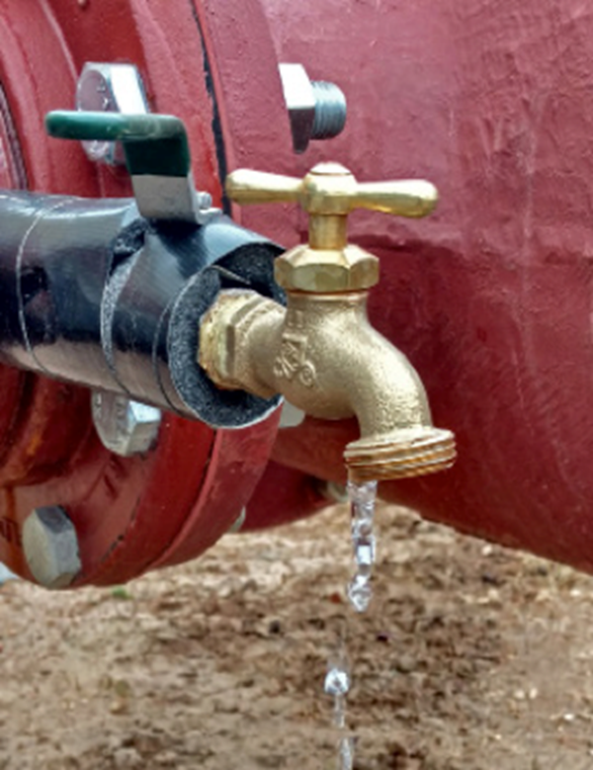
Questions?
Gary Regner
PWSS Program QA Manager
Gary.Regner@tceq.texas.gov
512/239-4528

