Slide 1
Ethics, NDT, and a Good Night’s Sleep
Phil Trach
Laboratory Testing, Inc.

Slide 2
It’s easy to do the right thing…

Slide 3
It’s easy to do the right thing…
…when there’s no other choice.

Slide 4
A clear conscience is a soft pillow.

Slide 5
A clear conscience is a soft pillow.

Slide 6
A clear conscience is a soft pillow.
Proverb from Africa, France, Germany, and maybe Confucius, Benjamin Franklin, and Amelia Earhart

Slide 7
A clear conscience is a soft pillow.
Cool 1970’s paneling, huh?

Slide 8
“I am wondering, why are you here?”
- Yoda, The Empire Strikes Back

Slide 9
Poll
Why am I attending this webinar?
I want to learn and share about ethics in NDT.
I want to know why Phil still has paneling in his bedroom. It’s not 1968.
I get a fraction of a Level III recertification point for attending.
I want to know if that’s really Phil’s teddy bear.

Slide 10
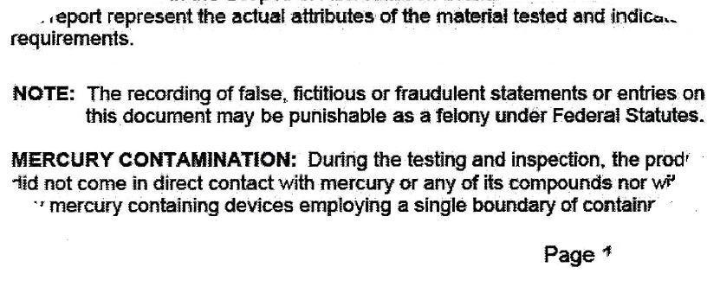
We know about this…

Slide 11
…and not to do this…

Slide 12
Why?
Where does this stuff come from?
Where does it go?
How do we get there?
How do we make “getting there” easier?

Slide 13
How?
# # #
# # #
# # #

Slide 14
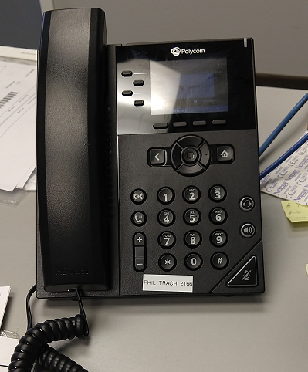
How?

Slide 15
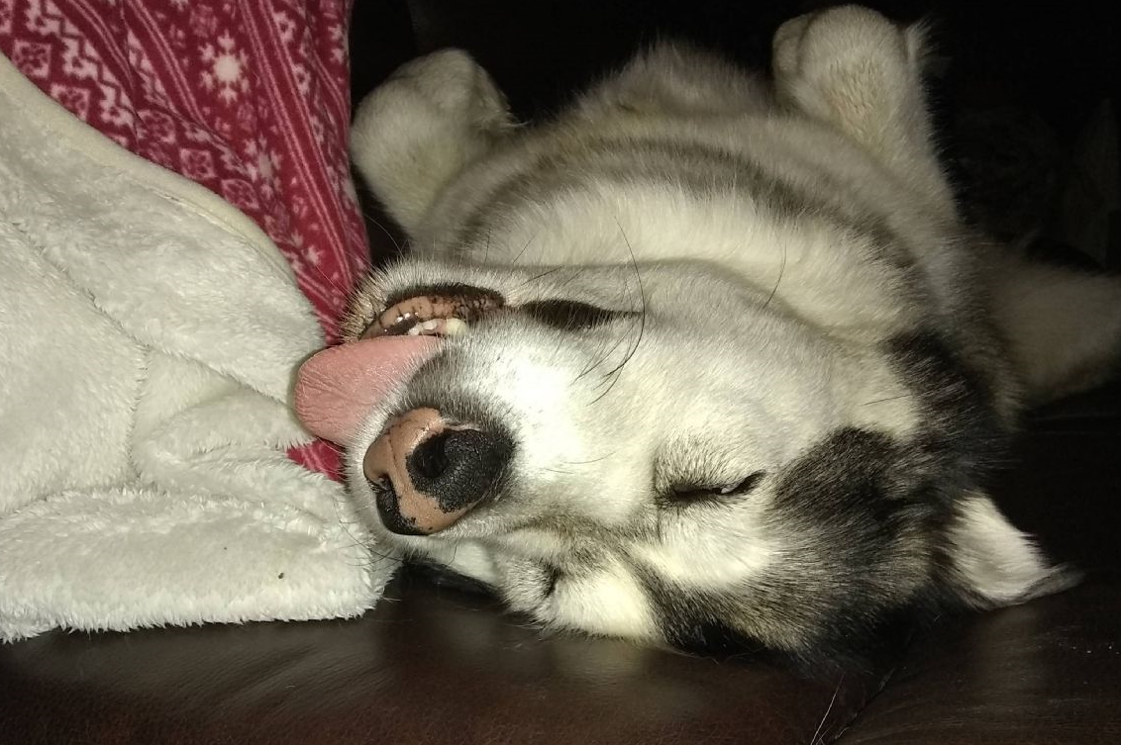
How?
(not my dog)

Slide 16
Sleepless in Seattle Philadelphia PWT 6/9/22
Poll: How many times have you lost sleep over an ethical NDT issue?
(This doesn’t count working late or getting up early because of a high workload)
Never
Once or twice
A few times
Often
What is this “sleep” thing?

Slide 17
Sleepless in Seattle Philadelphia PWT 6/9/22

Slide 18
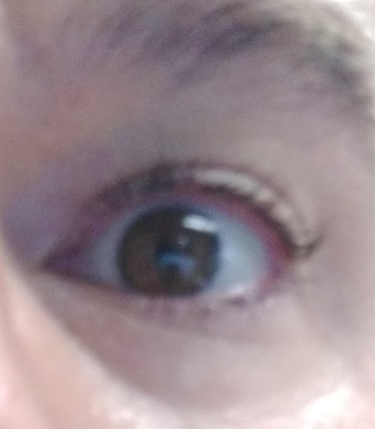
Sleepless in Seattle Philadelphia PWT 10/28/20

Slide 19
Sleepless in Seattle Philadelphia PWT 6/9/22
!

Slide 20
Sleepless in Seattle Philadelphia PWT 6/9/22
?

Slide 21
Sleepless in Seattle Philadelphia PWT 6/9/22
!

Slide 22
Sleepless in Seattle Philadelphia PWT 6/9/22
?

Slide 23
Sleepless in Seattle Philadelphia PWT 6/9/22
[God] wants men to be concerned with what they do; [the devil’s] business is to keep them thinking about what will happen to them.
C.S. Lewis, The Screwtape Letters

Slide 24
Sleepless in Seattle Philadelphia PWT 6/9/22
.

Slide 25
Sleepless in Seattle Philadelphia PWT 6/9/22
.

Slide 26
Sleepless in Seattle Philadelphia PWT 6/9/22
Pr(someone investigates) ≈ 0.001
Pr(it fails) ≈ 0.0001
Pr(it fails and someone investigates and I get fired) ≈ 0.0000001

Slide 27
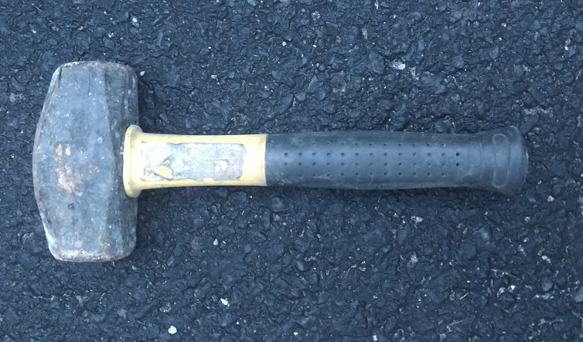
Sleepless in Seattle Philadelphia PWT 6/9/22

Slide 28
Sleepless in Seattle Philadelphia PWT 6/9/22
You sleep better when you
(and your people)
do the right thing.

Slide 29
It’s easy to do the right thing

Slide 30
It’s easy to do the right thing when there’s no other choice.

Slide 31
Starting points…

Slide 32
Starting points…
Collected by C.S. Lewis,
The Abolition of Man

Slide 33
Starting points…
Do the right thing always Deliver results
Honor commitments Walk in your customer's shoes
Practice transparency Make quality personal
Speak straight Practice blameless problem-solving
Treasure, protect, and promote our reputation
Get clear on expectations

Slide 34
All at once?
Do the right thing always Deliver results
Honor commitments Walk in your customer's shoes
Practice transparency Make quality personal
Speak straight Practice blameless problem-solving
Treasure, protect, and promote our reputation
Get clear on expectations
Both/And
instead of
Either/Or

Slide 35
Another poll…
Are we having fun yet?
Definitely, yes!
Yes, definitely!
I suppose, maybe, I guess…
I’m not here for fun. I hate fun.

Slide 36
For those of you who hate fun…

Slide 37
Get your coffee…
The ASNT Membership Code of Ethics.

Slide 38
Get your coffee…
The ASNT Membership Code of Ethics.
Woo. Hoo.

Slide 39
The ASNT Membership Code of Ethics
In spirit and in word, this Code of Ethics shall guide the actions of the members of The American Society for Nondestructive Testing.
It is the duty of all members to conduct themselves in accordance with the following precepts:

Slide 40
The ASNT Membership Code of Ethics
1. To uphold at all times the reputation of the Society and the dignity of membership therein.

Slide 41
The ASNT Membership Code of Ethics
2. To pursue their professional discipline and activities in a spirit of fairness to all concerned — employer, employees, customers and competitors — consistent with the high ideals of personal honor and integrity.

Slide 42
The ASNT Membership Code of Ethics
3. To refrain from associating themselves with any enterprise that would use their name or that of the Society in any manner countenancing misrepresentation.

Slide 43
The ASNT Membership Code of Ethics
4. To avoid damage directly or indirectly to the professional reputation, prospects or business of another member of the Society.

Slide 44
The ASNT Membership Code of Ethics
5. To advertise only in a professional manner; to avoid using improper or questionable methods of soliciting professional work, and to decline any connection with improper patronage.

Slide 45
The ASNT Membership Code of Ethics
6. To inform clients or employers of any business affiliations, interests or connections which might influence their fair judgment.

Slide 46
The ASNT Membership Code of Ethics
7. To treat as confidential their knowledge of any business affairs or technical information of employers, clients or customers, and to make no disclosure of such information without their express consent.

Slide 47
The ASNT Membership Code of Ethics
8. To accept financial or other compensation for a particular service from one source only, except with the full knowledge and consent of all interested parties.

Slide 48
The ASNT Membership Code of Ethics
9. To perform their work in the highest professional manner, protecting the life, safety and health of their associates and of the general public.

Slide 49
The ASNT Membership Code of Ethics
10. To contribute to the advancement of nondestructive testing by the interchange of information and experience with others, taking full advantage of the mediums provided by the Society--symposia, conventions and the press.

Slide 50
The ASNT Membership Code of Ethics
11. To encourage and provide opportunity for professional development and advancement of their employees or those under their supervision.

Slide 51
The ASNT Membership Code of Ethics
12. To consider their membership in the Society as affording a distinct opportunity to apply their special talents for the service of mankind.

Slide 52
The ASNT Membership Code of Ethics
13. To refrain from any statements or acts which constitute hostile or offensive behavior and any forms of intimidation or harassment of any kind by and between members of ASNT whether sexual, racial, ethnic or religious in origin.

Slide 53
Poll
Have you actually read this before today?
Yes.
I skimmed it once or twice.
I didn’t know there *was* a Membership Code of Ethics.
No.

Slide 54
The ASNT Membership Code of Ethics
“the reputation of the Society and the dignity of membership therein”
“avoid damage directly or indirectly to…another member”
“to perform their work in the highest professional manner”
“Creating a safer world!”
“apply their special talents for the service of mankind”

Slide 55
The ASNT Level III Code of Ethics

Slide 56
The ASNT Level III Code of Ethics

Slide 57
The ASNT Level III Code of Ethics

Slide 58
The ASNT Level III Code of Ethics
8.3. The Level III shall conduct themselves in an honest and ethical manner.

Slide 59
The ASNT Level III Code of Ethics

Slide 60
The ASNT Level III Code of Ethics
"…shall not…use their certification…in such a manner as to bring ASNT into disrepute.”

Slide 61
The ASNT Level III Code of Ethics
forthright candid complete integrity
immediately report
Protect the safety, health, and welfare of the public
refuse to accept only when qualified
completely objective conscientiously avoid conflict of interest

Slide 62
The ASNT Level III Code of Ethics
forthright candid complete integrity
immediately report
Protect the safety, health, and welfare of the public
refuse to accept only when qualified
completely objective conscientiously avoid conflict of interest
SHALL
SHALL NOT

Slide 63
The ASNT Level III Code of Ethics

Slide 64
The ASNT Level III Code of Ethics
5.3 The Level III shall show professional and appropriate behavior, including,
but not limited to, online and social media.

Slide 65
The ASNT Level III Code of Ethics

Slide 66
The ASNT Level III Code of Ethics

Slide 67
The ASNT Level III Code of Ethics

Slide 68
The ASNT Level III Code of Ethics
The internet is forever.

Slide 69
I have permission…
…from LTI’s president to post this:
…from me to break the Fundamental Rule of Powerpoint Slides…
Phil,
It’s okay to break a style rule once in a while.
Sincerely,
Phil

Slide 70
From our Quality Manual…

Slide 71
From our Quality Manual…

Slide 72
Yet another poll…
Do you have similar text in your Quality Manual?
A. Yes, I keep it on my desk for just this situation
B. I didn’t look it up just now, but I’m quite sure
C. I don’t know offhand, but something like it is probably there
D. I have no idea, no one reads those things anyway
E. What’s a Quality Manual?

Slide 73
From our Quality Manual…
Why have one?
I mean, other than that the industry requires it.

Slide 74
From our Quality Manual…
Traceability is part of ethics
4.2.iii.a

Slide 75
A more serious poll…
Which is these is the worst consequence you ever personally had from making a tough ethical call?
Job change (quit or dismissed)
Formal disciplinary action
Informal but real consequence (e.g. bad performance review)
Informal comment with no lasting consequences
None of these things have ever happened to me

Slide 76
Stating and asking the obvious…
An ounce of prevention is worth a pound of cure.
How do you *prevent* ethical breaches?
Honesty is the best policy.
How do you keep people honest,
especially in the face of some strong temptations?

Slide 77
Stating and asking the obvious…
How do you make it easy to do the right thing and hard to do the wrong thing?

Slide 78
What you might do…
How do you make it easy to do the right thing and hard to do the wrong thing?
(Stating the obvious)
Fraud and Falsification Statement and Penalty
Audits and Overchecks
Personal Examples
when the tough call has to be made
of when making the tough call doesn’t “hurt”

Slide 79
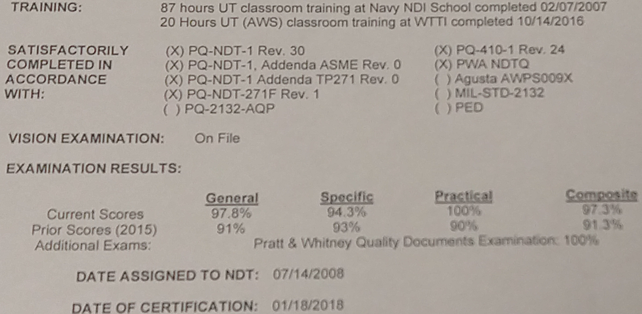
A personal example…

Slide 80
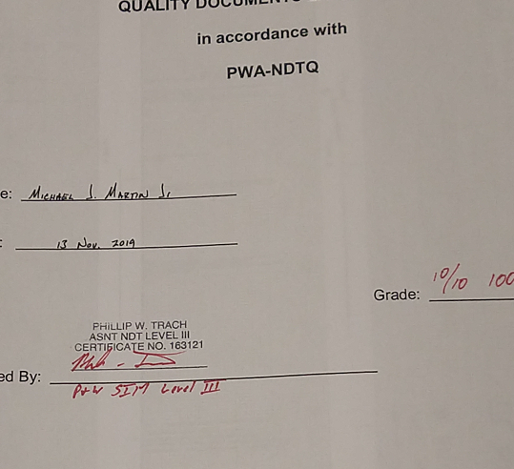
A personal example…

Slide 81
A personal example…

Slide 82
A personal example…
IF IT’S NOT DOCUMENTED,

Slide 83
A personal example…
IF IT’S NOT DOCUMENTED,
IT DIDN’T HAPPEN.

Slide 84
A personal example…
(But who’s gonna know?)

Slide 85
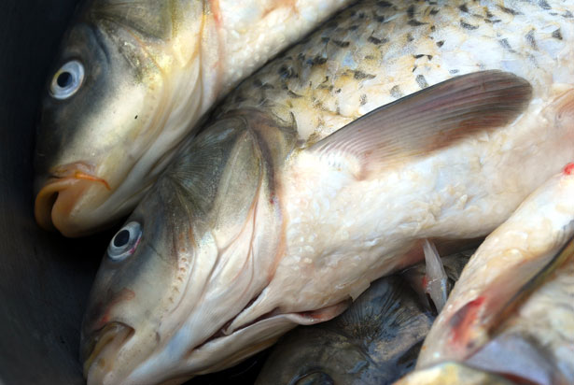
A personal example…

Slide 86
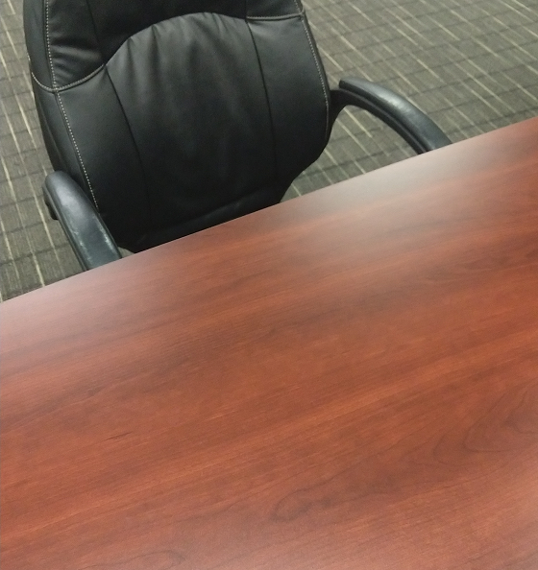
A personal example…

Slide 87
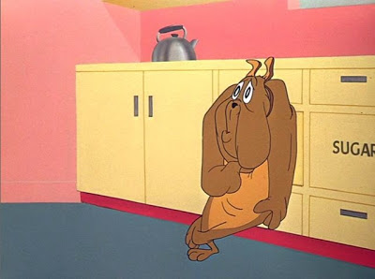
Some adjectives…
Trustworthy?
Above reproach?
No questions?

Slide 88
Illustrations…

Slide 89
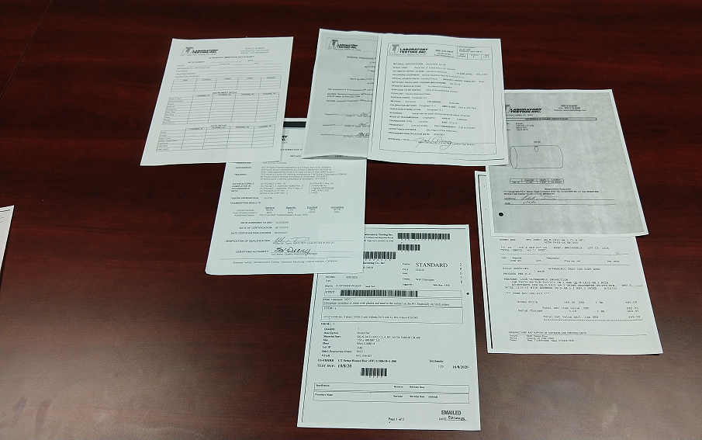
Illustrations…

Slide 90
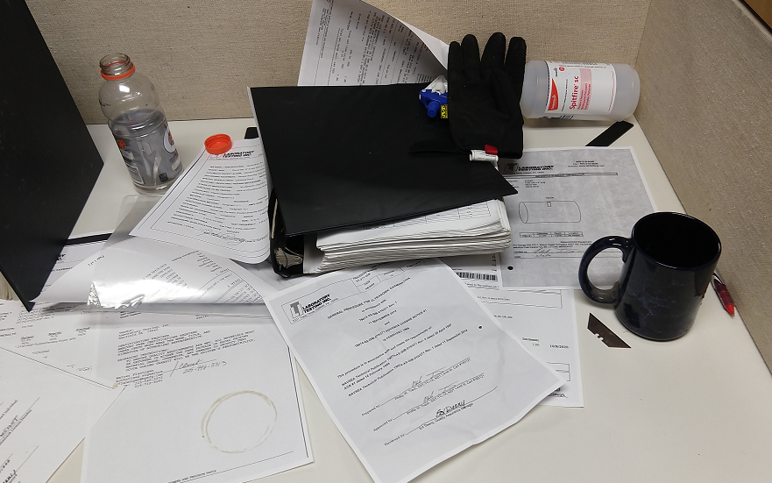
Illustrations…

Slide 91
And audits (ugh)…
Three rules…

Slide 92
And audits (ugh)…
Three rules…
Honest

Slide 93
And audits (ugh)…
Three rules…
Honest
Brief

Slide 94
And audits (ugh)…
Three rules…
Honest
Brief
“I don’t know.”

Slide 95
And audits (ugh)…
Two approaches…

Slide 96
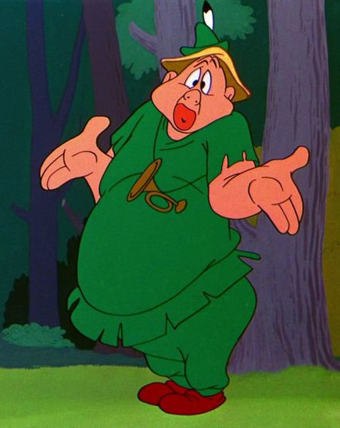
And audits (ugh)…
Two approaches…

Slide 97
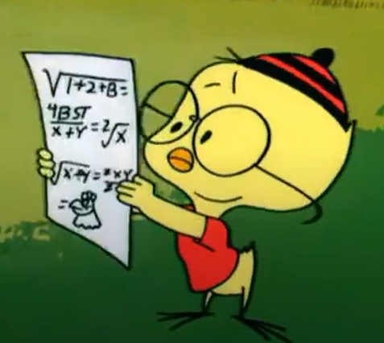
And audits (ugh)…
Two approaches…

Slide 98
Some suggestions I’ve gotten:
“…checklists, so nothing gets missed and you can see that someone at least claimed to follow it.”
“Make sure the purchasing documents are clear about requirements…”
“…approach auditing with a healthy sense of skepticism and distrust…”
“…not taking their word for it…”
“I have to review required processes and procedures and check them off.
Oversights are eliminated.”
“Overchecks with signoffs…”

Slide 99
Some things which work…
…and which might be worth thinking about and applying where you are….

Slide 100
Some things which work…
Time…

Slide 101
Some things which work…
Time…
Never time to do it right, but always time to do it over.

Slide 102
Some things which work…
Right equipment…

Slide 103
Some things which work…
Right equipment…
Any tool can be the right tool.
- Red Green

Slide 104
Some things which work…
Training…

Slide 105
Some things which work…
Training…
I hear, and I forget;
I see, and I remember;
I do, and I understand.
- (attributed to China)

Slide 106
Some things which work…
QA Systems…

Slide 107
Some things which work…
QA Systems…
Testing, calibration, and QA personnel shall have the authority, independence and organizational freedom to identify quality problems or risks, recommend solutions and control further processing of nonconformances until proper disposition has occurred.
- LTI QSPM Para 4.2.5

Slide 108
Some things which work…
Oversight…

Slide 109
Some things which work…
Oversight…
As Captain...I am responsible for the conduct of the crew under my command.
James T. Kirk, Star Trek VI: The Undiscovered Country

Slide 110
Some things which work…
Documentation…

Slide 111
Some things which work…
Documentation…
If it’s not documented, it didn’t happen.
- (various, used often in ASNT)

Slide 112
Some things which work…
Culture…

Slide 113
Some things which work…
Culture…
All anyone asks for is a chance to work with pride.
- W. Edwards Deming

Slide 114
Some things which work…
Continuous Improvement…

Slide 115
Some things which work…
Continuous Improvement…
If it ain’t broke, you haven’t played with it enough.
- (various, one of the author’s favorites)

Slide 116
Some things which work…
Pay Attention…

Slide 117
Some things which work…
Pay Attention…
In the fields of observation,
chance favors only the prepared mind.
- Louis Pasteur

Slide 118
It’s easy to do the right thing

Slide 119
It’s easy to do the right thing when there’s no other choice.

Slide 120
It’s easy to do the right thing when there’s no other choice. ptrach@labtesting.com

