Slide 1


Asia Pacific: ISMPP U
Bridging Perspectives: GPP2022 Implementation in APAC vs Other Geographies - Evidence-based Insights and Trends
December 4, 2024
Webinar will begin promptly at: ​
10:30 PM ET/ 9:00 AM IST
Notes:
Hello everyone; welcome and thank you for joining today’s ISMPP U, titled: Bridging Perspectives: GPP2022 Implementation in APAC vs Other Geographies - Evidence-based Insights and Trends
Please take a moment to capture a screenshot for CMPP credit. You will also be sent a certificate with credit attached after the webinar.

Slide 2






















ISMPP Would Like to Thank the following TITANIUM and PLATIMUM Corporate Sponsors for their ongoing support of the Society:
Notes:
First a sincere thank you to all of ISMPP’s titanium and platinum corporate sponsors for their ongoing support of the Society.

Slide 3

ISMPP Announcements
Application deadline for the March CMPP
exam is February 1
Notes:
And, for those who are seeking to become CMPP-certified or looking to renew your certification, the application deadline for the next exam window is 1 February 2025

Slide 4
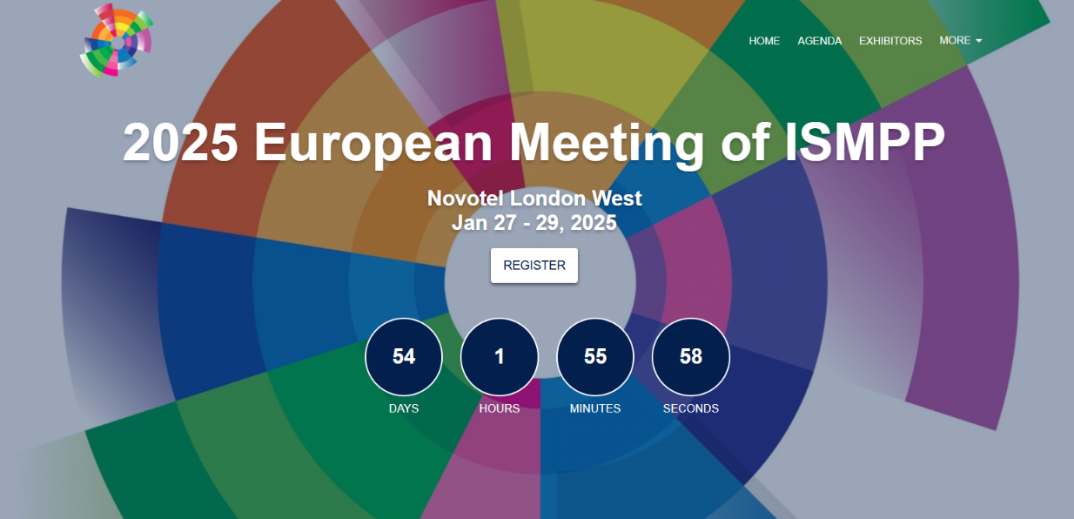

Slide 5
AGENDA
Introduction | Haruko Isomura | 5 min
GPP2022 survey results presentation & Audience Poll | Anupama Kapadia Raghuraj Puthige | 35 min
Q & A |  | 15 min
Closing Remarks |  | 5 min

Slide 6
How To Ask Questions
Feel free to ask a question at any time, however all questions will be held until the end the of the presentation.
To ask a question, open the Q&A window, type your question into the
Q&A box. Click Send
Note: Check Send Anonymously if you do not want your name attached
to your question in the Q&A
We will make every effort to respond to all questions live (out loud)
Notes:
You can submit a question at any time during the presentation by following the instructions on this slide.
The faculty will answer questions at the end of all the presentations.

Slide 7
Disclaimer
Information presented reflects the personal knowledge and opinions of the faculty and does not necessarily represent the position of their current or past employers
Notes:
Please take a moment to read our general disclaimer.

Slide 8
Objectives
By the end of the session, attendees will:
Understand how APAC regions differ in their approach to publication ethics and transparency
Understand regional differences in publication strategy following a patient-centric approach and how these differences affect effectiveness
Gaining insight into different approaches to authorship criteria and conflict-of-interest management
Understand how adoption and implementation of publication extenders vary across regions as well as how AI is being integrated into medical publications across the world
Notes:
Listed here are the learning objectives for today’s webinar. (please read them aloud or summarize if you feel comfortable)

Slide 9
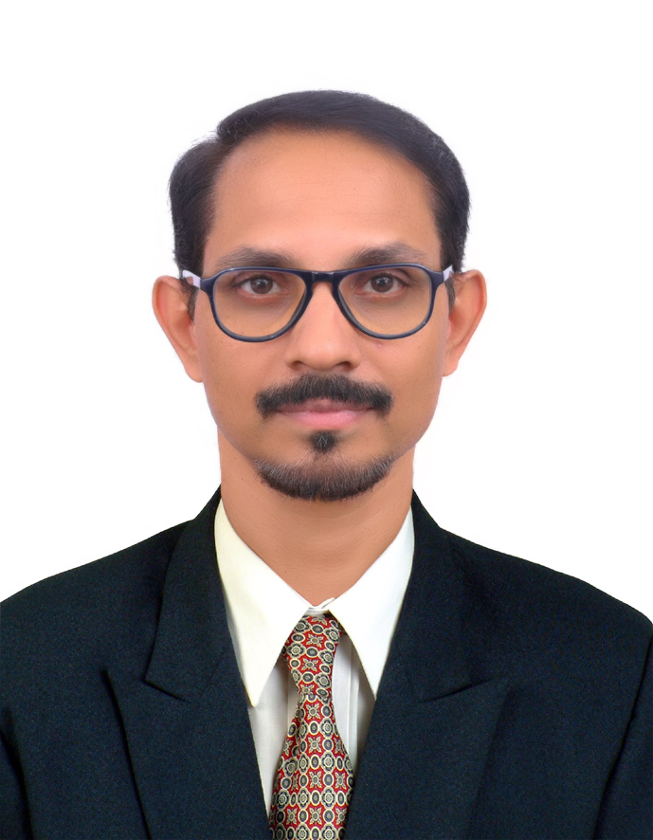
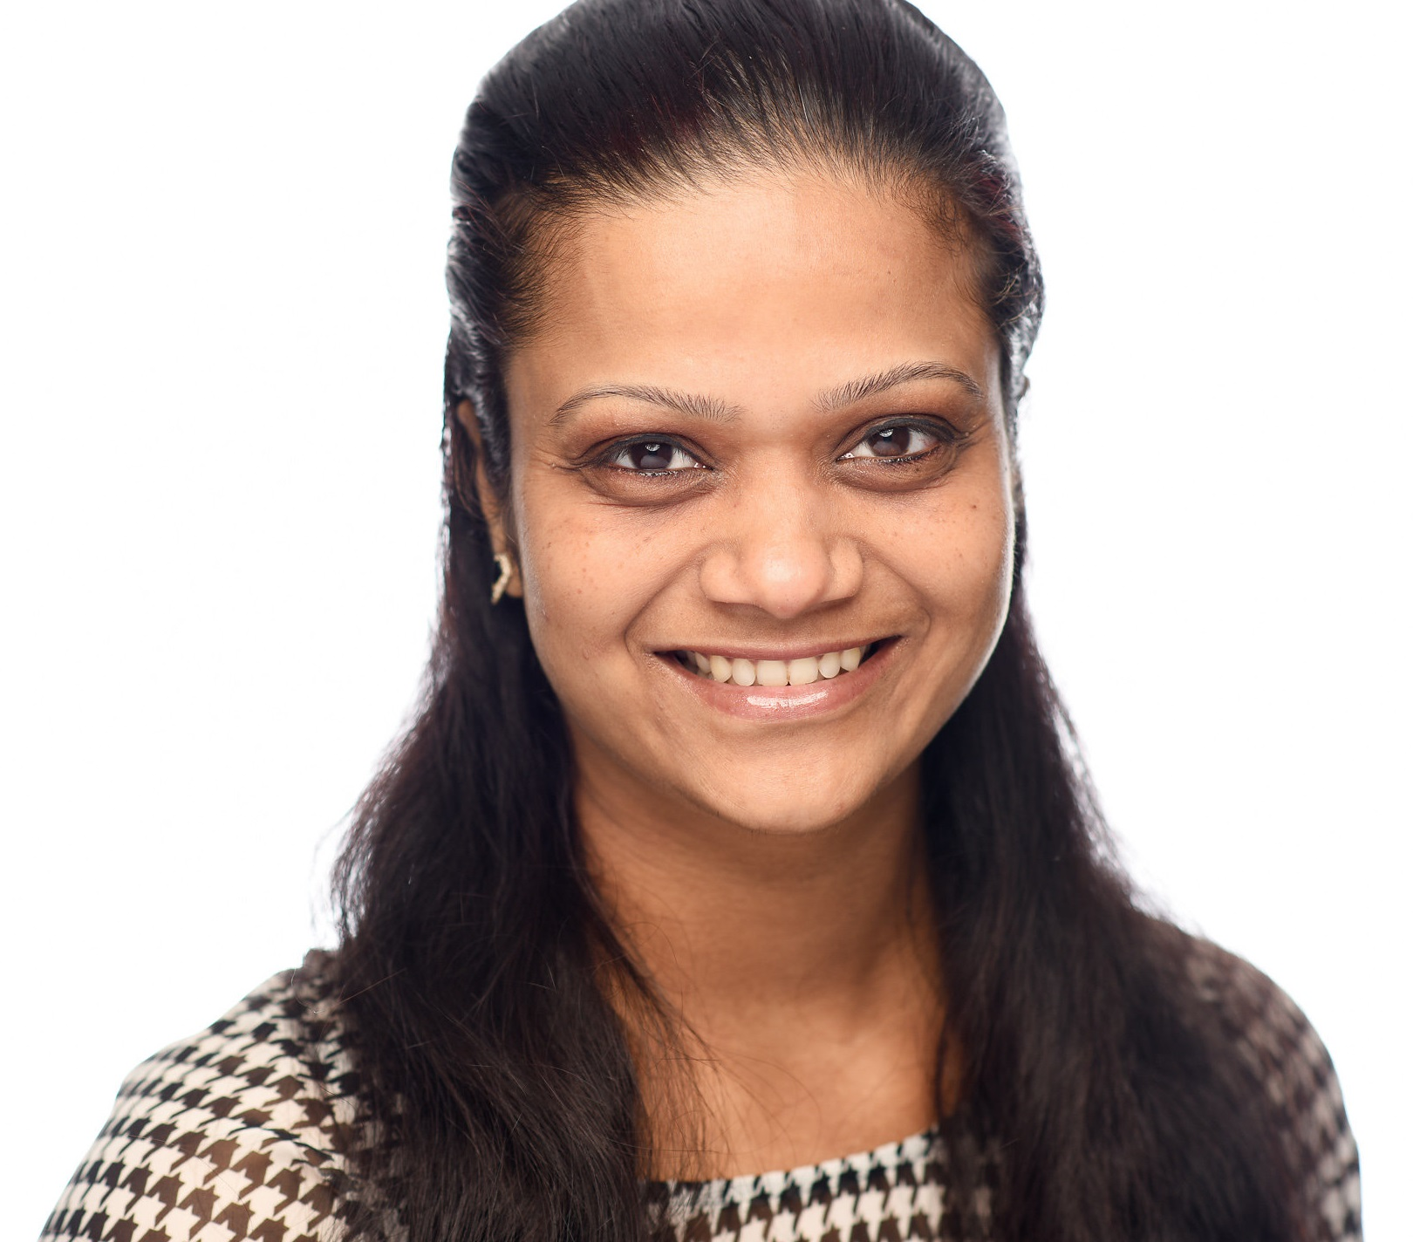

Faculty
Speaker
Speaker
Moderator
Raghuraj Puthige PhD., eMDP
Function Head
Medical Communications
Enago Life Sciences, India
Dr. Anupama Kapadia (PT, MIAP)
Department Head
Enago Life Sciences & Publication Support
Editor-in-Chief, Enago Academy, India
Haruko Isomura CMPPTM
Publication Lead
Medical Research Excellence, JMO,
Takeda Pharmaceutical Company, Japan
Notes:
Haruko

Slide 10
GPP2022 Survey Results
Highlights on APAC-Specific Responses
Anupama Kapadia
Raghuraj Puthige

Slide 11
Background: Understanding GPP2022 and its Relevance
What is GPP2022?
  Good Publication Practice (GPP) 2022 is the latest iteration of global guidelines for ethical, transparent, and effective publication of industry-funded biomedical research¹
  It builds upon GPP3 (2015) and expands guidance to cover new challenges like diversity, patient-centric approaches, and innovative publication practices (e.g., plain-language summaries)²
1. Battisti PW et al,. Ann Intern Med 2015 Sep;163(6):461-4
2. DeTora et al,. Ann Intern Med 2022 Sep;175(9):1298-1304.
Notes:
Anupama

Slide 12
Background: Understanding GPP2022 and its Relevance
Why Focus on Differences between APAC and the Rest of the World (ROW)?
  The Asia-Pacific (APAC) region represents a unique landscape with cultural, linguistic, and regulatory diversity
  ROW in this study represents regions with established practices but varying degrees of adherence and confidence in GPP2022
  This comparative study sheds light on regional differences and identifies opportunities for improvement
  We conducted a study to understand the impact and integration of GPP2022 guidelines into the existing processes within pharma, publishing, agency, and academic circles
Notes:
Anupama

Slide 13
Background: Understanding GPP2022 and its Relevance
Study Context:
  Examines adoption, impact, and challenges of GPP2022 in APAC and ROW.
  Focus areas include authorship, transparency, misconduct, diversity, and patient involvement.
Objective of the Presentation:
  To highlight the regional trends, insights, and opportunities for aligning global publication practices with local needs.
Notes:
Anupama

Slide 14
Audience Poll #1
Question: How confident are you in the effectiveness of the GPP2022 guidelines in your region?
Very confident
Somewhat confident
Neutral/Unsure
Not confident
Notes:
Anupama

Slide 15
Result 1: Demographics and Background:
Rest of the World (ROW) vs APAC Region
Characteristics | ROW | APAC*
Participants | 73 | 27
Gender | Females: 56%, Males: 42%, Other: 1%: | Females: 48%, Males: 52%, Other: 0%
Highest education- doctoral degree | 53% | 52%
Profession | Scientists/researchers:30%, Publication professionals: 29%, Scientific/medical writers:18% | Scientists/researchers: 37%, Publication professionals: 15%, Scientific/medical writers: 33%
MedComms experience | 0 to 5 years: 27%, >15 years: 36% | 0 to 5 years: 48% >15 years: 22%
Familiarity with GPP2022 | Very familiar: 41%, Somewhat familiar: 25% Not familiar: 34%, | Very familiar: 30%, Somewhat familiar: 41% Not familiar: 30%,
*Participants were from Australia, China, India, Indonesia, Japan, Malaysia, Pakistan, and Vietnam
Note: 1. While the sample size for APAC is smaller, the results are interpreted carefully, and limitations are acknowledged to avoid overgeneralisation.
2. By comparing the percentage of respondents rather than raw numbers, the analysis ensures that the differences observed are proportional and not influenced by the disparity in sample sizes.
Notes:
Raghuraj

Slide 16

Result 2a: Ethical Considerations and Transparency
How comprehensive do you think GPP2022 is in addressing ethical considerations in medical publications?
ROW
APAC
APAC respondents are more likely to view GPP2022 as completely effective (40.0%) compared to the rest of the world (19.0%). Additionally, fewer APAC respondents are neutral or unsure (20.0%) compared to ROW (34.9%), indicating greater confidence in GPP2022 within the APAC region.
Notes:
Raghuraj

Slide 17
Result 2b: Ethical Considerations and Transparency
Has the focus on transparency and data sharing in GPP2022 impacted your approach to medical publications?
ROW
APAC
APAC respondents reported a significantly stronger impact of GPP2022 on transparency and data sharing, with 52.0% noting a definite impact compared to only 11.1% in ROW. Additionally, fewer APAC respondents were neutral (16.0%) compared to ROW (28.6%).
Notes:
Raghuraj

Slide 18
Result 3a: Role of Authors, Contributors and Conflicts of Interest
Do you find the criteria for authorship and contributorship outlined in GPP2022 clear?
ROW
APAC
APAC respondents showed a higher level of clarity regarding authorship and contributorship criteria in GPP2022, with 79.2% finding them clear compared to 63.2% in ROW. This indicates a better understanding of the APAC region
Notes:
Raghuraj

Slide 19
Result 3b: Role of Authors, Contributors and Conflicts of Interest
Have the guidelines on authorship and contributorship in GPP2022 changed your practices in recognizing contributions?
ROW
APAC
APAC respondents showed a higher shift in practices regarding authorship and contributorship, with 41.7% indicating mostly changed practices, compared to 19.30% in ROW. Meanwhile, a larger percentage of ROW respondents (38.60%) reported no change.
Notes:
Raghuraj

Slide 20
Result 3c: Role of Authors, Contributors and Conflicts of Interest
Does GPP2022 address conflicts of interest in medical publications effectively?
ROW
APAC
APAC respondents showed a slightly higher confidence in GPP2022 addressing conflicts of interest (54.2% yes) compared to ROW (45.6% yes). More respondents in ROW (43.9%) were neutral/unsure.
Notes:
Raghuraj

Slide 21
Result 4a: Publication Practices and Misconduct
Has GPP2022 influenced your approach to publication planning and setting timelines?
ROW
APAC
APAC respondents showed greater influence from GPP2022 on publication planning, with 33.3% heavily influenced and 12.5% completely influenced. ROW, however, had a higher proportion (32.1%) reporting no influence.
Notes:
Raghuraj

Slide 22
Result 4b: Publication Practices and Misconduct
Are you equipped to handle publication misconduct, such as plagiarism or data falsification, with the guidelines provided by GPP2022?
ROW
APAC
APAC respondents feel they need more detailed coverage on handling publication misconduct, with 58.3% indicating this, while ROW respondents are more confident, with 32.1% feeling equipped. A notable proportion in ROW (26.4%) remains neutral/unsure.
Notes:
Raghuraj

Slide 23
Audience Poll #2
Question: How do you perceive regional collaboration in publication practices across APAC and ROW?
  Very collaborative, with shared best practices
  Some collaboration, but room for improvement
  Not very collaborative, mostly isolated practices
  Not sure
Notes:
Raghuraj

Slide 24
Result 5: Diversity, Equity and Inclusion (DE&I)
Are the DE&I principles well integrated into the GPP2022 guidelines for medical and scientific publications?
ROW
APAC
A large portion of ROW respondents (51.9%) are neutral/unsure about the integration of DE&I principles in GPP2022. In comparison, APAC respondents are more confident, with 50.0% stating that most principles are covered
Notes:
Anupama

Slide 25
Possible Challenges
➕
Language Barriers in Providing Feedback
  Many APAC authors prefer feedback in their native language, and English feedback may lack detail and clarity
Cultural and Communication Differences
  Hierarchical decision-making and cultural norms in APAC can impact feedback quality and adherence to global guidelines
Perceived Lack of Enforcement and Motivation
  Some authors question the relevance of global guidelines due to a perceived lack of enforcement and local context
1. Hesp B et al,. Current medical research and opinion vol. 39,6 (2023): 919-931.

Slide 26
Result 6a: Publication Extenders
How familiar are you with the concept of publication extenders (e.g., supplements and companion publications)?
ROW
APAC
ROW respondents demonstrate equal levels of complete and partial familiarity with publication extenders (25.5% each). APAC respondents are predominantly mostly familiar (41.7%) but have fewer who are completely familiar (8.3%).
Notes:
Anupama

Slide 27
Result 6b: Publication Extenders
Do you or does your organization incorporate publication extenders into its research communication strategy effectively?
ROW
APAC
ROW respondents are slightly more confident in incorporating publication extenders, with 35.3% mostly doing so. APAC respondents show equal proportions of mostly incorporating (33.3%) and being neutral/unsure (33.3%), indicating higher uncertainty.
Notes:
Anupama

Slide 28
Result 6c: Publication Extenders
Do you feel that publication extenders are adding value to the dissemination of research findings?
ROW
APAC
APAC respondents demonstrate stronger confidence in the value of publication extenders, with 33.3% stating they certainly add value and another 25.0% agreeing in most cases. In contrast, ROW respondents are more evenly distributed, with 31.4% agreeing in most cases, 29.4% stating they certainly do, and 17.6% remaining neutral/unsure.
Notes:
Anupama

Slide 29

Result 6d: Publication Extenders
How familiar are you with the use of Plain Language Summaries (PLS) in scientific publications?
ROW
APAC
ROW has a higher percentage of respondents completely familiar (31.4%) compared to APAC (16.7%), while APAC has a higher proportion of neutral/unsure responses (20.8%) compared to ROW (9.8%).
Notes:
Anupama

Slide 30
Result 6e: Publication Extenders
Do you consider the role of PLS critical in making scientific research more accessible and widespread?
ROW
APAC
The majority of respondents in both ROW and APAC agree that PLS is critical for making scientific research more accessible, though ROW shows stronger agreement, with 76.5% of respondents supporting its importance.
Notes:
Anupama

Slide 31
Possible Challenges
➕
Lack of Awareness and Training:
  In APAC, awareness of tools like plain-language summaries (PLS) is still developing, as highlighted in your slides, where APAC respondents demonstrated greater uncertainty and less familiarity with publication extenders compared to ROW
Resource Constraints:
  APAC often has fewer resources allocated to medical publishing compared to more established markets, making it challenging to develop high-quality publication extenders
Cultural Resistance to Simplification:
  In APAC, where traditional academic norms emphasize technical complexity and rigor, researchers may resist publication extenders, fearing they oversimplify or devalue their work
Inconsistent Standards:
  APAC's linguistic and cultural diversity exacerbates the challenge of creating standardized publication extenders. Translating PLS into multiple languages while maintaining accuracy adds an extra layer of difficulty
1. Hesp B et al,. Current medical research and opinion vol. 39,6 (2023): 919-931.

Slide 32
Result 7a: Patient-Centric Approach
Has a patient-centric approach been integrated into your organization's publication development and planning?
ROW
APAC
Both ROW and APAC show a significant proportion of respondents who have not fully integrated a patient-centric approach, with ROW having more respondents in this category (26.5%). However, APAC has a higher percentage of full integration (25%) compared to ROW (12.2%).
Notes:
Anupama

Slide 33
Result 7b: Patient-Centric Approach
Are patients or patient advocacy groups involved in the publication process, from planning to dissemination?
ROW
APAC
ROW shows a higher level of non-involvement (38.8%) compared to APAC (12.5%), while APAC reports greater involvement from patients and patient advocacy groups, with 8.3% of respondents indicating full involvement compared to just 2.0% in ROW.
Notes:
Anupama

Slide 34
Result 7c: Patient-Centric Approach
Are there mechanisms in your organization to assess how publications affect patient understanding and well-being?
ROW
APAC
ROW has a much higher percentage of respondents (44.9%) reporting no mechanisms to assess publication impact, while APAC reports a higher proportion of mechanisms being very helpful (16.7%) compared to ROW (2.0%).
Notes:
Anupama

Slide 35
Possible Challenges
➕
Cultural and Institutional Barriers:
  In many APAC countries, patient involvement in research or publications is not yet a standard practice. The top-down hierarchical approach to research and publication often limits patient engagement in decision-making processes.
Lack of Frameworks:
  Frameworks for patient involvement, such as clear guidelines for including patient voices in publication planning, are still evolving in APAC. This gap leads to inconsistencies in how patient input is gathered and utilized.
Diverse Patient Needs and Languages:
  APAC's vast cultural and linguistic diversity makes it challenging to address patient needs effectively. For instance, patients in rural areas may have lower health literacy, making it harder to produce content that resonates across various audiences.
Privacy and Ethical Considerations:
  Variations in data privacy laws across APAC countries (e.g., strict regulations in Japan versus more lenient frameworks in developing markets) create complexities in managing patient data for publications.
Limited Patient Advocacy Networks:
  Unlike ROW, where patient advocacy groups are more established, many APAC countries lack well-organized patient groups that can collaborate effectively with researchers.
1. Hesp B et al,. Current medical research and opinion vol. 39,6 (2023): 919-931.

Slide 36
Audience Poll #3
Question: What do you think is the most important focus for future iterations of the GPP guidelines?
  Improving transparency and data sharing
  Better handling of publication misconduct
  Stronger integration of DE&I principles
  Improving patient-centric approaches
  Other (please specify)
Notes:
Anupama

Slide 37



Results 8: Open-ended Responses
Open-ended Questions | Comparison from ROW and APAC responses
Creation or use of PLS in your publications | ROW: PLS faces challenges in readability and regulatory constraints, with limited innovation due to multi-round reviews APAC: PLS is growing in interest but remains focused on following journal guidelines and creating user-friendly summaries Overall, both regions show rising interest, though innovation is modest
Use of AI in scientific Publication | ROW: AI use should be fully disclosed, with authors verifying AI-generated content and following evolving guidelines like ISMPP. APAC: Transparency about AI's purpose, sources, and limitations is essential, with adherence to GPP guidelines Both regions emphasise the importance of acknowledgment and building trust through clear disclosure
Gaps in GPP 2022 guidelines | ROW: Gaps GPP 2022 guidelines include unclear authorship roles, issues with AI hallucinations, and a need for stricter controls on non-contributing authors APAC: Lack of detailed AI ethical guidelines and practical instructions, with calls for clarity on AI use, participant consent, and publication extenders like PLS Both regions emphasise the need for better guidance on AI use, accountability, and pathways for researcher access.
Notes:
Raghuraj

Slide 38
Conclusion
  Key Takeaways
  APAC Strengths:
    Higher confidence and impact of GPP2022 on transparency and ethical practices
    Stronger integration of DE&I principles and patient-centric approaches
  APAC Opportunities:
    Increasing access to training and resources for ethical publication practices.
    Leveraging digital tools for transparency and data sharing
    Enhancing global collaboration to standardize ethical guidelines
    Promoting regional leadership in adopting innovative practices like patient-centric approaches
Notes:
Raghuraj

Slide 39
Conclusion
Strategic Insights:
  Collaboration between APAC and ROW can foster shared learning and standardize best practices.
  GPP2022 has laid the foundation for innovation in ethical publishing, but ongoing education and localized implementation are crucial
Call to Action:
  For Stakeholders: Invest in training, resources, and tools to enhance understanding and adherence to GPP2022
  For Organizations: Prioritize transparency, DE&I, and patient-centricity in publication planning.
  For Researchers: Embrace innovative practices like plain-language summaries to make research accessible and impactful
  For the GPP committee: Continuously refine guidelines based on global feedback, monitor adherence, and foster dialogue to address emerging challenges in ethical publishing
Notes:
Raghuraj

Slide 40
Conclusion
Looking Ahead:
  GPP2022 represents a dynamic framework, and its evolution will depend on feedback and advancements in publication practices
  Together, we can bridge gaps and ensure that ethical publication practices continue to advance global scientific integrity
Notes:
Raghuraj

Slide 41
Acknowledgements
The presenters express their gratitude to Dikran Toroser (USCD, USA) and Anisha Mehra (Ferring, UK)for their valuable contributions in shaping and/or reviewing the concept, direction of the survey, and analysis
Furthermore, the presenters extend their gratitude to the survey participants for their engagement and honest feedback, the webinar attendees for their active involvement and interaction, and the ISMPP APAC committee for facilitating this webinar and fostering interaction among all participants, nurturing invaluable learning and knowledge sharing
Notes:
Raghuraj

Slide 42
Thank You!
If you have additional inputs, please contact us on our emails given below:
Raghuraj Puthige: raghuraj.puthige@ls.enago.com
Anupama Kapadia: anupama.kapadia@ls.enago.com
Notes:
Haruko

Slide 43
Audience Q&A
To ask a question, open the Q&A window, type your question into the Q&A box. Click Send.
Notes:
And now it's time to answer your live questions. As a reminder, please type them into the Q&A box at the bottom of your screen.

Slide 44
Upcoming ISMPP U Webinars
December 11, 2024:​
Actioning EDI for Our Industry: Turning Principles into Practice
Notes:
Be on the lookout for our December ISMPP U around promoting equity, diversity, and inclusion when communicating with HCPs and Patients. Registration will open soon.

Slide 45
Asia Pacific: ISMPP U
Bridging Perspectives: GPP2022 Implementation in APAC vs Other Geographies - Evidence-based Insights and Trends
December 4, 2024
Webinar will begin promptly at: ​
10:30 PM ET/ 10:30 AM IST
Notes:
If you were unable to capture a screenshot at the beginning of the session, please do so now.
Please take a moment to capture a screenshot for CMPP credit. You will also be sent a certificate with credit attached after the webinar.

Slide 46

Thank you for attending!
We hope you enjoyed today's presentation.
After closing out of Zoom, please click the CONTINUE button
on your screen to take our short survey. Thank you!
Notes:
Please take a moment to fill out the survey link that will be sent to you.
After closing out of ZOOM, please click the ‘continue’ button on your screen to take a short survey.
Thank you!

Slide 47
Anupama Kapadia, (PT, MIAP), Department Head, Enago Life Sciences & Publication Support Editor-in-Chief, Enago Academy
Anupama is a licensed specialist in Physical Medicine and Rehabilitation (Orthopedics) with 17+ years of experience in scholarly publishing, including authoring 10+ publications and posters
She leads portfolios on scientific and medical communications, publication support, research integrity, researcher training, and projects enhancing editorial and peer review systems
She is an active member and volunteer in organizations like ISMPP, MAPS, COPE, ISMTE, EASE, ALPSP, and C4DISC, with a focus on knowledge and best practices sharing
She also actively participates in annual scholarly publishing industry events like Peer Review Week, Open Access Week, and Publication Integrity Week
CMPP, certified medical publications professional; ISMPP, international society of medical publications professional

Slide 48
Raghuraj Puthige, PhD, eMDP, Function Head, Medical Communications, Enago Life Sciences
Raghuraj is the Function Head, Medical Communications at Enago Life Sciences, India
He has over 16 years of medical communications experience and has worked in regulatory and scientific writing for global pharma companies
Actively involved in contributing thought leadership in Medical Communications
Passionate about leading and mentoring people in medical communications and has been instrumental in establishing high-performing teams in every organization where he has led them
CMPP, certified medical publications professional; ISMPP, international society of medical publications professional

Slide 49

Moderator: Haruko Isomura, ISMPP CMPP™, Publication Lead, Medical Research Excellence, Japan Medical Office, Takeda Pharmaceutical Company
Haruko is a regional publication manager in Japan and takes care of various publication
She has about 10 years experiences in medical publication field with expertise in project management and training
She is involved in translation of GPP into Japanese, the member of ISMPP CMPP certification board, and the member of ISMPP Asia-Pacific Education Taskforce
CMPP, certified medical publications professional; ISMPP, international society of medical publications professional

