Slide 1

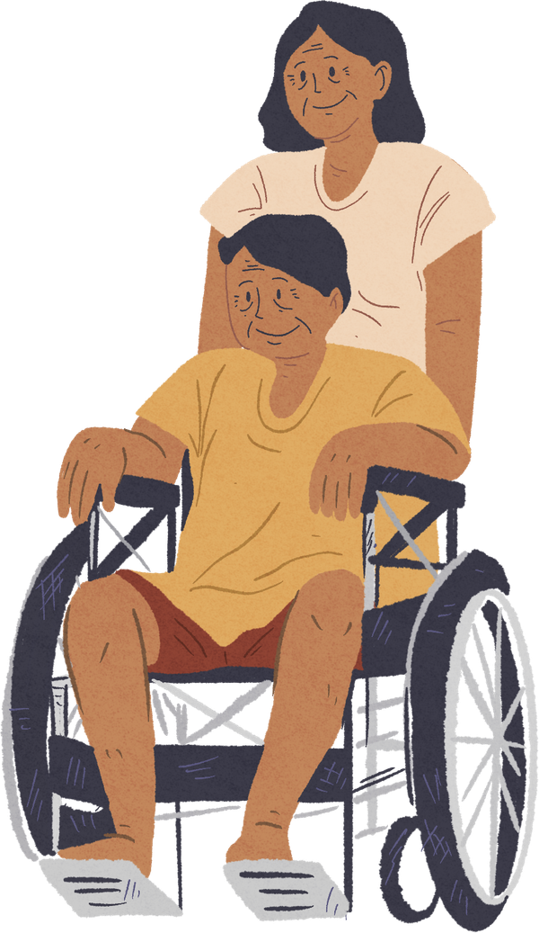

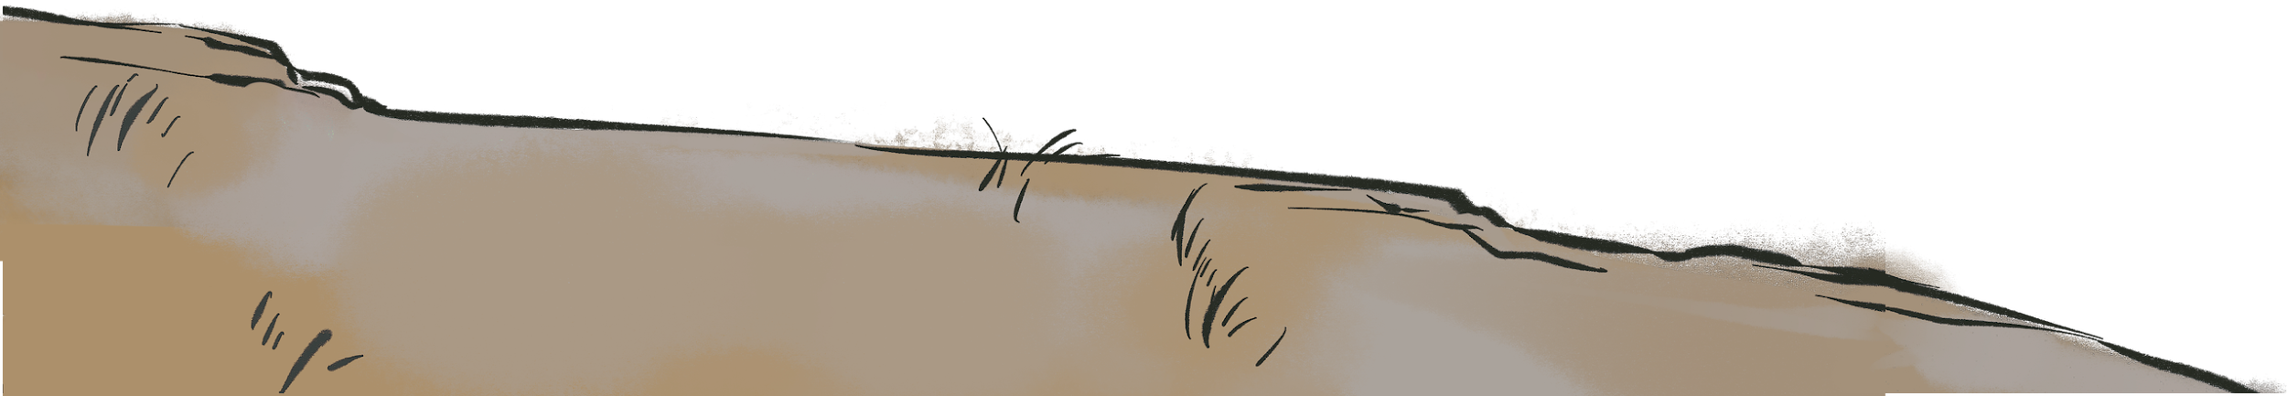


Disability Justice Foundations for Public Health
Disability Justice Foundations for public health

Slide 2




Land Acknowledgement
We are hosting this webinar from the ancestral and unceded territory of the Nacotchtank (Anacostan), Piscataway, and Pamunkey People.
www.piscatawaytribe.org
www.pamunkey.org

Slide 3
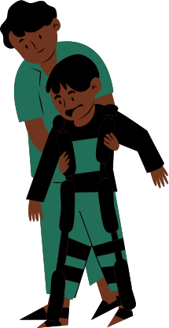
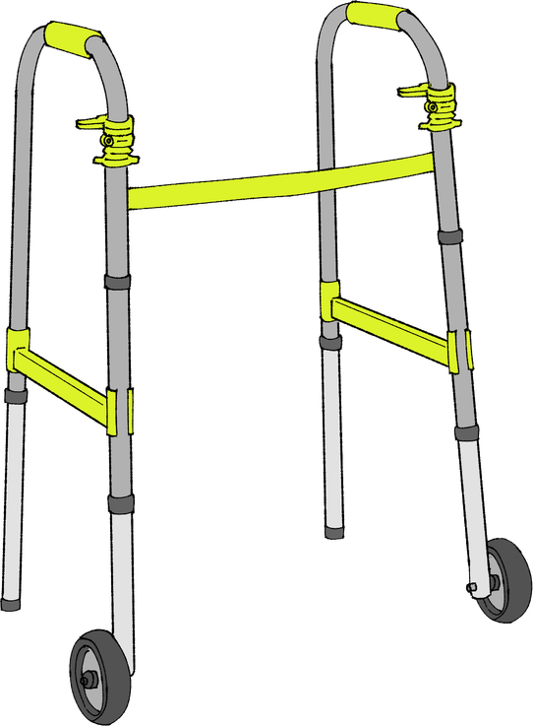
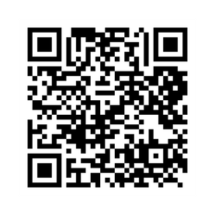
reminders
Disability justice is:
  A public health imperative
  A systems-change framework, not an awareness training
Catch the rest of the series
Disability Justice: Public Health for Collective Liberation

Slide 4
Acknowledgements
Thank you to the APHA staff who brought this webinar together!
Ki'Ana Speights, Tia Taylor Williams, Rya Griffis , Mary Storstrom, Kate Robb, Shweta Arya, Anush Hakobyan, Katie Avelar, Samiha Ahmed
Speacial thanks to our disability justice advisory board, some of whom will be speaking today and throughout the webinar series!
Thank you to our funder, the Robert Wood Johnson Foundation (RWJF)!

Slide 5


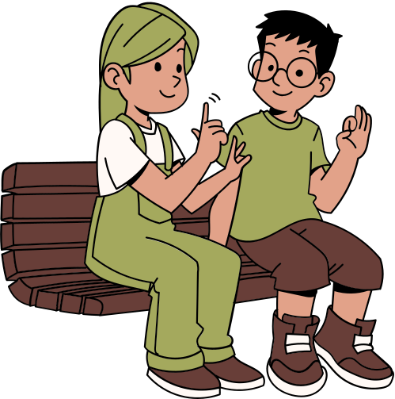


Housekeeping
  Participation norms:
    Cameras optional
    Engagement in the chat is welcomed
    Put questions in the Q&A feature
    Take care of access needs without apology
  This entire webinar series offers continuing education (CE) credit
  Recording, slides and resources will be available by 4/20
  Zoom accessibility features: transcript and ASL interpreters
    Chat Rya Griffis for additional access needs

Slide 6


Continuing education
During the past 24 months, the following planning committee members, speakers, or moderators had no financial relationship with an ineligible company that might potentially be biased or impact the content of the educational session.

Slide 7

What to expect today
Option for audience engagement
01
Master Planning Eugenics: Mapping, Navigating and Negotiating the Intersections and Overlays of Race, Class, Disability, & Queerness
Grounding
05
02
Origins & core concepts of disability justice
An intersectional view of disability models in the United States
03
06
Q&A
04
Disability Justice and Settler Colonialism
07
Closing reflection

Slide 8
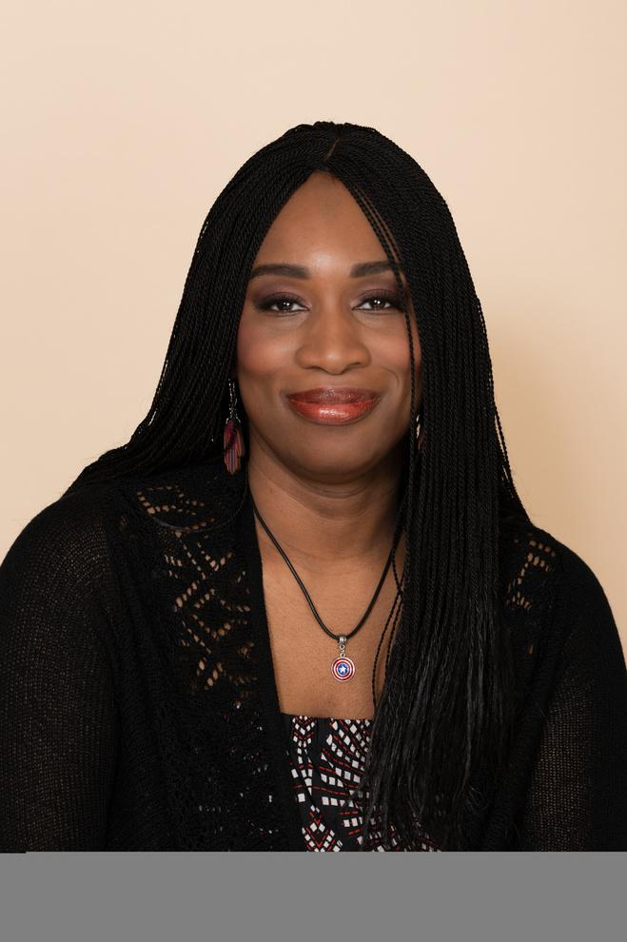
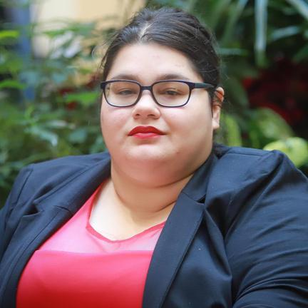
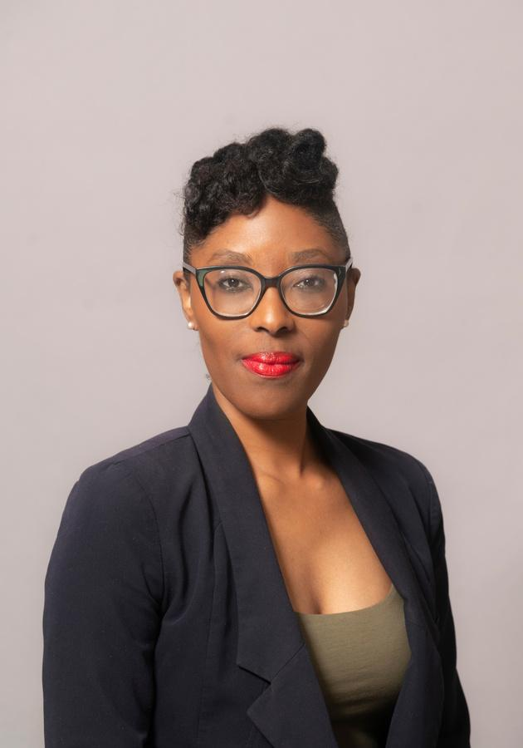
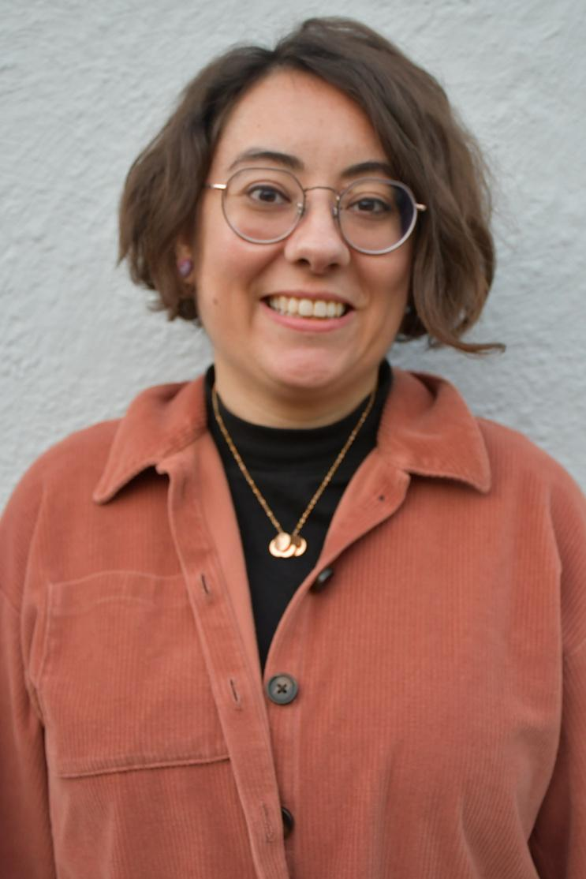
Presenters
Dr. Hassanatu Blake
(she/her)
Associate Clinical Professor & Inaugural Director of Global Health Undergraduate Program
Dr. Morénike Giwa Onaiwu
(she/they)
Global Human Rights and Disability Justice Activist-Scholar, Consultant, Advocate, Author and Educator
Jess L. Wilcox Cowing
(they/them)
Visiting Assistant Professor in Women, Gender & Sexuality Studies at Goucher College
Yolanda Vargas
(she/her)
Private Contractor and Consultant

Slide 9
TBD

Slide 10
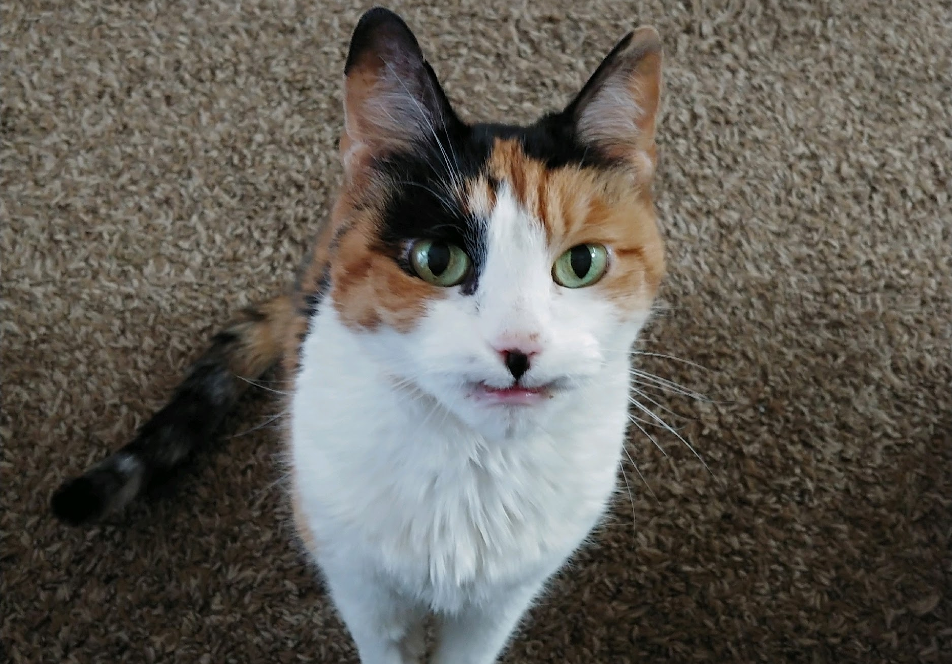
BREATHE.
Gummy Bear Vargas: Black, white and orange calico cat smiling at the camera

Slide 11
10 PRINCIPLES OF DISABILITY JUSTICE
INTERSECTIONALITY “We do not live single issue lives” –Audre Lorde. Ableism, coupled with white supremacy, supported by capitalism, underscored by heteropatriarchy, has rendered the vast majority of the world “invalid.”
LEADERSHIP OF THOSE MOST IMPACTED “We are led by those who most know these systems.” –Aurora Levins Morales
ANTI-CAPITALIST POLITIC In an economy that sees land and humans as components of profit, we are anti-capitalist by the nature of having non-conforming body/minds.
COMMITMENT TO CROSS-MOVEMENT ORGANIZING Shifting how social justice movements understand disability and contextualize ableism, disability justice lends itself to politics of alliance.
RECOGNIZING WHOLENESS People have inherent worth outside of commodity relations and capitalist notions of productivity. Each person is full of history and life experience.

Slide 12
PRINCIPLES OF DJ CONT.
SUSTAINABILITY We pace ourselves, individually and collectively, to be sustained long term. Our embodied experiences guide us toward ongoing justice and liberation.
COMMITMENT TO CROSS-DISABILITY SOLIDARITY We honor the insights and participation of all of our community members, knowing that isolation undermines collective liberation.
INTERDEPENDENCE We meet each others’ needs as we build toward liberation, knowing that state solutions inevitably extend into further control over lives.
COLLECTIVE ACCESS As brown, black and queer-bodied disabled people we bring flexibility and creative nuance that go beyond able-bodied/minded normativity, to be in community with each other.
COLLECTIVE LIBERATION No body or mind can be left behind – only moving together can we accomplish the revolution we require.

Slide 13
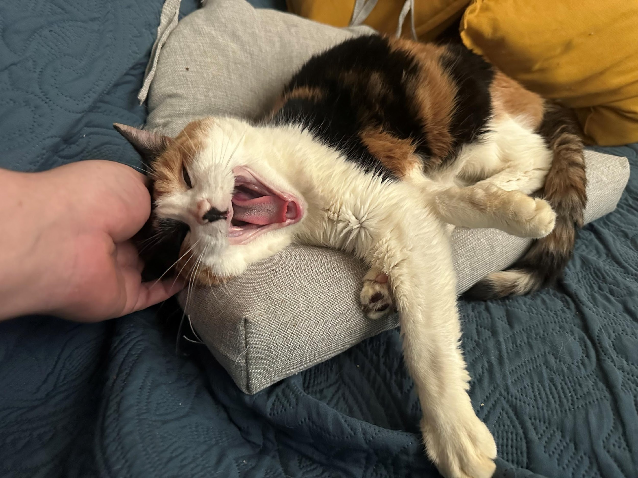
SOCIAL DETERMINANTS OF HEALTH (AKA WHY I SCREAM)

Slide 14
SOURCES
https://ajph.aphapublications.org/doi/10.2105/AJPH.2024.307972- Health Care Access
https://www.thenationshealth.org/content/special-section-improving-health-and-equity-people-intellectual-and-developmental - Employment and Income
https://blog.ucs.org/guest-commentary/climate-adaptation-adaptive-climate-justice-and-people-with-disabilities/- Housing
https://www.apha.org/getcontentasset/7d4b2b33-bd98-4d73-bf82-f8ded2c48add/7ca0dc9d-611d-46e2-9fd3-26a4c03ddcbb/idd_primer_2024.pdf?language=en- Transportation and Built Enviroment

Slide 15

SEGMENT 1 · 2:06 – 2:12 PM · Dr. Hassanatu Blake
A Moment of
Reflection
Think about a moment when a system, service, or institution
made assumptions about what you could or couldn't do.
💬 Share one word in the chat:
Restricted · Unseen · Controlled · Labeled · Ignored · Other?
Lived Experience
is the starting point

Slide 16
Disability is shaped by power.
HOOK — GLOBAL PERSPECTIVE + POWER
1 in 6
1 in 4
3x
people worldwide
live with a disability
U.S. adults report
a disability
more likely to face
healthcare barriers
WHO, 2023
CDC, 2024
Lancet Public Health
Marta Russell (1951–2013): Argued that disabled people are often commodified under capitalism — nursing homes as a mechanism to manage and profit from disabled labor supply. These structures reflect histories of colonialism, racism, and medical control.
SEGMENT 1, PART B · 2:08 PM · Dr. Hassanatu Blake

Slide 17
Dr. Morénike Giwa Onaiwu
(she/they)
Global Human Rights and Disability Justice Activist-Scholar, Consultant, Advocate, Author and Educator

Slide 18
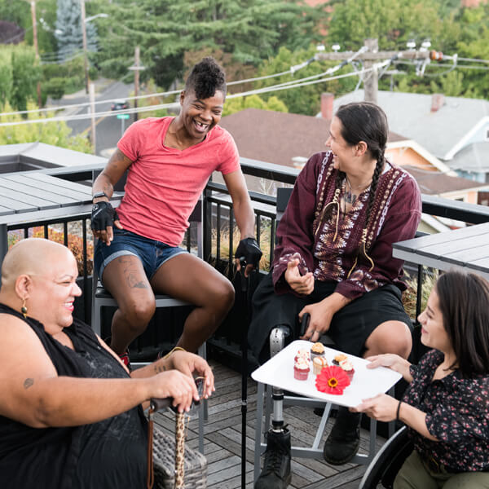
Disability Justice and Settler colonialism
Jess Wilcox Cowing

Slide 19
Please feel free to sit, lay down, stim, grab a blanket, have camera on or off. Do what you need to do!
Access Check in:

Slide 20
Today’s Goals
Introduce settler colonialism
Consider settler colonialism and DJ
Discuss application to Public Health

Slide 21
Ableism: a system of oppression that targets disabled people and people perceived to be disabled
Disability: a condition or experience that affects the way you move through the world
Keywords:

Slide 22
Settler colonialism: an oppressive system of state control occupying Indigenous homelands
The U.S., Canada, Australia all are settler nations
keywords:

Slide 23
On whose homelands do you live?
Go to: https://native-land.ca/maps/native-land
Land Acknowledgement

Slide 24
Disability Justice is #LandBack
Disability Justice is #StandingRock and #WaterIsLife
DJ principle 4: Commitment to Cross-Movement Organizing

Slide 25
Indigenous Environmental Network
“IEN’s activities include building the capacity of Indigenous communities and tribal governments to develop mechanisms to protect our sacred sites, land, water, air, natural resources, health of both our people and all living things”
Example

Slide 26
Mashpee Wampanoag dishestablishment order:
“The land within the Mashpee Reservation has been Mashpee Wampanoag land since time immemorial.”
example

Slide 27
Consider your connection to disability and Native/Indigenous issues
Address and acknowledge your privilege and resources
Support, uplift, listen to directly impacted leaders
So what does it mean to be in solidarity?

Slide 28




Thank You.
What Comes Next.
CLOSING & NEXT STEPS
Wrap Up
Grounding → DJ origins → Disability models → Settler colonialism & ableism
Closing Question
What gives you hope right now in disability justice or public health?
Optional: Share reflections in the chat.
Webinar 2 in 3 Weeks
Deeper dive + unanswered Q&A. Watch for APHA announcement.
CE Credits & Survey
Complete evaluation. Claim certificate from APHA Now — link in chat.
SEGMENT 3 · ~3:27–3:30 PM · Dr. Hassanatu Blake

Slide 29
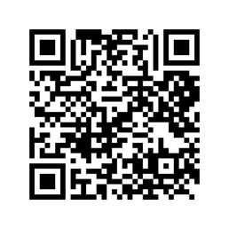
Thank You!
Disability Justice: Public Health for Collective Liberation
Catch the rest of the series

