Slide 1
Stop Losing Donors.
Turn One-Time Gifts into Reliable Monthly Revenue
Erica Waasdorp,
President, A Direct Solution

Slide 2
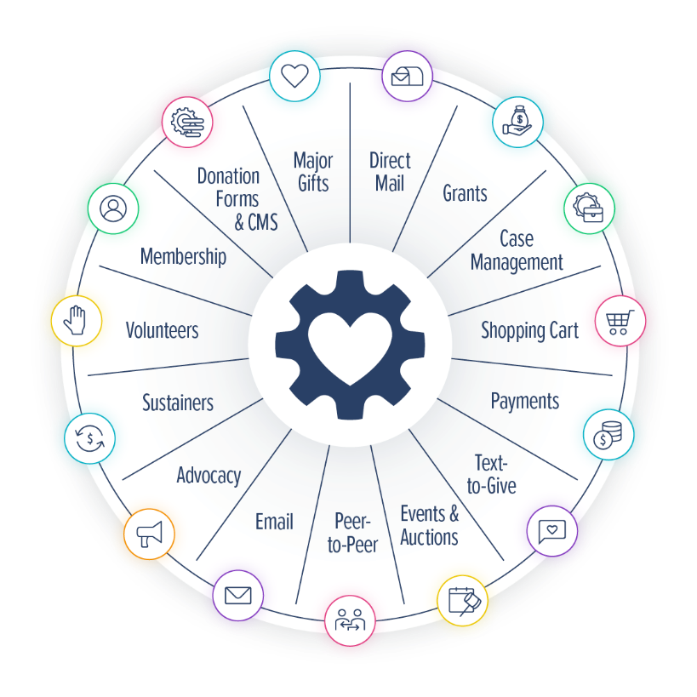
CharityEngine Was Built for Nonprofits Tired of:
Cobbled-Together Systems
Multiple Vendor Logins
Siloed Data
Poor Usability and a Frustrated Team
Escalating and Unexpected Costs

Slide 3
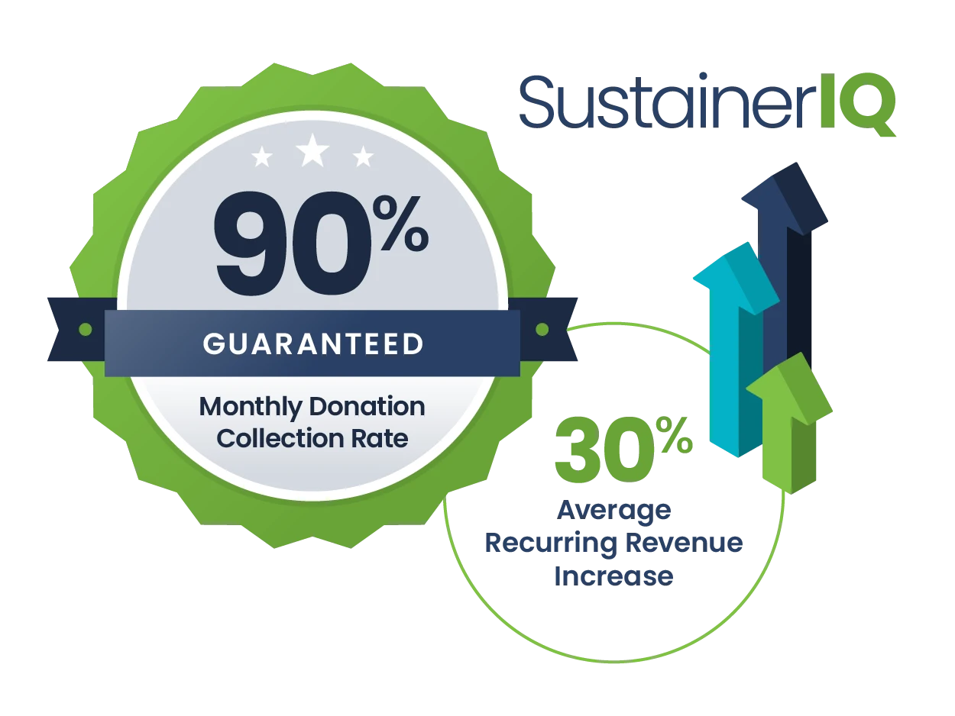
Unsurpassed Monthly Giving Results
Specialized technology for monthly giving
Guaranteed 90% revenue retention (70-80% standard)
No one else can say this!
Notes:
SustainerIQ is subscription billing technology designed for recurring payments.
Other CRMs use e-commerce payment tools meant for one-time transactions, not recurring billing!

Slide 4

“Technology alone won’t grow a sustainable giving program, but it can be either your biggest barrier or your best ally — and CharityEngine has clearly become an ally for organizations scaling sustainable giving.”
— Dave Raley, Author of The Rise of Sustainable Giving, and Co-Host of the Sustainable Giving Podcast

Slide 5
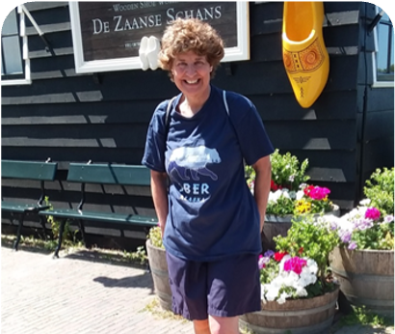
Hello, my name is Erica Waasdorp!
42+ Years experience in direct response
32+ Years experience in fundraising and monthly giving
Author, Blogger, Presenter, AFP Master Trainer
Recurring donor growth and retention consultant
Married, one cat, two boys, three grandkids

Slide 6
Today’s agenda
Craft a compelling “tiny story” that makes monthly giving irresistible
Make the ask with language and tactics that actually work
Build momentum with the right mix of focus, systems, and stewardship
Your questions…

Slide 7

Monthly donors are so…

Slide 8
Because they provide…
Reliable Revenue and More Money
Donors can give in a way that’s comfortable
Efficient use of resources
Legacy gifts and thus lifetime value
Retention Rates improve
And more…
Younger donors like it

Slide 9
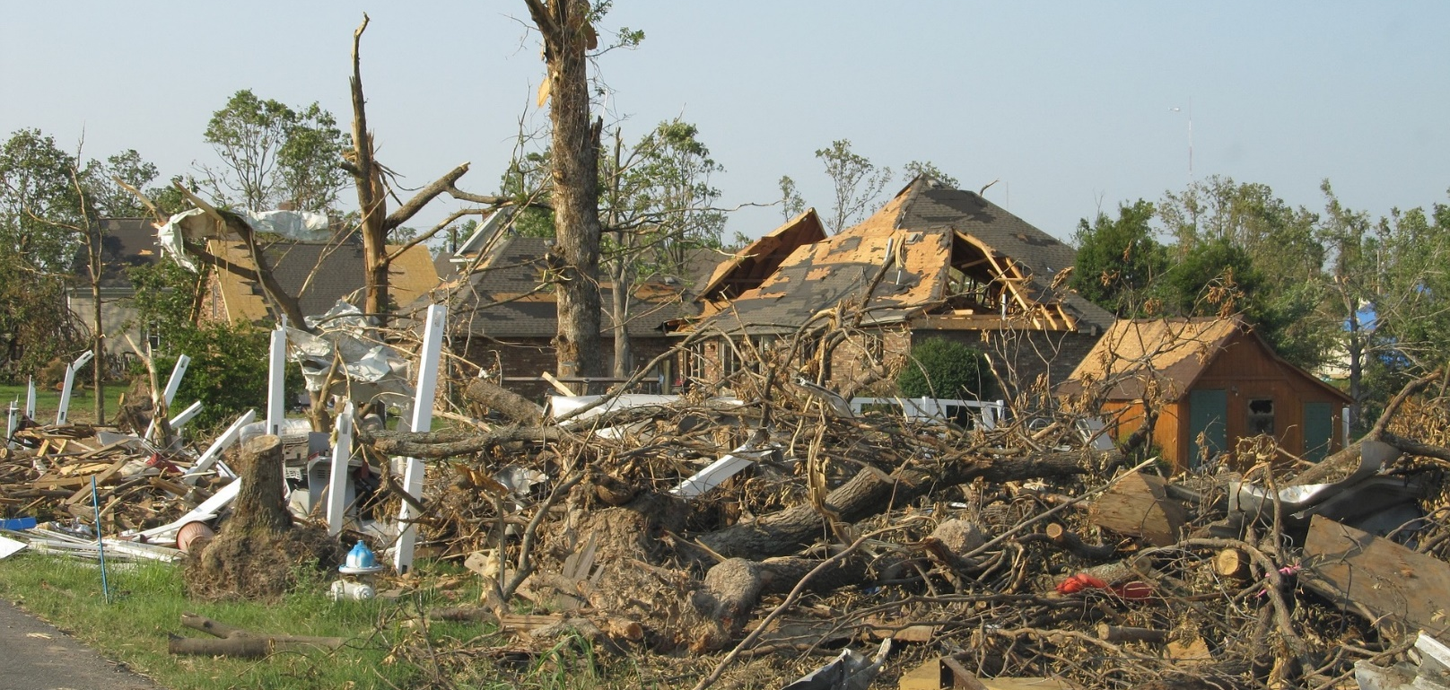




You can PLAN on unrestricted funds to be there no matter what!

Slide 10
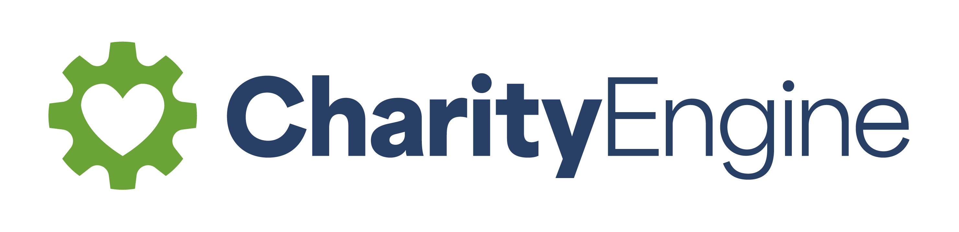
Retention rates improve
They double!
Source: 2024 Neon One Recurring Giving Report

Slide 11
Monthly Giving continues to grow
Revenue from monthly giving increased by 5%
Accounted for 31% of all online revenue in 2024.
One-time revenue was flat year-over-year.
Source: M&R Benchmarks April 2025

Slide 12
Monthly giving can come in through all sources
Source: Human services organization, Blackbaud 2025

Slide 13
Let’s look at some definitions
Recurring donors
Sustainers
Committed givers
Regular givers
Specific names…

Slide 14
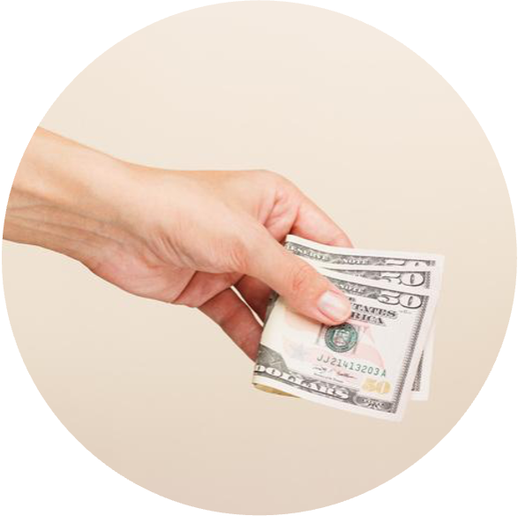
Monthly donors give more money

Slide 15
What’s the 5-year value of a typical monthly donor?

Slide 16
$1,500+ or even more…
Oh, the difference it will make!

Slide 17
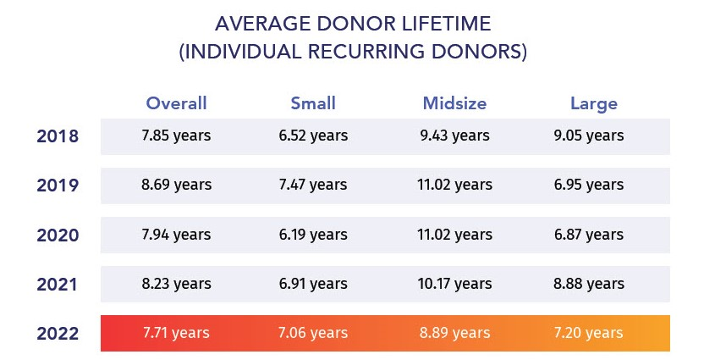
Oh, their lifetime is more than 5 years!
Source: Neon One 2024 Recurring Giving Report

Slide 18
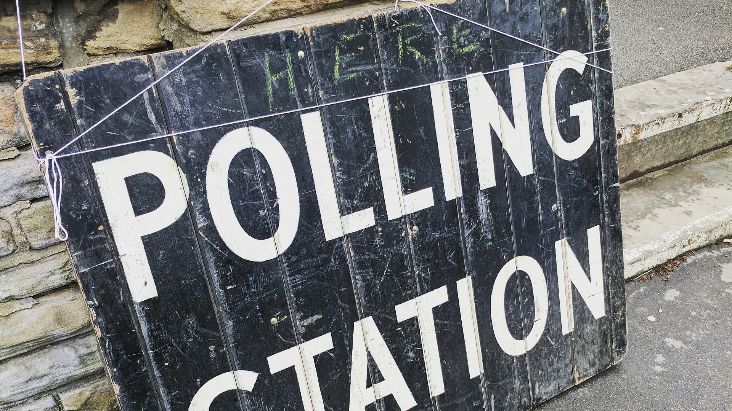
How many monthly donors do you have?

Slide 19
Create your own benchmarks
 | # of Monthly Donors | Average gift | Average Yearly Gift | Cumulative
1 year value | 100 | $25 | $300 | $30,000
8 year value | 100 | $25 | $300 | $180,000
Notes:
Erica

Slide 20

Why donors give monthly…
Donors want to help!
Monthly is easy
Monthly fits their budget

Slide 21


Key elements for growth
COMMITMENT
SYSTEMS
TANGIBLE AMOUNTS
STORYTELLING
Notes:
Kate – talk about our testing in email and maybe ads….different messages with difference audience…mission based messages are most effective. So many angles you can take. Not “save the org money and save on paper” make it easier on you.

Slide 22
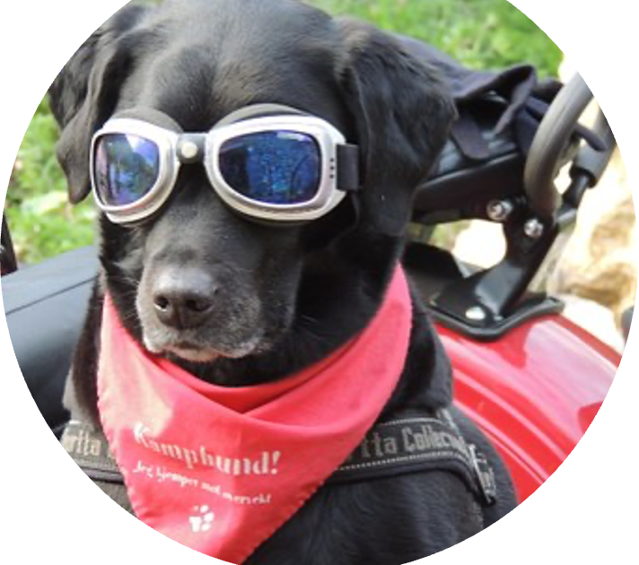
Commit and have a driver
Make someone accountable
Keeps program on track

Slide 23
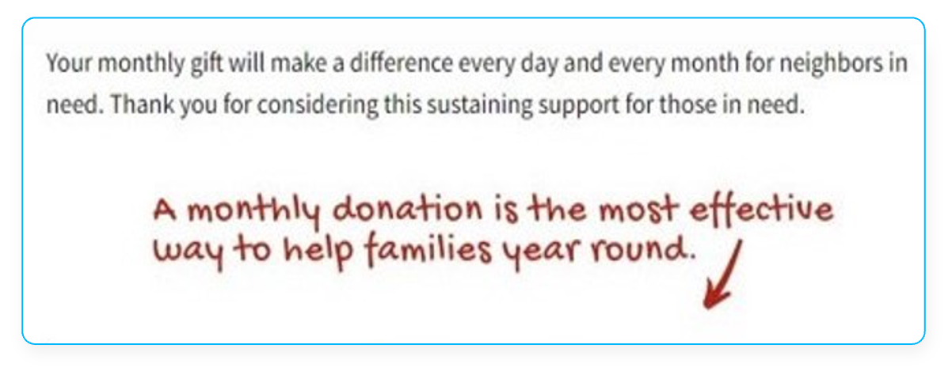
Create mini story/nudge/value proposition
Source: Volunteers of America

Slide 24
Start with a one-liner
You can help create lasting change by giving monthly to the World Vision Fund, empowering people to lift themselves out of poverty

Slide 25
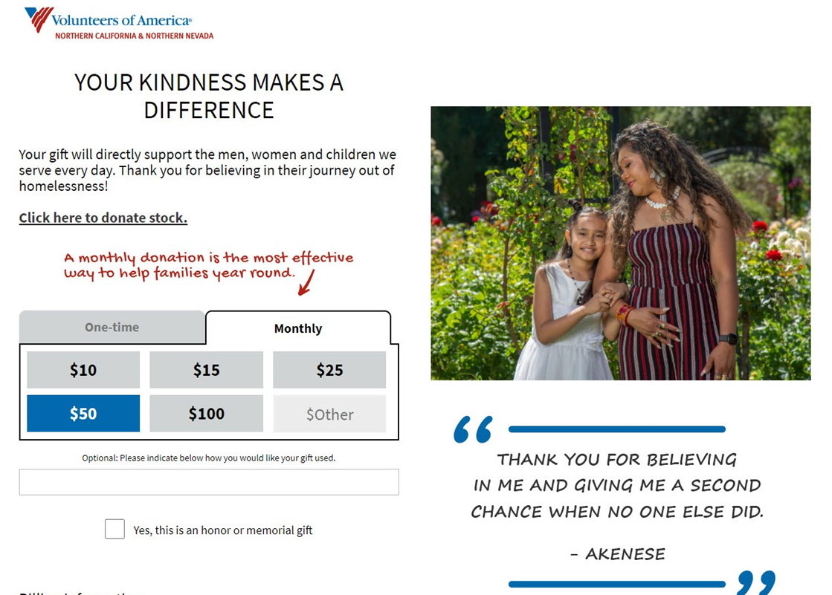
Review your donation form options
Use your nudge
Notes:
Mention simple header and design, several pre-filled payment options, clear option to become a monthly donor, clean donate button. Make it easy to give – recognize returning donors and offer many ways to pay.

Slide 26
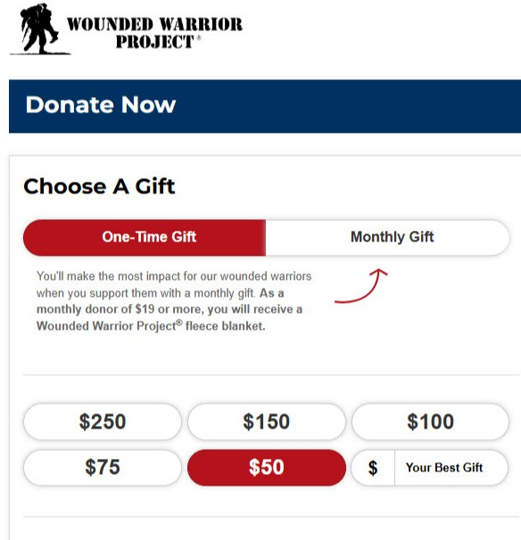
Review your donation form options
Create a monthly version or very clear toggle
Notes:
Mention simple header and design, several pre-filled payment options, clear option to become a monthly donor, clean donate button. Make it easy to give – recognize returning donors and offer many ways to pay.

Slide 27
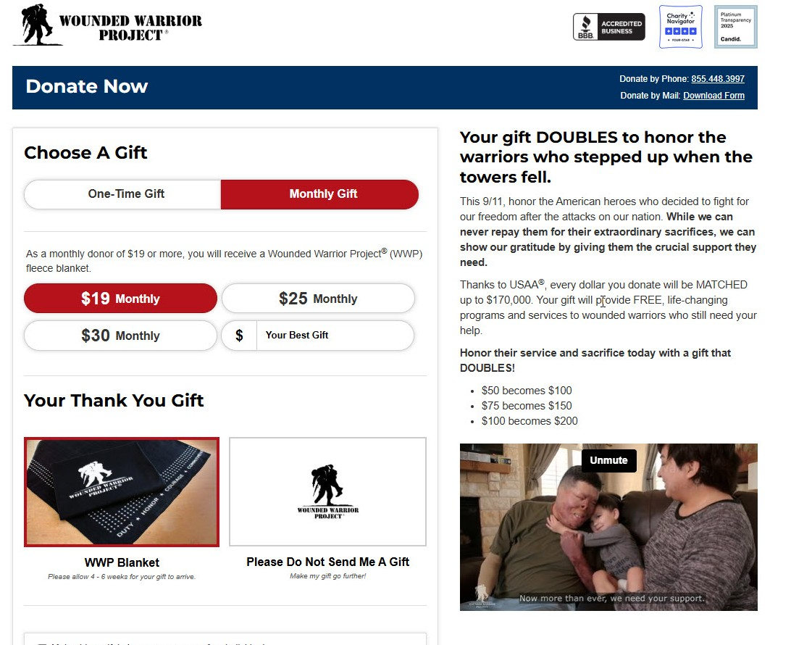
Review your donation form options
Create a very clear toggle
Notes:
Mention simple header and design, several pre-filled payment options, clear option to become a monthly donor, clean donate button. Make it easy to give – recognize returning donors and offer many ways to pay.

Slide 28
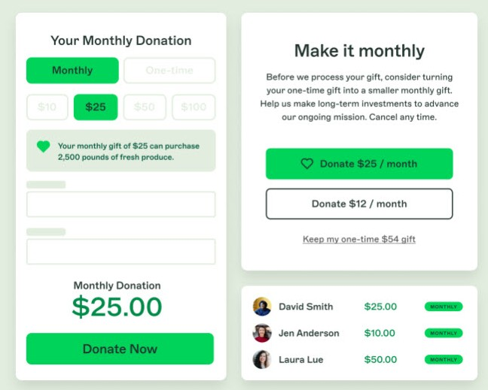
Review your donation form options
Can you do a lightbox?
Source: 4aGoodCause
Notes:
Mention simple header and design, several pre-filled payment options, clear option to become a monthly donor, clean donate button. Make it easy to give – recognize returning donors and offer many ways to pay.

Slide 29
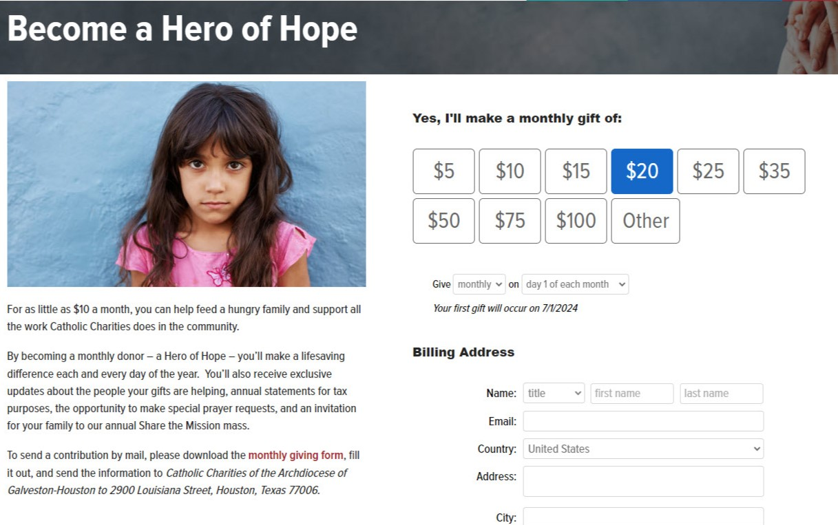
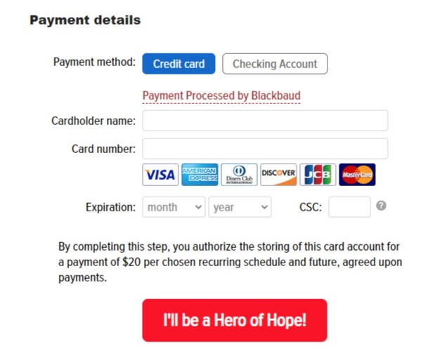
Make it monthly, and only monthly!

Slide 30

Direct donors to your form
Add a button
Make it easy to find

Slide 31
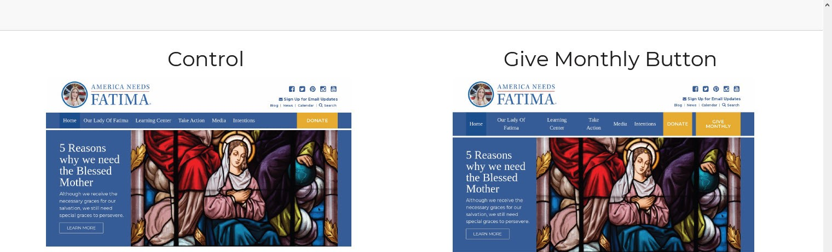
Add 2nd button to the home page…
Source: America Needs Fatima

Slide 32
What do you think was the impact of adding that second button?

Slide 33
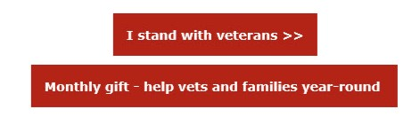
Drive donors to the monthly giving page

Slide 34
Add a button to your emails
Source: Catholic Charities of Galveston and Houston

Slide 35
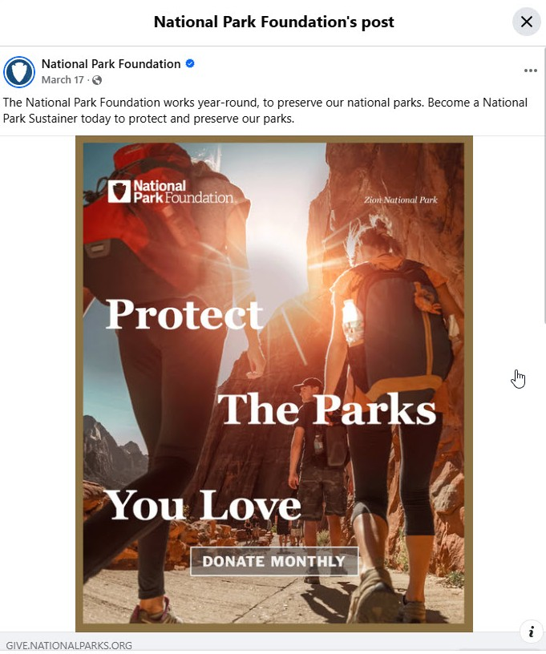
Use your social media
Source: NPF Meta ad

Slide 36
Use your email signature

Slide 37
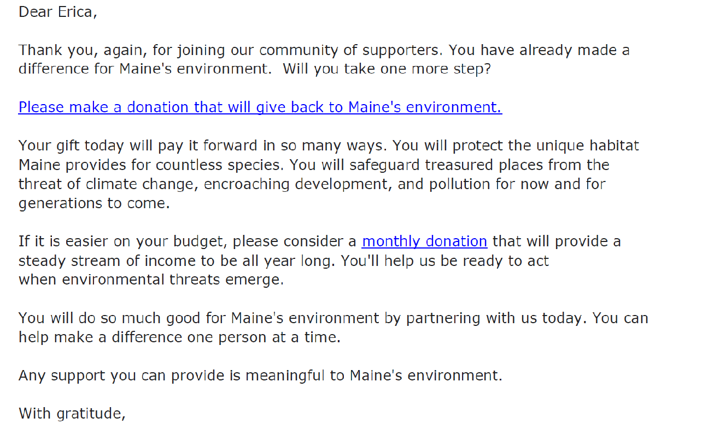
Use your welcome emails
Include Monthly ask
Source: Maine Conservation Voters

Slide 38
Use special invite emails (campaign)
Source: MSPCA

Slide 39
Add option to your appeal reply form

Slide 41
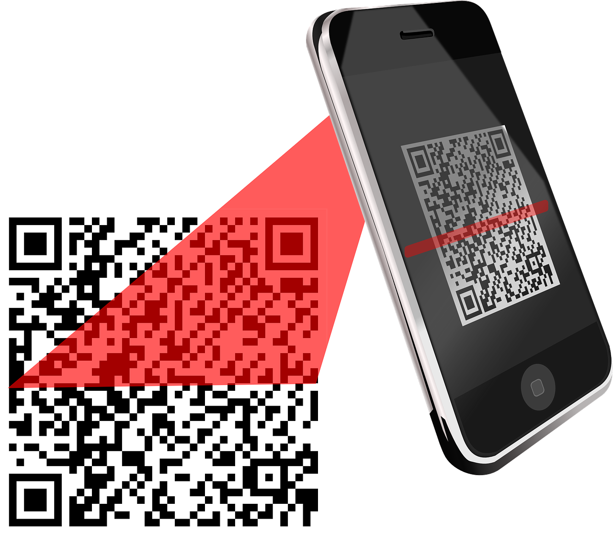
Add nudges to your letter
Sources: Hope Walks appeal and American Air Museum

Slide 42
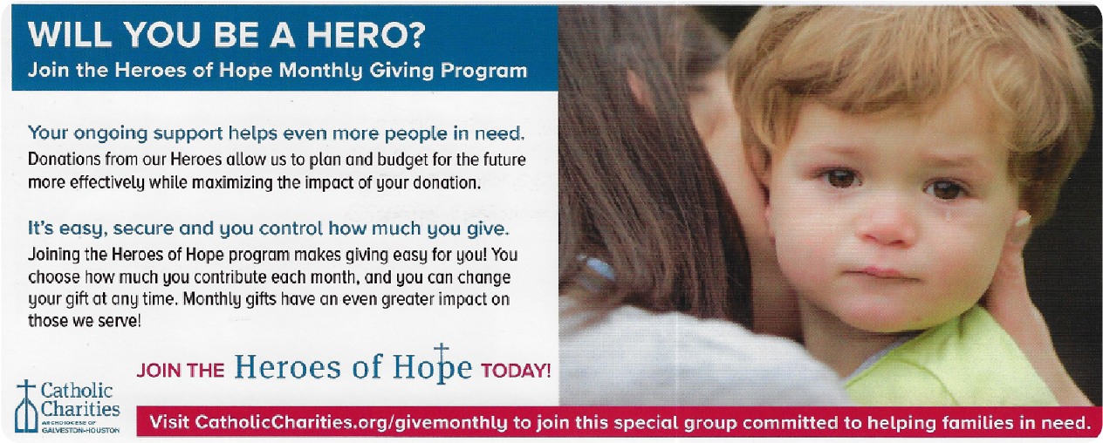
Add buck slip to appeal or thank you letter
Source: Catholic Charities Archdiocese of Galveston-Houston

Slide 43
Use a postcard
Use QR code to link to monthly page
Source: Water For People

Slide 44
Add emails to other channels
Source: Water For People

Slide 45

Use the phone

Slide 46
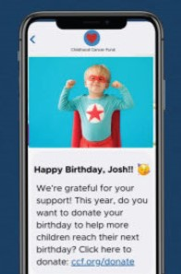
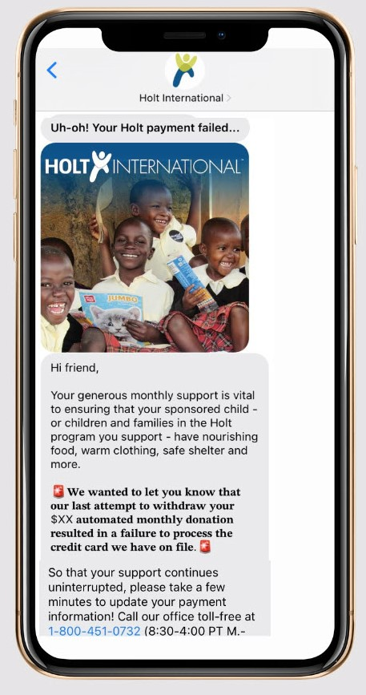
Use texts for asking, giving, thanking, reminding and special occasions
Notes:
Kelly – DP Text can include URL of form

Slide 47
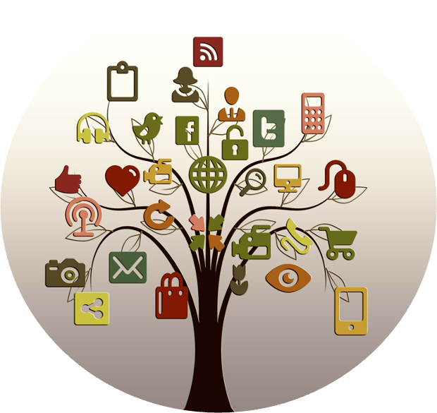
Create ‘surround sound’ effect
Mail
Phone
Email
Digital
Text
Social media

Slide 48
Make your recurring donors feel special, but keep your promises doable
  Donor can expect updates on how their gifts are helping
  Donor can expect overview of all giving every January

Slide 49
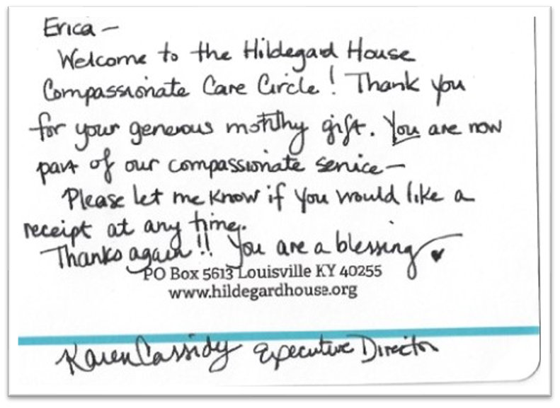
Mail your thank you and make it personal
Source: Hildegard House

Slide 50
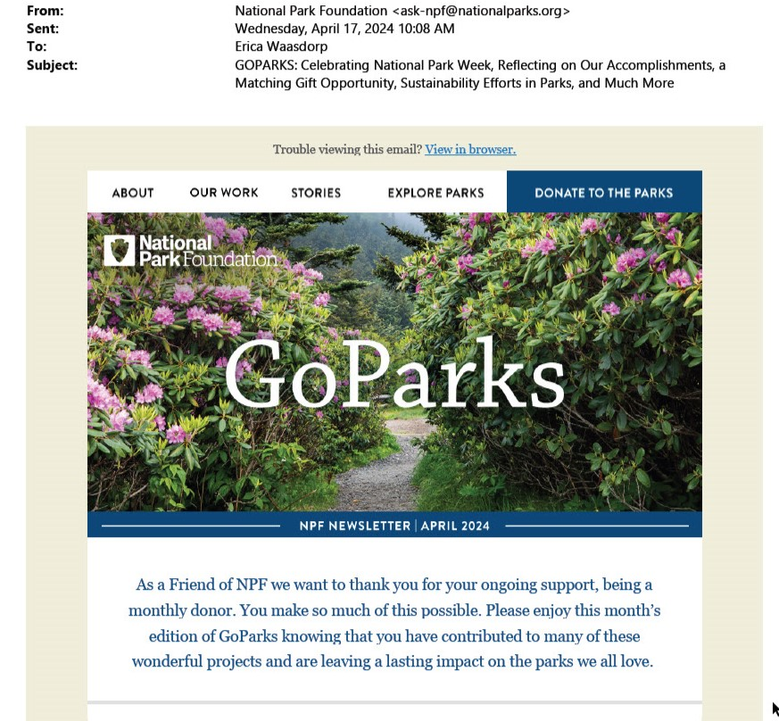
Segment your data so you can recognize your recurring donors

Slide 51
Share impact stories

Slide 52
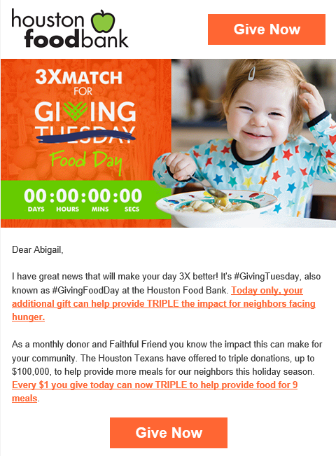
Include monthly donors in your Giving (Tues)day campaigns
Always recognize their monthly gift.
Ask for an extra or special gift.
Source: Houston Food Bank

Slide 53
Remember the 3 R’s
Recycle
Reuse
Repurpose

Slide 54
Key Takeaways
Generating monthly donors is important and deserves focus
There are MANY tactics to grow your monthly donor program
Pick what you’re comfortable with
Start with a mini story and a button!

Slide 55
What will you do next to grow your monthly donors?

Slide 56

Write down your goals

Slide 57
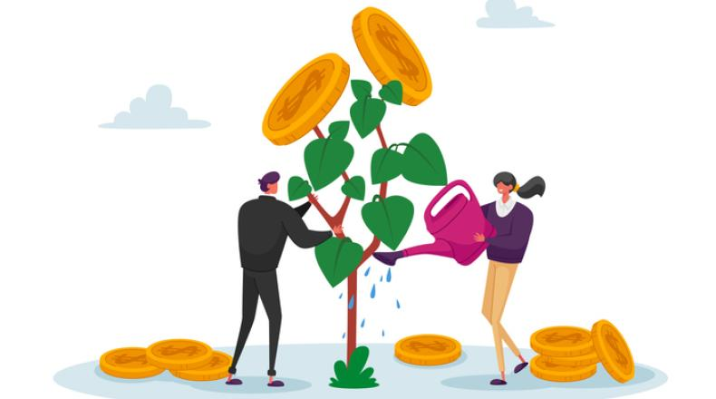
The best time to plant a tree was
20 years ago.
The second best time is NOW!

Slide 58

Questions?

Slide 59

Contact Erica
Erica Waasdorp, A Direct Solution
erica@adirectsolution.com
https://www.linkedin.com/in/erica-waasdorp-544b74
All pictures are from Pixabay unless otherwise indicated

Slide 60
Download Free Resources
Monthly Donor Tax letter
Monthly Donor Annualizer
Monthly donor retention playbook
Monthly donor roadmap
And more…
Go to www.adirectsolution.com

Slide 61
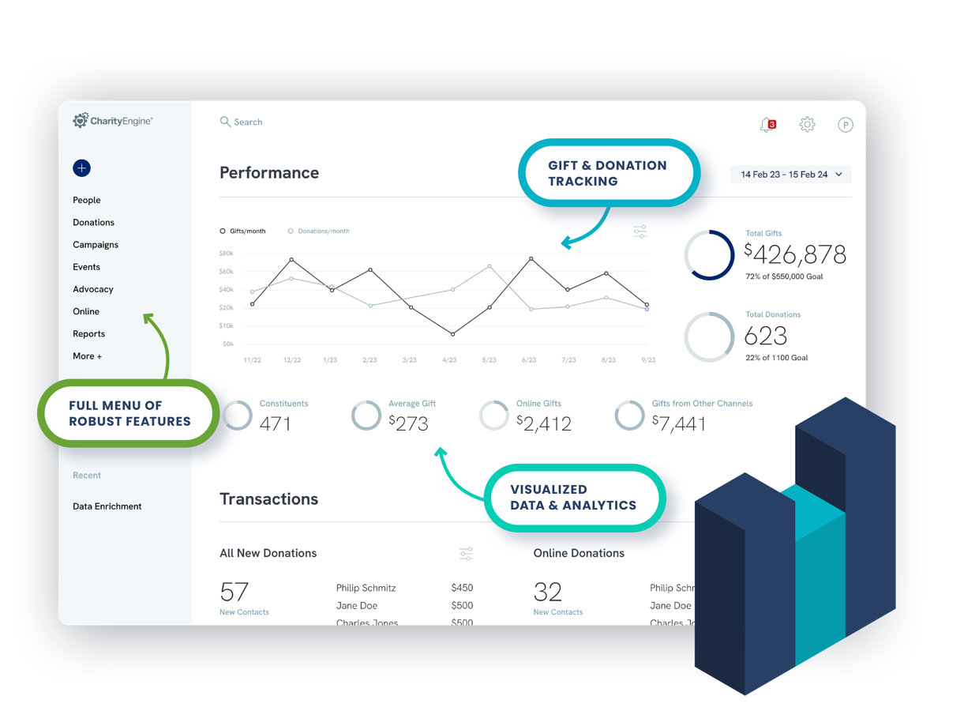
A Complete Fundraising Platform
One solution.
Unlimited potential.

