Slide 1


ISMPP University
Integrating Patient Perspectives in Publications Planning: The What, How and Why
March 26, 2025
Webinar will begin promptly at: ​11:00 AM ET/ 4:00 PM GMT
Notes:
Hello everyone; welcome and thank you for joining today’s ISMPP U titled: Integrating Patient Perspectives in Publications Planning: The What, How and Why..​
Please take a moment to capture a screenshot for CMPP credit. You will also be sent a certificate with credit attached after the webinar.

Slide 2
To activate captions
Access the captions button: In the meeting controls toolbar, click the "Show Captions" icon (usually looks like a "CC")
Select language:
  Click the arrow next to the "Show Captions" button
  Select your preferred language from the "Speaking Language" dropdown menu
Notes:
To access captions; use the meeting controls toolbar and click "show captions." You can also select your desired language.

Slide 3






















ISMPP Would Like to Thank…
Notes:
ISMPP would like to thank the following Titanium and Platinum Corporate Sponsors for their ongoing support of the Society

Slide 4

ISMPP Announcements
Application deadline for the September CMPP
exam is August 1
Notes:
And, for those who are seeking to become CMPP-certified or looking to renew your certification, the application deadline for the next exam window is August 1st, 2025

Slide 5

ISMPP Professional Excellence Awards
The awards program was established to honor the work and dedication of members who have a proven track record of excellence and achievement in the medical publications and communications profession. Award nominations are collected through peer submissions and reviewed by the Professional Excellence Awards Selection Committee. The awards are given out yearly at the ISMPP Annual Meeting. Winners to be announced at the 21st Annual Meeting of ISMPP
Lifetime Achievement Award
President’s Award
Rising Star Award
Outstanding Committee Member Award
CMPP Award
Notes:
The 2025 ISMPP Professional Excellence Awards are underway again this year. We are honoring these five awards listed on screen. Award winners will be announced on May 13, 2025 at the 21st Annual Meeting of ISMPP.

Slide 6
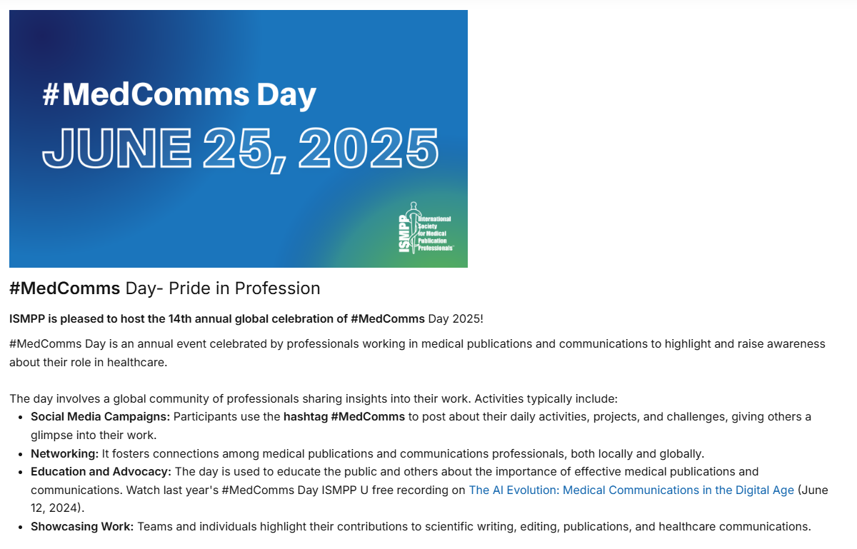
Notes:
ISMPP is pleased to host the 14th Annual global celebration of Medcomms day 2025. Please join us for an open to all 90-minute webinar offering. You can also view last year's open webinar titled the AI Evolution: Medical Communications in the Digital Age here.

Slide 7
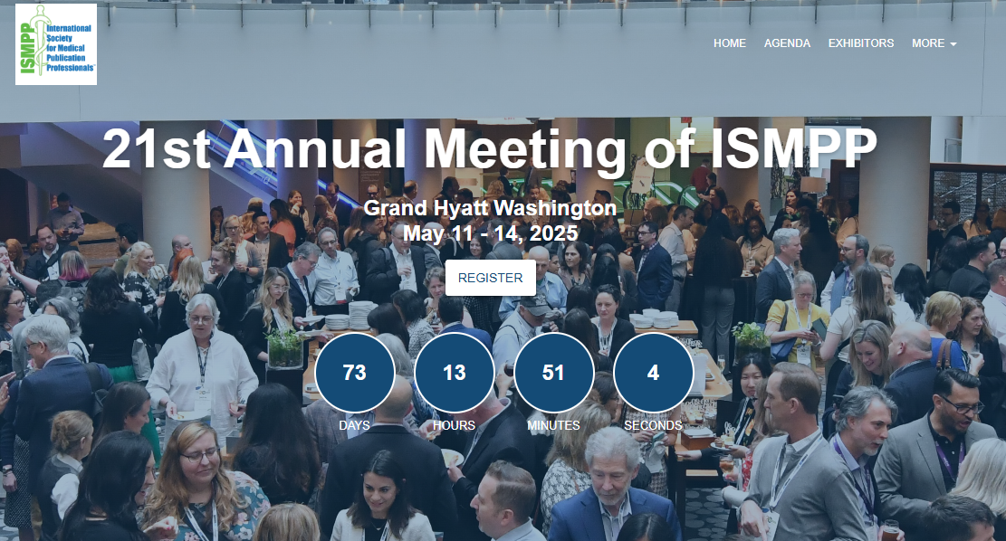
Notes:
Registration for the 21st Annual Meeting of ISMPP is now open.

Slide 8
How To Ask Questions
Feel free to ask a question at any time, however all questions will be held until the end the of the presentation.
To ask a question, open the Q&A window, type your question into the
Q&A box. Click Send
Note: Check Send Anonymously if you do not want your name attached
to your question in the Q&A
We will make every effort to respond to all questions live (out loud)
Notes:
You can submit a question at any time during the presentation by following the instructions on this slide.
The faculty will answer questions at the end of all the presentations.

Slide 9
Disclaimer
Information presented reflects the personal knowledge and opinions of the faculty and does not necessarily represent the position of their current or past employers
Notes:
Please take a moment to read our general disclaimer.

Slide 10
Learning Objectives
By the end of this session, attendees will be able to:
Understand the potential benefits of involving patients in publications in terms of impact and reach
Identify where patients can be effectively involved in publication planning, including discussion around the benefits and challenges
Understand how to implement a process for regularly and meaningfully involving patients
Notes:
Please read learning objectives aloud.

Slide 11
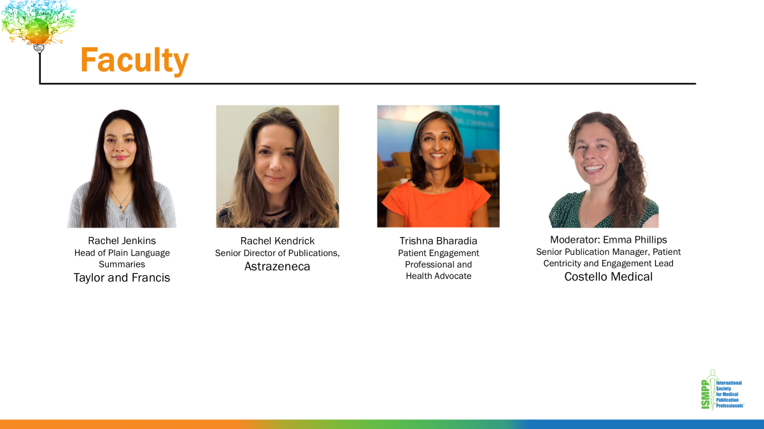
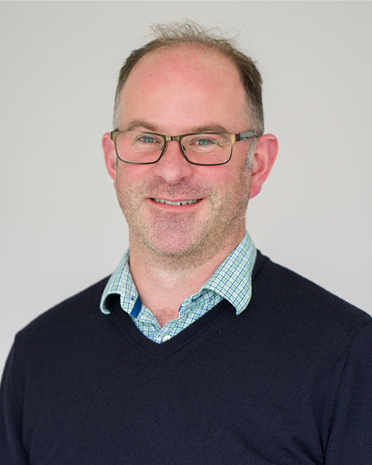
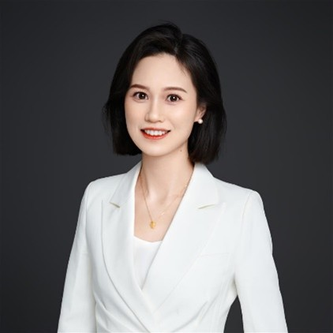
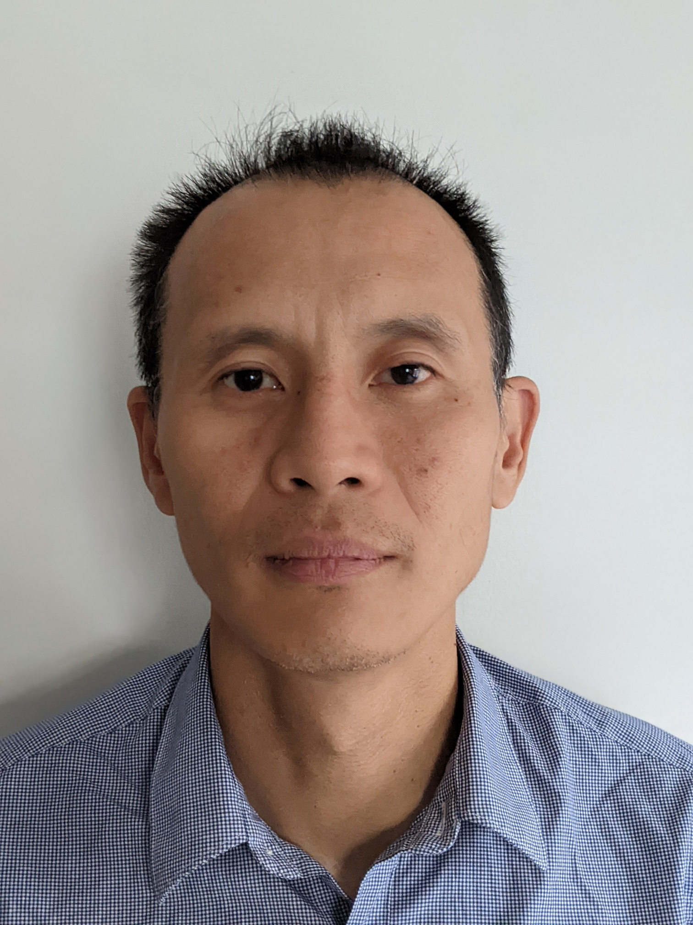
Faculty
Blair Hesp
Principal Consultant at First in Human Communications and Managing Director at Kainic Medical Communications, a multi-award winning medical communications agency
Susan Shu Wang
Senior Manager-Scientific Communications Group Leader, Lilly Suzhou Pharmaceutical
Moderator: Chu Kong Liew
Scientific Director at the Envision Pharma Group and co-chair of the ISMPP Asia Pacific Education Committee
Notes:
Please say the name, title and organization

Slide 12
Patient involvement & engagement in publications
Rachel Jenkins
rachel.jenkins@tandf.co.uk

Slide 13
Why is patient involvement & engagement important?
patient involvement in conducting research
patient interest
recognition of the value
Provides unique insights
Increases understanding of lived experience
Improves publication design & accessibility
Increases publication reach & impact
https://bmcmedresmethodol.biomedcentral.com/articles/10.1186/s12874-025-02495-4#:~:text=For%20example%2C%20journals%20such%20as,of%20the%20study%20%5B7%5D.

Slide 14


How can publishers encourage patient involvement & engagement?
Patient and caregiver authorship:
Help design or provide feedback on study design
Help collect or describe results that are important to patients
Analyze results that may include patient perspectives
Share insights and feedback on the patient perspective during the writing process
Review publication drafts to ensure patient feedback has been included
Support journal selection e.g., Open Access
Authorship guidance: https://authorservices.taylorandfrancis.com/editorial-policies/guidance-for-patient-authors/
How to write & publish a PLS: https://authorservices.taylorandfrancis.com/publishing-your-research/writing-your-paper/how-to-write-a-plain-language-summary/?_ga=2.133010887.83394517.1742763201-753329978.1741727989

Slide 15




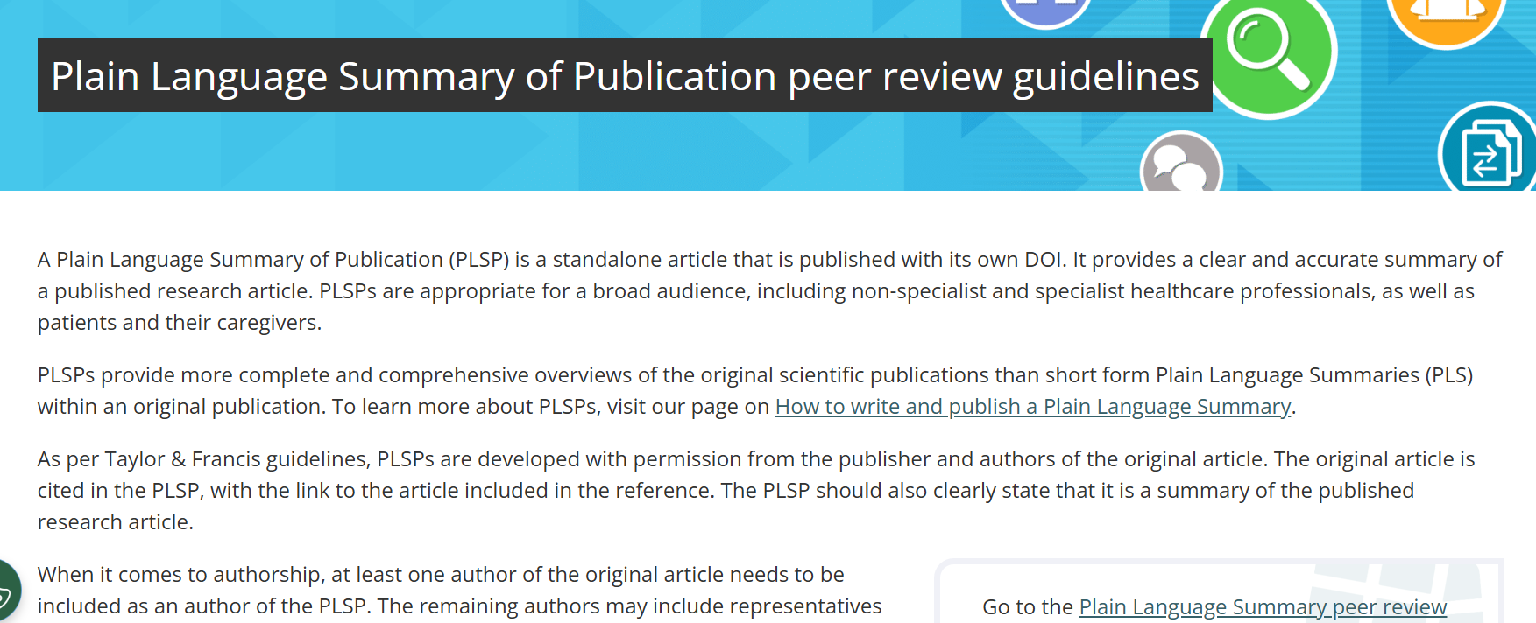



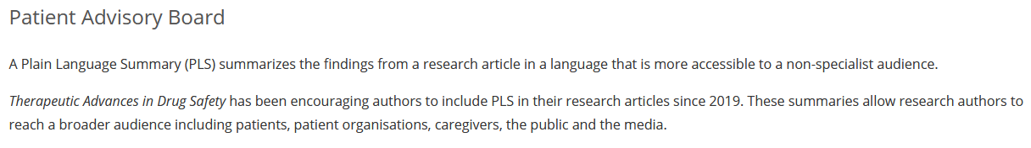
How can publishers encourage patient involvement & engagement?
Patient reviewers:
Review relevance of a publication
Review readability and sensitivity of publication
https://editorresources.taylorandfrancis.com/reviewer-guidelines/review-checklist/plain-language-summary-of-publication-peer-review-guidelines/

Slide 16


How can publishers encourage patient involvement & engagement?
Publish diverse article formats:
Share with patients and caregivers
Social media
Peers
Patient groups
Optimize SEO
65% of patient participants (n=165) considered PLS “easy to understand”
Patient organization representatives (n=22) considered both plain text and infographics to be helpful/very helpful in making PLS understandable for a patient audience
Video abstracts and PLS produced the highest comprehension, understanding, enjoyment, and desire for more updates
Readers with science background = 201
Readers with science-related background = 156
Readers with non-science background = 181
1. Bredbenner K, et al. PLoS ONE 2022;14(11):e0224697.
2. Iqbal TR, et al. Curr Med Res Opin. 2023; 39(sup 1)..
3. van den Broek R, et al. Curr Med Res Opin. 2022; 38(sup 1).

Slide 17
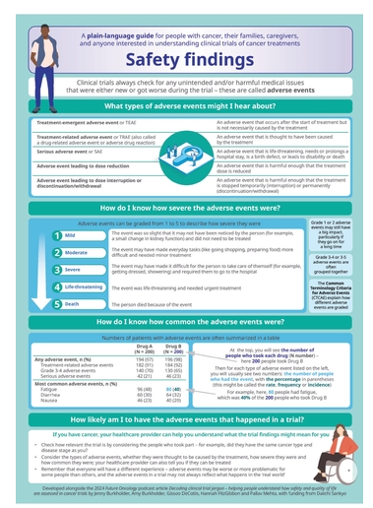
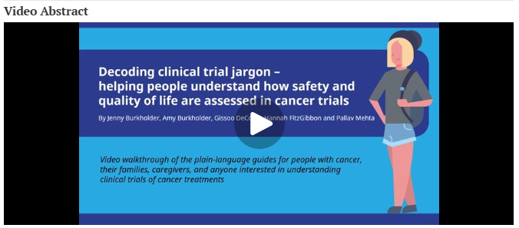

Podcast example: Decoding clinical trial jargon: helping people understand how safety and quality of life are assessed in cancer trials
Published in Dec 2024
Patient authorship
942 downloads
https://www.tandfonline.com/doi/full/10.1080/14796694.2024.2422808

Slide 18
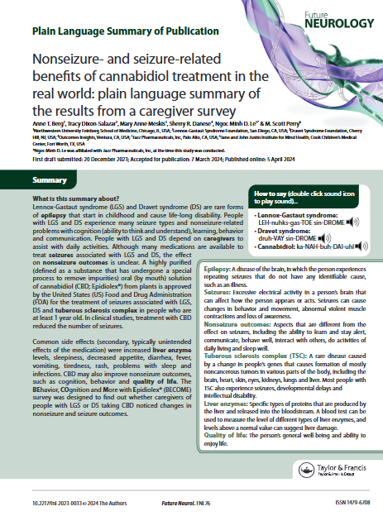
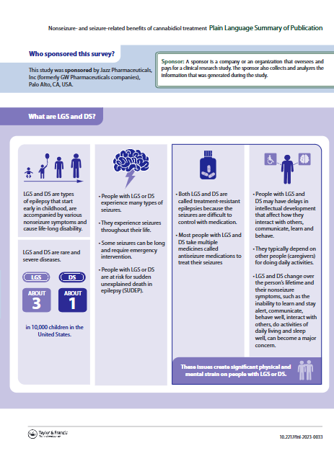


PLSP example: Nonseizure- and seizure-related benefits of cannabidiol treatment in the real world: plain language summary of the results from a caregiver survey
Published in Jun 2024
Patient authorship
Patient peer review
Shared with patient groups post-publication
1295 downloads
https://www.tandfonline.com/doi/metrics/10.2217/fnl-2023-0033

Slide 19
Does patient involvement impact publication metrics?
86 PLSPs published in 2024 analyzed:
10 had 1+ patient or caregiver authors
76 did not have any patient authors
Patient-authored publications resulted in…
127%
increase in downloads
x5
higher Altmetric scores
40%
traffic sources from Google

Slide 20

Does patient engagement impact publication metrics?
Full abstract to be presented at ISMPP Annual 2025:
160 PLSPs published between 1st Jan 2023 – 16th January 2025
Compared PLSPs with extenders* (n= 21) vs without extenders (n=146)
*Extenders included graphical abstracts, infographics, videos, podcasts and translations
PLSPs with extenders showed…
154%
increase in downloads
Winter S, et al. Curr Med Res Opin. 2022; 38(sup 1).

Slide 21
Does patient involvement & engagement in publications impact patient-centered communication?
71% (47/66) of HCPs rated PLS as ’very/extremely useful’, videos (64%) and infographics (65%). Nearly half of these HCPs (43%; 20/47) went on to use the PLS with their patients and one in six HCPs (8/47) referred patients/families to the online PLS⁶
HCPs were rated as the most important source of information, followed by medically focused websites, patient summaries of scientific articles, and scientific journals.⁴
Healthcare Professionals
Patients
Infographics (31%) and
PLS (20%) were the most valued digital information types… availability of PLS increases the likelihood of sharing information with patients⁵
4. Georgieva A, et al. Curr Med Res Opin. 2018; 34(sup 1).
5. Gadiot R, et al. Curr Med Res Opin. 2022; 38(sup 1).
6. Lobban D, et al. Curr Med Res Opin. 2022; 38(sup 1).

Slide 22

Future directions
Provide resources and training for all stakeholders
Drive patient-centered publications
Quantify how publications are used by patients
Increase discoverability of publications to patient audiences

Slide 23
Practical Strategies for Integrating Patients into Publication Planning
Speaker: Rachel Kendrick, Senior Director of Publications, AstraZeneca

Slide 24
Practical Strategies for Integrating Patients into Publication Planning
Identifying key touchpoints where patients can contribute meaningfully
Addressing common challenges, such as confidentiality, training, and alignment with compliance guidelines
Best practices for fostering collaboration between pharma, patients, publishers, and agencies
Notes:
Here are some special reasons to join ISMPP! Knowledge, Community and Professionalism. Check out our website and Join ISMPP Today!

Slide 25
Practical Strategies for Integrating Patients into Publication Planning
Identifying key touchpoints where patients can contribute meaningfully
Addressing common challenges, such as confidentiality, training, and alignment with compliance guidelines
Best practices for fostering collaboration between pharma, patients, publishers, and agencies
Notes:
Here are some special reasons to join ISMPP! Knowledge, Community and Professionalism. Check out our website and Join ISMPP Today!

Slide 26

Practical Strategies for Integrating Patients into Publication Planning
Identifying key touchpoints where patients can contribute meaningfully
Addressing common challenges, such as confidentiality, training, and alignment with compliance guidelines
Best practices for fostering collaboration between pharma, patients, publishers, and agencies
Notes:
Here are some special reasons to join ISMPP! Knowledge, Community and Professionalism. Check out our website and Join ISMPP Today!

Slide 27
Practical Strategies for Integrating Patients into Publication Planning
Identifying key touchpoints where patients can contribute meaningfully
Addressing common challenges, such as confidentiality, training, and alignment with compliance guidelines
Best practices for fostering collaboration between pharma, patients, publishers, and agencies
Notes:
Here are some special reasons to join ISMPP! Knowledge, Community and Professionalism. Check out our website and Join ISMPP Today!

Slide 28

Establishing Structured Approaches for Meaningful Patient Engagement: Pfizer’s Publications Collaborative Board
Speaker: Trishna Bharadia BA(hons), MFPM(hon)
Email: trishna.bharadia@gmail.com
LinkedIn

Slide 29
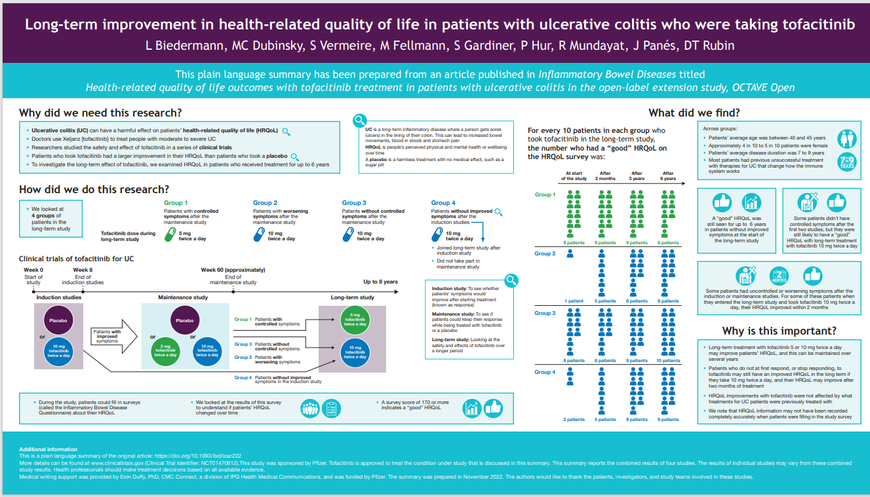



What was Pfizer’s route to the Collaborative Board?
Plain language summaries
Patients and publications
Patient Advocate Advisory Board
Publications Collaborative Board

Slide 30



Pfizer’s Global Publications Team Held Patient Advisory Board
OBJECTIVES
Identify patient preferences for scientific publications as readers/consumers
Reading level and format (e.g., print, digital, video, audio, infographic)
Types of medical publications
Understand sources of information and barriers to access
Enhance Pfizer’s partnership with patients in the development of publications
Determine appropriate roles
Establish a process
Decide on output of advisory board meeting and plans for continued engagement
Equity, Diversity & Inclusion Representation:
10 Patient Advocates from 3 different countries
Gender: 7 women, 3 men
Therapy Areas: Inflammation (1)
Oncology (4)
Organ Donor (1)
Neurology (1)
Rare Disease (2)
Vaccines (1)
Notes:
ANGELA

Slide 31
Collaborative Board members
  Identified
  (Advisory) Collaborative
  Board members
  from internal resources
  8 Collaborative
  board members
  Diversity &
  inclusion: therapeutic area, publication experience, gender, ethnicity/race, age
  Established
  “Terms of Reference”
  Annual contracts
  with fees based
  on fair market value

Slide 32



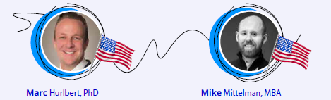
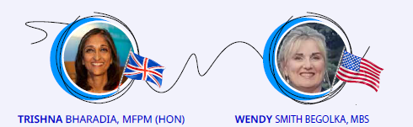
Collaborative Board patient members
Thanks to everyone for
your hard work and dedication. I thoroughly enjoyed working alongside all of you and look forward to what’s to come
Great job all!

Slide 33
Selection of Achievements
2021
2022
2023
  Advisory Board kick-off
  Collaborative Board formed
  Patient Authorship Guidance developed
  Agreement
  Travel
  SOP
  Patient author
  welcome kit
  2021 Open Access
  Week supported
  Mission and purpose established
  Collaborative Board infographic and communication
  Strategic plan and projects endorsed
  Started monitoring metrics on PLS, Open Access and Patient Authorship
  External awareness
  Patients as Partners Europe
  DIA Medical Affairs
  and Scientific Communications
  Developed Pfizer Patient Authorship Pledge
  Database of patient-friendly publications started
  Input into Pfizer’s work e.g. Generative AI PLS project, Medical Information
  Raised awareness internally & externally e.g. Pfizer Health Literacy Community of Practice, ISMPP, MAPS, DIA Global Forum
  Developed patient-centred vendor selection criteria
  Reviewed Taylor & Francis Publishers PLS/PSLP Peer Review Guidelines

Slide 34

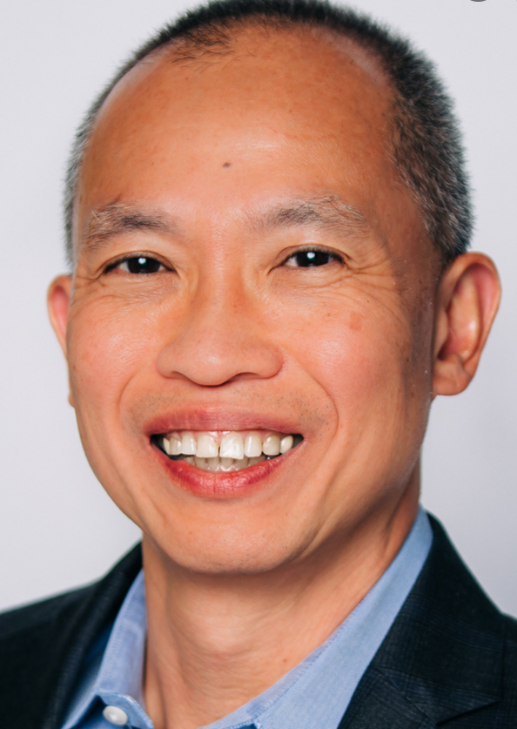
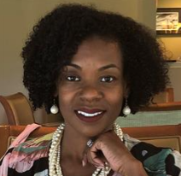



The Guidance is a tool that empowers every colleague with publication responsibilities to value and elevate the voice of the patient expert; in a space where even junior researchers have often been muffled or marginalized. It adds a level of un-reinterpreted truth to the discussion and conclusions and ultimately the public narrative.
Looks great! Good work team! Really great to see it ready to go!!!
Thank you for the opportunity to participate with such a wonderful group of people!
Trishna Bhardia, The Spark Global
L.J. Tan, Immunization Action Coalition (IAC)
This is great! In oncology we’d like to engage with more patient authors in the coming year and this will certainly help.
Nikki Alexander Parrish, Vaccines Medical Affairs, Pfizer
Thanks to everyone for your hard work and dedication. I thoroughly enjoyed working alongside all of you and look forward to what’s to come.
Great job all!
Dheepa Chari, Oncology Medical Affairs, Pfizer
Wendy Smith Begolka, National Eczema Association
Tiah Tomlin, My Style Matters Inc.

Slide 35

Key points to consider
Those involved have:
  Experience in working with pharmaceutical companies
  Experience in patient involvement in publications
  Understanding of the importance of diversity and inclusion
  Drive, commitment and passion for patient involvement in research
Some training might be required e.g. Microsoft Teams
Talk to legal/compliance early
Importance of co-creation and transparent dialogue

Slide 36


Options
Scaling up to establish
a Collaborative Board may not be feasible
What’s important is to engage the patient voice
Invite at least 1 to advise your organisation
on HOW to work with patients
Survey a group of patients to gather evidence
Hold an advisory board meeting

Slide 37
Audience Q&A
To ask a question, open the Q&A window, type your question into the Q&A box. Click Send.
Notes:
And now it's time to answer your questions. As a reminder, please type them into the Q&A box at the bottom of your screen.

Slide 38
Upcoming ISMPP University Webinars
May 21,
2025
We’re Not In Kansas Anymore – Harnessing The Power of Data Visualization
Notes:
Also, be on the lookout for our next ISMPP U scheduled for May 21, Harnessing the Power of Data Visualization.

Slide 39
ISMPP University
Integrating Patient Perspectives in Publications Planning: The What, How and Why
March 26, 2025
Webinar will begin promptly at: ​11:00 AM ET/ 4:00 PM GMT
Notes:
Just in case you did not have time to take a screenshot at the beginning of the presentation for CMPP credit, please do so now.

Slide 40

Thank you for attending!
We hope you enjoyed today's presentation.
After closing out of Zoom, please click the CONTINUE button
on your screen to take our short survey. Thank you!
Notes:
Thank you again for attending today’s webinar. Slides and recording of this webinar will be available in the next 24 hours on the ISMPP website.
Finally, please take a moment to fill out the survey link that will be sent to you. After closing out of ZOOM, please click the ‘continue’ button on your screen to take a short survey.
Thank you!

Slide 41

Rachel Jenkins, Head of Plain Language Summaries, Taylor & Francis
Rachel is Head of Plain Language Summaries at Taylor & Francis and oversees the initiative, including Plain Language Summary of Publication articles (PLSPs)
Her background focuses on novel publication extenders, including video and podcast articles, translations and interactive articles
Prior to this, Rachel worked as an Editor for journals and digital websites in the healthcare space
CMPP, certified medical publications professional; ISMPP, international society of medical publications professional

Slide 42
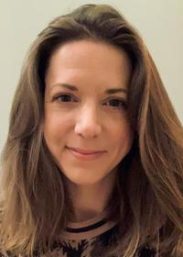
Rachel Kendrick, Senior Director, Publications, AstraZeneca
Rachel has more than 14 years’ experience in publications and scientific communications, in the pharmaceutical industry and the medical communications field
Within AstraZeneca, she is responsible for publication planning, strategy and delivery across all products and disease areas within the late-stage cardiovascular, renal and metabolism (CVRM) therapy area
Rachel, along with her team, leads a number of cross-functional initiatives focusing on Patient Involvement in Publications, Clinical Trial Transparency, and optimizing enhanced publication content
CMPP, certified medical publications professional; ISMPP, international society of medical publications professional

Slide 43
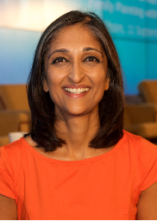
Trishna Bharadia, Patient Engagement Professional and Health Advocate
Multi-award winning with ~15 years experience working with multiple stakeholders in patient advocacy and engagement
Visiting lecturer on patient engagement at King's College London's Centre for Pharmaceutical Medicine Research
Specific experience in patient involvement in medical publications, information and communications
Connect with me on LinkedIn and find my publications on ORCID!
CMPP, certified medical publications professional; ISMPP, international society of medical publications professional

Slide 44

Moderator: Emma Phillips, Senior Publication Manager, Patient Centricity and Engagement Lead, Costello Medical
Emma has over 7 years of experience in medical writing and publications; supporting with the development and delivery of scientific communication platforms and strategic publication plans at Costello Medical
Emma leads the Patient Engagement team at Costello Medical, aiming to embed a patient-centric approach across the company by supporting exceptional work and championing meaningful partnerships with patients and across the healthcare sector
She is also a member of the ISMPP Patient Engagement Taskforce that focuses on developing educational tools and best practices for collaborating with patients and advocacy groups in medical communications
Prior to this, Emma completed a Bachelor's degree in Psychology and Physiology at the University of Oxford and a PhD in Neuroscience from King’s College London
CMPP, certified medical publications professional; ISMPP, international society of medical publications professional

