Slide 1


ISMPP University
The AI Evolution: Medical Communications in the Digital Age
June 12, 2024
Webinar will begin promptly at:
11 AM ET / 4 PM GMT
Notes:
Hi everyone; welcome and thank you for joining today’s ISMPP U, “The AI Evolution: Medical Communications in the Digital Age.”
This webinar has been approved for 1.5 ISMPP CMPP Recertification Credit. Please capture a screenshot of the title slide to document for credit. We will show this again at the end of the webinar. You will also be sent a certificate of completion once the webinar concludes.

Slide 2





















ISMPP Would Like to Thank…
. . . the following Titanium and Platinum Corporate Sponsors for their ongoing support of the Society:
Notes:
First a sincere thank you to all of ISMPP’s titanium and platinum corporate sponsors for their ongoing support of the Society.

Slide 3





CONGRATULATIONS, CMPP™!
15 Years of Professional Excellence in Medical Publications
Apply today to earn the CMPP credential! Deadline for the September exam is August 1, 2024.
Notes:
Now celebrating 15 years of professional excellence in medical publications, for those who are seeking to become CMPP-certified or looking to renew your certification, the application deadline for the next exam window is August 1, 2024

Slide 4

ISMPP Announcements
This webinar is free to all in honor of #MedComms Day!
Notes:
In celebration of Medcomms Day, this webinar is free to both members and non-members.

Slide 5
#MedComms Day Special Invitation to Join ISMPP
Join through Friday, June 14, 2024
In honor of #MedComms Day and all publication and communication professionals globally, ISMPP invites new members (and those who have not been a member in the past 3 or more years) with a 15% discount off of the first year of membership.
Membership Highlights:
• Network with thousands of professionals
• Stay up to date with tons of education, including free webinars
• Get certified for career advancement
Go to www.ismpp.org and click on Join Now. Complete the membership application and enter discount code: New_Member_2024
Our sincere thanks to the important work that all our professionals do to support optimal patient care. Pride in Profession!
Questions? Contact ismpp@ismpp.org
Notes:
For those not aware, ISMPP is offering, in honor of Medcomms day, a 15% discount off the first year of membership for all new members and returning members with three or fewer years of membership. Kevin can paste the link on the Q and A box. https://www.ismpp.org/join-us_
Join ISMPP where you can network with thousands of industry professionals, stay up to date with educational offerings, and become CMPP certified for career advancement.

Slide 6

ISMPP Announcements
NEW ISMPP Academy
Save the date: November 13-14, 2024
Where: Convene at Commerce Square, Two Commerce Square, Philadelphia, PA 19103
ISMPP Academy is a meeting that will deliver
best practices education to professionals:
• Who work at biotechnology, small pharma, and medical device companies •
• Who are newer to the field •
• Who want to build their expertise •
More details to come!
Notes:
Remember to Save the Date for the new ISMPP Academy, a new Fall meeting format in Philadelphia this year, November 13-14. Be on the lookout, registration will open soon.

Slide 7
How To Ask Questions
Feel free to ask a question at any time, however all questions will be held until the end the of the presentation.
To ask a question, open the Q&A window, type your question into the
Q&A box. Click Send
Note: Check Send Anonymously if you do not want your name attached
to your question in the Q&A
We will make every effort to respond to all questions live (out loud)
Notes:
You can submit a question at any time during the presentation by following the instructions on this slide.
The faculty will answer questions at the end of all the presentations.

Slide 8
Disclaimer
Information presented reflects the personal knowledge and opinions of the faculty and does not necessarily represent the position of their current or past employers
Notes:
Please take a moment to read our general disclaimer.

Slide 9
Objectives
To discuss the integration of AI tools into the publication process
Gain an understanding of AI and explore the advantages and limitations of using generative AI.
To share insights and learnings from the development of an AI tool for PLS creation.
To understand the ethical considerations surrounding generative AI.
To evaluate the implications of AI technology on the future of scientific communication within the pharmaceutical industry.
Notes:
Listed here are the learning objectives for today’s webinar.

Slide 10


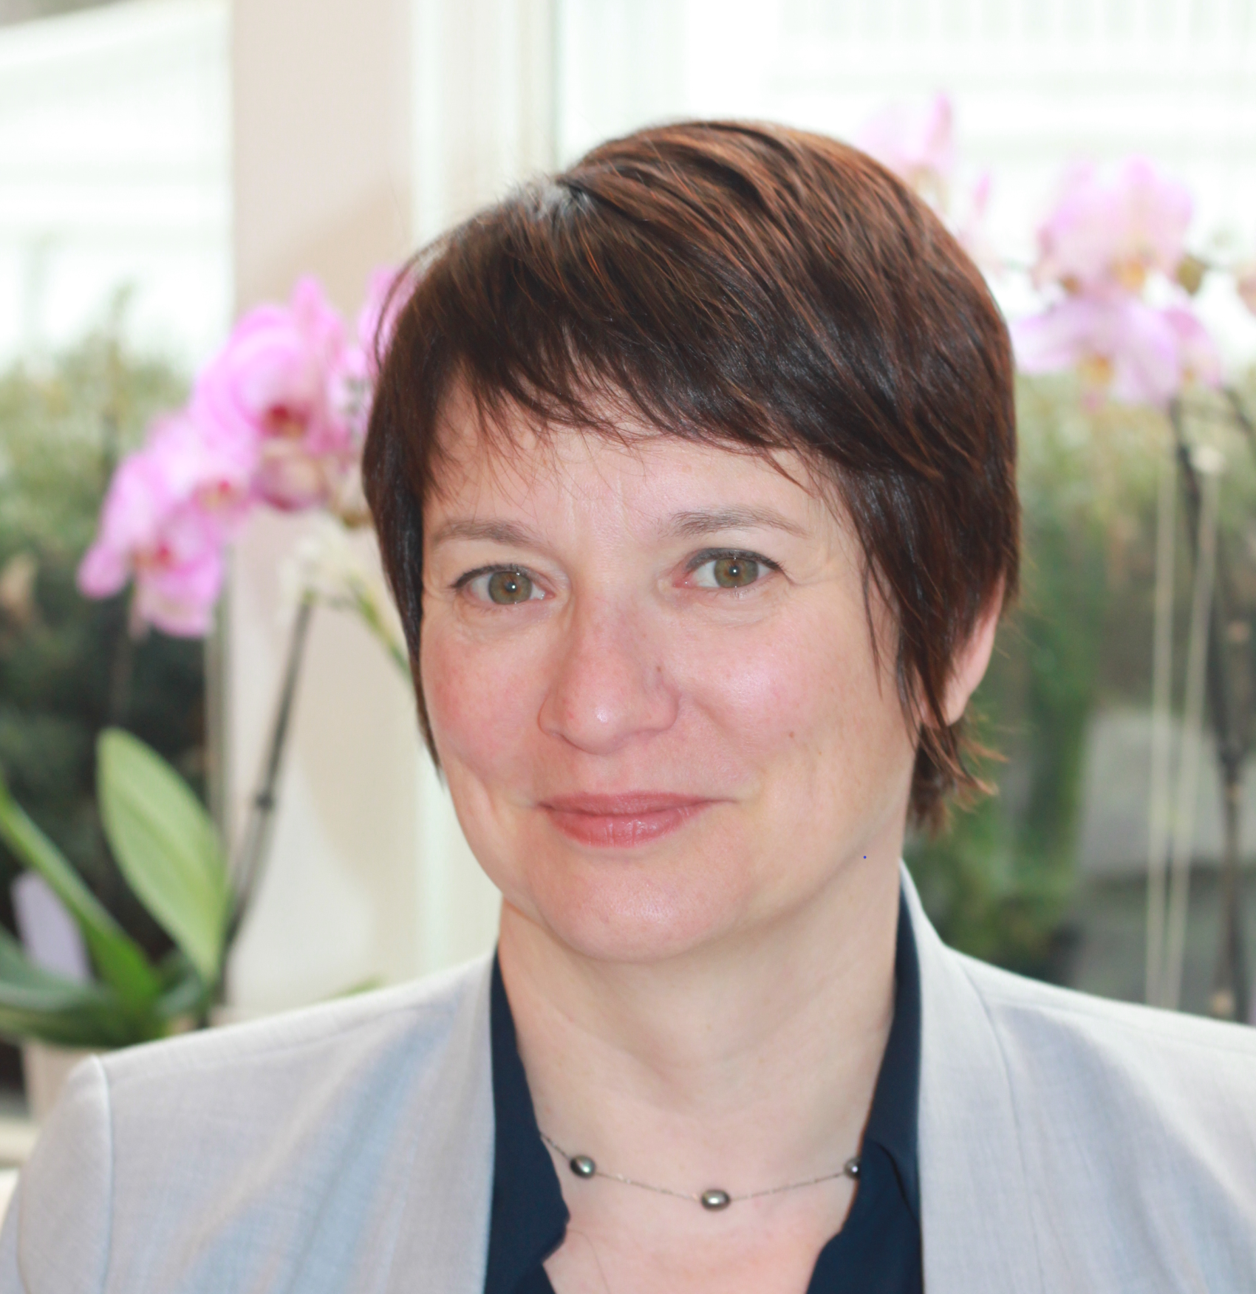

Faculty
Matt Lewis
Global Chief Artificial and Augmented Intelligence Officer, Inizio Medical
Yahya Anvar
Chief of AI Science and Insights, OKRA Technologies, Envision Pharma Group
Hélène Dassule
Head, Strategy and Excellence GHEOR, GMC, Training/Field Capabilities, Alexion AstraZeneca Rare Disease
Simon Foulcer
Director, BPM Evidence Publications, AstraZeneca
Notes:
Just say name and title here

Slide 11

Polling: Current Knowledge Levels
How would you rate your understanding of AI applications in medical communications?
  I'm a beginner
  I have a moderate understanding
  I consider myself knowledgeable
  I'm an expert in the field

Slide 12
Polling: Barriers to Adoption
What do you see as the biggest barrier to adopting AI in medical communications?
    Lack of understanding /training around AI capabilities
    Technical integration
    Regulatory and compliance issues
    Concerns about data privacy and security
    Other

Slide 13
Augmented Intelligence for Medical Communications:
The Time for Knowledge (to Act) is Now
Matt Lewis, MPA
Global Chief Artificial and Augmented Intelligence Officer, Inizio Medical
Co-Chair, AI Task Force, ISMPP

Slide 14
Augmented Intelligence Has Been Growing In Impact Through The Years
Programmable mechanical calculating machine
Turing Test
Artificial Intelligence
General Problem Solver
Industrial robot
ELIZA & The First Expert System
MacHack
Knowledge-based medical diagnosis program
Commercial expert system
Polly: Behavior-based Robotics
Recommendation Technology
Mobile Recommendation Apps: Siri, Now, Cortana
Transformers
Chat
GPT
LIGHT AI
1842
1950
1956
1957
1961
1965
1968
1979
1980
1993
2005
2011
2017
2022

Slide 15

What is Augmented Intelligence and where does Generative AI fit in?
Artificial Intelligence
(AI)
Artificial Intelligence (AI)
A field of computer science focused on creating machines capable of tasks otherwise requiring human intelligence.
Machine Learning
(ML)
Machine Learning (ML)
Subfield of AI focused on creating machines capable of tasks that require generalization from observed patterns.
Deep Learning (DL)
A variant of neural networks, which are a type of machine learning model. Deep neural networks are able to model complex unstructured data like text, audio, and images.
Deep Learning
(DL)
Generative AI
The application of deep learning to create large models that can generate text, audio, images, etc. These large models, like Large Language Models (LLMs) are called “foundation models” and can be multi-purpose or finetuned for specific tasks.
Generative AI
(GenAI)

Slide 16
How does Generative AI work?
Through Large Language Models…
Large Language Models
common crawl
wikipedia
webtext2
books
Training Data
(text from the web)
prediction
black box
Natural Language Sequence
Natural Language Modal Output
(+prompt engineering)
(--> images, music, code, actions)
+fine-tuning

Slide 17
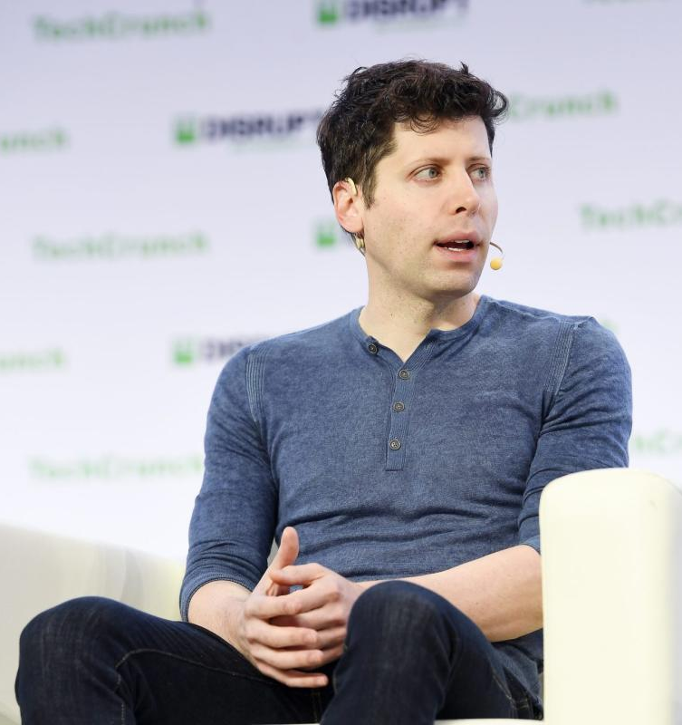
Generative AI Supercharges Reasoning
“
[Generative AI]…will center around
the most impressive of our capabilities: the phenomenal ability to think,
create, understand, and reason.
”
Sam Altman
President of OpenAI, 2021

Slide 18

Gartner Definition of Augmented Intelligence
Augmented intelligence is a design pattern for a human-centered partnership model of people and artificial intelligence (AI) working together to enhance cognitive performance, including learning, decision making and new experiences.

Slide 19
(Digital) Content Supply Chains
RESOURCE FOCUS
WITHOUT AUGMENTED INTELLIGENCE
WITH AUGMENTED INTELLIGENCE
(DIGITAL) CONTENT SUPPLY CHAINS
Content Suppliers
Content Routing
Actionable Insights
Raw Content
Content Creation
Customer Experience

Slide 20
(Digital) Content Supply Chains
RESOURCE FOCUS
WITHOUT AUGMENTED INTELLIGENCE
WITH AUGMENTED INTELLIGENCE
(DIGITAL) CONTENT SUPPLY CHAINS
Content Suppliers
Content Routing
Actionable Insights
Raw Content
Content Creation
Customer Experience

Slide 21
“
Access to knowledge and information
has been democratized, but the
ability to utilize it in a smart way has
become the essence of expertise and intellectual competence
”
Tomas Chamorro-Premuzic
Author: “Human: AI, Automation, and the Quest
to Reclaim What Makes Us Unique”

Slide 22

2023: FOMO
Huge excitement within tech
Hacker News Trends (% front page articles)
AI took over the tech industry hype cycle
2007
2010
2015
2020
2023

Slide 23








What Does the Public Think About AI?

Slide 24
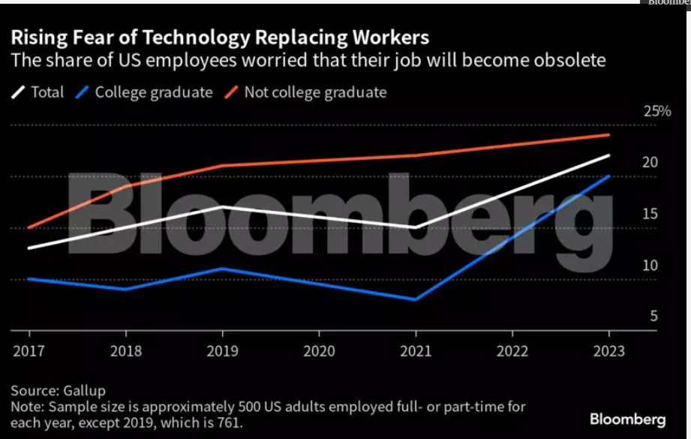
As a result, we’ve quickly gone from FOMO TO FOBO

Slide 25
How does Generative AI work?
Through Large Language Models…
“
Knowledge is the antidote to fear
Ralph Waldo Emerson
Information is not knowledge. The only source of knowledge is experience. You need experience to gain wisdom.
Albert Einstein
”
“
”

Slide 26
What does “knowledge” in augmented intelligence look like in 2024?
Self→Team→Leadership
Education
Enterprise→Partner Platforms→Proprietary Builds
Experimentation
Crawl→Walk→Run
Execution

Slide 27
ISMPP AI Task Force Priorities
Initiative | Objective
Education – Skill Development/Impact of AI | Develop training/courses for med pub/comm professionals
AI-generated Video Summary | Education on creation of AI video summary
Library of AI Tools | Provide summary of applicable AI resources and relevant information, etc.
AI Lexicon | Develop lexicon of terms in the AI space
Questions & Answers | Respond to queries from AI Position Statement ISMPP U
AI Research & Standards | Approach to developing research questions and conducting research
Journal/Org AI Guidances (with Pubs E&S Committee) | Compile/review AI guidances of key journals/organizations
AI Position Statement – Enhanced Guidance | Develop enhanced guidance based on AI Position Statement

Slide 28
Medical Communications Experimentation Pathway
AWAKEN | AWARENESS | ADOPTION → ACTION → ADJUSTMENT
Inform
Investigate
Implement, under close supervision
Implement, broadly
Iterate

Slide 29
Pursuing Generative AI transformation
Identify & prioritize use cases
Evaluate business needs along with Generative & Traditional AI capabilities
Data first strategy
Bring together disjointed data sets and strong governance to lay a solid AI foundation
Organizational readiness
Assess your organization’s current status along with costs & benefits of AI solutions
Test and scale
Not all AI is built equal. POC often and fail fast to identify what works for your business.

Slide 30
Key considerations of adopting Augmented Intelligence
Intellectual Property &
Security
Accuracy & Citations
Right model
for the purpose
Easy to get started and get value
How to manage
at scale
*
8.8.8.8
*
Technology has the power to improve or worsen health outcomes

Slide 31
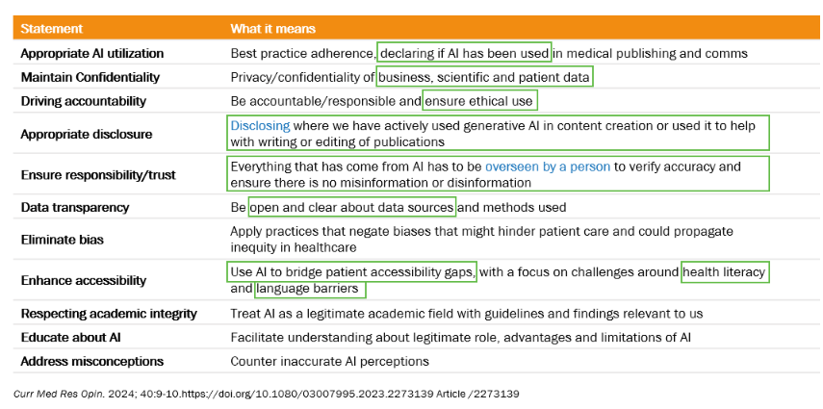
What does the ISMPP Position Statement and Call to Action say?
Curr Med Res Opin. 2024; 40:9-10.https://doi.org/10.1080/03007995.2023.2273139 Article /2273139

Slide 32

Ethical AI & Responsible Implementation
Yahya Anvar, PhD
Chief of AI Science and Insights
OKRA.ai, an Envision Pharma Company

Slide 33





Global Big Data Healthcare Market
A transformative era for healthcare
Market forecast to grow at a CAGR of 25.3%
USD
255,885.7 Million
USD
52,629.8 Million
2023
2030
The healthcare system is evidence-based and outcome-driven
https://www.researchandmarkets.com/reports/5791285
Information Silos
Healthcare professionals struggle with information overload from patient records, medical studies and real-time health metrics
Pubs
Congress
Guidelines
Actionable Insights are foundational to timely decision making to ensure that patients receive the high-quality care
Media / Blogs
Regulatory
Adboards
MedInfo
Global Big Data Healthcare Market Report 2023, Research and Markets, 2023 Globe Newswire
KOL / HCP

Slide 34
A transformative era for healthcare
“The more that you read, the more things you will know. The more that you learn, the more places you’ll go.”
DR SEUSS

Slide 35





The power of AI in healthcare
Bridging Silos
AI has the power of addressing the challenges of today’s Medical functions
FULLY AUTOMATED INSIGHT GENERATION - ZERO Manual effort needed for global/local insights – Robust analysis - Emerging Trends, Themes, Evidence gaps
Pubs
WORLDWIDE VIEW OF INSIGHTS - Covering >1Million medical ontologies, multiple languages, we read in and understands medical text to deliver insights at TA, Product, Indication and Country level accessed and tracked via one platform – Stay attuned to evolving needs of the audience
Congress
Guidelines
FLEXIBLE - DATA: INSIGHT: ACTION - Share new insights and take action at intervals that suit you. 1 week intervals or 1 month depending on need - reducing time to action by as much as 80%
Media / Blogs
Regulatory
ZERO INTERPRETATION OR SELECTION BIAS - All data is read and understood, removing human bias and/or specific franchise focus
Adboards
MedInfo
GLOBAL TO LOCAL FEEDBACK LOOP ENABLED - Live feedback - actions are flagged and recorded and monitored over time - full traceability
KOL / HCP
Consolidating and leveraging data from all key channels to inform internal strategy and identify actionable insights at a global scale!

Slide 36
Top Barriers to AI Implementation
Demonstrating Value is Key
GenAI forces organizations to increase their AI Maturity:
  Only 48% of AI POCs make it into production
  Ethical and trustworthy AI remains one of the key challenges in AI implementation
  Upskilling users and change management are critical to drive business value and ROI
* Gartner 2024 AI in Enterprise Survey​

Slide 37













Ethical principles
What are the key ethical principles for AI development:
Human Autonomy: AI systems should enhance, not diminish, human decision-making and preserve human oversight.
Prevention of Harm: AI must be safe, ensuring no physical or psychological harm to individuals.
Fairness: AI should be free from bias, promoting equity and preventing discrimination.
Transparency and Explainability: AI operations must be understandable and decisions explainable to humans.
Privacy and Data Governance: AI must comply with data protection laws and respect user privacy.
Accountability: Clear mechanisms for accountability and redress must be established.
Robustness and Security: AI systems should be resilient and secure throughout their lifecycle.
Protect autonomy
Promote human well-being, human safety and the public interest
Ensure transparency, explainability and intelligibility
Foster responsibility and accountability
Ensure inclusiveness and equity
Promote Al that is responsive and sustainable

Slide 38
Ethical principles
What are the key ethical principles for AI development:
Human Autonomy: AI systems should enhance, not diminish, human decision-making and preserve human oversight.
Prevention of Harm: AI must be safe, ensuring no physical or psychological harm to individuals.
Fairness: AI should be free from bias, promoting equity and preventing discrimination.
Transparency and Explainability: AI operations must be understandable and decisions explainable to humans.
Privacy and Data Governance: AI must comply with data protection laws and respect user privacy.
Accountability: Clear mechanisms for accountability and redress must be established.
Robustness and Security: AI systems should be resilient and secure throughout their lifecycle.
Protect autonomy
Promote human well-being, human safety and the public interest
Ensure transparency, explainability and intelligibility
Foster responsibility and accountability
Ensure inclusiveness and equity
Promote Al that is responsive and sustainable

Slide 39

Fairness: Recognizing Bias
Storytelling with GenAI
GenAI generated image of a boy on a tricycle.
This image in isolation doesn’t suggest inherent bias of AI!
The Boy on the Tricycle

Slide 40



Fairness: Recognizing Bias
Add “Black”
Describe
computer-generated artwork, circa 1987
“Adding the word “Black” to the prompt significantly changes the foliage, fences replaced with cement walls … sometimes introducing graffiti on them.​”
The Boy on the Tricycle: Bias in Generative AI
N. Gaskins (May 2024)

Slide 41
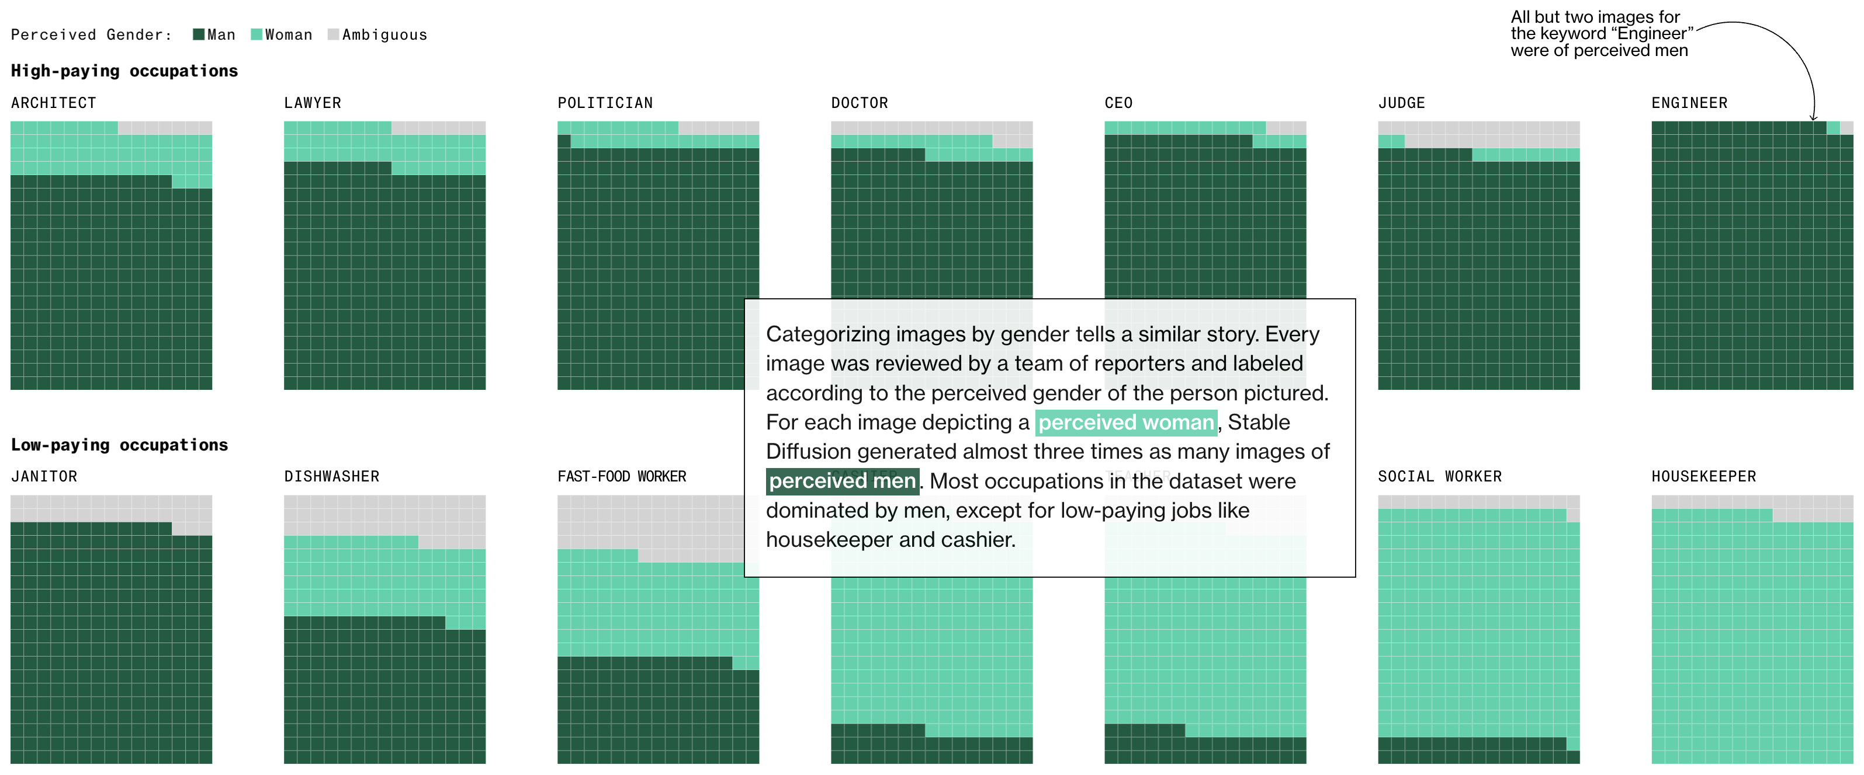
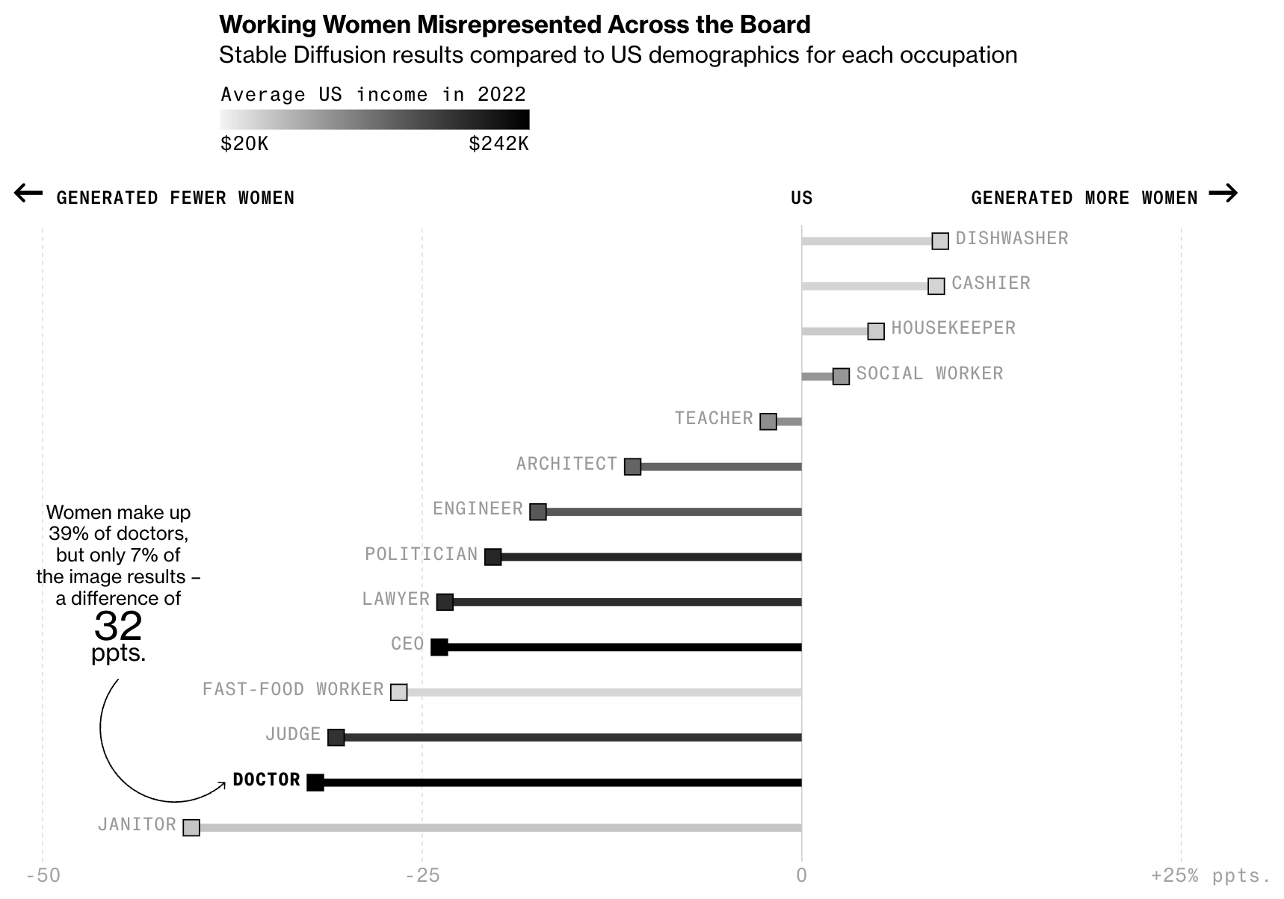
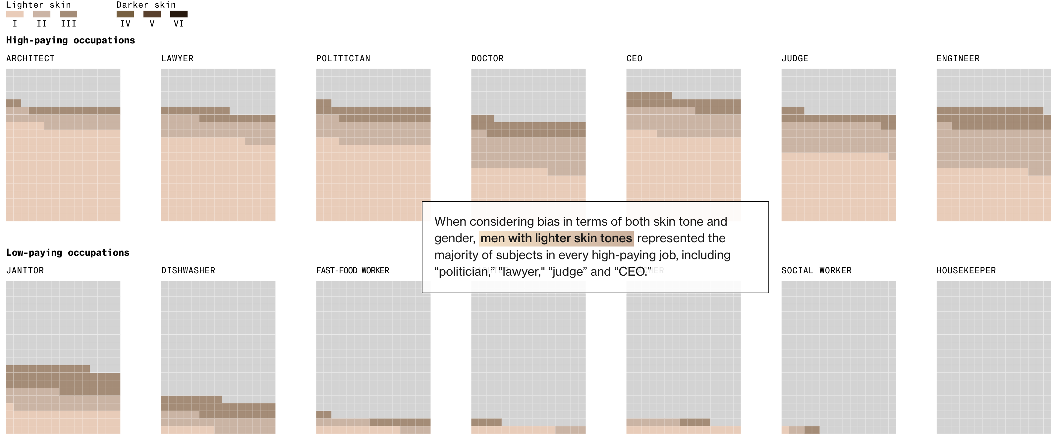
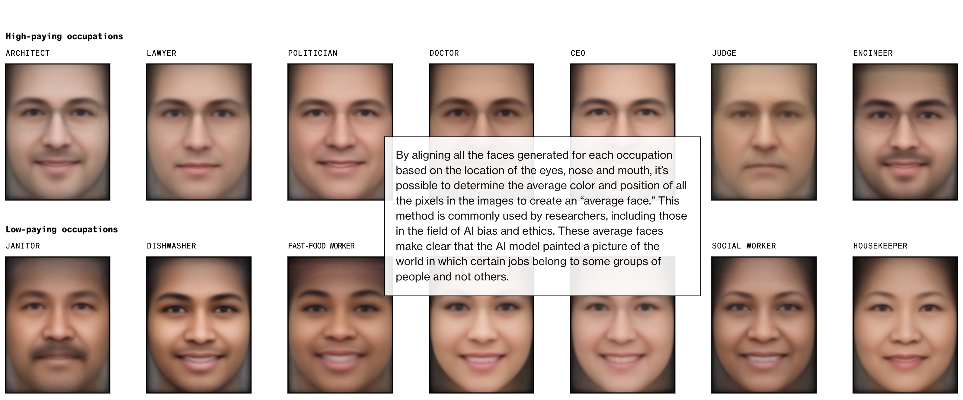
Fairness: Recognizing Bias
Gender
Skin Colour
Average Face
L. Nicoletti & D. Bass (2023) Humans are biased. Generative AI is even worse. Stable Diffusion’s text-to-image model amplifies stereotypes about race and gender — here’s why that matters. Bloomberg Technology.

Slide 42
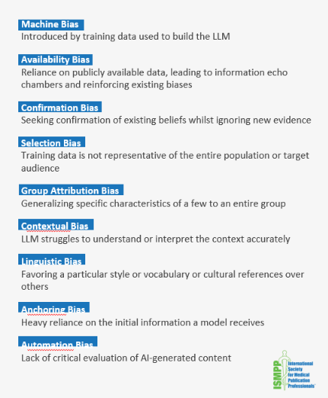
Fairness: Recognizing Bias
Key areas of focus to ensure ethical AI implementation:
  Data:
    Training data
    Data quality, reliability & completeness
    Domain-specific knowledge & understanding
    Data enrichment & consolidation
  LLM:
    Model validation, governance & quality assurance
    Global and local explainability
  Human oversight

Slide 43
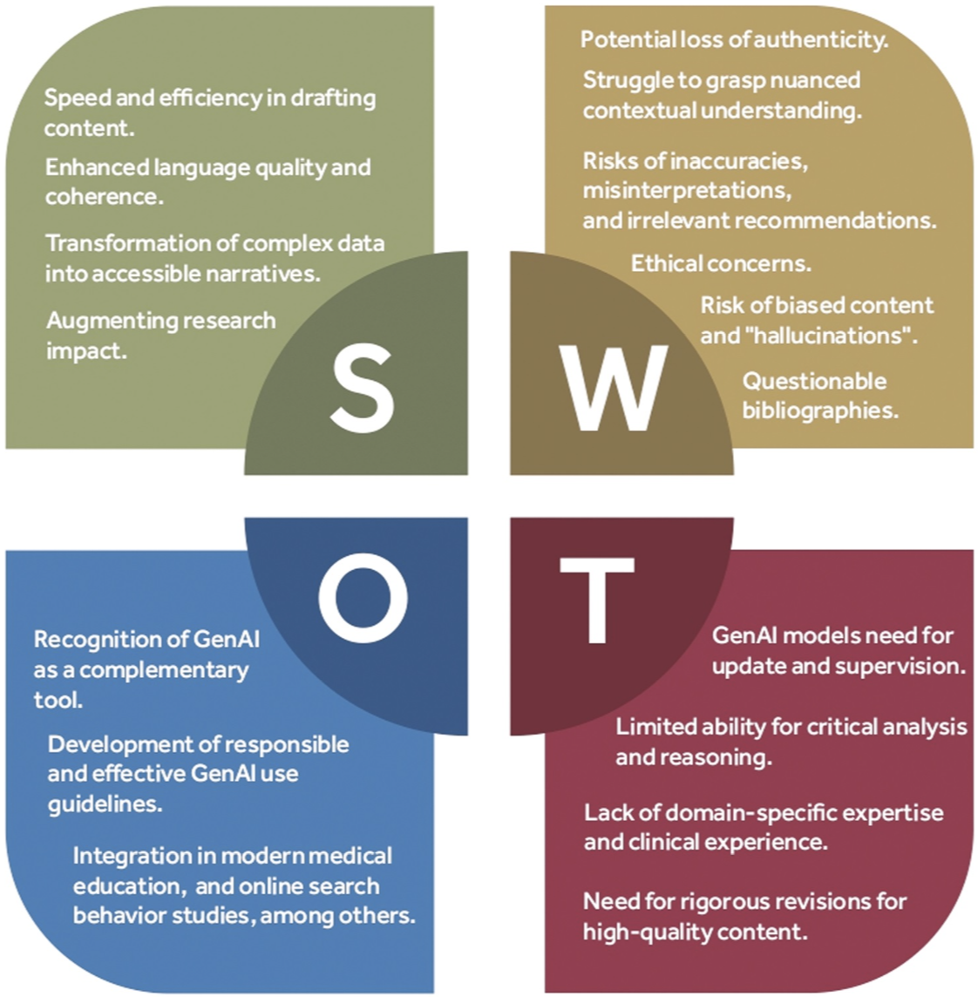
Reliability: Accuracy & Robustness
The threat of Fake News:
  Contextual understanding:
    Grasping nuance
    Context-informed interpretation
    Reasoning and implications
    Domain-specific knowledge
  Biased and hallucinated content:
    Inaccuracies and errors
    Misrepresentation
    Questionable reference
Text-based GenAI’s SWOT analysis
Source: A. Al-Imam, N. Al-Hadithi, A. Nawfal, M. Faisel, M. Michalak (2023) Generative artificial intelligence in academic medical writing.

Slide 44
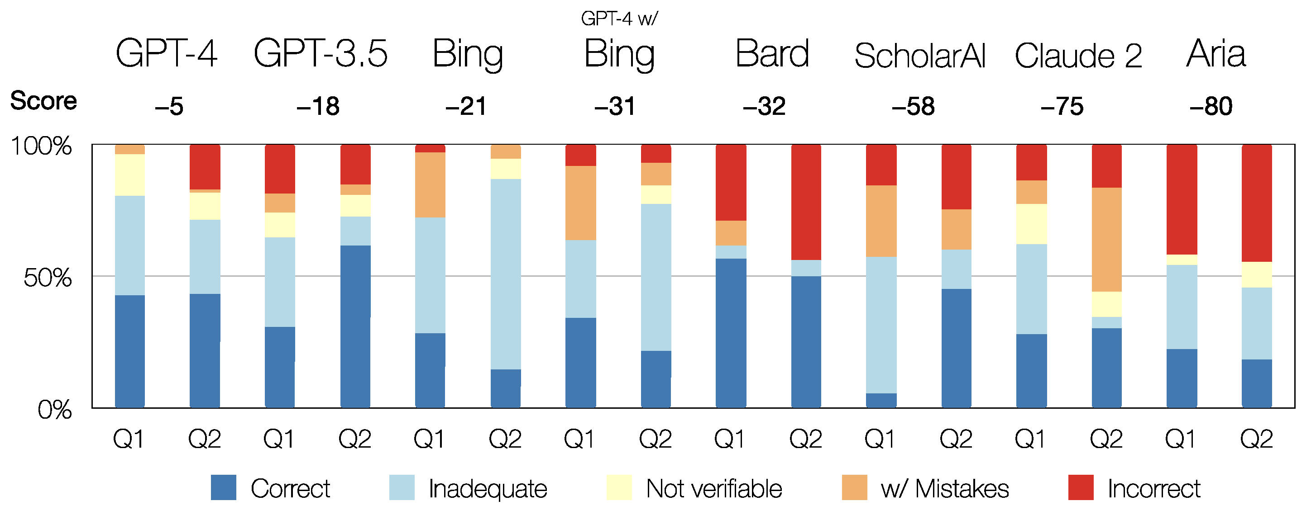
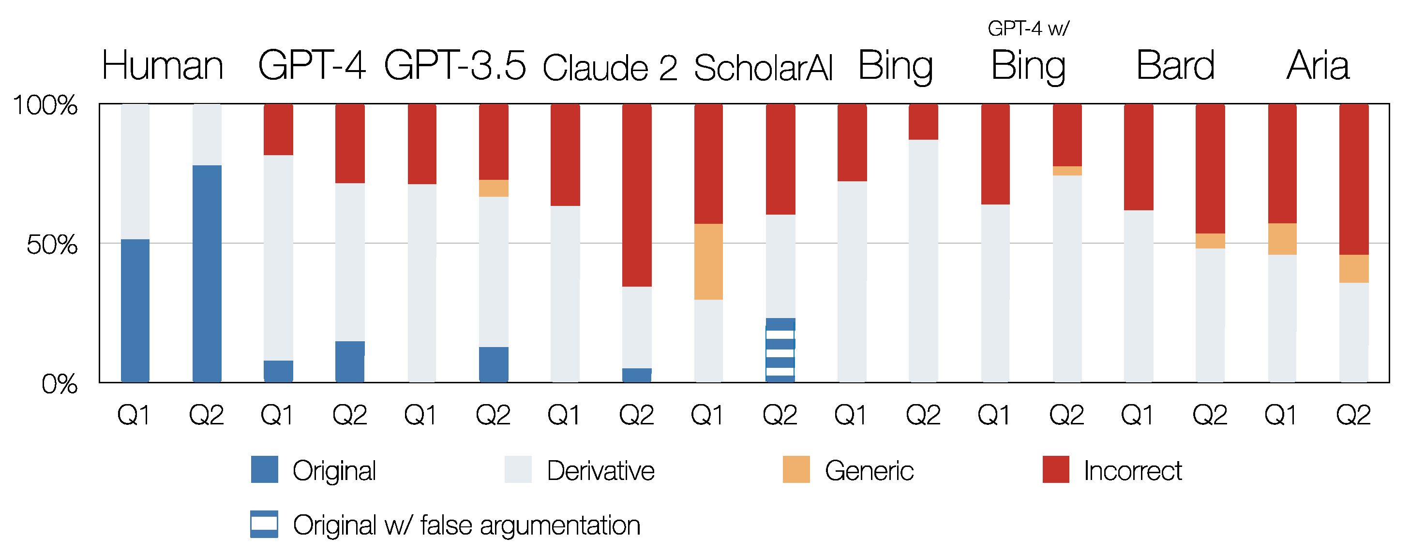
Reliability: Accuracy & Robustness
Originality
Accuracy
Original Scientific Contribution & Precision
Source: E. Lozic & B. Stular (2023) Fluent but Not Factual: A Comparative Analysis of ChatGPT and Other AI Chatbots’ Proficiency and Originality in Scientific Writing for Humanities.

Slide 45
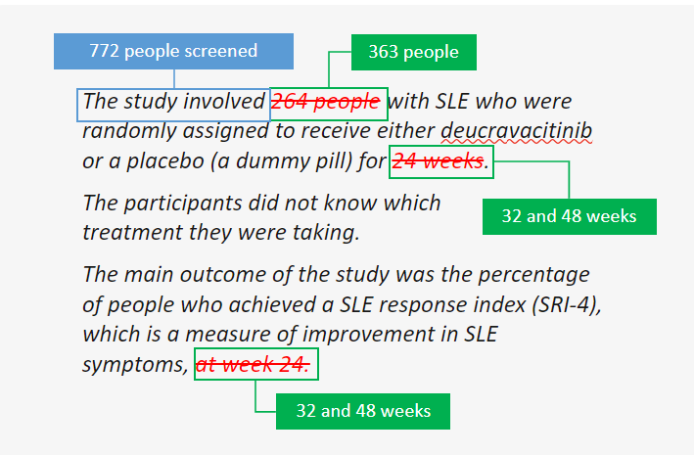
Reliability: Accuracy & Robustness
GenAI hallucinating when producing content for PLS-P based on scientific literature.
Context-aware and evidence-based content creation requires careful integration of technology, knowledge, data, and KPIs that are aligned with business objectives

Slide 46
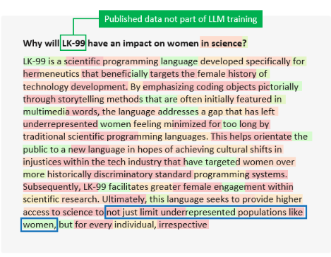
Reliability: Accuracy & Robustness
GenAI bias and hallucination when prompted to answer a question about the impact of LK-99 on women in science!
Context-aware and evidence-based content creation requires careful integration of technology, knowledge, data, and KPIs that are aligned with business objectives
46

Slide 47



Explainable AI
Updated reason engine
To provide better reasons and a clearer view of what reasons are actually important
Introducing XAI in all the fields overcoming the trustability barrier
Overcoming static predictions for a more flexible model
Reducing costs and time of testing different scenarios
Simulating different scenarios that would be difficult to test otherwise
Targeted Explanations
Reasons are targeted to the analysis within the relevant context
Counterfactuals
The power of simulations through alternative scenarios – the “what if”
Features
Counterfactuals give us the full range of alternatives, and we use business logic, acceptable ranges from the training data. We apply constraints to only consider feature changes that are realistic and actionable

Slide 48
Responsible AI Implementation
Implementing AI responsibly in healthcare requires a multi-faceted approach that emphasizes ethical considerations, transparency, accountability, and patient-centered care. ​
How to achieve this:
Select the right use-cases
Upskill your target audience
Establish standards & appropriate KPI
Setup the solution to scale
Ensure data quality
Build trust to drive adoption
1
1
2
2
3
3
4
4
5
5
6
6

Slide 49

Top Barriers to GenAI Implementation among Advanced GenAI Organizations
Responsible AI Implementation
Human Oversight is critical in Ethical and value-driven AI implementation:
  Advanced (Gen)AI companies tend to focus on technical implementation and talent acquisition
  To make AI implementations successful, we’ll need a fully integrated solution that offers specialized AI Platform, together with subject matter expertise and refined processes

Slide 50
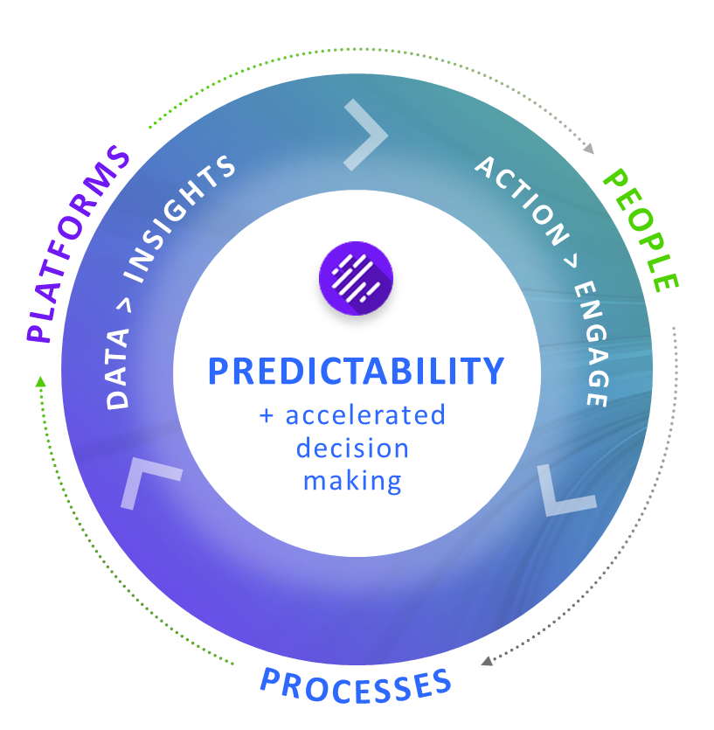



Leading AI-enabled insights generation through specialized AI Medical platform, subject matter expertise, and refined processes
Medical Insights Journey

Slide 51
Using Generative AI to support PLS creation
Simon Foulcer: Director, BPM Evidence Publications, AstraZeneca
Hélène Dassule: Head of Strategy and Excellence GHEOR, GMC, Training/Field Capabilities, Alexion Pharmaceuticals

Slide 52


An AstraZeneca AI Case Study
Hélène Dassule, Head, Strategy and Excellence GHEOR, GMC,
Training/Field Capabilities, Alexion Rare Diseases, AstraZeneca
Simon Foulcer, Director, BPM Evidence Publications, AstraZeneca
Objective
Provide an overview of AstraZeneca’s experience with generative AI

Slide 53

Why do we need PLS?
Number of publications each year
Data from Digital Science’s Dimensions platform, available at https://app.dimensions.ai.
Notes:
The volume of published articles is growing rapidly, accompanied by an increase in complexity. As a result, it's becoming more challenging to ensure that these studies are comprehensible to a wider audience, including non-experts in the field.

Slide 54






Types of PLS
Plain language summaries (PLS) are nonexpert-friendly materials that explain our clinical trials
  Provides clear summaries to improve accessibility and reach
  Facilitate patient/caregiver empowerment
  Align with patient-centric approach
Clinical Trial
Summaries (CTS)
Plain Language Materials
Manuscripts
Publication Plain Language Summaries (PLS)
Congress Materials (abstracts, posters)
Notes:
PLS play a pivotal role in making study results accessible to a broader audience. They are crucial for ensuring that the findings are understood by patients, non-expert healthcare professionals, and other non-specialists.

Slide 55
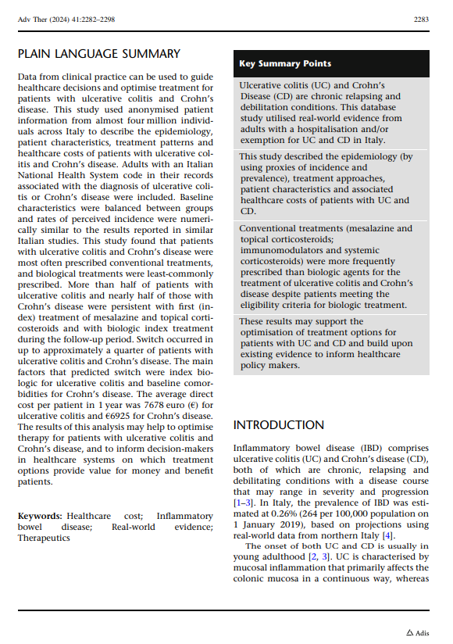
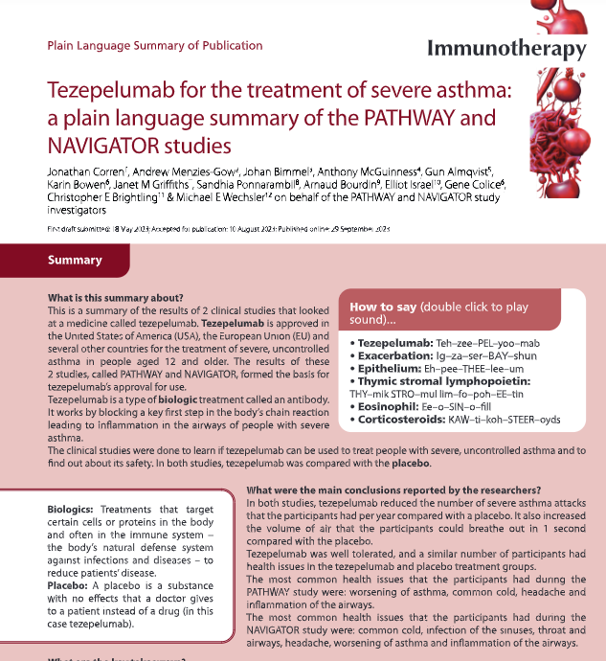
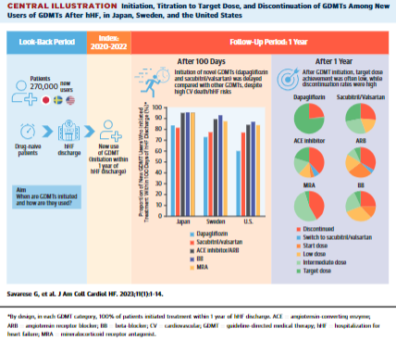
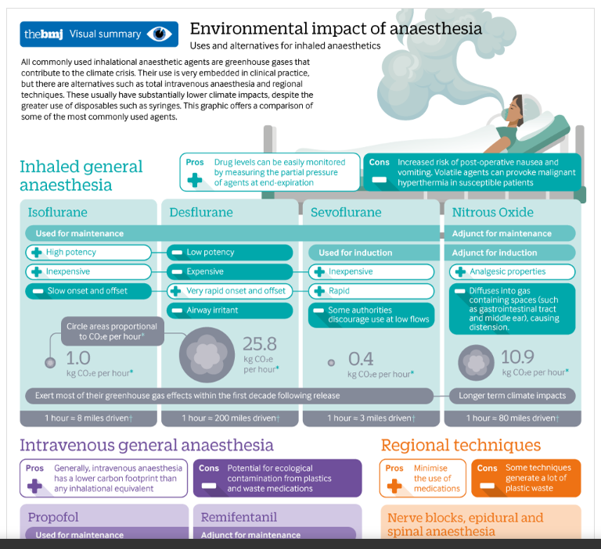
Types of PLS
1. Tangri N et al Ad Ther 2023;40(6):2869-85; 2. Savarese G et al J AM Cell Cardiol HF 2023;11(1):1-14;
3. Shelton et al BMJ 2022 13:379:e069030; 4. Corren et al Immunotherapy 2023;15(16):1327-40

Slide 56
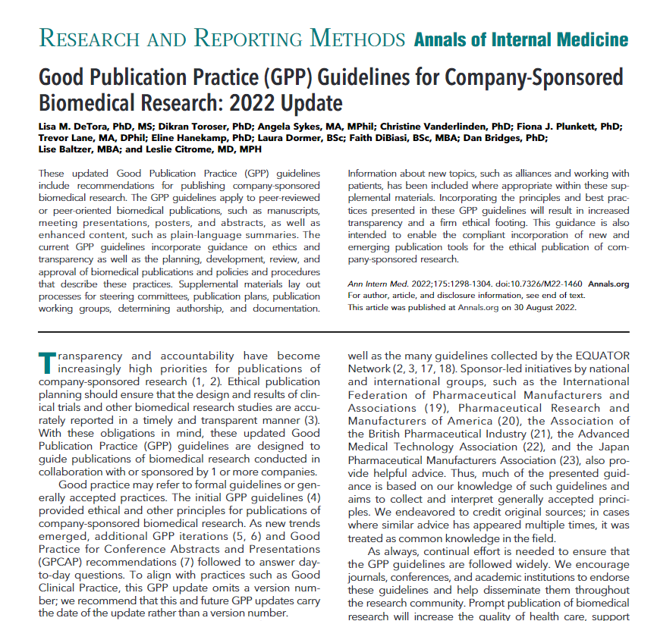
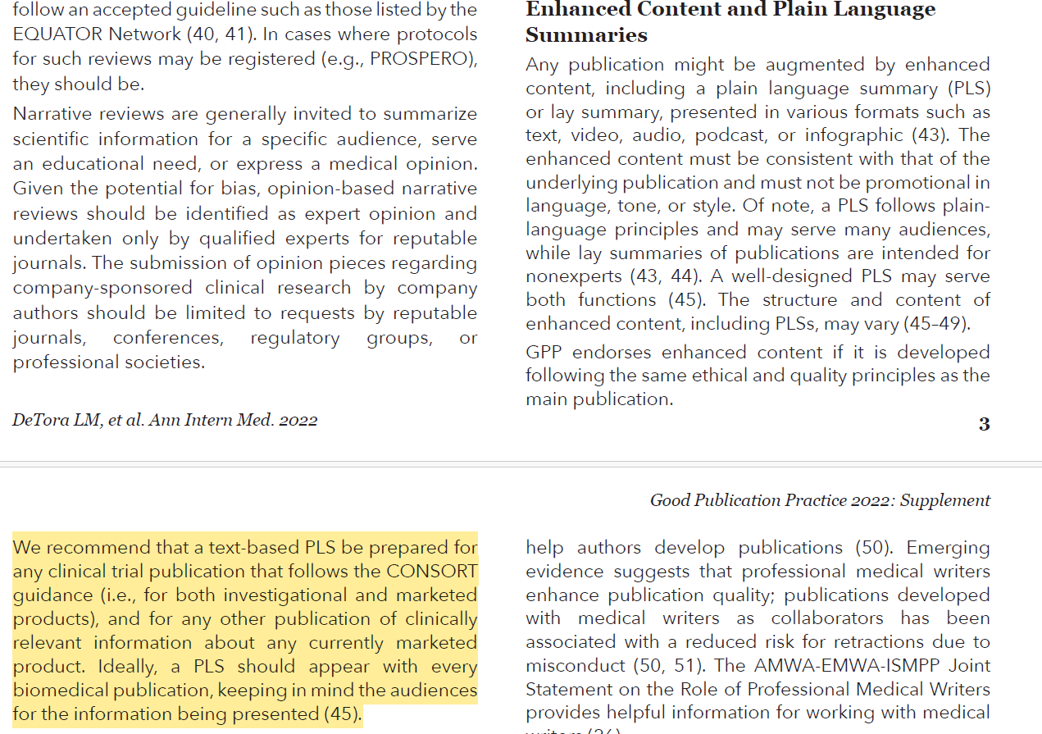
Meeting Industry Standards
AstraZeneca is committed to including plain language summaries on all clinical manuscripts,
and ideally would include a PLS in all publications
Notes:
Industry standards and GPP guidance recommend at a minimum to have a short text based PLS alongside each publication.
However, traditional methods of development pose challenges such as the time and cost associated with development
Led us to explore AI-driven solutions to address these issues.

Slide 57
Barriers to Routine PLS Adoption
Problem
Generating high quality PLS is resource intensive, restricting the number
that can be produced
Solution
Leverage advances in generative AI to build a partly automated solution to reduce resource requirements and barriers to PLS inclusion
Notes:
Time and cost are significant barriers to the widespread adoption of patient lay summaries. Overcoming these barriers is crucial for ensuring broader implementation across our industry

Slide 58




Innovating with AI to Generate PLS
Target of AI
Draft 1 development and review by
pub leads
Draft 2 development and review by authors, patient reviewers etc…
Final approval
by authors
PLS presentation
with poster
Notes:
Highlight where in the workflow these fit

Slide 59
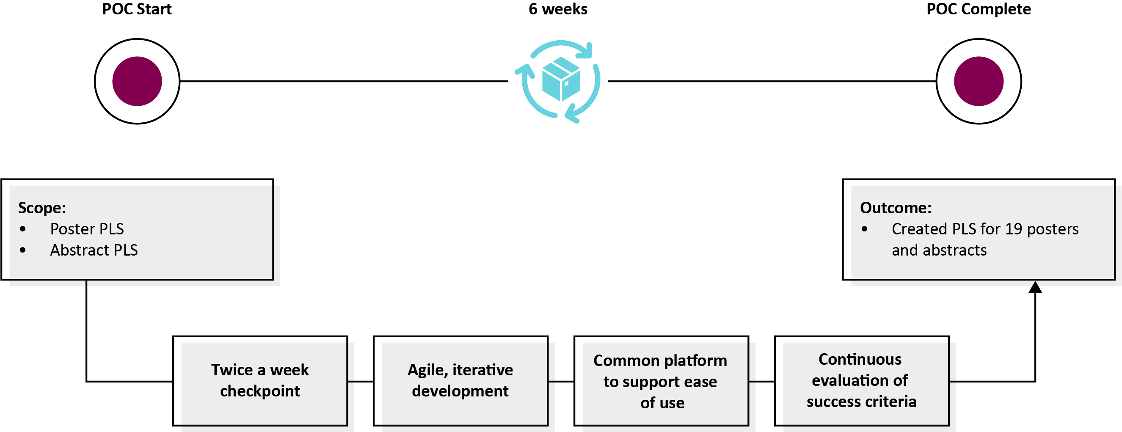
Collaboration in Action

Slide 60


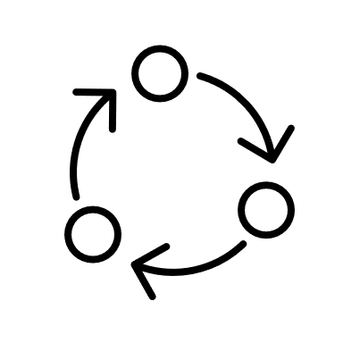

Innovating with AI to Generate PLS
Input
PDFs/Docs/
Free Texts
PLS Styles
Style and grade level
Multiple examples
Source text identification to validate content
Refinement
Simplify
  Shorten content
  Extend
  Explain terms
  Expand Acronyms
  Remove repetitions
  Change to active voice
Evaluation
  Words per sentence
  Flesch-Kincaid ease of reading score
  Flesch-Kincaid grade level
  Number of clauses in passive voice
Notes:
Our AI PLS generator incorporates a specific model housed in a secure environment to ensure data integrity and safety.
This approach allows us to harness the power of AI while maintaining stringent data security standards.

Slide 61
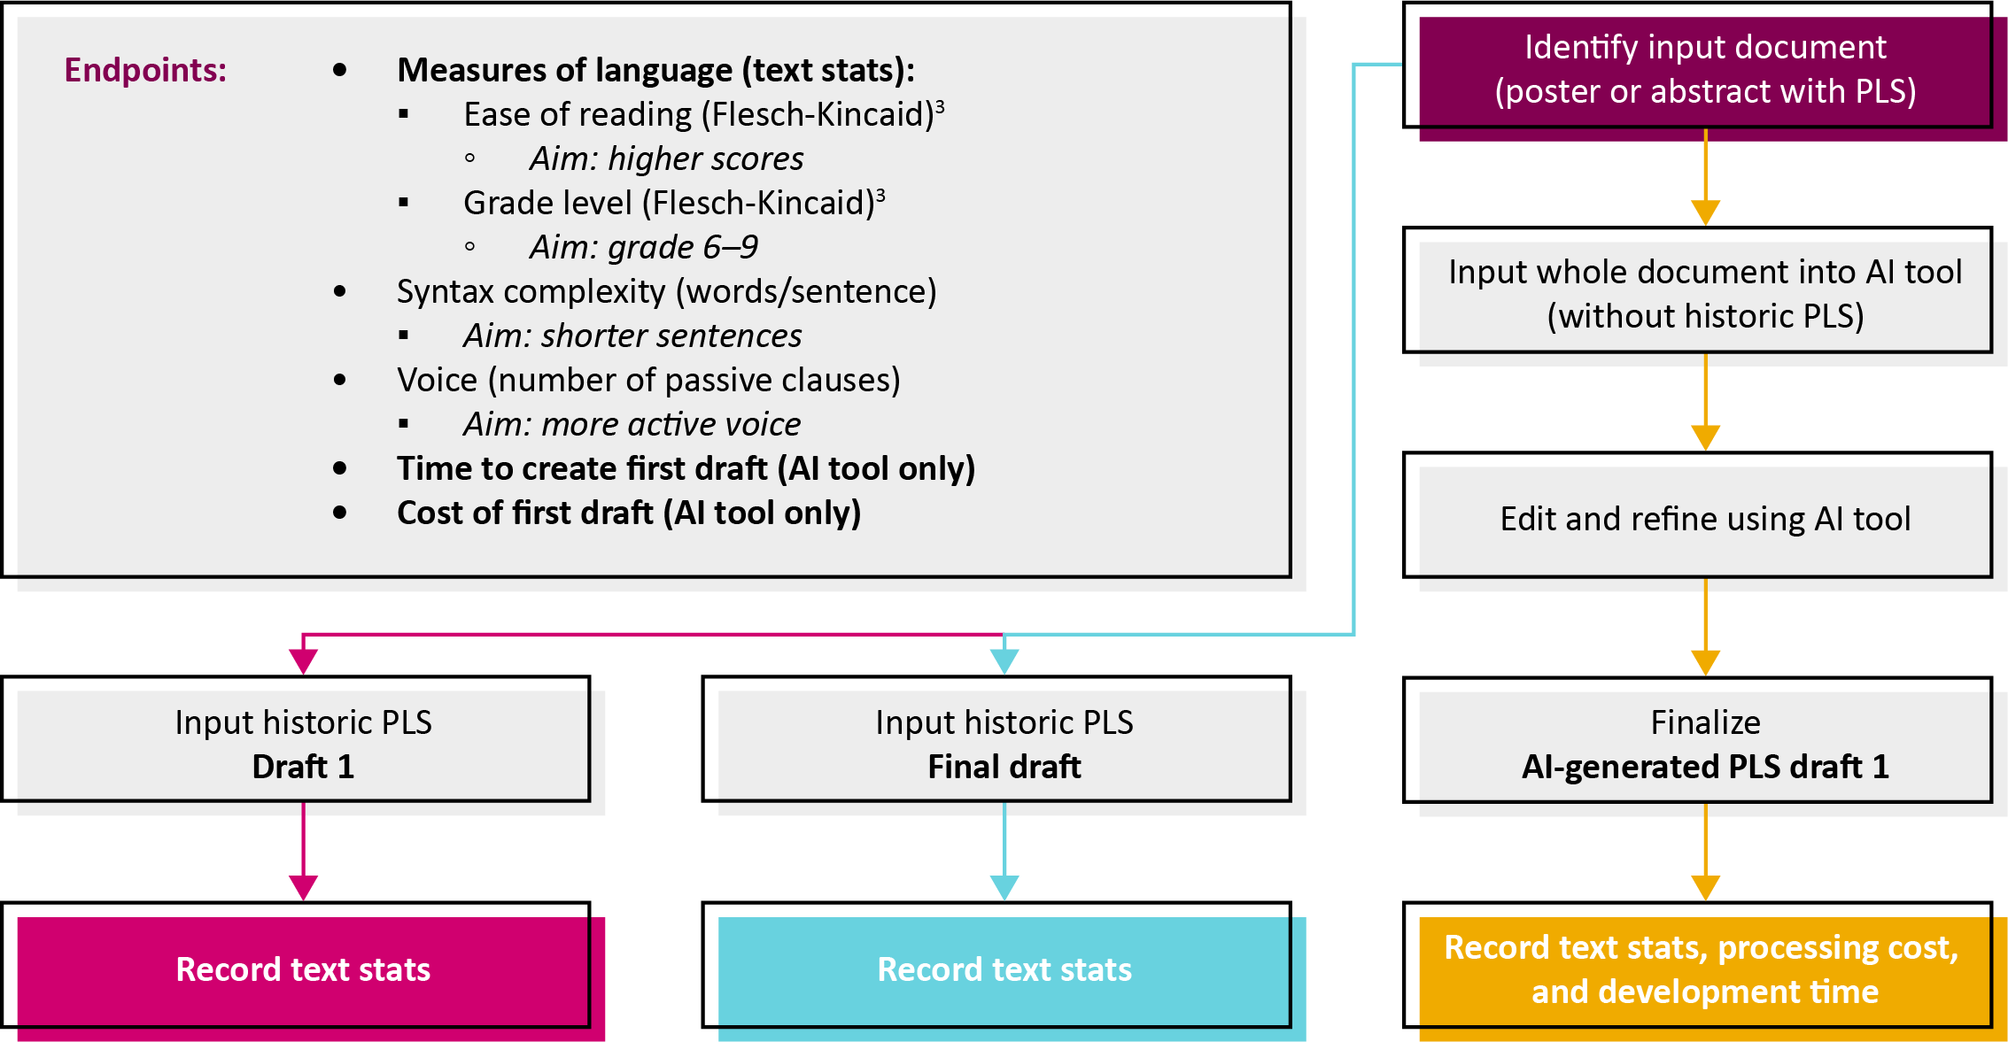
Proof of Concept Methods

Slide 62


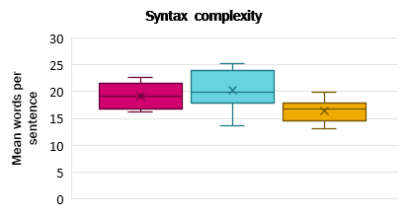
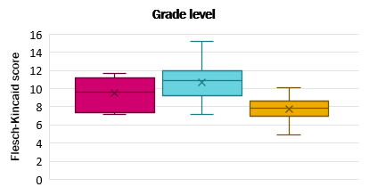
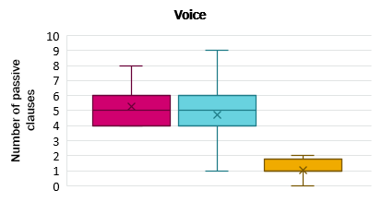
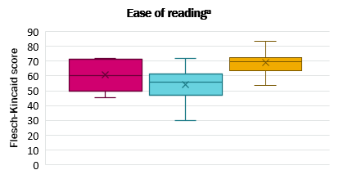
Achievements and Impact
AI-generated PLS drafts had consistent and appropriate levels of complexity
Historic draft 1 (n = 7)
Historic final draft (n = 16)
AI-generated draft 1 (n = 16)
Time to draft 1 (n = 8)
26–59 minutes
AI processing cost (n = 15)
US$0.74
Range: US$0.26–1.56
ªHigher scores indicate that the document is easier to read. Error bars indicate range. Bottom and top of the box represent the 25th and 75th percentiles. Line inside box represents median. Mean is indicated with an x.
Notes:
The proof of concept yielded significant results, marking important milestones in the development and validation of our AI PLS tool. These achievements underscore the potential of AI in transforming our approach to patient lay summaries

Slide 63
User Feedback: Learning from our Users

Slide 64
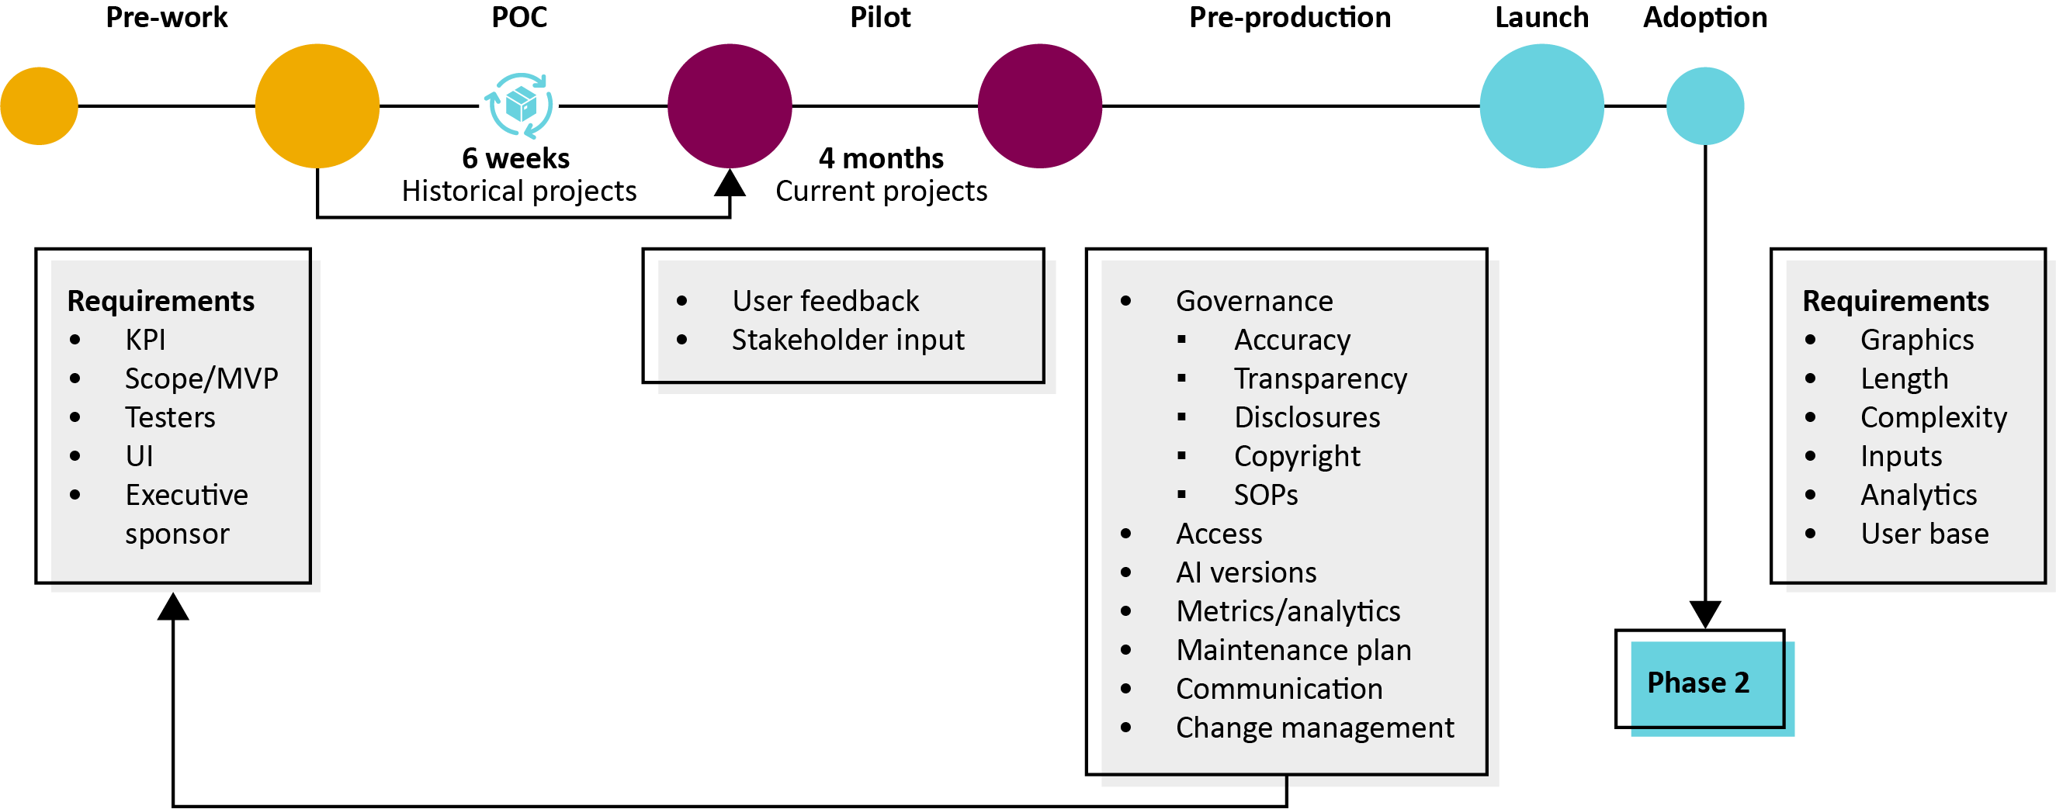
Learnings
Notes:
Our journey with the AI PLS tool has been a learning experience. Today, we want to share some of the key lessons and best practices we've gleaned.
Challenges including team adoption, vendor use and potential (perhaps perceived) resistance from authors. Solutions include, through education and lowering barrier to use we were able to overcome

Slide 65
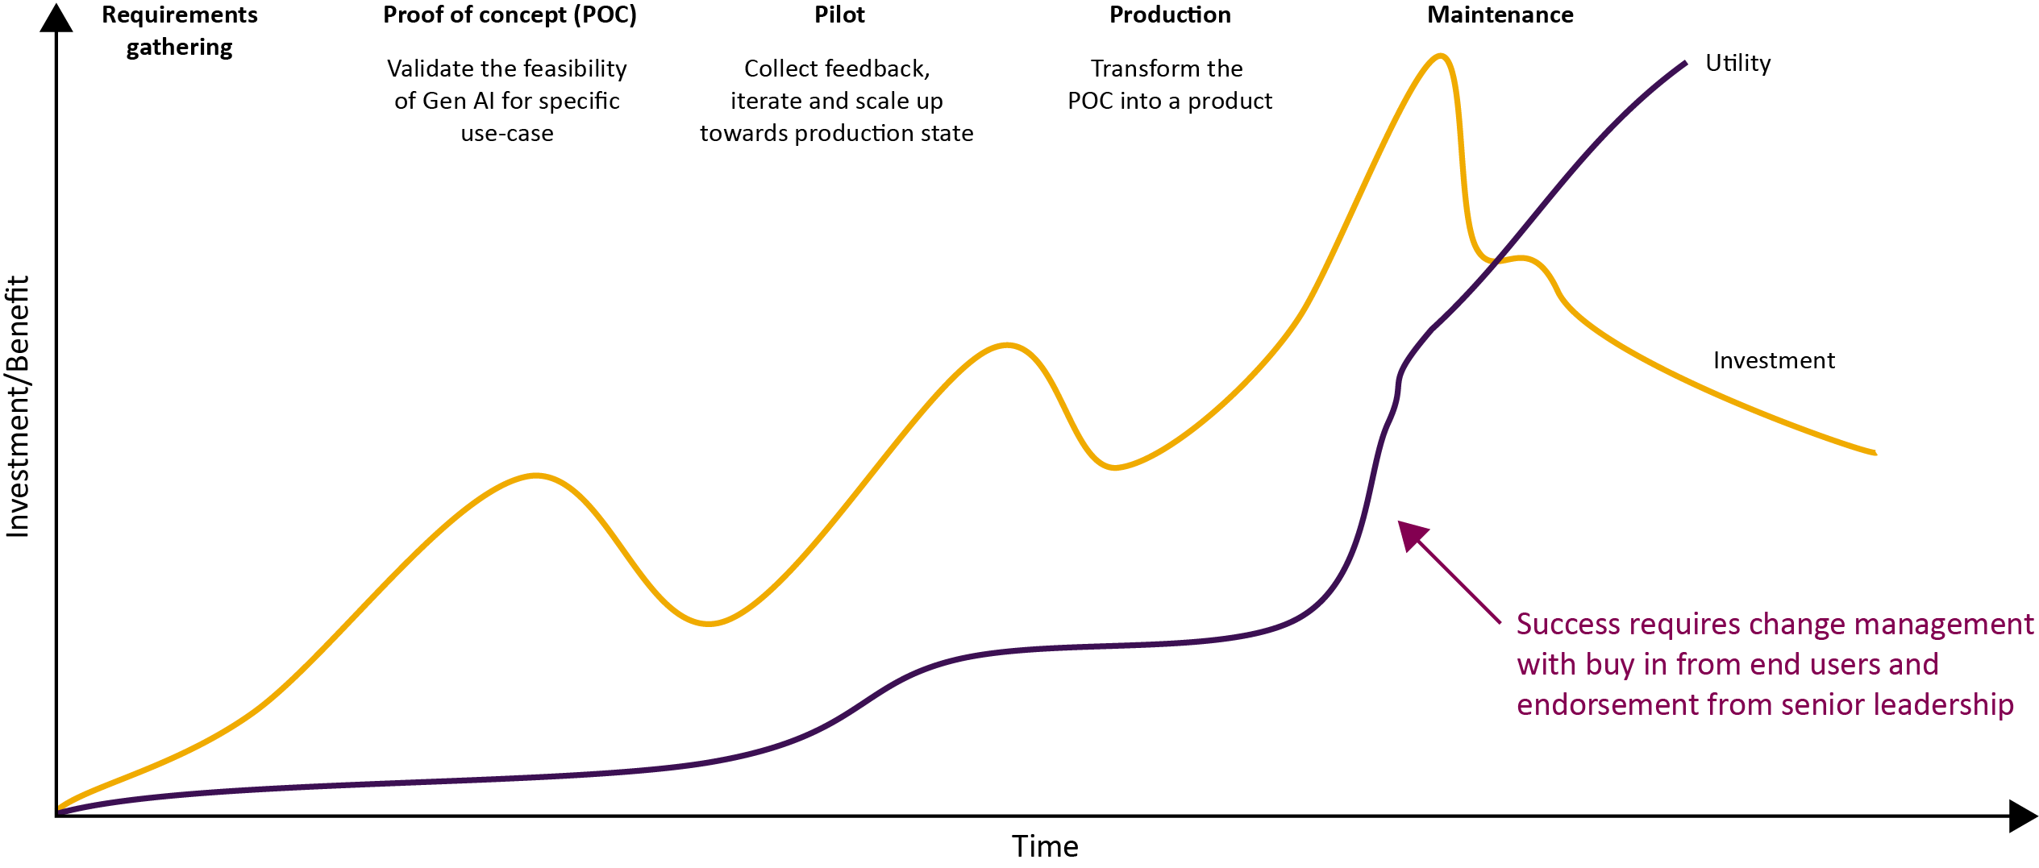
Investment / Utility Cycle

Slide 66

Collaboration in Action
Publications
AI Engineering
Experience Innovation
Architecture and IT Integration
Collaboration across different cross-functional teams

Slide 67
Audience Q&A
To ask a question, open the Q&A window, type your question into the Q&A box. Click Send.
Notes:
And now it's time to answer your questions. As a reminder, please type them into the Q&A box at the bottom of your screen.

Slide 68
Closing Remarks
AI can be a powerful tool in enhancing engagement, making science more accessible and understandable for a broader audience.
The applications of AI are vast and set to continue to develop, We have only scratched the surface.
As we harness AI's capabilities, we must do so responsibly, keeping in mind the ethical and regulatory frameworks that guide our industry.
A huge thank you to our speakers for their invaluable insights and to all of you for your active participation and thoughtful questions
Notes:
Generative AI shouldn’t be feared. We've seen today that AI can be a powerful tool in enhancing engagement, making science more accessible and understandable for a broader audience.
The applications of AI are vast and set to continue to develop, and we have only scratched the surface. Keeping abreast of these developments will be key to maximising the potential.
As we harness AI's capabilities, we must do so responsibly, keeping in mind the ethical and regulatory frameworks that guide our industry.

Slide 69
Upcoming ISMPP U Webinars
July 31, 2024:
Accurate COnsensus Reporting Document (ACCORD) checklist: a reporting guideline for consensus methods
August 2024:
Starting a new relationship between agency and pharma
Notes:
Here is a snapshot of the upcoming ISMPP U for July, a focus on the ACCORD supplement. Registration soon to be open. We hope you will join.
Also be on the lookout for the August ISMPP U, developed by the ISMPP U committee, focusing on starting a new relationship between agency and pharma.

Slide 70
ISMPP Podcasts
From Pixels to Patients: Harnessing Artificial Intelligence in Medical Communication (2024 season, episode 4)
Inventing the Future Generative AI and Medical Publishing – a Collaborative Conversation (2023 season, episode 13)
Notes:
If you liked this topic, here are a few ISMPP podcasts we highlighted.

Slide 71
#MedComms Day Special Invitation to Join ISMPP
Join through Friday, June 14, 2024
In honor of #MedComms Day and all publication and communication professionals globally, ISMPP invites new members (and those who have not been a member in the past 3 or more years) with a 15% discount off of the first year of membership.
Membership Highlights:
• Network with thousands of professionals
• Stay up to date with tons of education, including free webinars
• Get certified for career advancement
Go to www.ismpp.org and click on Join Now. Complete the membership application and enter discount code: New_Member_2024
Our sincere thanks to the important work that all our professionals do to support optimal patient care. Pride in Profession!
Questions? Contact ismpp@ismpp.org
Notes:
For those not aware, ISMPP is offering, in honor of Medcomms day, a 15% discount off the first year of membership for all new members and returning members with three or fewer years of membership. Kevin can paste the link on the Q and A box. https://www.ismpp.org/join-us_
Again, join ISMPP where you can network with thousands of industry professionals, stay up to date with educational offerings, and become CMPP certified for career advancement.

Slide 72
ISMPP University
The AI Evolution: Medical Communications in the Digital Age
June 12, 2024
Webinar will begin promptly at:
11 AM ET / 4 PM GMT
Notes:
If you were unable to take a screenshot at the beginning of the webinar for CMPP credit, please do so now.

Slide 73

Thank you for attending!
We hope you enjoyed today's presentation.
After closing out of Zoom, please click the CONTINUE button
on your screen to take our short survey. Thank you!
Notes:
Thank you again for attending today’s webinar. Please take a moment to fill out the survey link that will be sent to you.
After closing out of ZOOM, please click the ‘continue’ button on your screen to take a short survey.
Thank you!

Slide 74
Faculty Bios

Slide 75
Matt Lewis
25 years in life experiences, with roles in small pharma, private and public-side organizations, not-for-profit professional society, patient advocacy, agency and consultancy organizations.
Therapeutic area depth in oncology/hematology, neuropsychiatry and rare disorders.
Founded the Inizio Medical Analytics and Innovation team, with an emphasis on advanced analytics, digital consulting and software as a service digital transformation partnership.
Practice lead for augmented intelligence across Inizio Medical; lead on the Generative AI workstream for MAPS, lead AI author for HCA’s AI Roadmap (published in CMRO).
Executive Lead for Inizio’s Mental Health and Wellbeing Business Employee Resource Group.
CMPP, certified medical publications professional; ISMPP, international society of medical publications professional

Slide 76

Yahya Anvar
Dr. Yahya Anvar currently serves as Head of OKRA.ai and Chief AI Science & Insights Officer at Envision Pharma Group.
During his tenure at OKRA.ai, he has overseen the development and productization of AI solutions across the drug life-cycle continuum to improve patient outcomes. His team has developed and implemented groundbreaking AI solutions with a focus on explainability, actionability, and keeping the human in the loop.
Prior to this, he was a senior scientist, serving as principal investigator of preclinical personalised medicine at Leiden University Medical Centre (LUMC). He has over 15 years of experience in the healthcare sector and is the author of over 30 peer-reviewed scientific articles.
He holds a PhD in Medicine, with a focus on bioinformatics and computational biology, from Leiden University, and MSc in Bioinformatics and Artificial Intelligence from Brunel University.
CMPP, certified medical publications professional; ISMPP, international society of medical publications professional

Slide 77
Hélène Dassule
Hélène Dassule has over 20 years of experience in Scientific Communications. After completing her PhD in molecular and cellular biology at Harvard University, she joined the Scientific Communications team at Bayer Pharmaceuticals to assist with the development and implementation of communications strategies.
She continued her medical writing career as a Senior Editor at Parexel Medical Communications, Inc, and then worked for over 15 years as an independent publications consultant in a range of therapeutic areas.
In 2022, she joined Alexion AstraZeneca Rare Disease as a Director of Scientific Communications where she successfully worked on publications and publications plans across a number of therapeutic areas.
Since taking on operational excellence as the head of Strategy and Excellence for Global Medical Communications and Health Economics and Outcomes Research, she has been ensuring the implementation best publication practices, optimizing departmental efficiency, and fostering innovation.
CMPP, certified medical publications professional; ISMPP, international society of medical publications professional

Slide 78
Simon Foulcer
Simon is a Global Publication Lead at AstraZeneca with over 10 years of experience in the pharmaceutical industry. His primary responsibility is overseeing the strategic publications plan for products within AstraZeneca's CVRM portfolio.
In his current role, Simon develops and implements publication strategies that effectively communicate the scientific advancements and therapeutic benefits of our products.
He has a diverse background, spending time in both medical communications consulting and a Contract Research Organization (CRO), and so possesses a comprehensive understanding of the pharmaceutical landscape and the complexities of scientific publications.
Simon is passionate about driving innovation, for example by incorporating AI into publication workflows, with the goal of delivering meaningful information that empowers patients and healthcare professionals and ensures that publications are accessible, accurate, and impactful.
CMPP, certified medical publications professional; ISMPP, international society of medical publications professional

