Slide 1
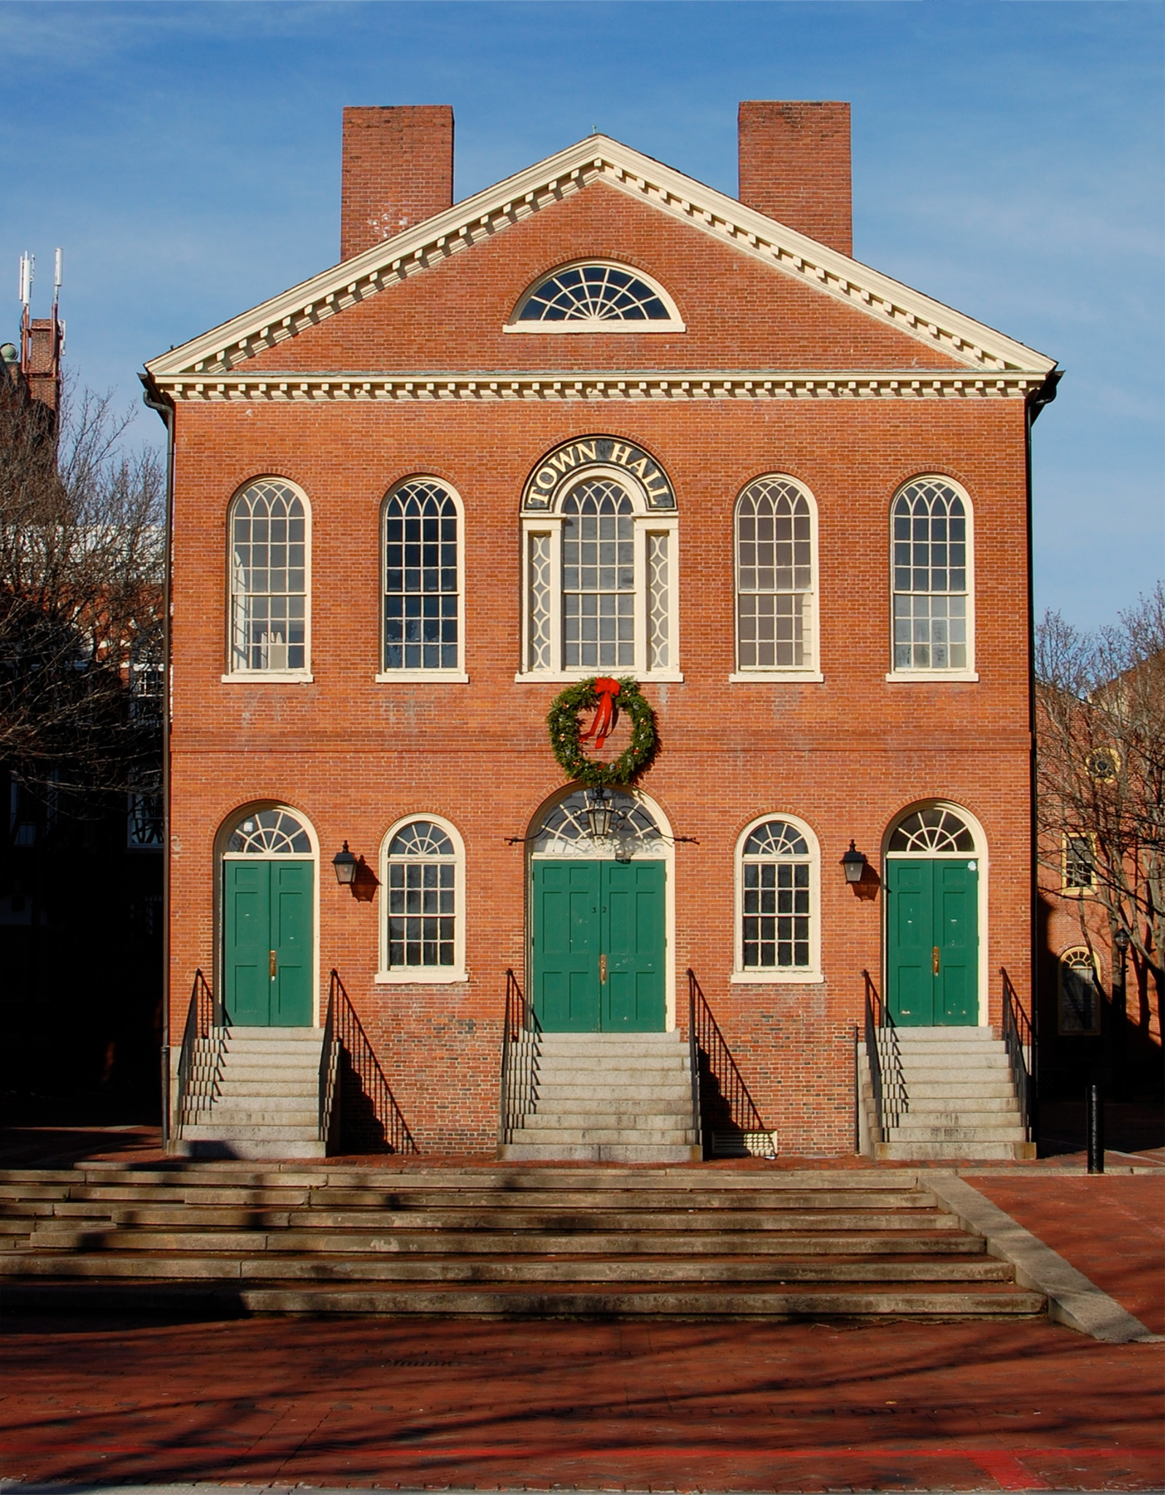
Welcome to the Community Town Hall
We will begin the event at 7:00 p.m. EST / 4:00 p.m. PST
Notes:
Rebecca Renshaw

Slide 2
Webinar Logistics
Participants are muted upon entry. Please ensure that microphone is muted.
You can add comments in the chat box. We will save questions for the last 15-20 mins of the presentation.
This session will be recorded and you can view it at a later time.
CART/ASL services are available.
AERBVI Community Town Hall: IDEA 50th Anniversary
Notes:
Sean Tikkun

Slide 3
Continuing Education Credits
Need professional development credits? ACVREP credits are available. Visit the AER website for instructions.
Opening CODE
AERBVI Community Town Hall: IDEA 50th Anniversary
Notes:
Sean Tikkun

Slide 4
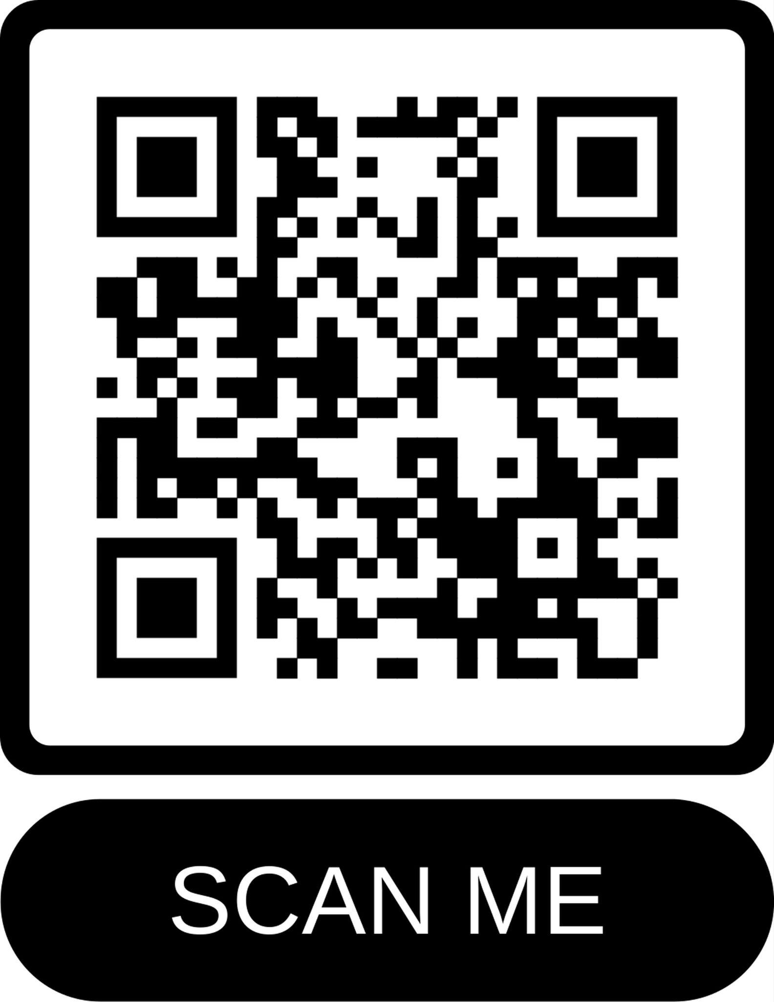
Take Action! Digital Toolkit
Access to materials for today’s session.
Town Hall Digital Toolkit
AERBVI Community Town Hall: IDEA 50th Anniversary
Notes:
Sean Tikkun

Slide 5

Association for Education and Rehabilitation of the Blind and Visually Impaired (AER)
AERBVI Community Town Hall: IDEA 50th Anniversary
Notes:
Rebecca Renshaw

Slide 6
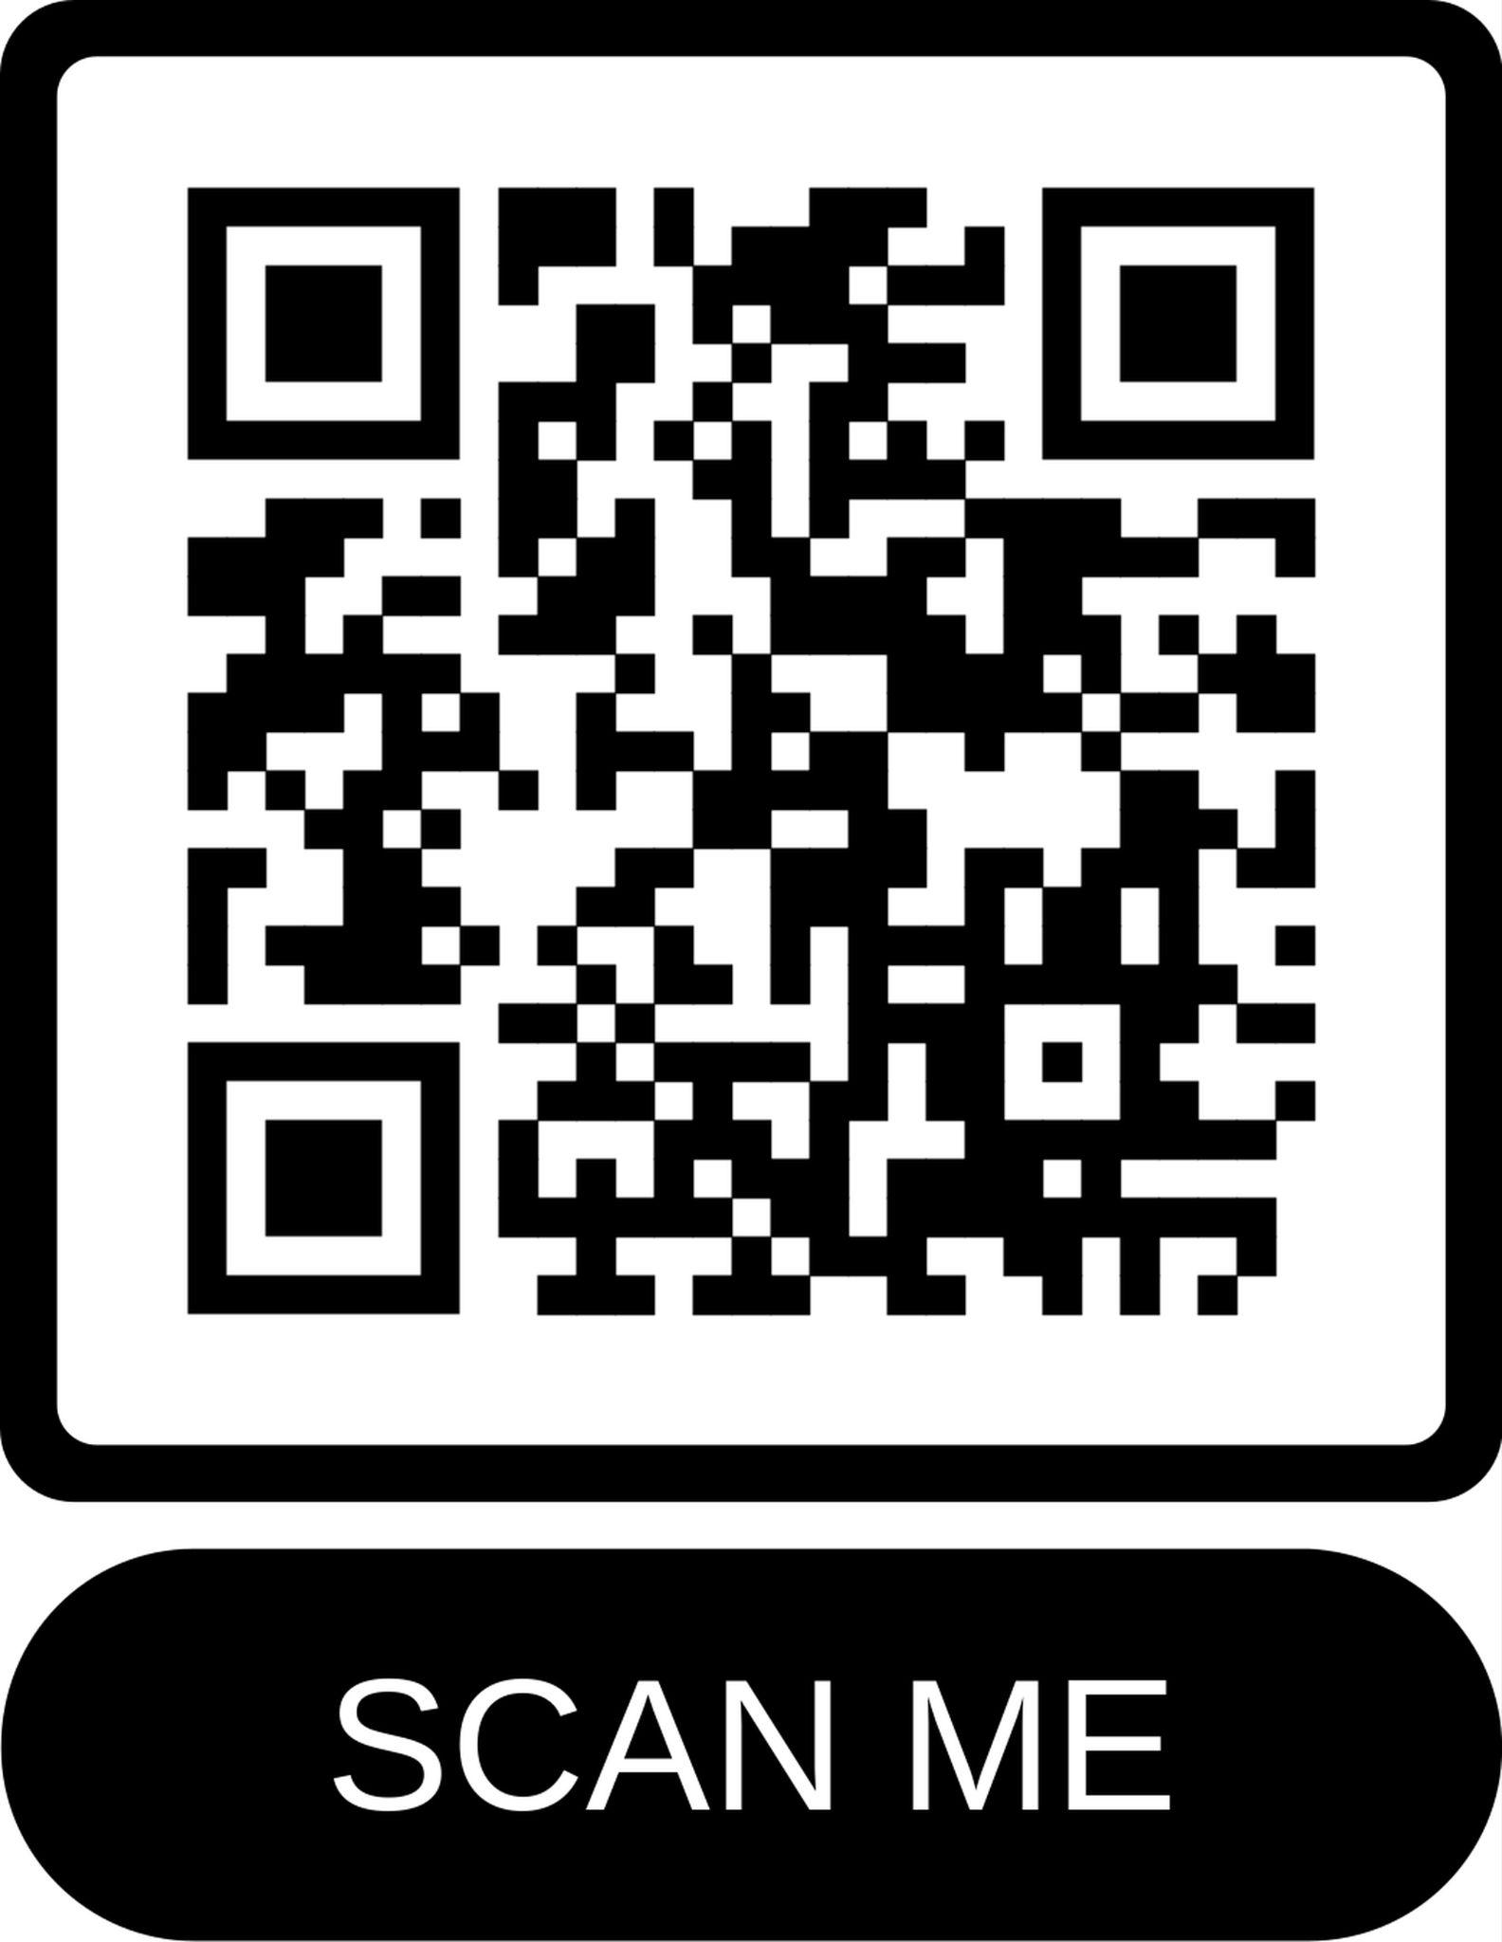
AER Speak4 - Take Action Now
AERBVI Community Town Hall: IDEA 50th Anniversary
Notes:
Rebecca Renshaw

Slide 7
Schedule
Welcome & Logistics (3-5 min)
Organization Spotlights (10 min)
Conversation with Panelists (40 min)
Audience Q&A (15-20 min)
Closing & Call to Action (3–5 min)
AERBVI Community Town Hall: IDEA 50th Anniversary
Notes:
Rebecca Renshaw

Slide 8

Council for Exceptional Children (CEC)
AERBVI Community Town Hall: IDEA 50th Anniversary
Notes:
Kuna Tavalin

Slide 9

CEC Division on Visual Impairment and DeafBlindness (DVIDB)
AERBVI Community Town Hall: IDEA 50th Anniversary

Slide 10

Academy for Certification of Vision Rehabilitation & Education Professionals
AERBVI Community Town Hall: IDEA 50th Anniversary

Slide 11

Success Beyond Sight
AERBVI Community Town Hall: IDEA 50th Anniversary

Slide 12

Orientation and Mobility Specialist Association (OMSA)
AERBVI Community Town Hall: IDEA 50th Anniversary
Notes:
Justin Kaiser

Slide 13

Vision Serve Alliance (VSA)
AERBVI Community Town Hall: IDEA 50th Anniversary

Slide 14

National Family Association of the DeafBlind (NFADB)
AERBVI Community Town Hall: IDEA 50th Anniversary

Slide 15

CHARGE Syndrome Foundation
AERBVI Community Town Hall: IDEA 50th Anniversary

Slide 16


Portland State University
AERBVI Community Town Hall: IDEA 50th Anniversary

Slide 17

American Foundation for the Blind
AERBVI Community Town Hall: IDEA 50th Anniversary
Notes:
Stephanie Enyart

Slide 18
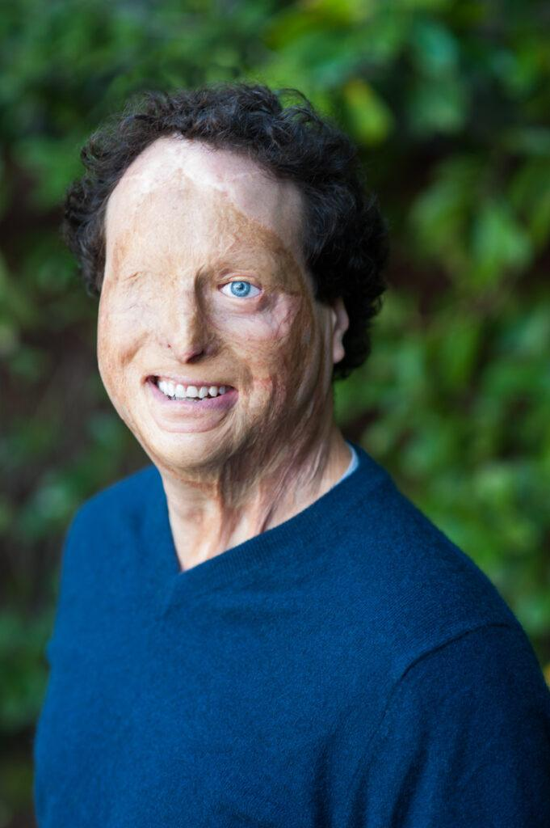
Panelists:
Joshua Miele

Slide 19
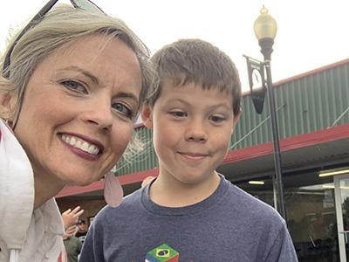
Panelists:
Sarah and Jack Chatfield

Slide 20
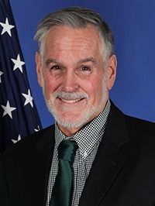
Panelists:
Larry Wexler

Slide 21

Questions?
AERBVI Community Town Hall: IDEA 50th Anniversary

Slide 22
Take Action! Digital Toolkit
Access to materials for today’s session.
Town Hall Digital Toolkit
AERBVI Community Town Hall: IDEA 50th Anniversary
Notes:
Sean Tikkun

Slide 23
AER Speak4 - Take Action Now
AERBVI Community Town Hall: IDEA 50th Anniversary
Notes:
Sean Tikkun

Slide 24
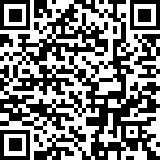
Your Feedback: Take the Survey
Please share your experience of this event with us via this short, anonymous survey (Mobile Friendly!):
Access the link from the
chat or use the QR code.
AERBVI Community Town Hall: IDEA 50th Anniversary
Notes:
Sean Tikkun

Slide 25
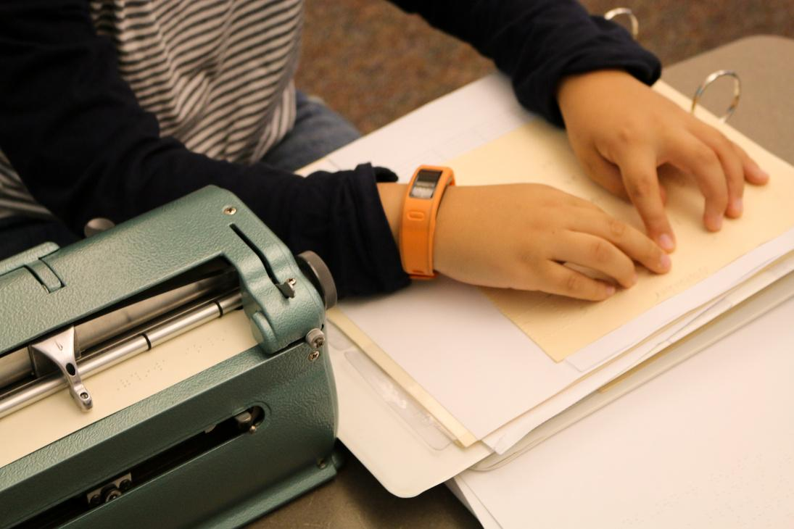
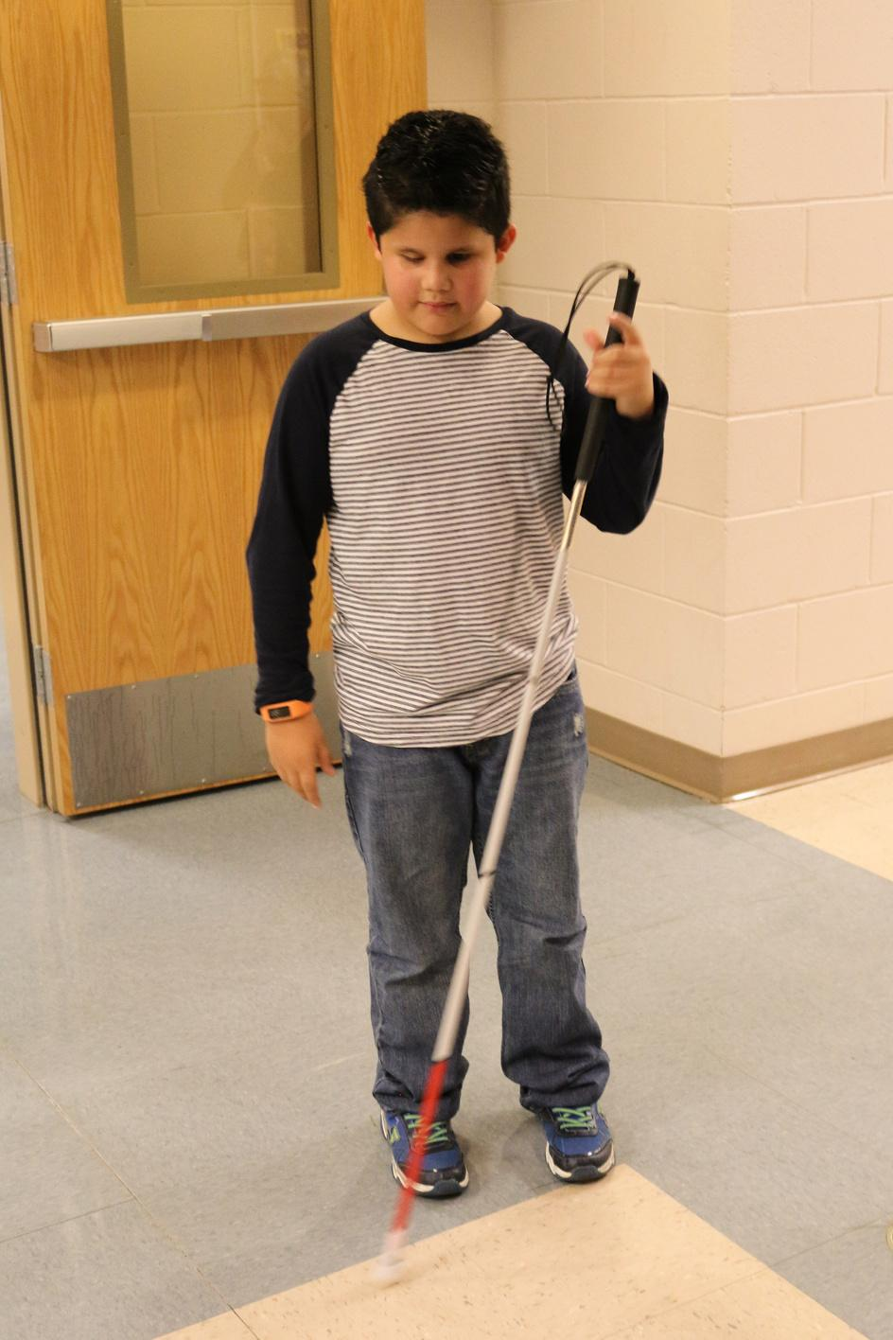
Thank you!

