Slide 1
ISMPP University
Retaining Top Talent in Medical Publications
September 18, 2024
Webinar will begin promptly at:
11 AM ET / 4 PM GMT
Notes:
Hi everyone; welcome and thank you for joining today’s ISMPP U, “Retaining Top Talent in Medical Publications"

Slide 2















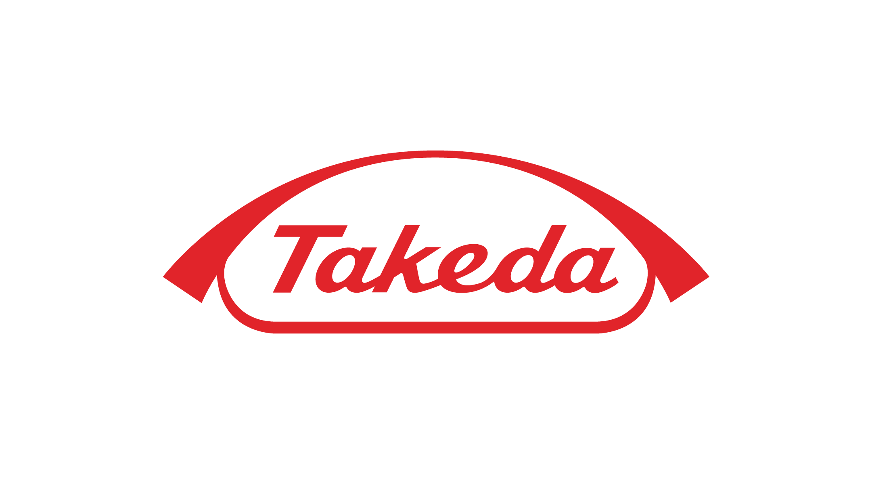




ISMPP Would Like to Thank…
2
. . . the following Titanium and Platinum Corporate Sponsors for their ongoing support of the Society:
Notes:
First a sincere thank you to all of ISMPP’s titanium and platinum corporate sponsors for their ongoing support of the Society.

Slide 3

ISMPP Announcements
Application deadline for the March CMPP
exam is February 1
Notes:
And, for those who are seeking to become CMPP-certified or looking to renew your certification, The application deadline for the next exam window is February 1, 2025

Slide 4

ISMPP Announcements
NEW ISMPP Academy
Save the date: November 13-14, 2024
Where: Convene at Commerce Square, Two Commerce Square, Philadelphia, PA 19103
ISMPP Academy is a meeting that will deliver
best practices education to professionals:
• Who work at biotechnology, small pharma, and medical device companies •
• Who are newer to the field •
• Who want to build their expertise •
Registration is open!
Notes:
Remember to Save the Date for the new ISMPP Academy, a Fall meeting format in Philadelphia this year, November 13-14. Be on the lookout, registration is now open.

Slide 5
How To Ask Questions
Feel free to ask a question at any time, however all questions will be held until the end the of the presentation.
To ask a question, open the Q&A window, type your question into the
Q&A box. Click Send
Note: Check Send Anonymously if you do not want your name attached
to your question in the Q&A
We will make every effort to respond to all questions live (out loud)
Notes:
You can submit a question at any time during the presentation by following the instructions on this slide.
The faculty will answer questions at the end of all the presentations.

Slide 6
Disclaimer
Information presented reflects the personal knowledge and opinions of the faculty and does not necessarily represent the position of their current or past employers
Notes:
Please take a moment to read our general disclaimer.

Slide 7
Learning Objectives
By the end of this session, attendees will:
  Understand the current challenges faced by organizations in talent acquisition and post-hire enrichment within the context of the fiercely competitive medical publications talent market
  Explore strategies for cultivating a compelling employer brand and creating pathways for career advancement to enhance employee commitment and reduce turnover rates in an increasingly competitive job market
  Identify actionable insights and best practices from industry experts to fortify talent acquisition strategies, mitigate job mobility, and nurture long-term employee success

Slide 8
Agenda
  Understanding Current Challenges
  Cultivating a Compelling Employer Brand
  Creating Pathways for Career Advancement
  Panel Discussion
  Q&A

Slide 9
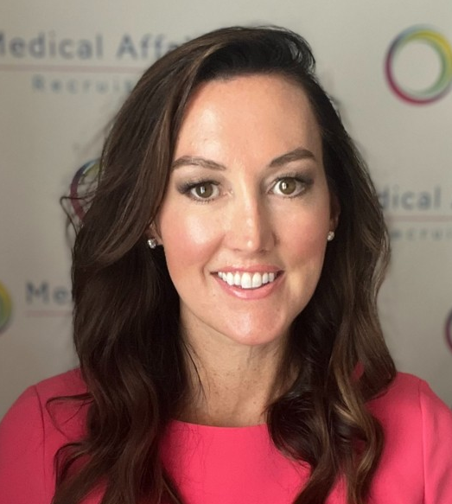


Faculty
Whitney Morris
Practice Lead, Medical Affairs Recruiting, LLC
Rachel Kennedy, PhD
Head of Scientific Communications, Moderna
Rachel Sopko Bibb, MBA, ISMPP CMPP™
Associate Director Scientific Communications Operations, Alnylam
Notes:
Today we are joined by two other esteemed faculty, we have Rachel Kennedy, a PhD and trained Neuroimmunologist who began her industry career as a Medical Science Liaison and is currently the head of Scientific Communications at Moderna. We are also joined by Rachel Sopko Bibb who has over a decade of industry experience on the agency side and has recently moved over to Alnylam where she is the Associate Director of Scientific Communications Operations. And I am Whitney Morris, the Practice Lead at Medical Affairs Recruiting LLC. With over eight years of experience in medical communications recruiting, I will be serving as your moderator and faculty member for today’s session.

Slide 10
Understanding Current Challenges
Whitney Morris, Practice Lead, Medical Affairs Recruiting LLC

Slide 11

Today’s Market
Less jobs
The Time of the “Haves” and the “Have Nots”
Why the layoffs?
  Big/Medium Pharma
Operational Reorganization
Realigning Strategic Priorities
Negative Results
-- Biotech/Small Pharma/Start up
Biotech: Q12024 $3B
Big Pharma: 18 companies laid off in June/July 2024 alone
Promising products
Lack of $$
LOTS OF CANDIDATES = FIERCE COMPETITION
Notes:
Overview of Talent Acquisition and Retention Issues (CLIENT DRIVEN MARKET)
According to pharmaceutical technology, the global pharmaceutical industry as a whole is down 8% in new job postings related to future of work compared to 2023.
It is the time of have and have nots. In Q1 2024, according to drugdiscoverytrends.com small biotechs secured nearly $3B in funding alone. On the other hand pharma as a whole is experiencing major layoffs with 18 companies laying off in June/July 2024 alone.
Biopharma layoffs have generally increased from Jan 2024 to today.
Why the layoffs? According to Drug Discovery and Development.com
Large and Midsized Companies:
Operational Reorganization: Many large companies have resorted to layoffs as part of broader efforts to streamline operations and improve efficiency. Similarly, Big Pharmas have undergone layoffs to realign their strategic priorities. Several large companies have experienced layoffs in the wake of disappointing clinical trial results or the discontinuation of drug development programs. Midsize companies have cut workers largely as a result of similar reasons.
Small Companies:
Small companies have implemented layoffs to focus on their most promising drug candidates and prioritize resources toward key projects. Some small companies have experienced layoffs as a result of challenges in securing funding or attracting investments in the current market conditions.
So what does this mean? Candidate heavy right now – competition is fierce!

Slide 12

Retention Issues
Poor Management / Ineffective Leadership
Toxic Culture
I Quit
Workload / Work-Life Balance
Compensation
Other Factors (geography, etc.)
Lack of Advancement Opportunities
Sense of Purpose
Notes:
While it is competitive for employees to get a new job, they are by no means locked in. If you take 30 seconds to scroll on LinkedIn on any given day you'll find at least a handul of new roles posted.
Let's discuss why people are leaving...
Pharma specifically set up to positively reinforce changing companies often. The biggest bump in pay is by changing companies, making retention a challenge for hiring managers.
However, it may surprise you that NO ONE leaves just for money, it is often a secondary but never a primary. Primary reasons include: lack of pipeline, lack of growth, not being challenged, mature/boring products. Given the market, retention could be easier but any doubt in the future is fueled by the market and can catapult a candidate to move out of the company.

Slide 13

Specific Challenges in Medical Publications Market
Shrinking
Shrinking teams: Realigning for efficiency
Changing
Changing roles: Making a lateral move
Growing
Growing teams: Finding the right talent
Retaining
Retaining teams: Refer to previous page. Challenge and engage!
Notes:
Because competition is tight if making a job change, understand it will likely be lateral in title.
Pubs are vital so they do not seem to be affected by decrease in jobs but have been realigned to maximize efficiency.
As roles become more and more specific and positions evolve, it is becoming harder to find people perfectly suited from a skillset perspective for a position i.e. digital, omni-channel, operations but also metric/technology, AI

Slide 14
Impact of Competitive Job Market
Past/Future Markets (Candidate Driven Market)
More Open Roles
Need to increase/alter/update benefits
Create very unique branding
More speed/efficiencies
Less available candidates
Financial resources
Today’s Market (Client Driven Market)
Less New Roles
Target very specific skillsets
Heavier workload for the team
Less sell, more selective
Candidate Heavy
Budget Cuts

Slide 15
Cultivating a Compelling Employer Brand
Rachel Kennedy, Head of Scientific Communications, Moderna
Notes:
This concludes my portion of the presentation now I am going to hand it over to Rachel Kennedy who is going to discuss cultivating a compelling employer brand

Slide 16
Importance of Employer Branding
Cultivating employee loyalty
  Fosters sense of belonging and commitment
  Reduces turnover and associated costs
Attracting and retaining high-quality talent
  Highlights unique value proposition (growth, impactful work, work-life balance)
  Ensures future potential within the organization
Building trust and engagement
  Communicates clear, authentic message about goals and culture
  Fosters trust, engagement, and sense of purpose
Employee advocacy
  Proud employees become brand advocates
  Strengthens company reputation and appeal
Supporting professional growth
  Offers clear career development paths and learning opportunities
  Retains talent through investment in growth and continuous learning
Enhancing workplace culture
  Shapes positive culture where employees feel valued and supported
  Reduces burnout and increases job satisfaction

Slide 17

Strategies to Enhance Employer Brand
Define a clear employee value proposition (EVP)
Enhance company culture
01
02
  Foster an inclusive, supportive, and innovative work environment
  Encourage open communication and collaboration across teams
  Articulate what sets your company apart
  Align EVP with company values and employee expectations
Solicit and act on employee feedback
08
03
Offer professional development opportunities
  Regularly gather feedback through surveys and focus groups
  Make visible changes based on feedback to show responsiveness
  Provide clear career progression and continuous learning programs
  Invest in employee growth through training and mentorship
Promote diversity, equity, and inclusion (DEI) efforts
07
04
Leverage employee testimonials and success stories
  Implement and communicate DEI programs and goals
  Celebrate diversity and foster a sense of belonging
  Showcase real experiences from current employees
  Use testimonials in recruitment materials and on social media
06
05
Strengthen leadership engagement
Improve work-life balance initiatives
  Offer flexible working options (remote, hybrid, flexible hours)
  Support employee wellness with health programs and mental health resources
  Ensure visible, transparent leadership communication
  Create a culture of recognition and appreciation from the top down

Slide 18
Case Studies and Examples
01
  German company around for over 350 years
✓
02
  Leading small-mid biotech @ Moderna
✓

Slide 19


Sunday Mindset
The average person spends about a third of their waking hours at work.
Notes:
Culture/ mental health / Monday Motivation

Slide 20
Creating Pathways for Career Advancement
Rachel Sopko Bibb, Associate Director Scientific Communications Operations, Alnylam
Notes:
Thank you Rachel and Whitney.
As Whitney discussed earlier, there are many reasons that people leave jobs. In this next piece, we will dive a bit deeper into one of those reasons: career advancement

Slide 21

Why do career pathways matter?
Our Greatest Asset = PEOPLE
In medical communications, we work with highly driven individuals that have specialized knowledge sets. We have a “very particular set of skills”
Strong competition within the industry
Employees are looking toward their futures
  Several surveys indicate more than half of employees are seeking new jobs
ThePhoto by PhotoAuthor is licensed under CCYYSA.
•70% of Gen Z and millennials are considering leaving their jobs soon (cnbc.com)
• Half of Your Employees Are Looking to Leave (gallup.com)
Notes:
So why do career pathways matter? A company’s greatest asset and often biggest expenditure is their workforce or people. In medical communications, we work with a set of often highly-driven people with advanced degrees who have a “very particular set of skills that were acquired over a long career”. It is not simple to just “train up” replacements for these skilled positions thus, retention is important. Our industry is small and specialized and there is strong competition throughout the industry to get those high performing individuals on our team. Along with competition from employers to hire the best, these driven employees are also looking toward their futures to see how they can advance and continue to grow – it’s human nature. Several recent surveys have reported that potentially more than half of employees are seeking new roles.

Slide 22
Why do career pathways matter?
Our Greatest Asset = PEOPLE
Employee retention strengthens teams
Cost to recruit and onboard new employees
Notes:
Why do we need to keep those high performers? Well, one: the cost to recruit, onboard and train new employees is much more than retaining already embedded personnel. Along with just the financial piece, there is lost productivity, historical knowledge, and efficiency as new employees are onboarded and it can take months or even a year for the team to find a new rhythm and achieve optimal efficiency again following a departure.

Slide 23
What Can We Do?
Competitive salaries and benefits
Normalize regular two-way feedback OPEN COMMUNICATION
Make time for each employee
Focus on culture
Stand behind your word
Transparency and communication
Balance between sustainable yet challenging workloads
Opportunities for professional development and career advancement
• Beyond Money: The Real Reasons Employees Stay Or Leave (forbes.com)
• Why employees are quitting and what to do about it (mckinsey.com)
• Why People Quit Their Jobs—and How Employers Can Stop It | TIME
Notes:
So what can we do? Over the next few slides we will review some tactics that can help. There is no “one size fits all” answer and often some combination of tactics will be the key to employee retention for your group. Overall, culture and the value proposition you bring to your employees will be major factors in their decision to stay or leave. Companies should ensure they offer competitive salaries and benefits; reviewing regularly to stay up to date or even be a leader in the industry. From a culture perspective, normalize and provide dedicated space for regular feedback and open communication. Get ahead of it with culture surveys, regularly scheduled 1:1s, and an open door policy. Employee retention should be an ongoing initiative and your eyes and ears should be open for changes in what you are hearing from your group to stay ahead of any issues. Along with strong communication, work to ensure your employees have a fulfilling work life by maintaining a balance between sustainable yet challenging workloads.

Slide 24
What Else Can We Do?
Mentorship programs
Regular formal and informal performance reviews
Customized career paths
Cross Training Opportunities
Enhance employee engagement
Regular review of compensation and benefits packages
Promote positive environment and work life balance, flexibility
Notes:
Some other items or tools to consider include making strong mentorship programs available, working with individuals to customize their career paths and providing cross-training opportunities. Also, one of the easiest things you can do right now is promote a positive work-life balance and allow for flexibility.

Slide 25
What Resources Are Available?
Learning Systems
Professional Organizations
Tuition Reimbursement Programs
Internal Mobility Programs
Career Development Plans
Notes:
Your organization likely already has access to some of the tools listed below like learning systems, collaborations with professional organizations, and tuition reimbursement programs. Help your team by regularly promoting and educating them on the resources available to them. Encourage full utilization of these tools and, from a leadership perspective, ensure that these systems and tools are reviewed and updated regularly as well to stay on top of industry trends and provide the best value and experience for your employees.
All this being said, even if you are engaged and open and employ all of these tactics and tools at your disposal; some employees will still move on to other roles, and that’s OK! This should be an ongoing cycle of introspection and learning on all sides to continue to try to optimize the experience in your group. A departure allows new ideas to join the team. A few things to remember: how you treat departing employees and handle change management in teams speaks volumes to your culture and will strongly factor into retention of other employees.
With that, I'll turn it back over to Whitney for our panel discussion

Slide 26
Panel Discussion
Notes:
Thank you to both Rachel Kennedy and Rachel Sopko-Bibb for your excellent presentations. It is now time to move to the panel discussion section of the webinar. We polled attendees a few weeks ago asking for specific questions they wanted answered during the webinar and we have few to go through here today. Our first question is addressed to.....
What are some good ways to keep new team members/junior writers engaged/motivated/connected in the remote environment? Rachel SB and Rachel Kennedy
How can we manage changing expectations of new team members? Rachel Kennedy
What are recent innovative strategies for creating work-life balance? How can companies recognise and reward top performers?
Impact on retention and pay due to current market situation/recession
Are there any skills/trainings that would make a candidate more attractive to hire?
How can we recruit and retain colleagues with a diverse range of educational backgrounds in medical communications, particularly medical writing? Whitney and Rachel SB
What is your top 'perk' that a company can offer? Whitney
Additional questions and thoughts on who could speak to it:
What is a specific recruiting challenge that is specific to the medical publication profession that may not be present in others? Whitney
What is a specific retention challenge that is specific to the medical publication profession that may not be present in others? Rachel SB and Rachel Kennedy
What are the top five reasons people leave? Whitney (I know you covered in presentation, but may be good to actually have a top five if possible)
Do you have any advice/best practices for onboarding new employees in a 100% remote environment? Rachel SB (I thought this was a good question and does have some value as to the difference. How is orientation different, how do you make sure you are making them feel welcome in remote environment, what tactics do you use to ensure they feel as connected to the organization as they would in an in-person environment, how do you manage employee performance and/or development a bit differently in remote environment, how do you keep the same pulse on new employees as you would in an in-person environment…Just some thoughts)

Slide 27
Audience Q&A
To ask a question, open the Q&A window, type your question into the Q&A box. Click Send.
Notes:
And now it's time to answer your live questions. As a reminder, please type them into the Q&A box at the bottom of your screen.

Slide 28
Upcoming ISMPP U Webinars
October 23, 2024:
Open Access in honor of International Open Access Day: Copyright Confusion: Demystifying Creative Commons Licences for Industry-Funded Research
November 13, 2024:
Can health literacy best practices in publications fuel innovation in patient-friendly electronic package information (ePI)?
Notes:
Here is a snapshot of the upcoming ISMPP U October, an open access webinar in honor of International Open Access Day focusing on Copyright Confusion; Demystifying Creative Commons Licenses.
Also be on the lookout for the November ISMPP U centering on EPI. Registration is now open.

Slide 29

Thank you for attending!
We hope you enjoyed today's presentation.
After closing out of Zoom, please click the CONTINUE button
on your screen to take our short survey. Thank you!
Notes:
Thank you again for attending today’s webinar. Please take a moment to fill out the survey link that will be sent to you.
After closing out of ZOOM, please click the ‘continue’ button on your screen to take a short survey.
Thank you!

Slide 30

Whitney Morris
Over the past two years Whitney’s focus has organically entrenched into the Medical and Scientific Communications space working on a number of roles ranging from Director to VP.
Prior to her role at Medical Affairs Recruiting, Whitney worked as a full desk executive recruiter, starting the Medical Affairs team for another firm. Desiring to join a smaller, more boutique firm, she made her way into Medical Affairs Recruiting, LLC.
Whitney is and has been involved with ISMPP since its inception and has had the pleasure of speaking and leading workshops for both.
CMPP, certified medical publications professional; ISMPP, international society of medical publications professional

Slide 31

Rachel Kennedy, PhD
Trained Neuroimmunologist (Post-Doc, Columbia University; PhD, GSBSE Maine) who began her industry career as a Medical Science Liaison (MSL) supporting Multiple Sclerosis in NYC and Boston
Over the past five years, she has held various global medical roles, including Chief of Staff to the CMO, Strategy & Business Planning Lead
Head of Scientific Communications at Moderna, overseeing communications for the entire portfolio
Passionate about generative AI and empowering people through collaboration
CMPP, certified medical publications professional; ISMPP, international society of medical publications professional

Slide 32
Rachel Sopko Bibb, MBA, ISMPP CMPP™,
Over a decade of medical communications experience on the agency side in scientific publications, strategy, planning, and team leadership
Fosters innovation and best practices to advance scientific communication capabilities
Volunteer serving on the ISMPP Patient Engagement Task Force
CMPP, certified medical publications professional; ISMPP, international society of medical publications professional

