Slide 1

Chairman Christi Craddick
Commissioner Ryan Sitton
Commissioner Wayne Christian
May 2017

Slide 2
Railroad Commission of Texas Guide to Self-Audit Submissions
Office of General Counsel
Natalie Dubiel
May 17, 2017

Slide 3
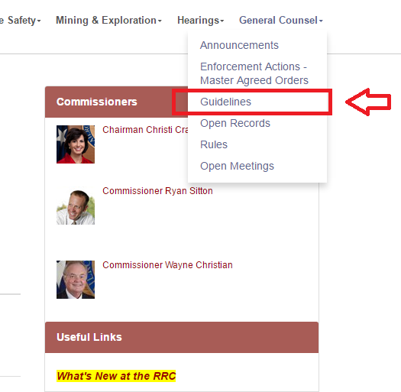
Background
The Guidelines were adopted as part of the Texas Oilfield Relief Initiative
Create a streamlined process for submissions
Can be found on the Commission’s website

Slide 4
Overview of the Act
The Texas Environmental, Health, and Safety Audit Privilege Act
  Tex. Civ. Stat. art. 4447cc
Four primary parts of the Act:
  Immunity
  Privilege
  Notices of Audit
  Disclosures of Violations

Slide 5
Overview of the Act
Immunity
  Immunity from administrative or civil penalties for properly disclosed voluntary violations
  A penalty is an “administrative, civil or criminal sanction imposed by the state to punish a person for a violation of a statute or rule”
  Does not apply to technical recommendations, injunctive relief, or remedial provisions

Slide 6
Overview of the Act
Immunity can be further limited. No immunity for violations:
  Intentionally or knowingly committed;
  Recklessly committed; or
  That resulted in a substantial economic benefit which gives the violator a clear advantage over its business competitors
No immunity for a person found by a court or an ALJ to have continuously committed significant violations and engaged in a pattern of disregard

Slide 7
Overview of the Act
Privilege
  Audit Reports developed under the Act are granted a limited evidentiary privilege
    Audit report: “a report that includes each document and communication…produced from an environmental or health and safety audit.”
  The privilege is for use in an administrative or civil proceeding

Slide 8
Overview of the Act
Situations in which the report can be disclosed without waiver of the privilege:
  To government officials pursuant to a confidentiality agreement;
  To government officials under a claim of confidentiality;
  Review of privileged documents by a governmental authority;
  Disclosure to nongovernmental parties to address matters raised by the audit; and
  Disclosure to nongovernmental parties pursuant to a confidentiality agreement

Slide 9
Overview of the Act
Disclosure to Commission Staff does not waive the privilege under two circumstances:
  Confidentiality agreement
  Claim of confidentiality
    Mark the documents “COMPLIANCE REPORT: PRIVILEGED DOCUMENT”
  Information required to be “made available” does not waive the privilege
    As opposed to information required to be “collected, developed, maintained or reported”

Slide 10
Overview of the Act
Disclosure to nongovernmental parties for the purpose of correcting or addressing violations does not waive the privilege:
  Employees, including temporary and contract employees
  Legal representatives
  Officers or directors
  Independent contractors
  Persons considering acquisition of the facility or operation

Slide 11
Overview of the Act
Disclosure to nongovernmental parties pursuant to a confidentiality agreement does not waive the privilege:
  A partner or potential partner;
  A transferee or a potential transferee;
  A lender or a potential lender; and
  A person or entity engaged in the business of insuring, underwriting or indemnifying the operation

Slide 12
Notice of Audit Letter
Notice Letter must be sent in accordance with the Act’s requirements and must include:
  Name and P-5 number
  Specific date that the audit will commence
  A description of the properties, leases or facilities to be audited
    Oil and Gas leases: lease numbers, wells identifiers, permit numbers
    Other operations: relevant numbers and physical locations
Notice should be emailed to: audit.notice@rrc.texas.gov

Slide 13
Disclosure of Violations Letter
You must submit this letter by certified mail to the Office of General Counsel to receive immunity
  Please send a courtesy copy to audit.notice@rrc.texas.gov
The disclosure must be “voluntary”
Must be disclosed within a reasonable time not to exceed six months
OGC will send a copy to Enforcement and any applicable Staff members

Slide 14
Disclosure of Violations Letter
A disclosure is voluntary if it includes:
  Same information contained in Notice Letter
  Certified mail reference number
  Specific date and time the audit was completed
  An affirmative assertion that a violation has been discovered during the audit period
  A description of each violation
  The duration of each violation
  The status and completion date of corrective action

Slide 15
Request for an Extension
The Commission may approve an audit period to extend further than six months “based on reasonable grounds”
Please include the reason why the extension is requested
Continuation of an audit past six months without prior approval of the Commission could limit the availability of immunity or privilege

Slide 16
Acquisitions
Audits are often conducted in connection with acquisitions
  Notice letters are not required for pre-acquisition audits
  Disclosure letters are due not more than 45 days after the acquisition closing date
  Audit may be continued after the acquisition closing date but must be noticed not more than 45 days after
  6 month rule still applies - a request for an extension is required for any longer

Slide 17
The RRC’s Guidelines
The Guidelines include an FAQ section
The Guidelines include an Appendix of form letters:
  Notice Letter
  Disclosures Letter
  Request for Extension Letter
  Pre-Acquisition Audit Notices
  Pre-Acquisition Audit Disclosures

Slide 18
Questions?
Phone: 512-463-2299
Email: natalie.dubiel@rrc.texas.gov

