Slide 1

Lighting a Path Forward
Aislinn Baltas and Robert Mendyk

Slide 2

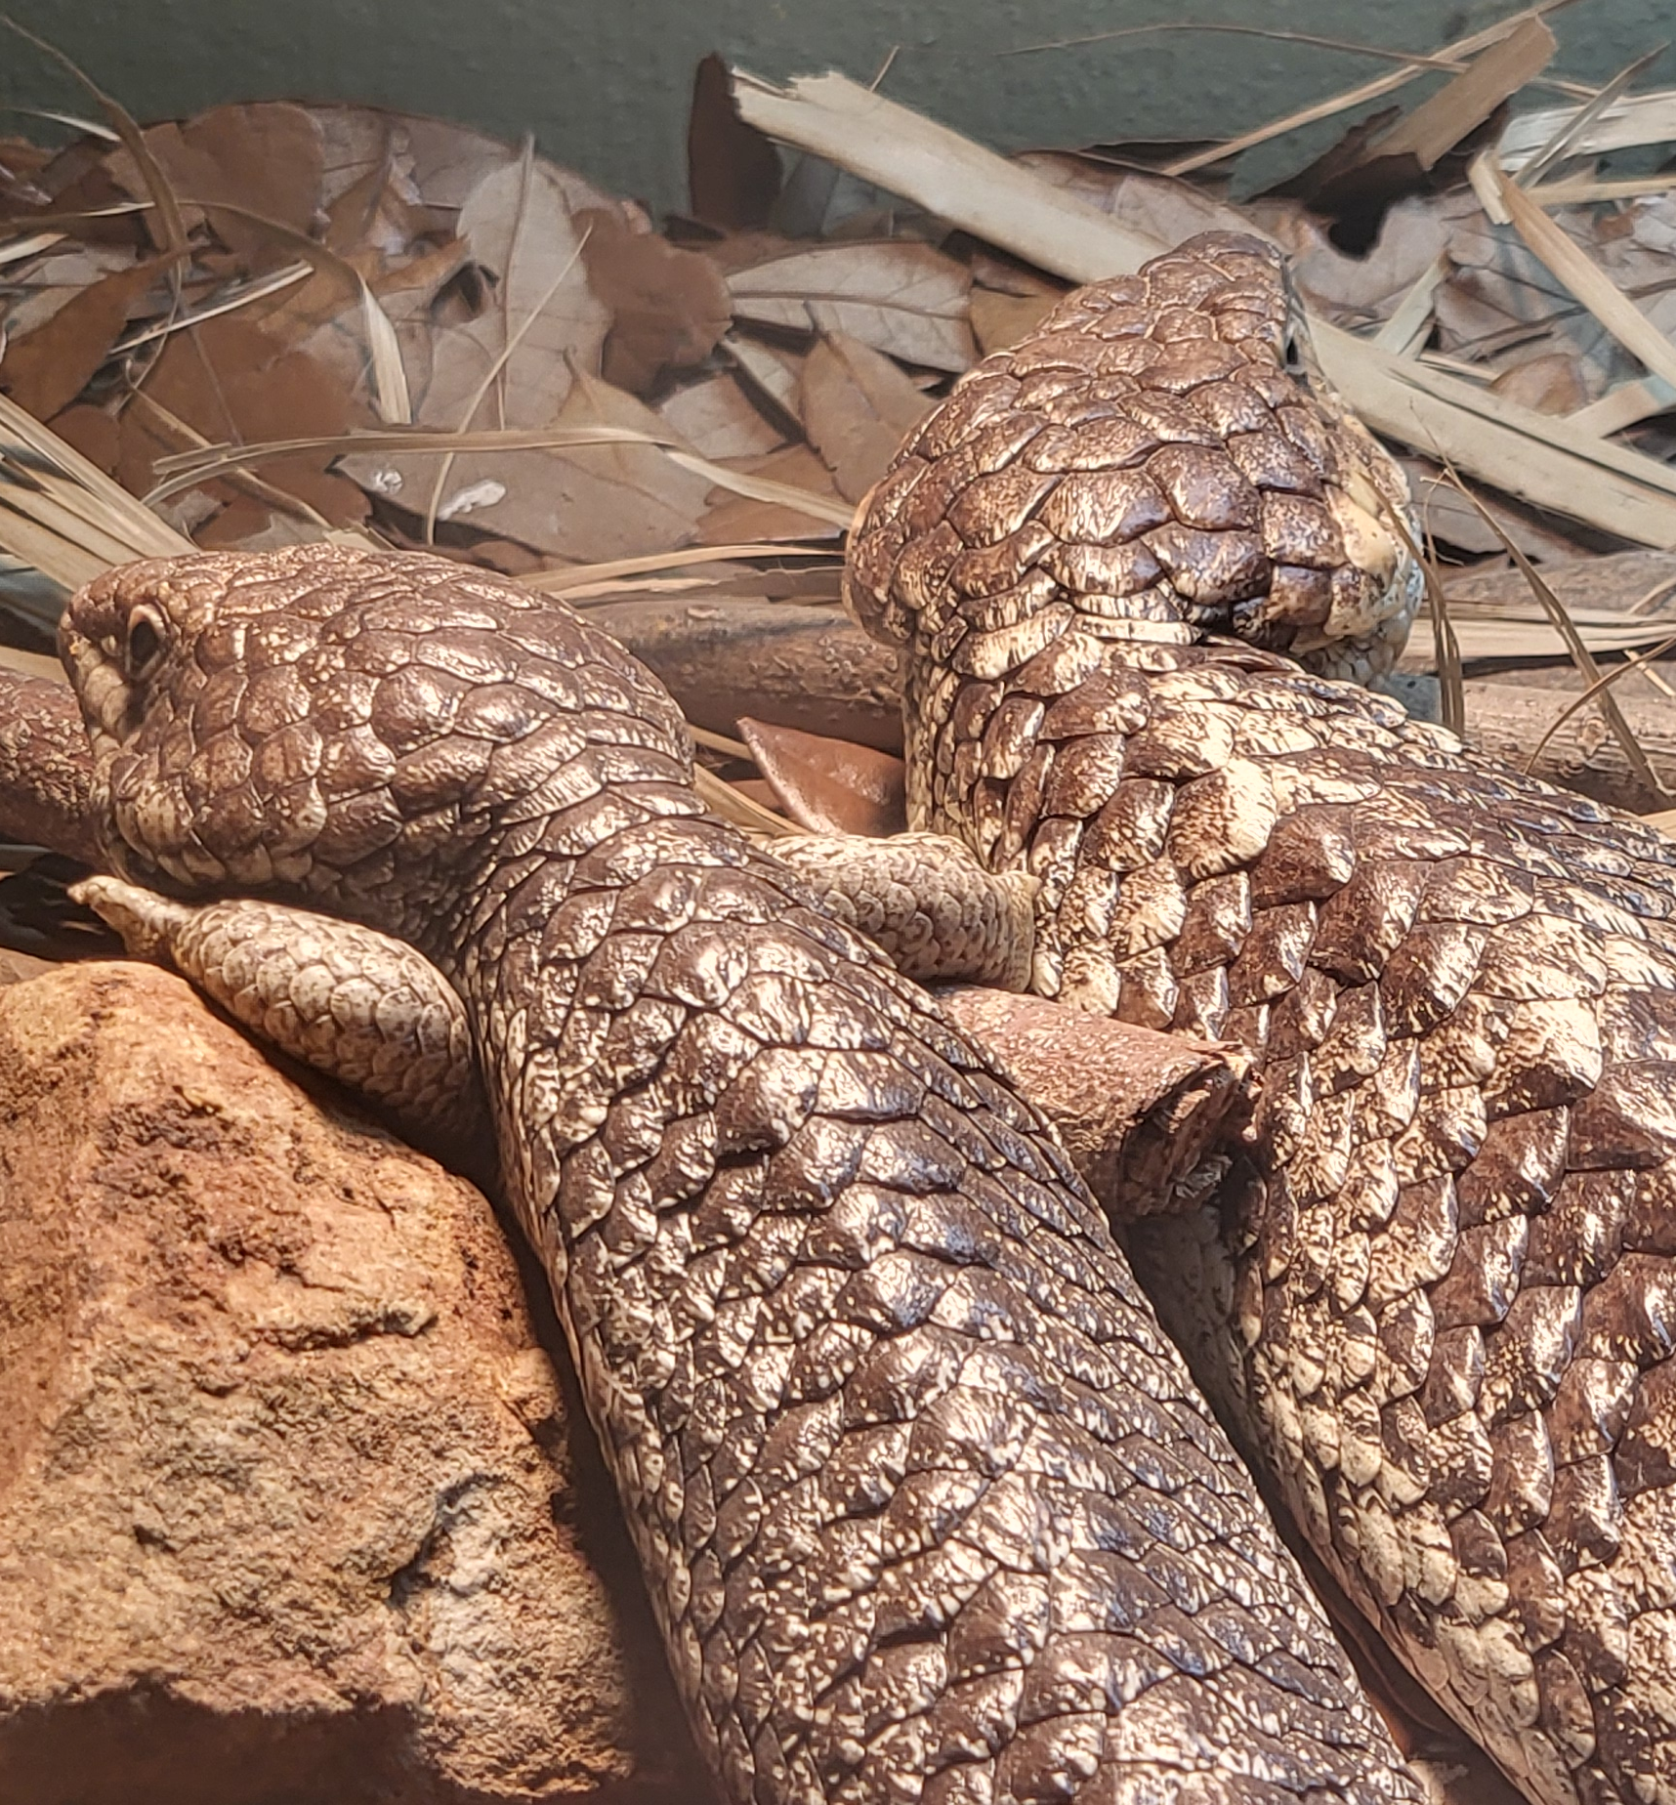
Background
June – aware of issue
July – letter to DOE
August – meeting with DOE and AVMA
September – introduction to NEMA

Slide 3
Collaboration
AZA Staff
AZA institutional representatives
AVMA
DOE
NEMA
ARAV

Slide 4
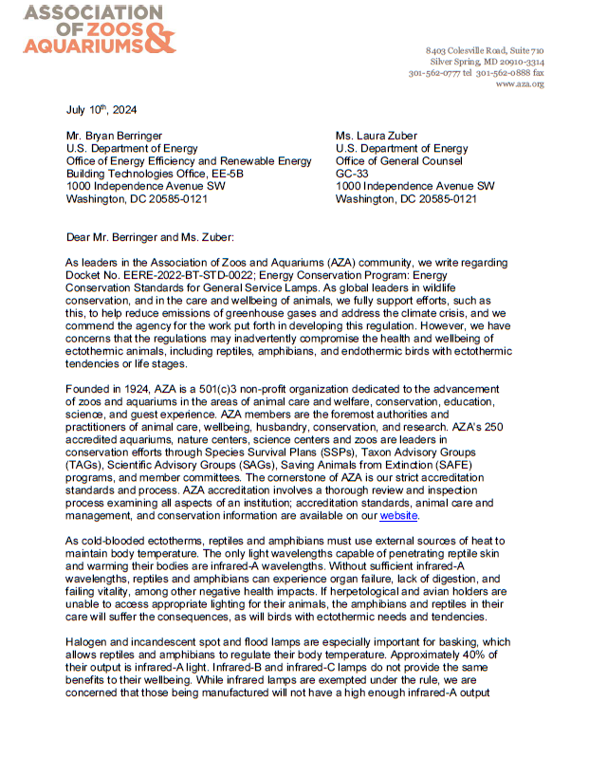
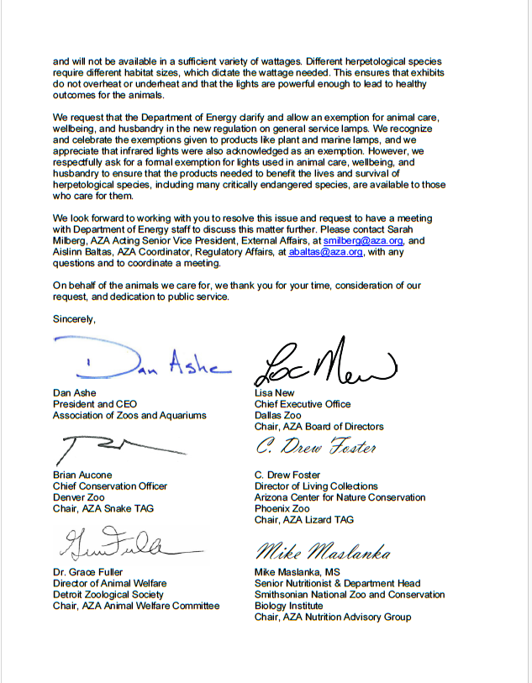
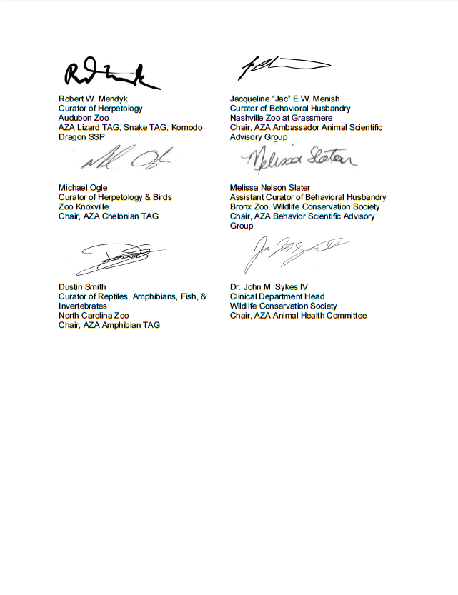
Letter to DoE

Slide 5
Follow-up Meetings with DoE and NEMA
Communicated our challenges with animal care and wellbeing
Provided technical/wavelength specifications for animal care needs
Discussed possibility of alternative lighting options
Performed rapid assessments of over 1,000 exempted lamps

Slide 6
Update

