Slide 1
Sneak Peek: What’s Happening at ISMPP 2025
‘Know Before You Go’
Notes:
Hello and welcome! Thanks for checking out this quick preview of the ISMPP 21st Annual Meeting. Whether you’ve already registered or are still considering joining us, this overview will give you a sense of what the meeting is all about and why it’s totally worth being there.
We’ll cover meeting highlights, how to prepare, and a few ways to get the most out of your experience. Let’s dive in and show you why this year’s meeting is not to be missed!

Slide 2
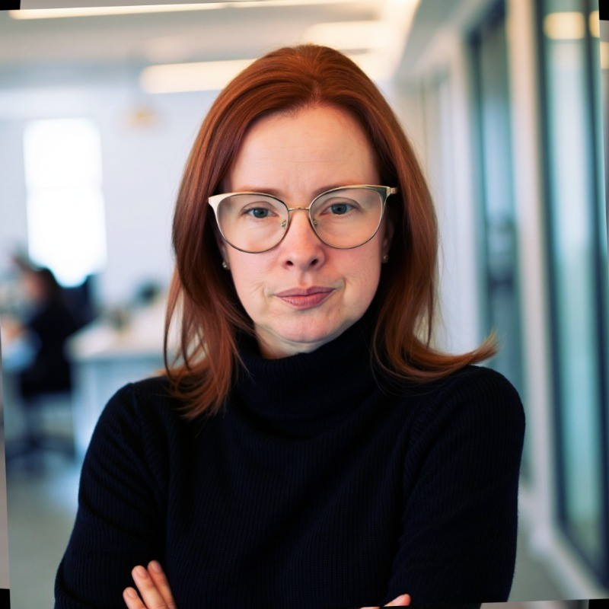
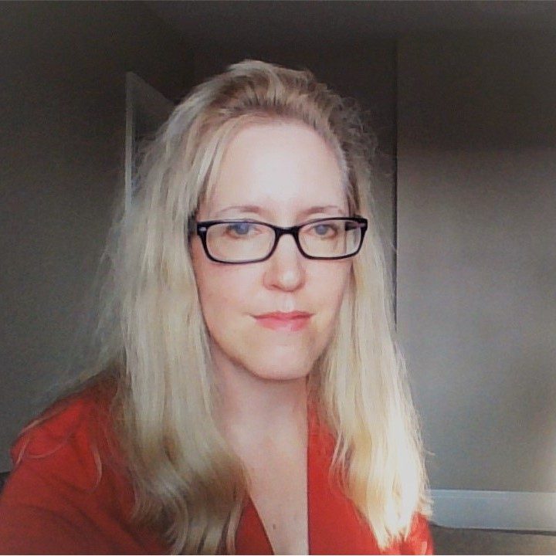
Today’s Speakers
Jenny Ghith
Senior Director,
Channel Integration and Innovation Lead,
Global Scientific Communications
GSK
Kris Schuler
Senior Director,
Oncology Scientific Communications
Team Lead,
GU & Breast Cancers
Pfizer

Slide 3
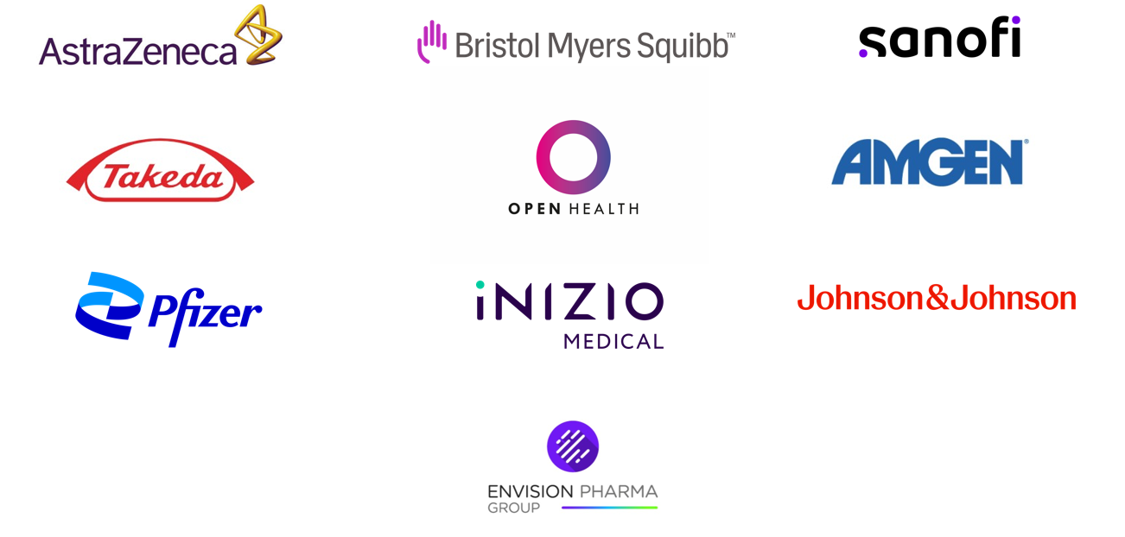
Thank you, 21st Annual Meeting of ISMPP Champion Sponsors!
Notes:
We’d like to give a huge thank you to our Champion Sponsors for their support by sending at least 10 delegates to the meeting.

Slide 4
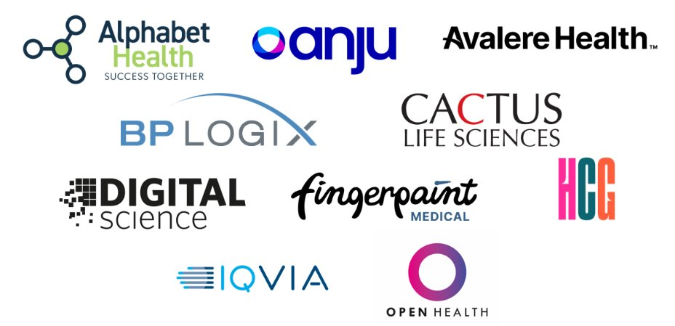
Network with our Sponsors at the 21st Annual Meeting of ISMPP!
Notes:
We’re also grateful to our meeting sponsors, many of whom have helped support things like our networking reception, lanyards, and specific sessions throughout the meeting.

Slide 5

Thank you, 21st Annual Meeting of ISMPP Media Partner!
Notes:
And thank you to the folks from Aspire Scientific and The Publication plan for your support spreading the word about our meeting. Be sure to check out their comprehensive daily summaries after the meeting!

Slide 6
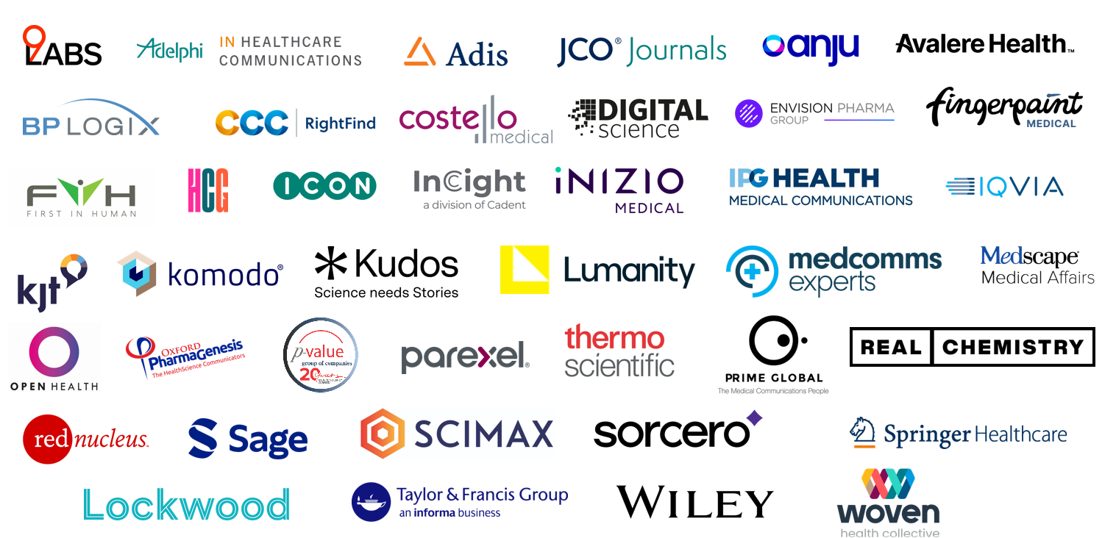
Visit our Exhibitors at the 21st Annual Meeting of ISMPP!
Notes:
Don't forget to check out our exhibitors—they offer valuable resources and innovations that can support your work. Stop by during breaks or the poster reception to explore what's new!

Slide 7

Grand Hyatt Washington DC
1000 H Street NW, Washington, DC 20001 | +1 202 582 1234
Notes:
We’re back at the Grand Hyatt in Washington, DC. Our meeting will take place across two dedicated floors, and there are plenty of restaurants and sights nearby if you’re heading out for meals or looking to catch up with colleagues outside of sessions.

Slide 8









Download the Meeting App Starting April 11
Download the Whova Meeting App where you are able to:
View
the meeting agenda, sessions times and locations
NEW!
Automatically claim your CMPP credits for attended sessions
Create meetups
Message other attendees
Start discussion boards
Play
games and win prizes!
Submit questions for session faculty
  Please login to Whova using the same email address that you used when registering for the meeting
Notes:
Download the Whova app starting April 11. It’s your go-to tool for everything: session info, location details, CMPP credits, messaging, and even some fun and games. Be sure to log in using the same email you used to register.

Slide 9

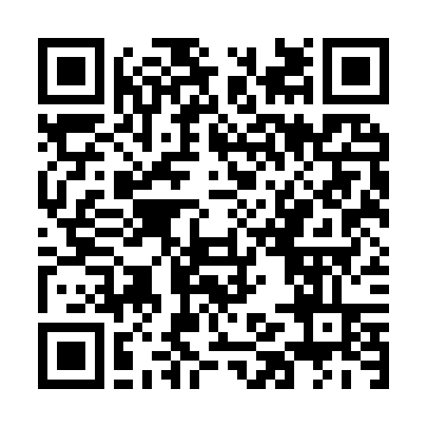
ISMPP CMPP Credit Tracking Just Got Easier!
Earn up to 17+ CMPP Credits while attending the Annual Meeting!
1
Download the Meeting Mobile App (Whova)
2
Scan the QR code posted in the session room when you attend.
THAT’S IT!
ISMPP will log your attendance and apply credit automatically to your tracker!
Notes:
Speaker Notes: To get started, the first thing you need to do is download the Whova app on your phone. It's available in both the Apple App Store and Google Play Store. Simply search for 'Whova,' and once you've installed it, make sure to log in with the details provided for the event.
When you enter the session room, you'll see a QR code posted at the entrance or around the room. All you need to do is scan it with your phone to check in. This step is quick and easy, and it will record your attendance for the session.
Once you've scanned the QR code, ISMPP will automatically log your attendance and apply the credit directly to your tracker. No extra steps required! It's all taken care of for you

Slide 10


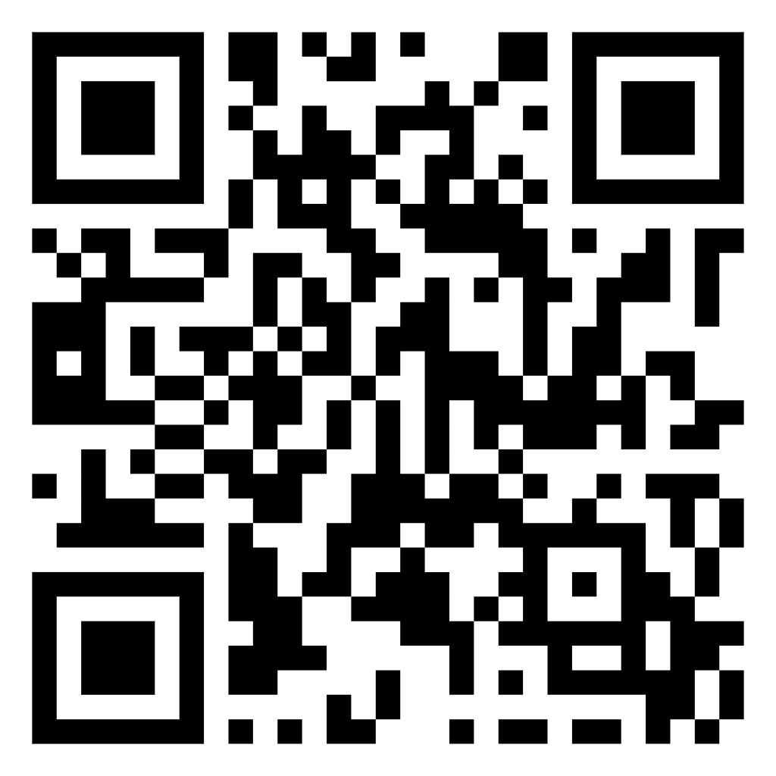
Get Social!
#
Official Meeting Hashtag:
#ISMPPAnnual
Scan To Access
Meeting Graphics
Suggested Hashtags:
#MedPubs
#MedComms
#BioTech
Notes:
We’d love for you to join the conversation online during the meeting! Use our official hashtag #ISMPPAnnual to share interesting insights, quotes, or takeaways from sessions. If you’re presenting a poster, feel free to share it as well—posters will be available open access starting on the first day of the meeting. And don’t forget to scan the QR code on this slide to access meeting graphics from ISMPP’s website you can post to help spread the word!

Slide 11
Meeting content

Slide 12








Diversity
Innovation
Channels
Artificial Intelligence
Content
Collaboration
Data
Data Generation
People
Models
Thought
Personalization
Notes:
Our theme this year is “Diversity and Innovation: In Concert.”
We’re exploring how different ways of thinking, working, and solving problems come together to move our field forward. From how we analyze data to how we communicate with stakeholders.
It also reflects the science behind what we do. Individual differences matter in research and treatment. As medical communications professionals, we help make sure those differences are clearly communicated, so the right information reaches the right people in the right way. That’s what supports better, more personalized care.
And like a concert, when all these pieces come together—different voices, tools, and perspectives—it creates something stronger than any one part alone.

Slide 13
Meeting sub-themes
Day 1
Day 2
Day 3
Amplifying Voices
Building Trust
Composing Connection Making Research Matter
Taking
the Lead Actionable Innovation
Collaborate
Communicate
Innovate
Notes:
Whether you're new to the field or deep into strategy and leadership, there’s something here for everyone—and plenty of content you can take home and put into practice.
Day 1 sets the tone, with a focus on collaboration across stakeholders—think patients, providers, pharma, and policymakers. We’ll explore topics like patient engagement tools, AI and copyright, bias in communications, and navigating ethical principles with the updated ISMPP Code of Ethics. Monday also has a roundtable session that digs into real-world topics like patient co-authorship, global communications, and RWE publishing. And the day closes with the poster reception.
Day 2 is the ensemble performance and takes us deeper into inclusion, accessibility, and future-facing strategy. Sessions highlight publication extenders, equity in clinical trials, and how to navigate the evolving interplay between pharmaceutical companies and agencies to effectively use AI. You’ll hear from editors and publishers, learn about new data-driven personalization strategies, and get practical tips for reaching broader, more diverse audiences. The big day ends with more roundtables, the professional excellence awards and the networking reception.
Day 3 is the closing set/the finale. We’ll dive into sessions on AI, digital therapeutics, global congress strategy, and practical frameworks for driving innovation in your organization.
.

Slide 14
Workshops
AI in Action:
Practical Implementation for Medical Communications
NEW!
Using Generative AI in Medical Communications: Harmonizing Needs to Innovate and Scale Technologies
Orchestrating Innovative Publications and Communications Through Patient Partnerships
Introduction to
Publications Planning:
The Best of the Basics
Advanced
Publication Planning:
Take Your Plan to the Next Level
Leading a Medical Publications
and Communications Function
in an Evolving Landscape
NEW!
Enhancing Visual Communication:
Creating Impact and Accessibility
NEW!
Navigating Digital Challenges:
Privacy, Accuracy,
and Social Responsibility
NEW!
Realizing Omnichannel Strategies
in Medical Communications
Notes:
We’re offering a variety of pre-meeting and post-meeting workshops this year, all designed to be interactive and hands-on. Each one is three hours long, giving you time to really engage with the material, work through examples, and ask questions.
You’ll find a wide range of topics—from foundational to advanced publication planning, data visualization and patient partnerships. We’re also running two AI-focused workshops: one on project implementation and another on scaling for organizations. Both AI workshops are offered on Monday and Wednesday, so you can pick the day that works best for you.
Whether you’re a newer or seasoned professional, or from a small or large company, the workshops are a great way to dive into specific topics and walk away with practical tools.

Slide 15
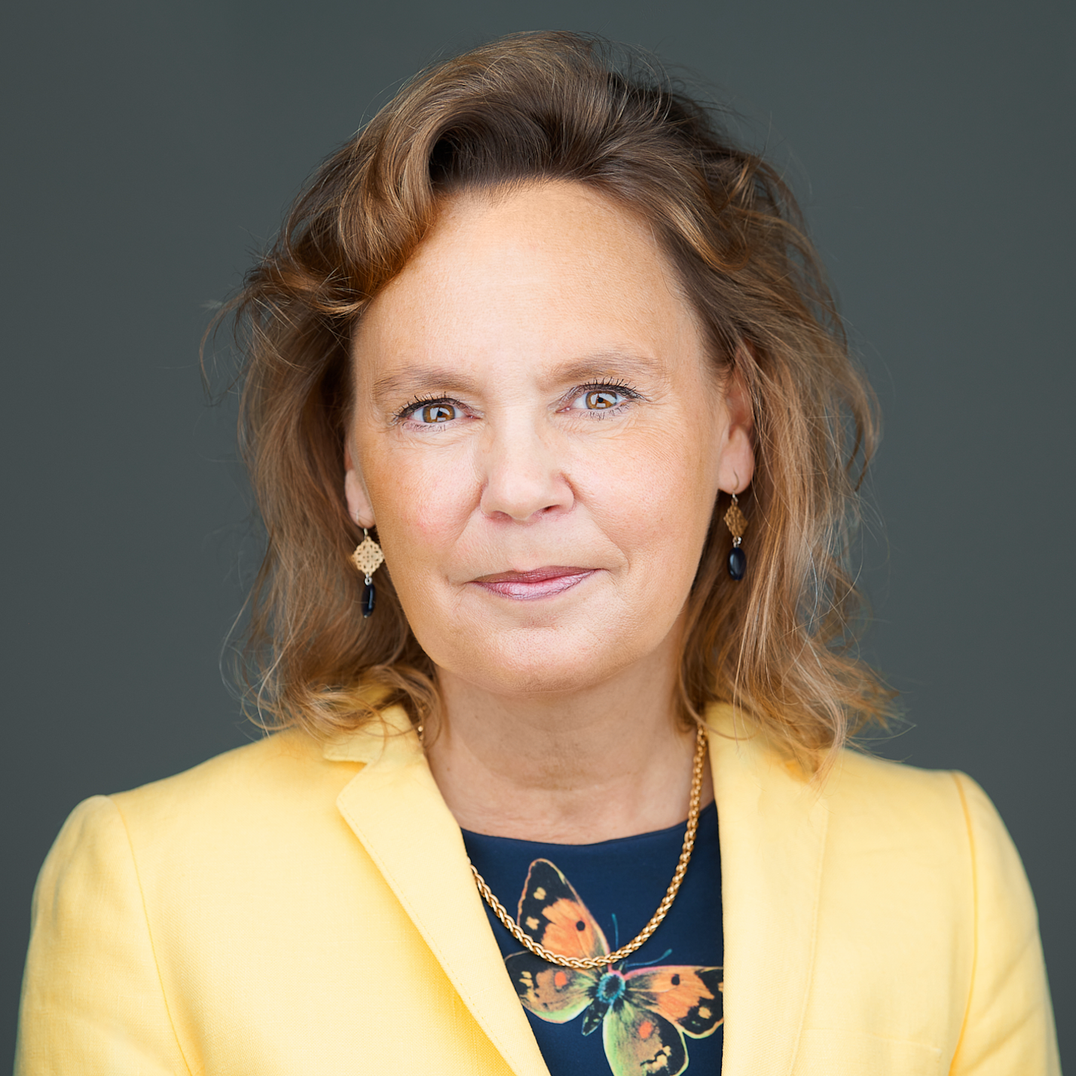
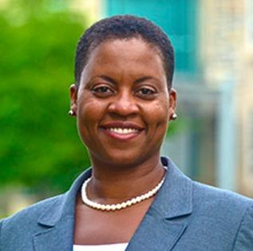
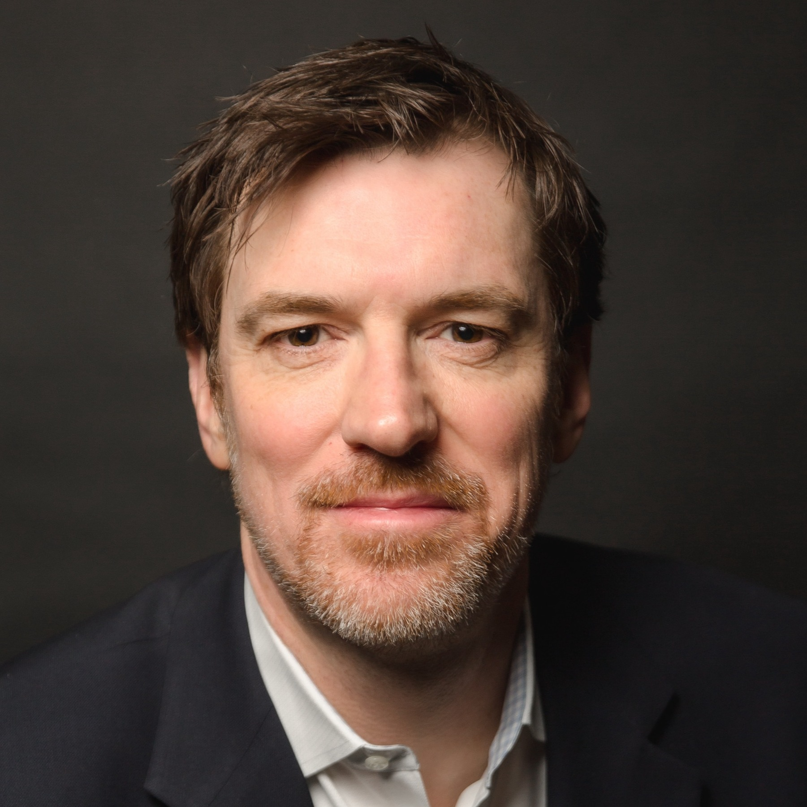
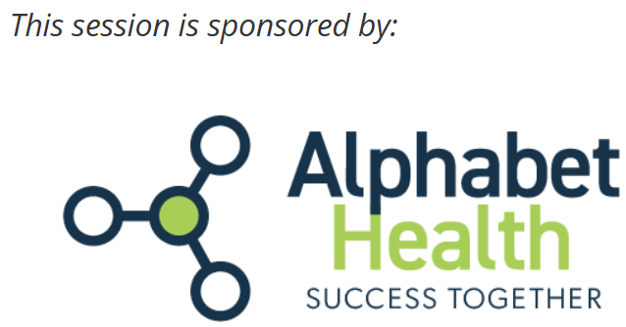
Keynote Speakers
Collaborate
Communicate
Innovate
Dr Verena Voelter
CEO and Founder,
5P Health Care Solutions
Dr Lisa Fitzpatrick
Founder and CEO,
Grapevine Health
Conor Grennan
Head of the Generative AI Initiative,
NYU Stern School of Business
Why Does It Take 5 to Tango in Healthcare?
Advancing Health Equity Through Inclusive Communication
Generative AI: How Human Expertise and Authenticity Matter More Than Ever
Notes:
We’ve got a really strong keynote lineup this year, each bringing a different lens to how we collaborate, communicate, and innovate in this evolving space.
On Monday, Dr. Verena Voelter kicks things off with “Why Does It Take 5 to Tango in Healthcare?” She’ll talk about the five key players in the healthcare ecosystem—patients, providers, pharma, payers, and policymakers—and how aligning them can drive meaningful innovation. She’s drawing from experience both in clinical care and the pharma industry, and will share practical strategies for navigating complexity and building collaboration across functions.
Tuesday morning, Dr. Lisa Fitzpatrick takes the stage. She’s a physician, epidemiologist, and founder of Grapevine Health, and she’ll focus on “Advancing Health Equity Through Inclusive Communication.” She’ll share insights on how to make our messages more accessible, more effective, and more inclusive—especially for patients and communities who often get left out of the conversation.
Then on Wednesday, we’re excited to welcome back Conor Grennan, who joined us last year and made a big impression with his energy and inspiration. This time, he’s tackling “Generative AI: How Human Expertise and Authenticity Matter More Than Ever.” He’ll walk us through a practical framework for using AI in a way that supports what we do best as professionals—without losing the human touch. If you’re feeling overwhelmed by all the AI noise, this session will help you reset and refocus. Big thanks to Alphabet Health for sponsoring this keynote.

Slide 16
Plenary sessions
A Chorus of Voices: Representation in
Medical Research
The Sound of Strategy:
Data-driven Personalized Communications
Harmonizing the Future: Generative AI's Effects on Medical Communications and Cross-Industry Collaborations
Behind the Music:
A Candid Conversation with Journal Editors and Publishers
Hot Topics and
Meeting Highlights
Presidential Address
Board of Trustees Plaque and Gavel Ceremony
Notes:
Our plenary sessions this year cover some of the most timely and thought-provoking topics in our field.
We have a session on representation in clinical research—why it matters for producing reliable results, and how broader participation can strengthen both the science and the relevance of trial findings.
We’ll also look at how to deliver data-driven, personalized communication that’s tailored to how people actually take in and respond to information.
There’s a session on generative AI that brings together pharma and agency voices to talk about collaboration, quality, and how AI is changing the way we work—and what that means for our future roles.
And then we’ll wrap up with a candid conversation with journal editors and publishers—covering everything from plain language summaries to retractions, and how to navigate a shifting publishing landscape.
We’ll also hear from Rob Matheis during the Presidential Address and CMPP update, with a look at what’s ahead for the society and the certification program. And we close the meeting with the Board of Trustees Plaque and Gavel Ceremony and hear from its leadership.

Slide 17
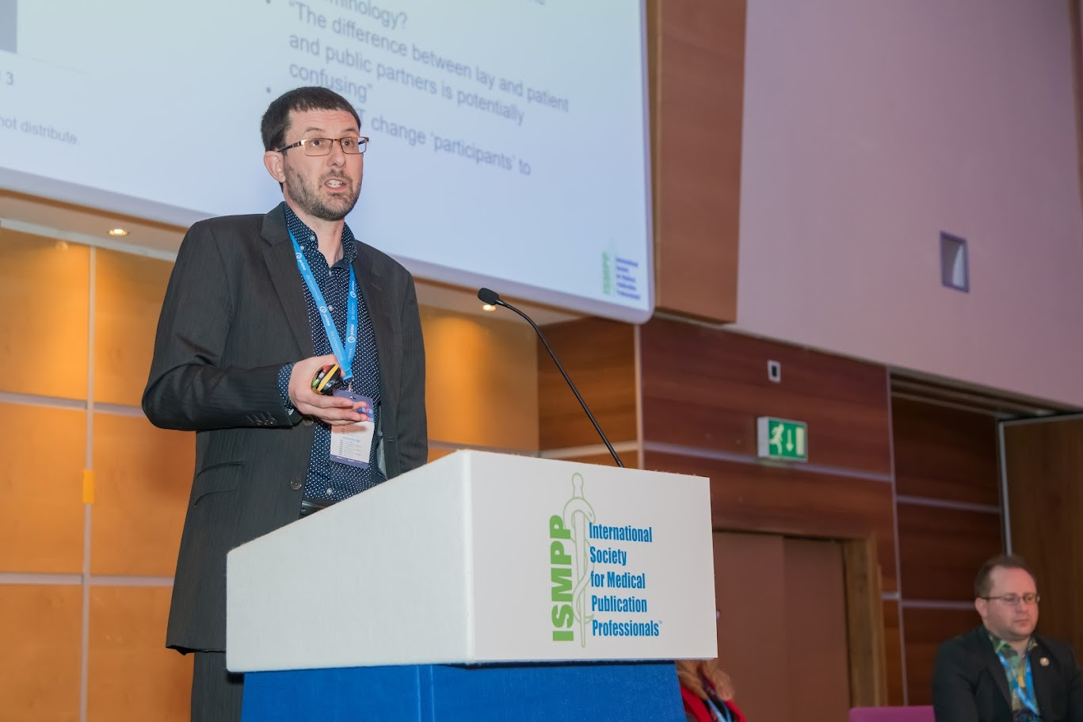
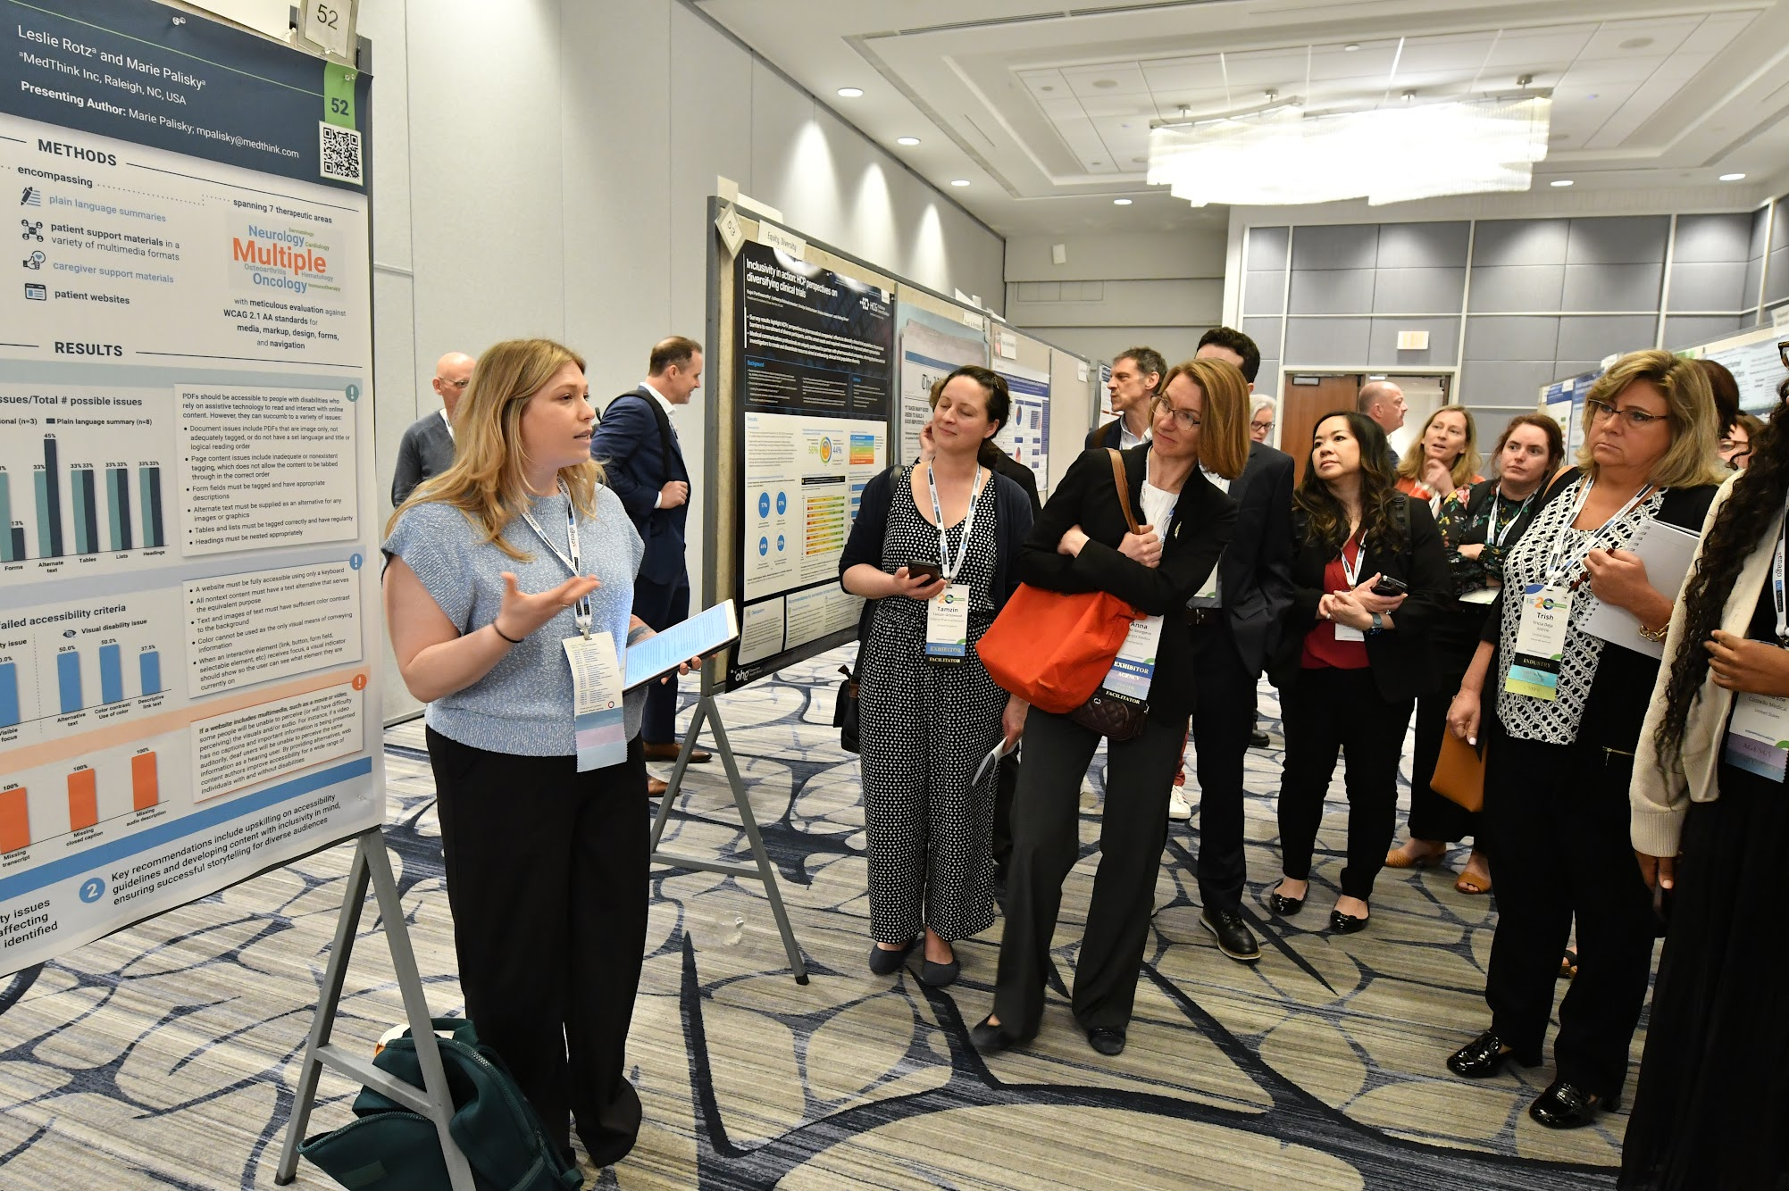
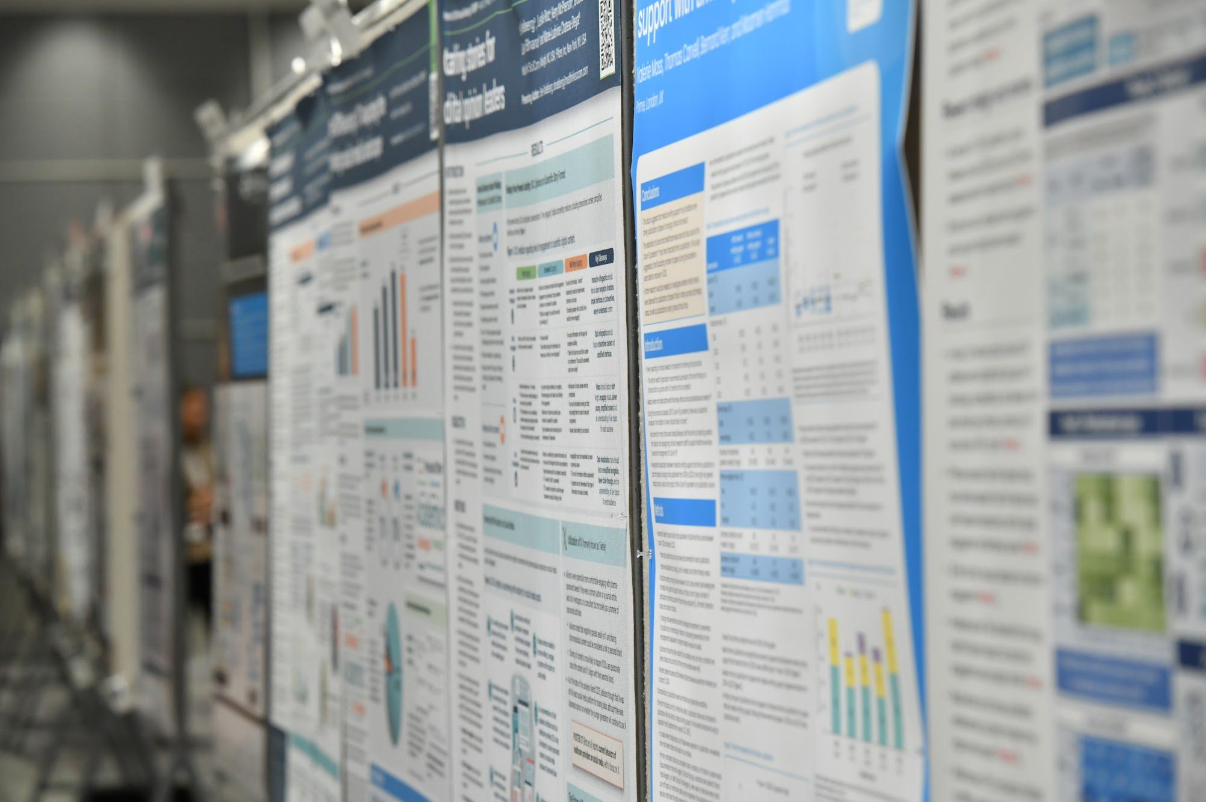
Member Research
Daily Oral Presentations
Daily Poster Tours
Poster Reception
Notes:
Each day of the meeting, we’ll feature oral presentations and guided poster tours highlighting member research—and we’re excited to showcase the incredible work being done across our community.
This year, we’ve got 72 posters covering a wide range of topics and a fun scavenger hunt being planned. These contributions reflect a real commitment to advancing our field—and they’re a great reminder that it’s our members who help move the needle of progress.
We hope you’ll carve out time to attend the sessions, connect with presenters, and take part in the conversation. It’s a chance to learn, get inspired, and support your peers doing meaningful work.

Slide 18
Top 10 Reasons to Attend
Expand Your Network
30 Member Proposals
130+ Companies Represented
Engaging Keynote Speakers
Networking and Poster Receptions
Cutting Edge Topics
Professional Excellence Awards
New Resources from ISMPP Committees
Exhibitors and NEW Product Theaters
CMPP CE Credits
Notes:
From networking and cutting-edge education to member research and CMPP credits, there are so many reasons to be part of this meeting. Thank you for investing your time with us.

Slide 19
ISMPP Code of Conduct
ISMPP is committed to providing a meeting environment that is welcoming and safe for participants. Attendees are expected to conduct themselves in a highly professional and respectful manner at all times. If you experience an incident that creates discomfort for you or another meeting attendee, please contact an ISMPP staff member at the meeting’s registration desk and/or email ismpp@ismpp.org. We look forward to a great meeting experience!
Notes:
Lastly, a reminder that ISMPP is committed to creating a safe, respectful environment. If you encounter anything that makes you or others uncomfortable, please report it to our team at registration or email us at ismpp@ismpp.org.

Slide 20
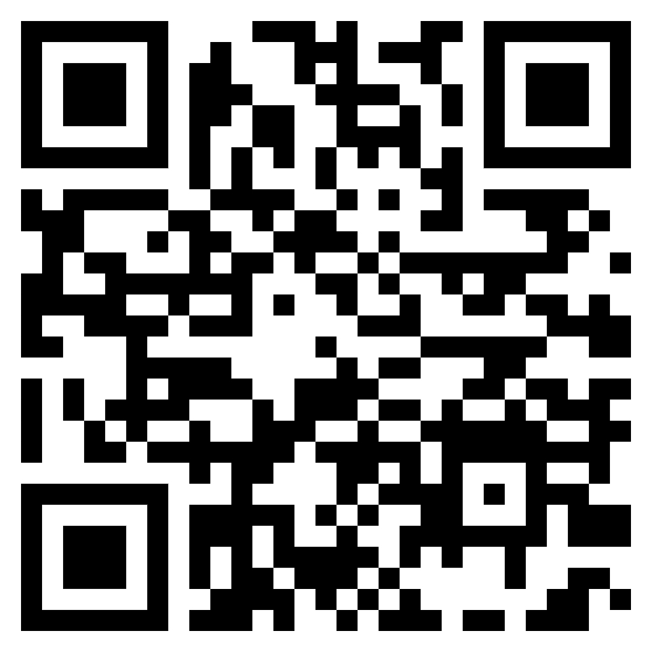
Full Agenda Online
Registration Closes April 25, 2025!

Slide 21
Sneak Peek: What’s Happening at ISMPP 2025
‘Know Before You Go’
Notes:
Hello and welcome! Thanks for checking out this quick preview of the ISMPP 21st Annual Meeting. Whether you’ve already registered or are still considering joining us, this overview will give you a sense of what the meeting is all about and why it’s totally worth being there.
We’ll cover meeting highlights, how to prepare, and a few ways to get the most out of your experience. Let’s dive in and show you why this year’s meeting is not to be missed!

