Slide 1

New Users Guide to NetDMR

Slide 2
Presentation Topics
What is NetDMR?
Electronic Reporting
EPA Databases
Account Creation (Live Presentation)
Basics of NetDMR (Live Presentation)

Slide 3
What is NetDMR?
Web-based tool that allows permittees to electronically submit Discharge Monitoring Reports (DMRs)
EPA hosts the national NetDMR
TCEQ previously hosted Texas NetDMR
On March 26, 2018, TCEQ began migrating its NetDMR users to the EPA’s hosted national NetDMR Customer
Retrieval Links (CRK) will be active till June 1, 2018 for customers able to migrate
Notes:
TCEQ NetDMR is no longer accessible to customers. Customers will now be required to utilize EPA’s NetDMR for e-reporting DMRs.

Slide 4
Electronic Reporting Rule
EPA NPDES Electronic Reporting Rule, effective December 21, 2016
E-reporting wavier (TCEQ Form 20754)
Multi-Sector General Permit (TXR050000s)
General e-reporting wavier until August 31, 2018
Beginning September 1, 2018 DMRs must be submitted electronically via NetDMR
Notes:
E-reporting wavier (Form 20754) available through the TCEQ Website:
Must apply for and obtain approval for an e-reporting wavier to be exempt from e-reporting.
Customers need to be aware of approved wavier expiration date.
MSGP systems will need to start reporting DMRs via NetDMR beginning September 1st.

Slide 5
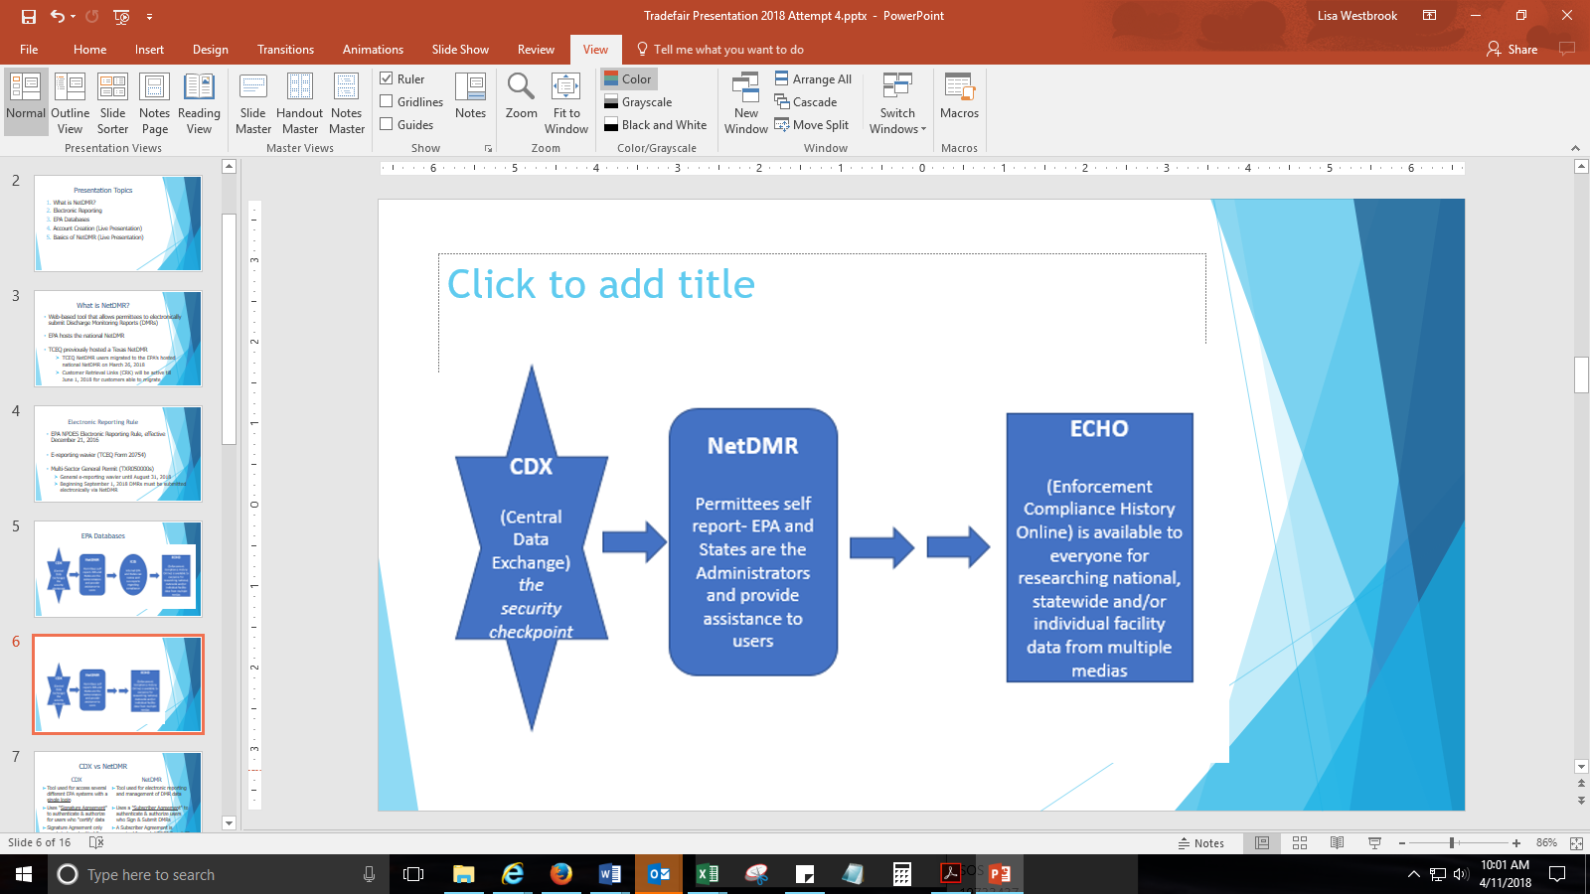
EPA Databases
Notes:
In order to access the NetDMR, you will need to have access to the EPA’s Central Data Exchange or CDX system.
The data is automatically submitted in NetDMR is transferred to the EPA’s NPDES database and this DMR data is then transferred to the EPA’s ICIS-NPDES database and then to the EPA’s hosted ECHO (Enforcement & Compliance History Online) for public viewing.
(To understand how CDX and NetDMR relate to each other think of it like an airport. CDX is like the TSA at the airport and NetDMR is like one of the many terminals an airport has. To gain access to the NetDMR, a customer must first have access to CDX.
You need access to both systems to be able to participate in e-reporting DMRs.)

Slide 6
CDX vs NetDMR
CDX
Tool used to access several different EPA systems with a single login
Uses "Signature Agreement" to authenticate & authorize for users who "certify' data
Signature Agreement needs to be submitted & approved only once per CDX account
NetDMR
Tool used for electronic reporting and management of DMR data
Uses a "Subscriber Agreement" to authenticate & authorize users who Sign & Submit DMRs
A Subscriber Agreement is required for each NPDES Permit ID Signatory Role Request
Notes:
The CDX is used for accessing multiple EPA systems with a single login.
Customers need to submit a electronic signature agreement for CDX access
Customers will only need to do this once either via paper or electronically.
NetDMR is the system used for e-reporting DMRs.
A subscriber agreement is required for each permit number for signatory role users.
For signatory role users with access to multiple permit numbers, a separate subscriber agreement is required for each permit.

Slide 7
CDX User Types & NetDMR Roles
Term | Who | Available NetDMR Roles | Definition
Permittee (signature) | If you work for the company and will sign/submit DMRs | Signatory, Permit Administrator, Edit, View | A person authorized to sign, view, edit and submit DMRs for a specific permit. Will also be able to approve roles for others except signatory.
Permittee (no signature) | If you work for the company but will NOT sign/submit DMRs | Permit Administrator, Edit, View | Can view, enter and upload DMRs into NetDMR, edit CORs, and approve roles for other users within NetDMR
Data Provider | Lab, Contractor or 3rd Party Affiliate | Edit, View | Allowed to view, enter and import DMRs into NetDMR and edit CORs but they cannot sign and submit forms
Internal User | This is for state/EPA Agency Personnel only | Internal Administrator | A regulatory authority staff member with a NetDMR Account
Notes:
You will need to know what you user type you want before you start setting up your CDX account and there are three CDX user types available for the public.
If you need to be able to submit DMRs, then you will need to have permittee signature user type in CDX.
Please do not choose Internal User, this option is for regulatory authorities only
Only the regulatory authority can approve signatory roles.
The first signatory will also be granted permit administrator.
A NetDMR User may have a combination of multiple roles within NetDMR.
Definitions:
Responsible Officials are authorized to sign and submit DMRs themselves (in accordance with 40 CFR 122.22) Duly Authorized Representatives are authorized to sign and submit DMRs on behalf of a Responsible Official

Slide 8
Account Creation (Live Presentation)
Notes:
NetDMR Support Portal has instructions on account creation and requesting access to a permit online. The link to the NetDMR support portal will be available at the end of this presentation.

Slide 9
CDX Account Creation - Pitfalls
Individual Email Needed
User ID (case sensitive)
3 to 8 Different security questions answers (case sensitive)
Program Service: NDMR-TX: Texas Commission on Environmental Quality
Choose Correct CDX User Type
Identity proofing (3rd party - LexisNexis): Uses personal identifying information
Last 4 numbers of SSN
Home address (cannot use PO Box)
Electronic Signing of ESA – click “Yes”
Notes:
DO NOT CHOOSE PROGRAM SERVICE: NDMR-R6: NETDMR: EPA REGION 06-AR-GM-LA-NM-OK-TX
This choice is only for NPDES permittees who primary regulatory authority is the EPA.
For permittee (signature) if you choose to electronically sign the electronic signature agreement then you will need to go through identity proofing.

Slide 10
NetDMR Access Requests - Pitfalls
EPA ID No. is needed (TX…)
When requesting access, enter permit ID No. & hit update
Parent or Facility
Choose Parent if you work at a corporate headquarters or offsite office
Choose Facility if you work at or near to the location of the wastewater treatment facility.
For electronically signed subscriber agreements, if you are a Duly Authorized Representative (DAR) and not an Responsible Official (RO), the RO will need a CDX account to approve
A DAR will need to know the RO’s first and last name, title, phone number, and email address
Notes:
Responsible Officials are authorized to sign and submit DMRs themselves (in accordance with 40 CFR 122.22)
Duly Authorized Representatives are authorized to sign and submit DMRs on behalf of a Responsible Official

Slide 11
Basics of NetDMR (Live Presentation)

Slide 12
Useful Website Links
NetDMR https://cdxnodengn.epa.gov/oeca-netdmr-web/action/login
NetDMR Support Portal (netdmr.Zendesk.com/hc/en-us) https://netdmr.zendesk.com/hc/en-us
Self-reported data can be accessible through EPA’s ECHO database https://echo.epa.gov/

Slide 13
Questions?

