Slide 1
Children in Conflict Zones: Child Protection in Emergency Situations
July 23, 2024

Slide 2
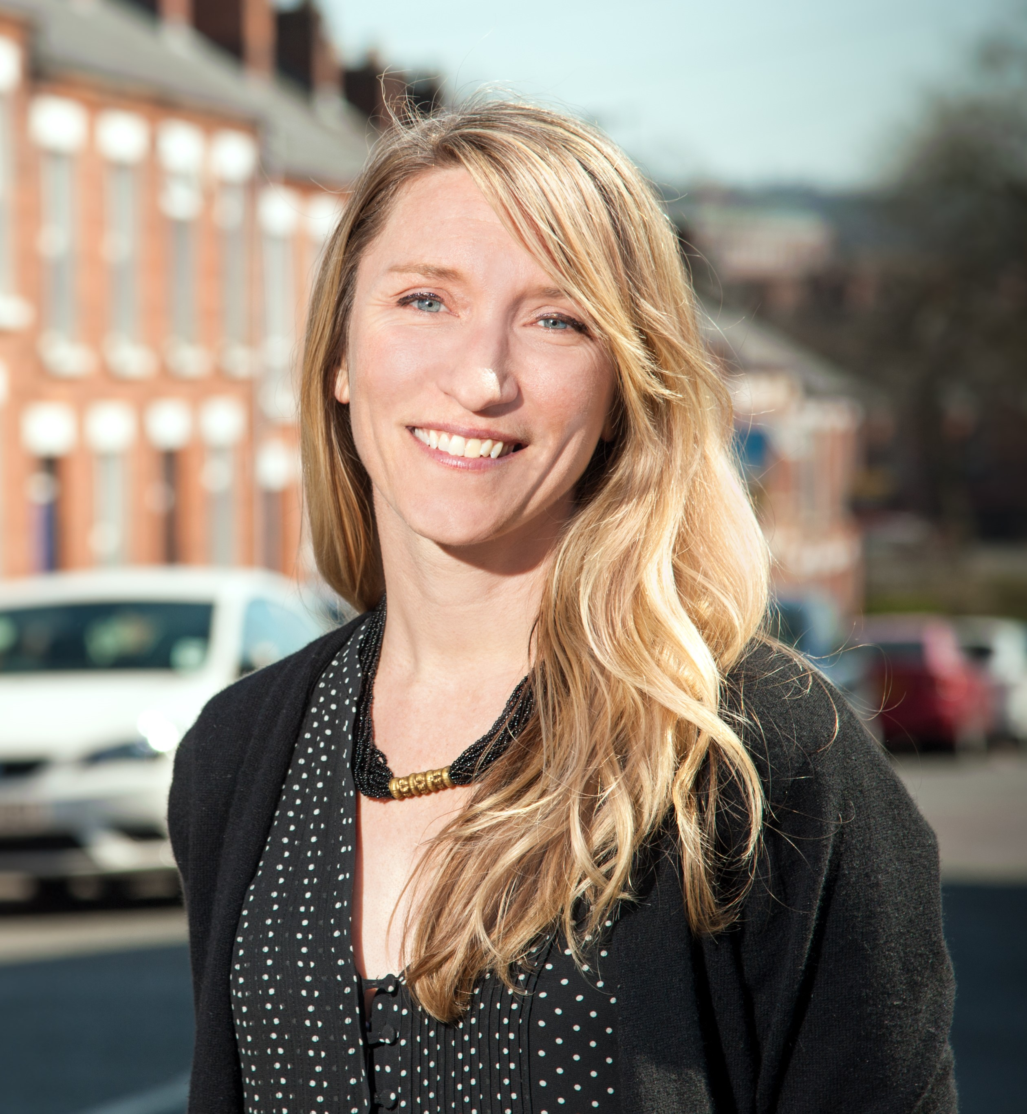
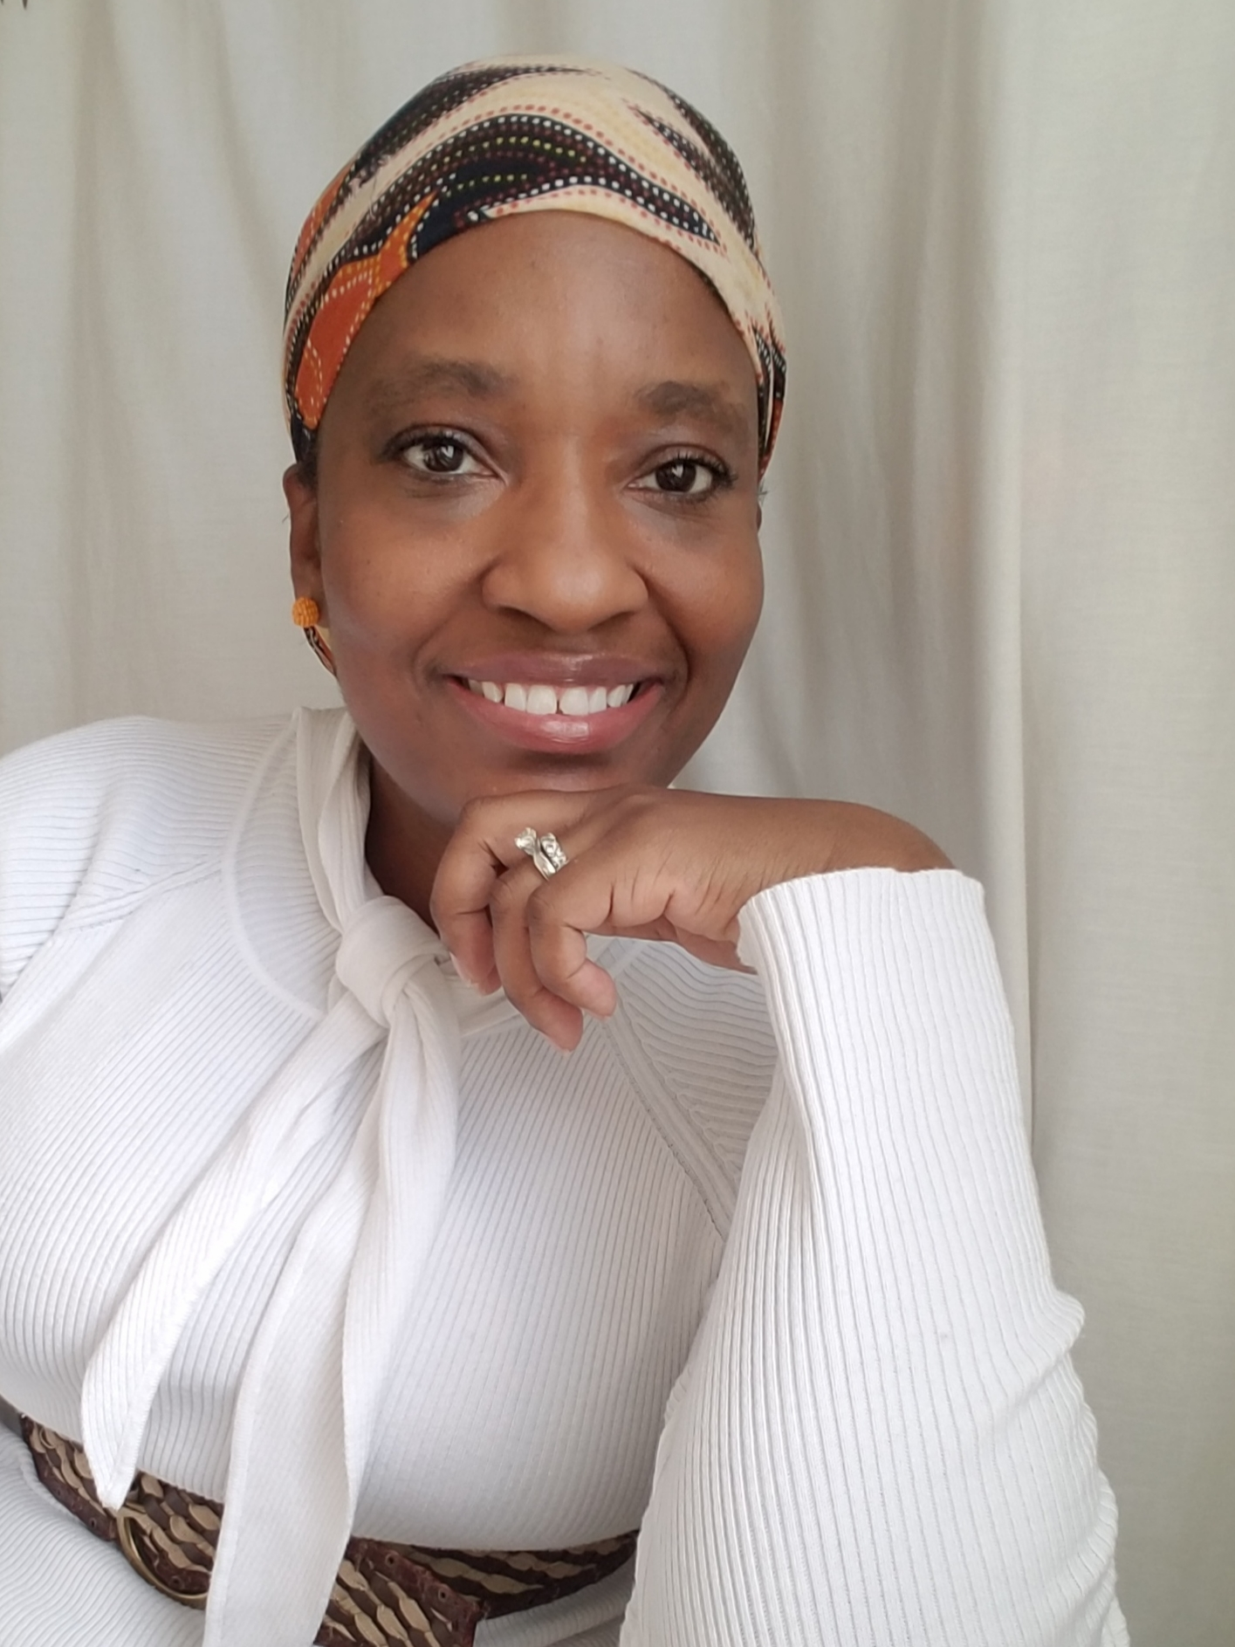
Moderators
Dr. Laura K. Taylor
University College Dublin
Dr. Valerie Adams-Bass
Rutgers University

Slide 3
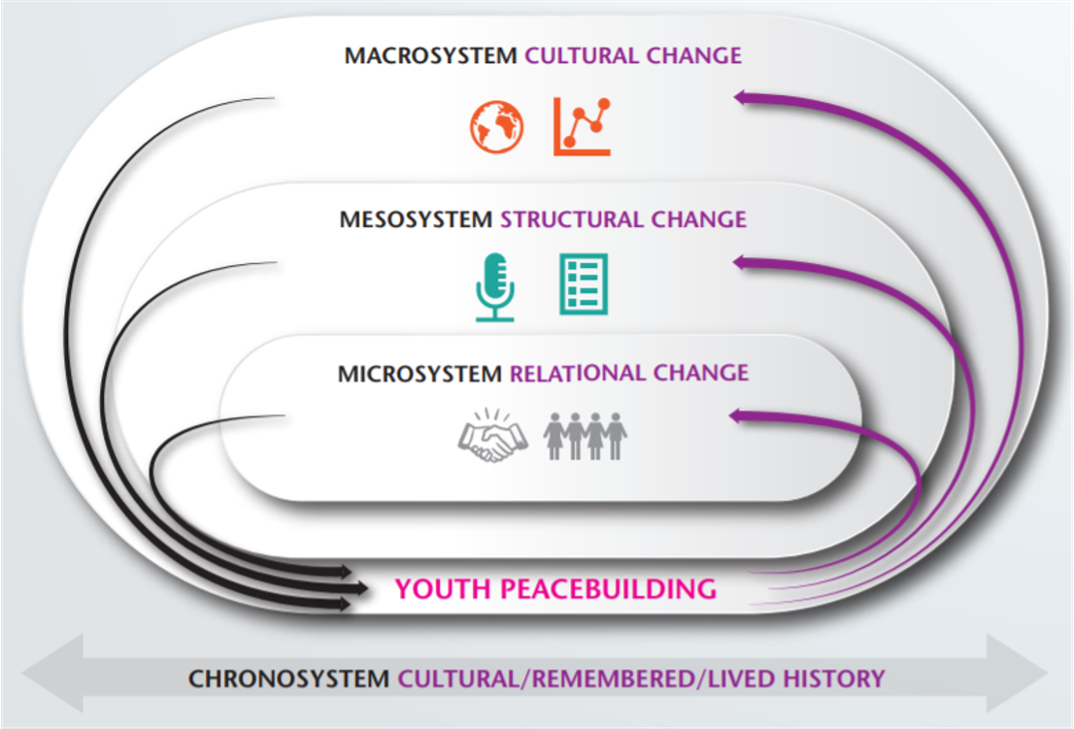
Developmental Peacebuilding Model
Psychology
Peace Studies

Slide 4
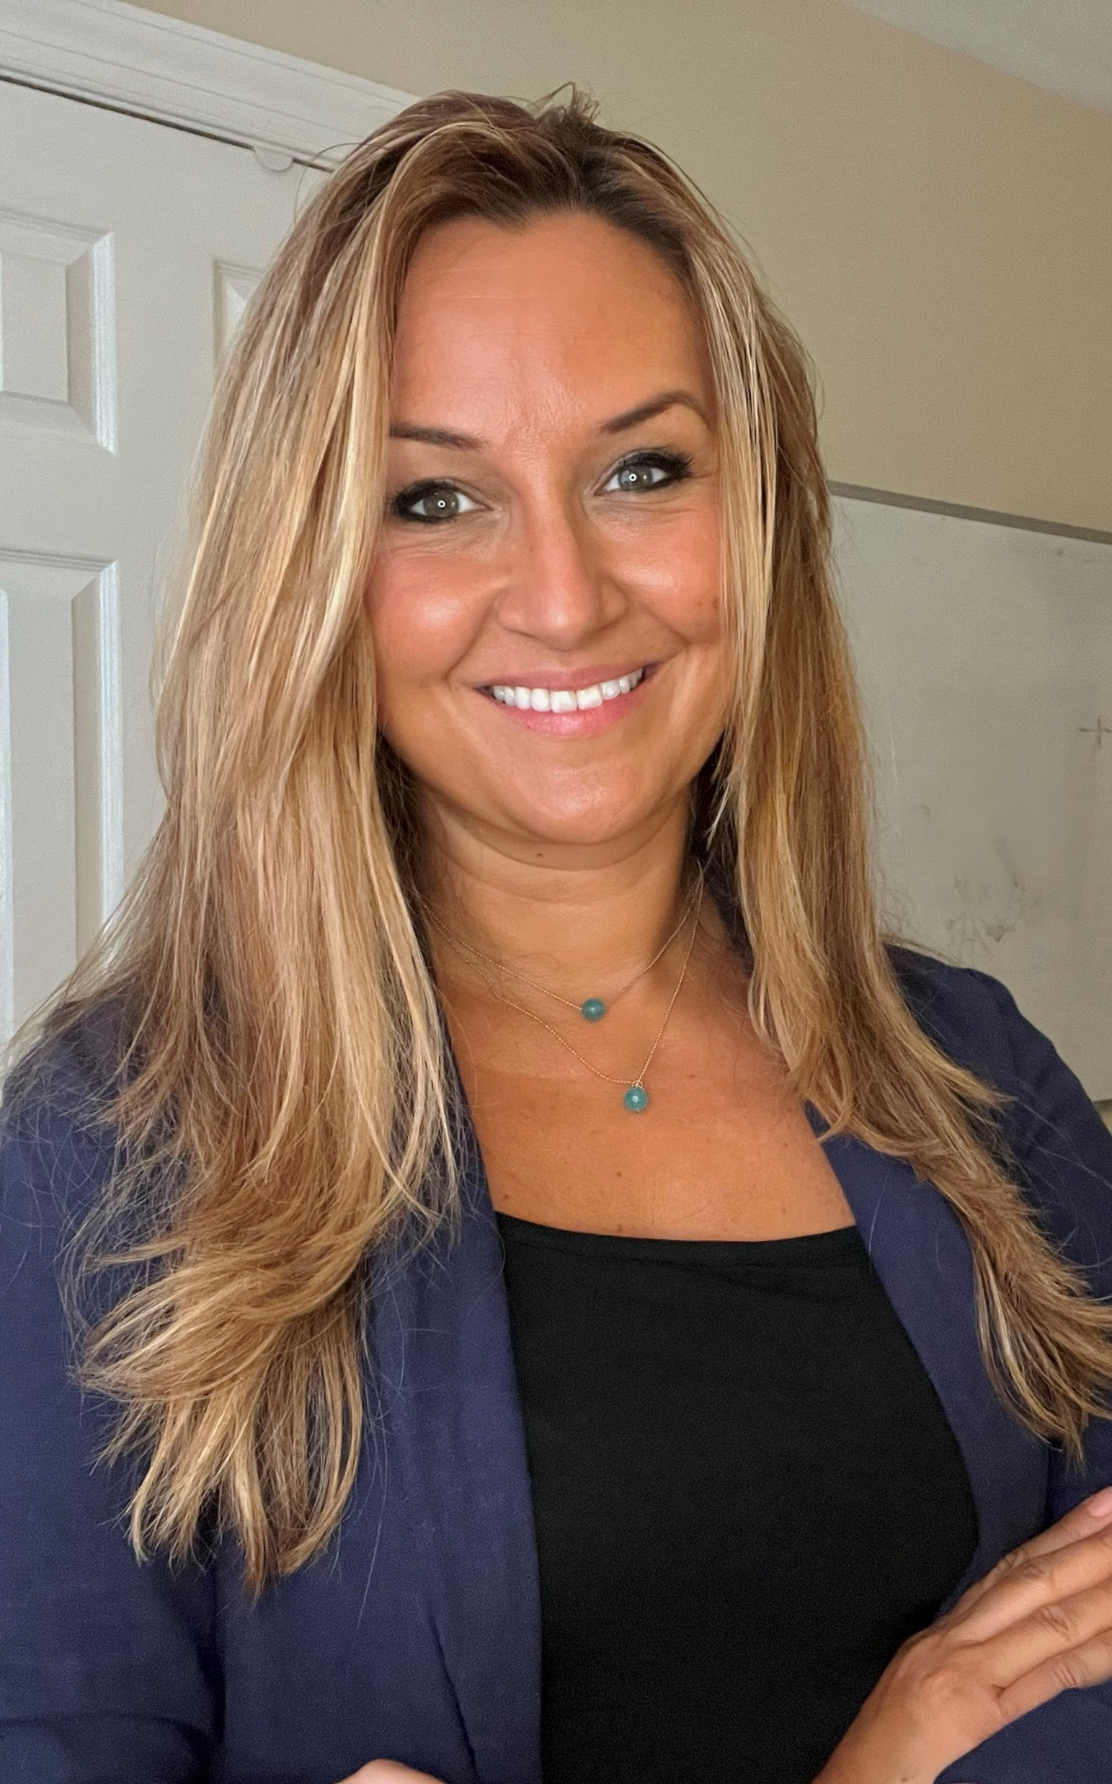
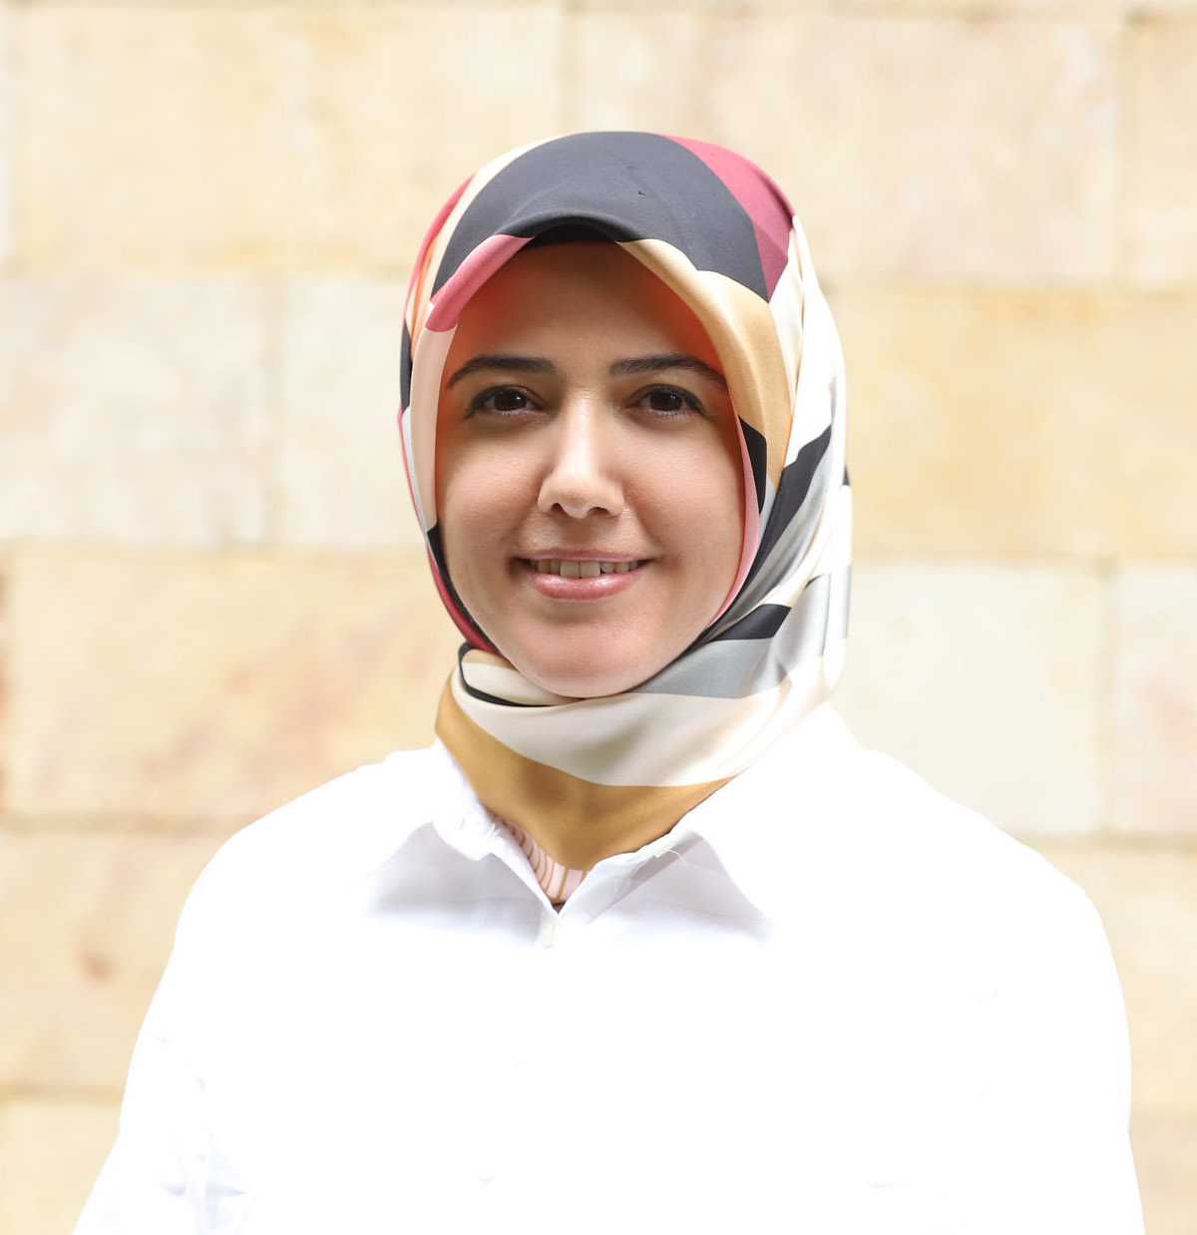
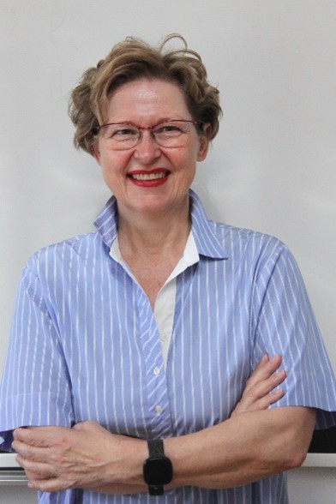
Speakers
Dr. Angelica Ponguta
Yale University
Dr. Ozden Pinar Irmak
University of Massachusetts, Boston
Dr. Dinka Čorkalo Biruški
University of Zagreb

Slide 5
Resources

Slide 6





Follow SRCD on Social Media
@SocietyforResearchinChildDevelopment
@SRCDtweets
@srcdorg
@srcdchilddevelopment

