Slide 1
Update on the Texas State Implementation Plan (SIP) and Federal Air Quality Standards
Kasey Savanich and Alison Stokes
Air Quality Division
2018 Environmental Trade Fair

Slide 2
Today’s Topics
National Ambient Air Quality Standards (NAAQS)
Design Values
2015 Revisions to the Ozone NAAQS
Status of Texas Air Quality Planning Activities

Slide 3
National Ambient Air Quality Standards

Slide 4
National Ambient Air Quality Standards
Required by the Federal Clean Air Act (FCAA)
The United States Environmental Protection Agency (EPA) sets these health-based standards for clean air, called National Ambient Air Quality Standards (NAAQS), for six criteria air pollutants:
Ground-Level Ozone (O₃);
Particulate Matter (PM);
Nitrogen Dioxide (NO₂);
Sulfur Dioxide (SO₂);
Carbon Monoxide (CO); and
Lead (Pb).

Slide 5
National Ambient Air Quality Standards
The EPA is required to review the NAAQS every five years. For more information on the review process, go to the EPA’s NAAQS review Web page. (https://www.epa.gov/criteria-air-pollutants/process-reviewing-national-ambient-air-quality-standards)
States with areas failing to meet the NAAQS (nonattainment) are required to develop and submit to the EPA state implementation plan (SIP) revisions.

Slide 6
Current NAAQS
Pollutant | Level | Averaging Time
Ozone (O₃) | 0.070 ppm* | Eight-Hour
Particulate Matter (PM_{2.5}) | 12.0 µg/m³ | Annual (Arithmetic Mean)
 | 35 µg/m³ | Twenty-Four-Hour
Particulate Matter (PM₁₀) | 150 µg/m³ | Twenty-Four-Hour
Nitrogen Dioxide (NO₂) | 53 ppb | Annual (Arithmetic Mean)
 | 100 ppb | One-Hour
Sulfur Dioxide (SO₂) | 75 ppb | One-Hour
Carbon Monoxide (CO) | 9 ppm | Eight-Hour
 | 35 ppm | One-Hour
Lead (Pb) | 0.15 µg/m³ | Rolling Three-Month Average
Note: Secondary NAAQS are the same as the primary NAAQS for all pollutants except SO₂, which has a secondary NAAQS of 0.5 ppm over three hours, and PM_{2.5}, which has a secondary NAAQS of 15.0 µg/m³ annually. More information can be found at EPA’s NAAQS Web page (https://www.epa.gov/criteria-air-pollutants/naaqs-table).
* In 1997, EPA revoked the one-hour ozone standard (0.12 ppm, not to be exceeded more than once per year) and in 2015 the EPA revoked the 1997 eight-hour ozone NAAQS (0.08 ppm); however, some areas have continued obligations under those standards (“anti-backsliding”). The 2008 eight-hour ozone NAAQS of 0.075 ppm also remain in effect for some areas.

Slide 7
NAAQS Review Schedule
Criteria Pollutant | Proposed Rule | Final Rule
Nitrogen Dioxide (NO₂) | July 14 2017 | April 6, 2018
Sulfur Dioxide (SO₂) | May 25, 2018 | January 28, 2019
Nitrogen Oxides (NO_{X}) and Sulfur Oxides (SO_{X}) Secondary Standard | 2021 | 2022
Particulate Matter (PM) | 2021 | 2022
Lead (Pb) | TBD | TBD
Ozone (O₃) | TBD | TBD
Carbon Monoxide (CO) | TBD | TBD

Slide 8
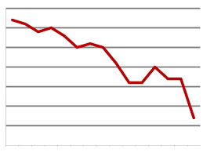
Design Values

Slide 9
Data Completeness
Most design value calculations require a data completeness check.
Data completeness checks vary by NAAQS, but in general:
A design value must have at least 75% complete data for the year;
A design value that exceeds the NAAQS but has incomplete data is still considered valid; and
Additional tests can be used to validate a design value with incomplete data.
See the EPA’s Scientific and Technical Information for an individual criteria pollutant (https://www.epa.gov/criteria-air-pollutants/naaqs-table).

Slide 10
Calculating Fine Particulate Matter (PM_{2.5}) Design Values
Annual PM_{2.5} Design Values:
Calculate the quarterly mean of the 24-hour PM_{2.5} measurements.
Average the quarterly means for each year; this is called the weighted annual mean.
The design value is the three-year average of the weighted annual mean PM_{2.5}.
24-Hour PM_{2.5} Design Values:
Determine the number of valid 24-hour PM_{2.5} concentrations for each year.
Use the number of valid days to find your 98th percentile value for the year.
The design value is the three-year average of the 98th percentile 24-hour PM_{2.5} concentration.

Slide 11
2017* PM_{2.5} Design Values
County | Annual Design Value (μg/m³) | 24-Hour Design Value (μg/m³)
Bexar | 8.4 | 20
Dallas | 8.9 | 18
Ellis | 8.7 | 18
El Paso | 8.9 | 23
Galveston | 6.7 | 22
Harris | 10.7 | 22
Harrison | 8.6 | 17
Hidalgo | 10.2 | 26
Nueces | 9.3 | 24
Tarrant | 8.7 | 18
Travis | 9.6 | 20
NAAQS | 12.0 | 35
*2017 design values are from EPA’s Air Quality System AMP 480 Report. Only counties with at least one valid design value are displayed in this table. Data are current as of 4/3/2018 and is subject to change.

Slide 12
Calculating Coarse Particulate Matter (PM₁₀) Design Values
24-Hour PM₁₀ Design Values
Find the number of expected exceedances per quarter (the number of days in the quarter, divided by the number of days with data, multiplied by the number of exceedances).
Add up the expected exceedances for the year.
The design value is the average of the number of expected exceedances over three years.

Slide 13
2017* PM₁₀ Design Values
County | Expected Exceedances
Bexar | 0
Dallas | 0
El Paso | 2
Galveston | 0
Harris | 0
Harrison | 0
Hidalgo | 0
Tarrant | 0
Travis | 0
Webb | 0
NAAQS | 1.0
*2017 design values are from EPA’s Air Quality System AMP 480 Report. Only counties with at least one valid design value are displayed in this table. Data are current as of 4/3/2018 and is subject to change.
.
Notes:
El Paso had one exceedance of the 24-hour PM₁₀ NAAQS in 2017. Currently there are no plans to submit an exceptional event analysis for El Paso, but those plans are subject to change.

Slide 14
Calculating Nitrogen Dioxide Design Values
Annual NO₂ Design Values:
The design value is the annual average of all valid one-hour NO₂ concentrations.
One-Hour NO₂ Design Values:
Determine the number of days with valid NO₂ concentrations for each year.
Use the number of valid days to find the 98th percentile of daily peak NO₂ values for the year.
The design value is the three-year average of the 98th percentile of the daily maximum one-hour NO₂ concentration.

Slide 15
2017* NO₂ Design Values
County | Annual Design Value (ppb) | One-Hour Design Value (ppb)
Bexar | 6 | 41
Brazoria | 5 | 32
Dallas | 9 | 45
Denton | 5 | 31
El Paso | 10 | 59
Ellis | 5 | 33
Galveston | 2 | 30
Gregg | 3 | 21
Harris | 14 | 49
Harrison | 2 | 18
Hunt | 4 | 27
Jefferson | 6 | 31
Kaufman | 3 | 26
McLennan | 3 | 24
Montgomery | 3 | 27
Navarro | 2 | 23
Orange | 3 | 28
Smith | 2 | 16
Tarrant | 12 | 44
Travis | 13 | 48
NAAQS | 53 | 100
*2017 design values are from EPA’s Air Quality System AMP 480 and AMP 450 Reports. Only counties with at least one valid design value are displayed in this table. Data are current as of 4/3/2018 and is subject to change.

Slide 16
Calculating Sulfur Dioxide Design Values
One-Hour SO₂ Design Values
Determine the number of days with valid SO₂ concentrations for each year.
Use the number of valid days to find the 99th percentile of daily peak SO₂ values for the year.
The design value is the three-year average of the 99th percentile of the daily maximum one-hour SO₂ concentration.

Slide 17
2017* SO₂ Design Values
County | One-Hour Design Value (ppb)
Bexar | 12
Dallas | 4
Ellis | 5
El Paso | 6
Galveston | 21
Gregg | 30
Harris | 18
Jefferson | 13
Kaufman | 9
McLennan | 6
Navarro | 39
Nueces | 4
Travis | 4
NAAQS | 75
*2017 design values are from EPA’s Air Quality System AMP 480 Report. Only counties with at least one valid design value are displayed in this table. Data are current as of 4/3/2018 and is subject to change.
Notes:
Additional monitors were installed in 2016-2017, data from these monitors are not included due to the lack of 3 year data.

Slide 18
Calculating Carbon Monoxide Design Values
One-Hour CO Design Values: The design value is the second-highest one-hour CO concentration for the year.
Eight-Hour CO Design Values: The design value is the second-highest non-overlapping eight-hour CO concentration for the year.

Slide 19
2017* CO Design Values
County | One-Hour Design Value (ppm) | Eight-Hour Design Value (ppm)
Bexar | 1.7 | 1.1
Cameron | 2.2 | 1.0
Dallas | 1.7 | 1.0
El Paso | 24.0 | 4.9
Harris | 2.1 | 1.9
Jefferson | 1.0 | 0.5
McLennan | 0.5 | 0.4
Tarrant | 1.4 | 0.9
Travis | 2.2 | 1.3
Webb | 3.0 | 2.2
NAAQS** | 35 | 9
*2017 design values are from EPA’s Air Quality System AMP 450 Report. Only counties with at least one valid design value are displayed in this table. Data are current as of 4/3/2018 and is subject to change.
**Because design values are reported to one decimal place, an area will not violate the CO NAAQS unless it measures greater than 35.4 ppm for one-hour CO or greater than 9.4 ppm for eight-hour CO.

Slide 20
Calculating Lead Design Values
Rolling Three-Month Lead Design Values:
Calculate the monthly mean of the 24-hour lead concentrations.
Calculate rolling three-month lead averages for a three-year period.
The design value is the maximum of the rolling three-month averages over a three-year period.

Slide 21
2017* Lead Design Values
County | Design Value (μg/m³)
Cameron | 0.00
Collin | 0.01
El Paso | 0.00
Kaufman | 0.17
Potter | 0.00
Webb | 0.01
NAAQS | 0.15
**2017 design values are from EPA’s Air Quality System AMP 480 Report. Only counties with at least one valid design value are displayed in this table. Data are current as of 4/3/2018 and is subject to change.
Notes:
High values in Kaufman are due to an event that occurred on September 4, 2017. There is a lead source to the south-southeast of the monitor in Kaufman county, Conecsus Tejas, that appears to be the source of the event. This facility reported 0.34 tons of lead in 2016.

Slide 22
2015 Revisions to the Ozone NAAQS

Slide 23
2015 Revisions to the Ozone NAAQS
On October 1, 2015, the EPA revised the primary and secondary NAAQS for eight-hour ozone.
Primary NAAQS protect public health
2008 NAAQS: 0.075 ppm
Revised NAAQS: 0.070 ppm
Secondary NAAQS protect public welfare (trees, plants, ecosystems, etc.)
2008 NAAQS: 0.075 ppm
Revised NAAQS: 0.070 ppm
Form is identical to the primary NAAQS but the target level is based on the W126 index.

Slide 24
Ozone NAAQS Revisions Timeline
Final Rule – October 1, 2015
State Area Designation Recommendations due to the EPA - October 1, 2016
EPA’s Round 1 Attainment/Unclassifiable Designations – November 6, 2017
EPA’s Response to State Recommendations for Remaining Areas – December 22, 2017
EPA Final Designations for Remaining Areas – April 30, 2018
EPA Final Designations for San Antonio Area – July 17, 2018
Implementation Plans – 2021 to 2022
Attainment of NAAQS – 2021 to 2038

Slide 25
Calculating Eight-Hour Ozone Design Values
Calculate the eight-hour daily peak at each monitor for each day.
Average the fourth highest eight-hour daily peak value from each of the most recent three years. This is the design value for your monitor. Do this for each monitor.
The design value for a county or Metropolitan Statistical Area (MSA) is the maximum design value from all of the monitors located within that county or MSA.

Slide 26
Calculating the Eight-Hour Ozone Design Value: Example
Monitor A has three years of complete data; sort daily peaks in descending order by year:
Take the 4th highest eight-hour daily peaks from each year and find the average:
 | 2011 | 2012 | 2013
Maximum Daily Peak Eight-Hour Ozone | 87 | 85 | 86
2nd Highest Daily Peak Eight-Hour Ozone | 85 | 83 | 80
3rd Highest Daily Peak Eight-Hour Ozone | 80 | 78 | 75
4th Highest Daily Peak Eight-Hour Ozone | 78 | 77 | 74
78 + 77 + 74
= 76.333 ppb
3
Now truncate your average:
76.333 = 76 ppb
This is the eight-hour ozone design value.

Slide 27
Comparing Design Values to the NAAQS
Design values must be greater than the NAAQS for an area to exceed.
For the 2008 NAAQS set at 75 ppb (0.075 ppm):
75.99999 ppb -> 75 ppb -> MEETS NAAQS
76.00001 ppb -> 76 ppb -> EXCEEDS NAAQS
For the revised NAAQS of 70 ppb (0.070 ppm):
70.99999 ppb -> 70 ppb -> MEETS NAAQS
71.00001 ppb -> 71 ppb -> EXCEEDS NAAQS
Notes:
Validity criteria:
Greater than the NAAQS.
If less than the NAAQS:
Each year must have 75% valid days.
The number of valid days averaged over three years must average 90% or more.

Slide 28
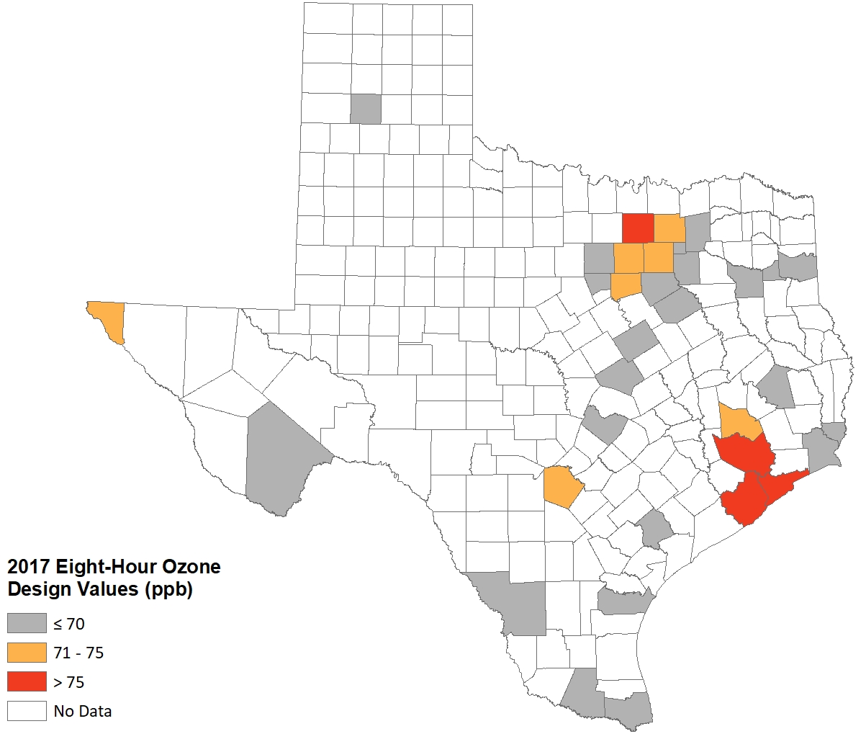
2017 Ozone Design Values by County
CSA/CBSA | County | 2017 8Hr Ozone DV (ppb)
Houston—The Woodlands | Harris | 81
Dallas—Fort Worth | Denton | 79
Houston—The Woodlands | Galveston | 77
Houston—The Woodlands | Brazoria | 77
Dallas—Fort Worth | Tarrant | 75
San Antonio—New Braunfels | Bexar | 74
Dallas—Fort Worth | Collin | 74
Dallas—Fort Worth | Dallas | 74
Houston—The Woodlands | Montgomery | 74
Dallas—Fort Worth | Johnson | 73
El Paso—Las Cruces | El Paso | 71
Dallas—Fort Worth | Parker | 70
Killeen-Temple | Bell | 69
Austin—Round Rock | Travis | 69
Dallas—Fort Worth | Hood | 67
Beaumont—Port Arthur | Jefferson | 67
Dallas—Fort Worth | Rockwall | 66
Dallas—Fort Worth | Ellis | 65
Longview-Marshall | Gregg | 65
Waco | McLennan | 65
Amarillo-Borger | Randall | 65
Victoria—Port Lavaca | Victoria | 65
Tyler-Jacksonville | Smith | 64
Dallas—Fort Worth | Navarro | 63
No CSA | Brewster | 62
Corpus Christi—Kingsville—Alice | Nueces | 62
Dallas—Fort Worth | Hunt | 62
Longview-Marshall | Harrison | 61
Dallas—Fort Worth | Kaufman | 61
Beaumont—Port Arthur | Orange | 60
No CSA | Polk | 60
Brownsville-Harlingen-Raymondville | Cameron | 57
McAllen-Edinburg | Hidalgo | 55
Laredo | Webb | 53
*2017 design values are calculated as of 4/3/2018 and subject to change. The El Paso design value excludes one concurred exceptional event from August 21, 2015.
**The Brewster County, Randall County, and Polk County monitors are part of the Clean Air Status and Trends Network (CASTNET) of monitors and report data directly to the EPA.
Notes:
Map and table created by Kasey Savanich (x1145) on April 3, 2018. Data from this map will not be certified in time to use in designations for the 2015 ozone NAAQS. Designations will be based on 2016 eight-hour ozone design values, which are discussed later in this presentation.

Slide 29
Status of Texas
Air Quality
Planning Efforts

Slide 30
Status of Texas Air Quality Planning Efforts
Criteria Pollutants
O₃
SO₂
Pb
CO
NO₂
PM
Other Statewide Air Issues
Interstate Transport Rule
Regional Haze

Slide 31
Ozone

Slide 32
Revoked One-Hour and 1997 Eight-Hour Ozone NAAQS
Redesignation Substitutes for revoked standards
HGB Severe Nonattainment Area
One-Hour Ozone Standard
Approved by EPA on October 20, 2015
1997 Eight-Hour Ozone Standard
Approved by EPA on November 8, 2016
DFW Serious Nonattainment Area
One-Hour and 1997 Eight-Hour Ozone Standards
Approved by EPA on November 8, 2016
Notes:
The redesignation substitute came from the EPA’s 2008 ozone SIP requirements rule as a way to lift anti-backsliding requirements for areas that have attained revoked standards.

Slide 33
2018 D.C. Circuit Court Ruling
The EPA’s final 2008 ozone standard SIP requirements rule was challenged in South Coast Air Quality Management District v. EPA.
On February 16, 2018, the D.C. Circuit Court vacated portions of the final rule including the Redesignation Substitute, among other issues.
The EPA filed a petition for rehearing on April 23, 2018.

Slide 34
2008 Eight-Hour Ozone Standard
Standard is 0.075 ppm
Design values of 75 ppb or less are attainment.
EPA finalized designations May 21, 2012.
July 20* established as the attainment date of each relevant calendar year
HGB Area
Brazoria, Chambers, Fort Bend, Galveston, Harris, Liberty, Montgomery, and Waller Counties
DFW Area
Collin, Dallas, Denton, Ellis, Johnson, Kaufman, Parker, Rockwall, Tarrant, and Wise Counties

Slide 35
HGB Area
Classified as a marginal nonattainment area for the 2008 ozone standard
Attainment deadline was July 20, 2015.
EPA approved a one-year extension to July 20, 2016.
The EPA reclassified the area to moderate on December 14, 2016.
Attainment deadline is July 20, 2018.
Area had to attain by end of 2017.
Attainment Demonstration and Reasonable Further Progress (RFP) SIP revisions were adopted December 15, 2016 and due to EPA January 1, 2017.

Slide 36
DFW Area
Classified as a moderate nonattainment area for the 2008 standard
Wise County added to nonattainment area
Attainment deadline July 20, 2018
RFP SIP revision adopted on June 3, 2015
Attainment Demonstration adopted on July 6, 2016
Due to court decision, the TCEQ developed this attainment demonstration SIP revision to reflect the 2017 attainment year.
EPA proposed approval of the SIP revision on May 3, 2018

Slide 37
DFW RACT Update SIP
The proposed DFW RACT Update SIP revision and voluntary Agreed Order between the TCEQ and TXI Operations, LP were approved by the commission on April 4, 2018.
The SIP revision would address the EPA’s final conditional approval of RACT.
The Agreed Order incorporates certain permit conditions as NO_{X} RACT.
Adoption agenda is scheduled for September 26, 2018

Slide 38
2015 Eight-Hour Ozone NAAQS
On October 1, 2015, the EPA lowered the NAAQS for ground-level ozone to 70 ppb.
Original state designation recommendations
Based on 2015 design values
Recommended nonattainment for the DFW and HGB areas as well as Hood, El Paso, and Bexar Counties.
Revised Recommendations
August 23, 2017 updated recommendation from TCEQ
Based on final 2016 monitoring data and information from exceptional events
Updated the recommendations for Hood and El Paso Counties to attainment
September 27, 2017 letter from the governor
No new areas in Texas should be designated nonattainment
Notes:
Texas designation recommendations were based on 2015 design values with the caveat that nonattainment recommendations may be revised to attainment based on 2016 design values. Hood County was recommended as nonattainment based on 2015 design values but is attaining the standard based on 2016 design values.
An exceptional event demonstration was submitted to EPA for the UTEP monitor in El Paso for a June 21, 2015 wildfire event. Exclusion of the exceptional event from design value calculations would result in the El Paso area meeting the NAAQS for the 2014 through 2016 period, so the recommendation for El Paso was updated to attainment pending exceptional event concurrence from EPA.

Slide 39
EPA Designations
Round One: Attainment/Unclassifiable designations made on November 16, 2017 for majority of Texas counties, effective January 16, 2018
Round Two: Designations by April 30, 2018
EPA sent 120-day letters on December 22, 2017 for remaining area designations
EPA proposed nonattainment for eight-county HGB area and 10-county DFW area
EPA proposed attainment/unclassifiable for Hood and El Paso Counties
Notes:
On November 16, 2017, the EPA designated the majority of Texas as attainment/unclassifiable for the 2015 eight-hour ozone NAAQS (82 Federal Register (FR) 54232), with an effective date of January 16, 2018. There were 49 counties in Texas that the EPA did not designate in Round One, located in the El Paso, San Antonio, HGB, and DFW areas.
In the EPA’s December 22, 2017 letter regarding proposed Round Two designations, the EPA proposed to designate the eight-county HGB area and 10-county DFW area as nonattainment and proposed that all remaining counties in Texas be designated as attainment/unclassifiable, with the exception of San Antonio area counties.
The EPA concurred with the El Paso UTEP June 21, 2015 exceptional event demonstration on December 15, 2017. The EPA noted in the technical support documents for the proposed Round Two designations that due to concurrence with the exceptional event determination, the UTEP monitor in El Paso County meets the 2015 ozone NAAQS for the 2014 through 2016 period.

Slide 40
Round Two 120-Day Response
Revised recommendation for HGB and DFW areas
Texas recommended attainment/unclassifiable designations for:
Rockwall County in the DFW area
Liberty and Waller Counties in the HGB area
Notes:
Revised recommendations for Rockwall, Liberty and Waller Counties were based on an assessment of the relevant factors used by EPA to evaluate appropriate boundaries for
nonattainment areas

Slide 41
Final Round Two Designations
Designations signed on April 30, 2018
Nine-county DFW nonattainment area:
Collin, Dallas, Denton, Ellis, Johnson, Kaufman, Parker, Tarrant, and Wise Counties
Six-county HGB nonattainment area:
Brazoria, Chambers, Fort Bend, Galveston, Harris, and Montgomery Counties
All other counties designated attainment/unclassifiable

Slide 42
San Antonio Designations
EPA requested additional information regarding designation recommendations for the San Antonio area on January 19, 2018.
March 19, 2018 120-day letter
EPA proposed attainment/unclassifiable designations for Atascosa, Bandera, Comal, Guadalupe, Kendall, Medina, and Wilson Counties.
EPA proposed to modify the governor’s recommendation for Bexar County.
At best, unclassifiable.
Texas’ response due May 11, 2018.
Final designations by July 17, 2018

Slide 43
County Designations for the 2015 Ozone NAAQS
*As of May 4, 2018. Designations are based off of 2016 eight-hour ozone design values.

Slide 44
2015 Ozone NAAQS Proposed Implementation Rule
Options for revoking the 2008 ozone NAAQS
1) One year from 2015 ozone NAAQS designations for the entire country
2) For areas designated nonattainment for the 2008 ozone NAAQS at the time of designations for the 2015 ozone NAAQS, only after approval of a maintenance plan for the 2008 NAAQS
Reasonably available control measures (RACM) for sources outside the nonattainment area
evaluate and implement RACM for sources located outside the nonattainment area, but within the state, for nonattainment areas classified as moderate or above
Reasonably available control technology (RACT) and RACM for marginal areas with an FCAA, §179B demonstration
Notes:
Under option 1, a redesignation substitute could be submitted for areas that are nonattainment for the 2008 ozone NAAQS at the time of revocation once the applicable criteria have been met. If the EPA finalizes option 2, it would mean that all nonattainment area requirements for the 2008 ozone NAAQS, including reclassification for failure to attain, would remain in place for nonattainment areas until those areas attain the 2008 ozone NAAQS and the EPA has approved a redesignation request and maintenance plan.
Under the current regulations, states are only required to evaluate RACM for sources located within the nonattainment area.
The EPA proposes to require states that submit a demonstration that a marginal nonattainment area would meet the NAAQS but for emissions from sources located outside the United States to evaluate and implement RACT and RACM. Under the current regulations, no such requirement exists.

Slide 45
Nonattainment Classification Ranges
Classification | Range Based on Percent-Above-Standard Approach 0.070 parts per million (ppm) | Potential Attainment Date
Marginal | 0.071 up to 0.081 ppm | 2021
Moderate | 0.081 up to 0.093 ppm | 2024
Serious | 0.093 up to 0.105 ppm | 2027
Severe – 15 | 0.105 up to 0.111 ppm | 2033
Severe – 17 | 0.111 up to 0.163 ppm | 2035
Extreme | 0.163 ppm or more | 2038
Notes:
The EPA included classification ranges as part of the proposed 2015 ozone NAAQS implementation rule. On March 1, 2018, the EPA issued a final rule establishing the Nonattainment Area Classifications Approach for the 2015 Ozone NAAQS.
Design value of 81 would be considered Moderate.

Slide 46
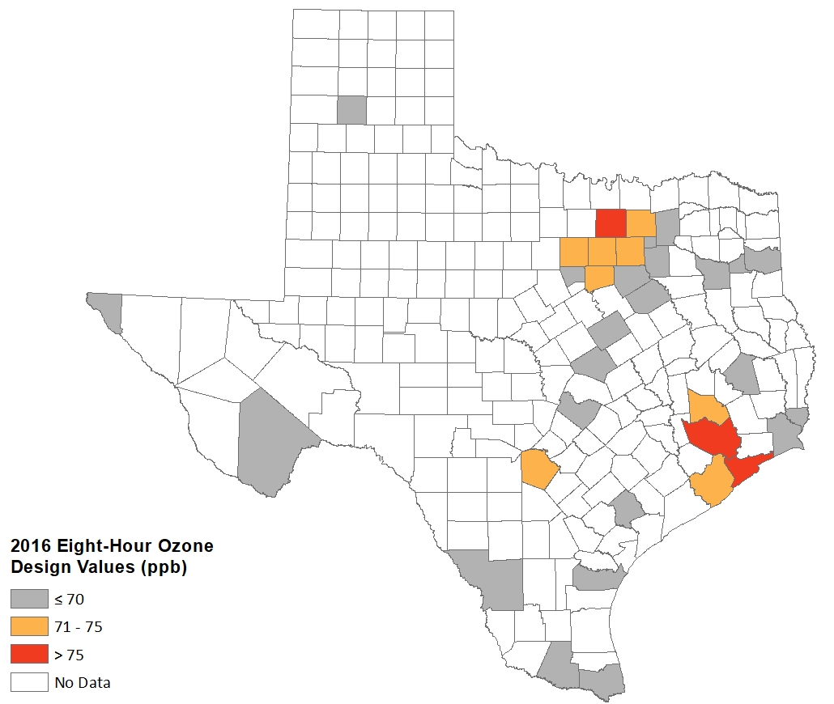
2016 Ozone Design Values by County
CSA/CBSA | County | 2016 8Hr Ozone DV (ppb)
Dallas—Fort Worth | Denton | 80
Houston—The Woodlands | Harris | 79
Houston—The Woodlands | Galveston | 76
Houston—The Woodlands | Brazoria | 75
Dallas—Fort Worth | Tarrant | 75
Dallas—Fort Worth | Collin | 74
San Antonio—New Braunfels | Bexar | 73
Dallas—Fort Worth | Parker | 73
Dallas—Fort Worth | Dallas | 72
Dallas—Fort Worth | Johnson | 72
Houston—The Woodlands | Montgomery | 72
El Paso—Las Cruces | El Paso | 70
Dallas—Fort Worth | Hood | 69
Beaumont—Port Arthur | Jefferson | 68
Killeen-Temple | Bell | 67
Longview-Marshall | Gregg | 66
Dallas—Fort Worth | Rockwall | 66
Austin—Round Rock | Travis | 66
Tyler-Jacksonville | Smith | 65
Victoria—Port Lavaca | Victoria | 65
Amarillo-Borger | Randall | 64
Corpus Christi—Kingsville—Alice | Nueces | 64
Beaumont—Port Arthur | Orange | 64
Dallas—Fort Worth | Ellis | 63
Waco | McLennan | 63
No CSA | Brewster | 62
Longview-Marshall | Harrison | 62
Dallas—Fort Worth | Kaufman | 61
Dallas—Fort Worth | Navarro | 61
No CSA | Polk | 61
Dallas—Fort Worth | Hunt | 60
Brownsville-Harlingen-Raymondville | Cameron | 57
McAllen-Edinburg | Hidalgo | 55
Laredo | Webb | 54
*2016 design values are calculated as 1/18/2018. The El Paso design value excludes one concurred exceptional event from August 21, 2015.
**The Brewster County, Randall County, and Polk County monitors are part of the Clean Air Status and Trends Network (CASTNET) of monitors and report data directly to the EPA.
Notes:
Map and table created by Kasey Savanich (x1145) on January 1, 2018.

Slide 47
Timeline
November 2017 | EPA Round One Attainment/ Unclassifiable Designations
March 2018 | EPA finalizes Classifications Rule
April 2018 | EPA signs (finalizes) Round Two designations and classifications
July 2018 | EPA signs (finalizes) designations for San Antonio area
June/Sep 2018 | Expected effective date of nonattainment designations
June/Sep 2020 | Emissions Inventory SIP revisions due for all nonattainment areas
June/Sep 2021 | Attainment deadline for marginal nonattainment areas
Notes:
Infrastructure and Transport SIP revisions due October 2018

Slide 48
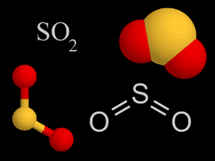
Sulfur
Dioxide

Slide 49
SO₂ NAAQS Revision
Revised June 2010
One-hour primary standard of 75 ppb
99th percentile over three years
Three-hour secondary standard of 500 ppb
Not to be exceeded more than once/year
Round 1 nonattainment designations in 2013
Only for areas that had monitored values over the standard
No areas in Texas designated as nonattainment
Notes:
Prior standard had been in place since 1971 for primary and 1973 for secondary standard
1971 = 24 hour of 0.14 ppm and 30 ppb annual average; secondary std was 500 ppb for 3-hr and 20 ppb annual average
1973 = secondary annual revoked and 3 hr. retained
FR 8/5/2013 effective date of 10/4, 2013. 5 yr. attainment date for those areas NA

Slide 50
Round 2 Designations
Designations Effective September 12, 2016:
Unclassifiable/attainment designations for Atascosa, Fort Bend, Goliad, Lamb, Limestone, McLennan, and Robertson Counties
Unclassifiable for designation for Potter County
Designations Effective January 12, 2017:
Nonattainment designations for three areas: (1) portions of Freestone and Anderson Counties; (2) portions of Rusk and Panola Counties; and (3) a portion of Titus County
Unclassifiable designation for Milam County

Slide 51
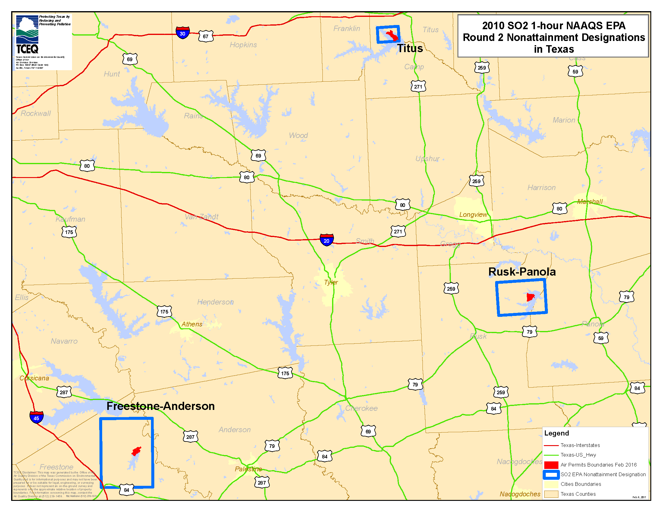
Texas SO₂ Nonattainment Areas

Slide 52
Attainment Demonstration SIP Revision Schedule
SIP revision due to the EPA: July 12, 2018
Controls must be in place: No later than January 12, 2021
Attainment deadline: No later than January 12, 2022
EPA reconsidering designations
Notes:
Vistra Energy filed a petition for reconsideration and administrative stay of the three nonattainment designations on February 13, 2017.
In a letter dated September 21, 2017 responding to Vistra Energy’s petition, the EPA stated its intention to undertake an administrative action with notice and comment to revisit the nonattainment designations in the Final Rule for portions of Freestone and Anderson Counties, Rusk and Panola Counties, and Titus County.
The TCEQ also submitted a petition for reconsideration to the EPA on December 11, 2017.

Slide 53
Data Requirements Rule
Signed August 10, 2015
Requires states to characterize air quality for SO₂ sources emitting 2,000 tons or more per year
Model
Monitor
Establish enforceable limits < 2,000 tons/yr.
Texas identified 24 facilities
Modeling for Oklaunion Power Station (Wilbarger County) submitted to EPA on January 12, 2017, demonstrating attainment
Monitoring for remaining facilities not already addressed under consent decree

Slide 54
Round 3 Designations
Final designations were made on January 9, 2018 with an effective date of April 9, 2018.
EPA designated 238 counties or portions of counties as separate unclassifiable/attainment areas.
Includes Wilbarger County for which modeling was submitted
Includes the portions of Anderson, Panola, Rusk, and Freestone Counties not previously designated nonattainment in Round 2

Slide 55
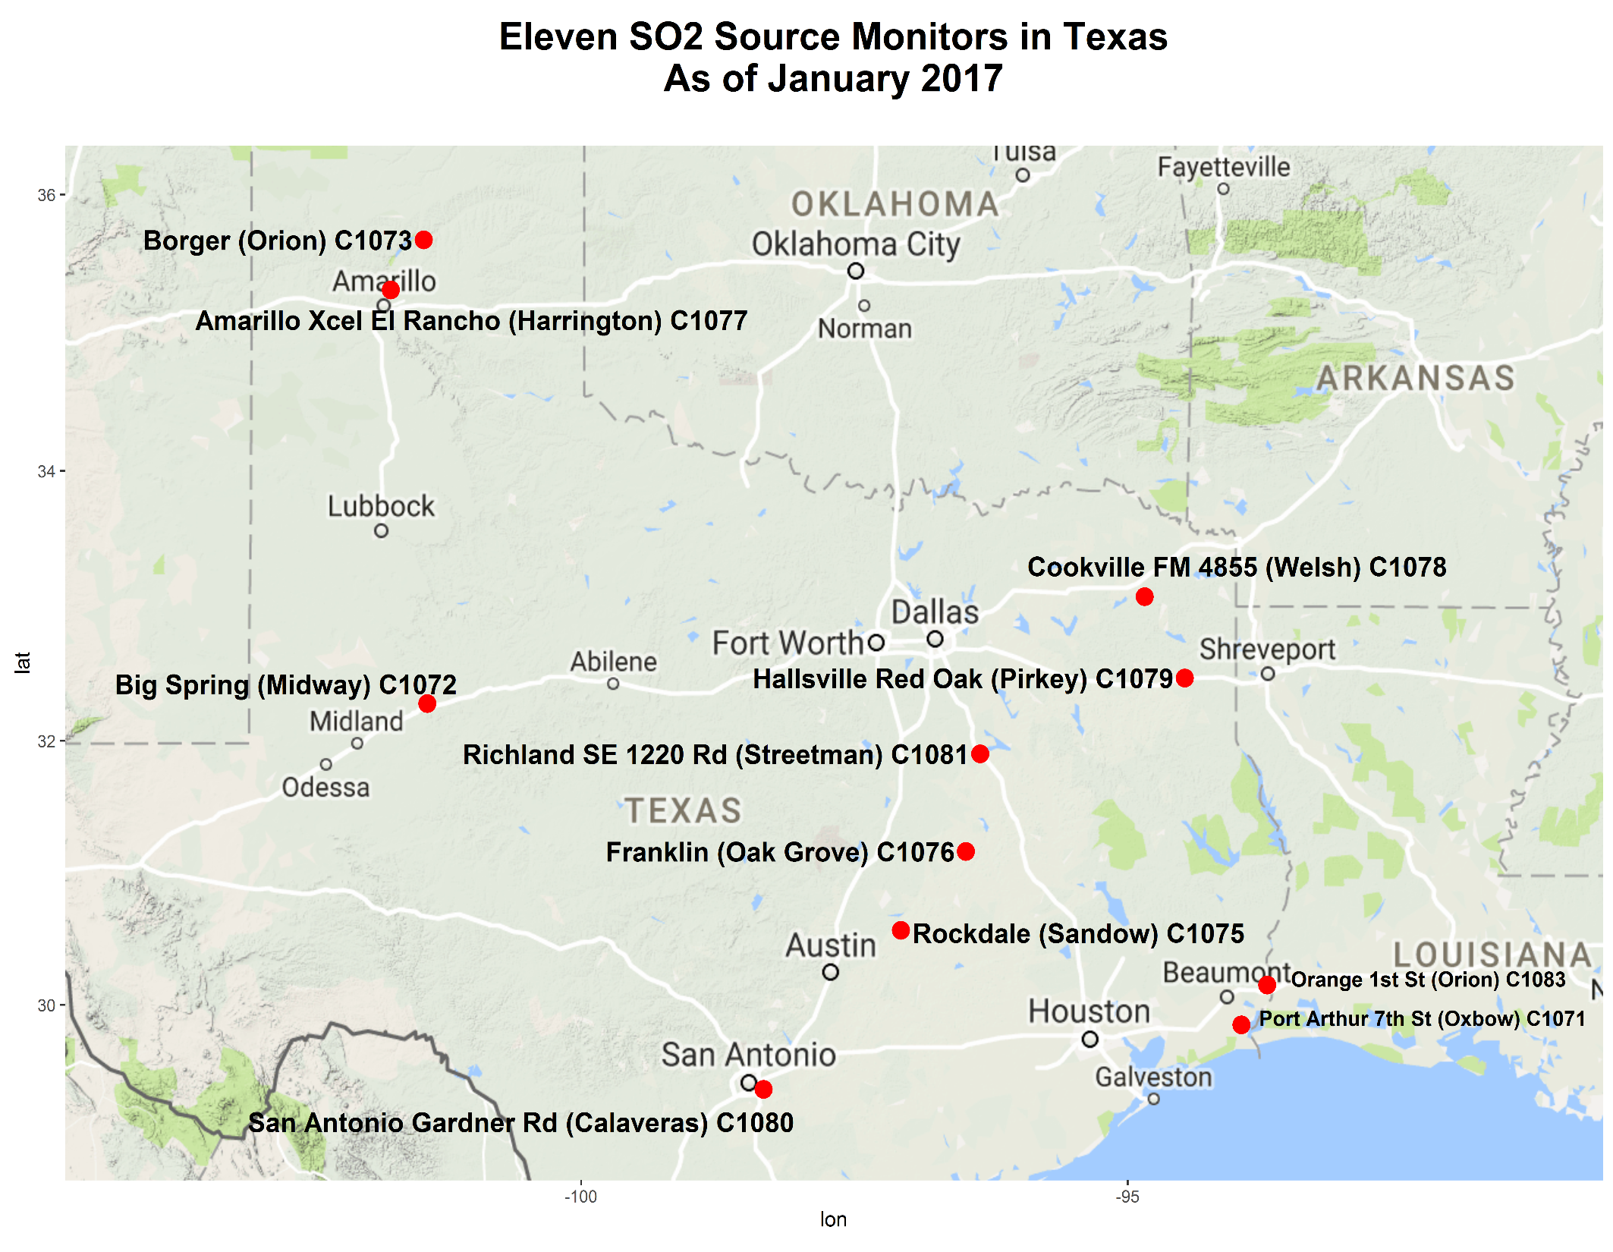
Notes:
Locations of the new monitors that were put in place for areas being characterized through monitoring for designation in Round 4

Slide 56
Timeline for Rounds 3 and 4 Designations
Jan 15, 2016 | List of applicable sources (24 sites)
July 1, 2016 | Approach for each site was due to EPA (Modeling protocol, Monitoring plan, Lower emission limits)
Jan 1, 2017 | Monitoring sites operational
Jan 13, 2017 | Deadline for modeling results and/or enforceable emission limits
Dec 31, 2017 | EPA designations for areas where states are not monitoring (Round 3)
Dec 31, 2020 | EPA designations for any/all remaining undesignated areas (Round 4)

Slide 57
Lead

Slide 58
Lead
Portion of Collin County nonattainment for the 2008 lead NAAQS
Area now has three years of monitoring data below the standard
Lead Redesignation Request and Maintenance Plan SIP revision adopted by the commission on October 19, 2016
June 29, 2017 EPA direct final approval; Effective September 27, 2017
Approved Redesignation Request and Maintenance Plan
Approved 2012 Attainment Demonstration for the 2008 Lead NAAQS and 2009 Second 10-year Maintenance Plan for the 1978 Lead NAAQS

Slide 59
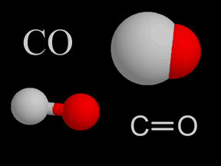
Carbon
Monoxide

Slide 60
CO NAAQS
2011 NAAQS requires one CO monitor to be collocated with one required near-road NO₂ monitor in Core-Based Statistical Areas (CBSA) with populations of 1 million or more.
Monitors installed in Houston and Fort Worth in 2015
Fort Worth California Parkway North
Houston North Loop
Monitors installed in Austin and San Antonio in December 2016
Austin North Interstate 35
San Antonio Interstate 35
All areas in Texas attainment

Slide 61
CO NAAQS
In 1990, El Paso was designated as a moderate nonattainment area for CO.
EPA approved a redesignation request and maintenance plan SIP revision, effective October 3, 2008.
A second 10-year limited maintenance plan was adopted by the commission on September 7, 2016 and EPA approval was published on March 21, 2017.
Notes:
Second 10-year maintenance plan was due to the EPA eight years after the effective date of redesignation, or October 3, 2016.

Slide 62
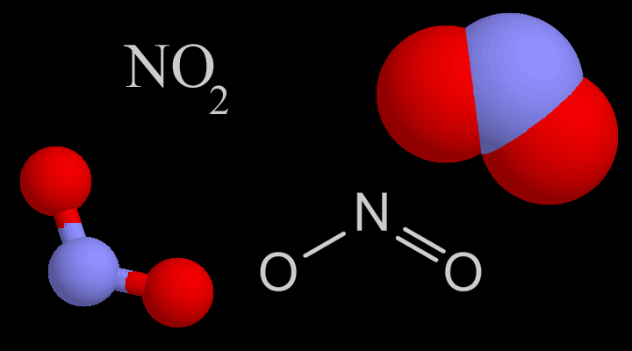
Nitrogen
Dioxide

Slide 63
2010 NO₂ NAAQS
Final rule published February 2010
No Texas nonattainment areas
Near-road monitoring network requirements
Requires one NO₂ monitor to be located in CBSAs with populations of 1 million or more
Monitors installed in Houston, Dallas, San Antonio, and Austin in 2014
Additional monitors installed in Dallas and Houston in 2015
Fort Worth California Parkway North
Houston North Loop
Near-road data to date shows compliance with the 2010 standard, highest 98th percentile one-hour measurements for Texas showing approximately less than half of NAAQS (or approximately less than 50 ppb)

Slide 64
Particulate
Matter

Slide 65
PM₁₀
El Paso was designated as a moderate nonattainment area for PM₁₀ in 1990.
EPA approved the El Paso SIP revision for PM₁₀ on December 14, 2015.
The SIP incorporates a revised Memorandum of Agreement and a Chapter 111 rule change for PM_{10.}
All other areas in Texas are classified as attainment/unclassifiable for PM_{10.}

Slide 66
PM_{2.5}
EPA revised the PM_{2.5} standard in December 2012
Annual PM_{2.5} standard lowered from 15 to 12 µg/m³
Designations finalized in December 2014
All areas of Texas designated unclassifiable/attainment

Slide 67
2012 PM_{2.5} Standard
Near-road monitoring network requirements
Requires one PM_{2.5} monitor to be collocated with the required near-road NO₂ monitor in CBSAs with populations of 1 million or more
Monitors installed in Houston and Fort Worth in 2015
Fort Worth California Parkway North
Houston North Loop
Monitors installed in Austin and San Antonio in January 2017
Austin North Interstate 35
San Antonio Interstate 35

Slide 68
Additional SIP Updates

Slide 69
Anti-Tampering and EAC LIRAP Removal SIP
SIP revision would remove:
30 TAC Chapter 114, Subchapter B, Motor Vehicle Anti-tampering Requirements; and
Section 114.86, Low Income Repair Assistance Program (LIRAP) for Participating Early Action Compact Counties
The requested action would withdraw four amendments to anti-tampering rules still pending action by EPA.
The proposed revision was approved by the commission on April 27, 2018 and a public hearing is scheduled in Austin on May 31, 2018 at 2:00 p.m. in Building E, Room 201S.
Notes:
Neither set of rules is a Federal Clean Air Act SIP requirement and neither was adopted into the SIP with associated emission reductions. The request to withdraw pertains to four amendments to the anti-tampering rules that were adopted by the commission but never acted upon by the EPA

Slide 70
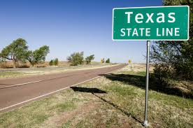
Interstate Transport

Slide 71
Cross State Air Pollution Rule (CSAPR)
Final rule published August 2011
Intended to replace the Clean Air Interstate Rule (CAIR)
Requires 28 states to reduce power plant emissions that cross state lines
Texas included for 1997 ozone and 1997 PM_{2.5} NAAQS
Numerous lawsuits filed by states, industry, other entities
D.C. Circuit remanded CSAPR 2014 SO₂ and ozone season NO_{x} budgets for Texas due to over-control
To address remanded SO₂ budgets, EPA removed Texas from CSAPR PM_{2.5} program and determined that no new Federal Implementation Plan (FIP) requirements for Texas sources are needed for PM_{2.5}
Remanded ozone season NO_{X} budgets replaced by CSAPR Update rule budgets beginning January 1, 2017
Notes:
Referred to as C-SAPR, Casper, transport
States are included if EPA determined a state significantly contributed to another state’s ability to attain or maintain compliance with one of the three standards.
Relies on cap and trade programs, with state-level budget caps (and unit-specific budget allowances)
PM_{2.5} program: annual NO_{X} and SO₂ budgets
Ozone program: ozone season NO_{X} budget

Slide 72
Interstate Transport for 2008 Ozone Standard
Texas submitted a SIP revision addressing transport obligations for the 2008 ozone NAAQS in December 2012.
EPA finalized disapproval on Texas’ 2008 ozone transport SIP on August 12, 2016.
EPA finalized the CSAPR Update Rule on October 26, 2016 to address interstate transport for 2008 ozone NAAQS and included Texas.

Slide 73
Infrastructure and Transport SIP Revisions for the 2015 Ozone NAAQS
Developed as separate SIP revisions
Transport SIP revision includes modeling analysis demonstrating that Texas does not significantly contribute to nonattainment or interfere with maintenance of the NAAQS in any other state
Approved for proposal on March 7, 2018
Public comment period ended April 10, 2018
Adoption scheduled for September 2018
Due to EPA by October 1, 2018

Slide 74
Infrastructure and Interstate Transport SIP Updates
NAAQS | SIP Adopted | EPA Action: Infrastructure | EPA Action: Transport | EPA Action: Visibility Transport
2008 Lead | 2011 | Approved 1/2016 | Approved 1/2016 | Approved 1/2016
2008 Ozone | 2012 | Approved 9/2016 and 10/2016 | Disapproved 8/2016 CSAPR Update FIP 10/26/16 (Effective 12/26/16) | Proposed Disapproval 12/2016; 10/17/2017 BART FIP (Effective November 16, 2017)
2010 NO₂ | 2012 | Approved 9/2016 and 10/2016 | Approved 9/2016 | Proposed Disapproval 12/2016; 10/17/2017 BART FIP
2010 SO₂ | 2013 | Approved 1/2016 | TBD | Proposed Disapproval 12/2016; 10/17/2017 BART FIP
2012 PM_{2.5} | 2015 | Proposed Approval 3/22/2018 | Proposed Approval 3/22/2018 | TBD
2006 PM_{2.5} | 2009 | Approved 1/2012 | Proposed Approval 02/14/2018 | Proposed Disapproval 12/2016; 10/17/2017 BART FIP
1997 PM_{2.5} | 2008 | Approved 1/2012 | Proposed Approval 02/14/2018 | Proposed Disapproval 12/2016; 10/17/2017 BART FIP
Notes:
The EPA disapproved portions of Texas’ infrastructure SIP regarding visibility transport for the 1997 PM2.5 NAAQS, the 1997 ozone NAAQS, the 2006 PM2.5 NAAQS, the 2008 ozone NAAQS, the 2010 NO2 NAAQS, and the 2010 SO2 NAAQS as part of the EPA’s October 2017 BART FIP and made a finding that the BART alternatives to address SO₂ and NO_{X} BART at Texas’ EGUs meet the interstate visibility transport requirements for these NAAQS.

Slide 75
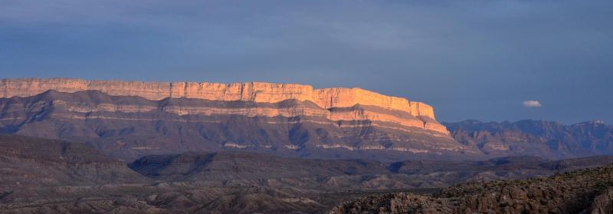
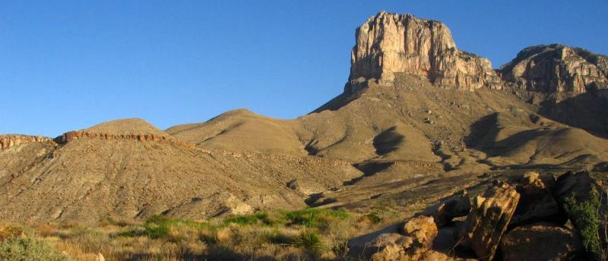
Big Bend National Park
NPS Photos
Regional Haze
Guadalupe Mountains National Park

Slide 76
Regional Haze
Rule requires states to restore visibility to natural conditions in 156 national parks and wilderness areas.
Regional Haze SIP revision was submitted to EPA in March 2009. Five-year Regional Haze Progress Report was submitted to EPA on March 20, 2014.
In 2017, EPA determined that Texas impacts 14 nearby Class I areas:
Texas: Big Bend and Guadalupe Mountains National Parks
Oklahoma: Wichita Mountains Wilderness
Arkansas: Caney Creek and Upper Buffalo Wilderness Areas
New Mexico (5), Missouri (2), Arkansas (2), and Colorado (2)
Notes:
14 Class I Areas from EPA’s final BART FIP October 17, 2017
Arkansas: Caney Creek and Upper Buffalo Wilderness Areas
Missouri: Mingo and Hercules-Glades Wilderness Areas
New Mexico: Bosque del Apache, Salt Creek, White Mountains, and Wheeler Peak Wilderness Areas; Carlsbad Caverns National Park
Colorado: Great Sand Dunes Wilderness Area and Rocky Mountain National Park

Slide 77
Regional Haze
EPA finalized the reasonable progress FIP on January 5, 2016 requiring power plants to reduce emissions on seven coal-fired power plants to reduce SO₂. However, the U.S. Court of Appeals for the Fifth Circuit stayed this FIP.
EPA’s Best Available Retrofit Technology (BART) FIP was final on October 17, 2017. EPA will administer it as a trading program including only specific EGUs in Texas and no out-of-state trading.
The EPA reconsidered that the final BART FIP satisfied interstate visibility transport for six NAAQS.
Notes:
In October 2017, Luminant announced the retirement in early 2018 of three coal fired power plants, which are listed in the FIP: Big Brown, Sandow, and Monticello. Houston Public Media, a service of the University of Houston, confirmed closure of all three plants in February 2018. The TCEQ received requests to void permits from all three of the plants by the end of March 2018 (Sandow, Big Brown, and Monticello).

Slide 78
Amendments to Regional Haze Rule
Final amendments published on January 10, 2017 in Federal Register
Extends the next SIP revision from 2018 to 2021
Five-year progress report no longer has to be a SIP revision
Increases consultations with Federal Land Mangers (FLM)
Expands Reasonably Available Visibility Impairment (RAVI), an FLM process, to all states
In January 2018, the EPA announced it plans to revisit aspects of the 2017 Regional Haze Rule revisions.

Slide 79
Contact Information
Kasey Savanich
Data Analysis Team
512-239-1145
kasey.savanich@tceq.texas.gov
Alison Stokes
SIP Team
512-239-4902
alison.stokes@tceq.texas.gov
To join the SIP/Air Quality update e-mail list go to: www.tceq.texas.gov/airquality/sip/sipcontact.html

Slide 80
Questions?

